Slide 1
Modeling the Formation of Secondary Organic Aerosol (SOA) in 0-D Box model framework
Special topic presentation
Samiha Binte Shahid
May 5, 2023

Slide 2
Outline
Motivation
Creating a Secondary Organic Aerosol (SOA) Model in 0-D box model framework
Parameters of SOA model
Verification of the SOA model
Future work and SOA model set-up

Slide 3
Motivation
SAPRC box model doesn’t have aerosol model.
Framework of 0-D Atmospheric modeling (F0AM) doesn’t have a thermodynamic equilibrium gas-particle partitioning model.
In the Thornton et al.2018 paper, “A Near-Explicit Mechanism Evaluation of Isoprene Photochemical Secondary Organic Aerosol Formation and Evolution: Simulation of Multiple Chamber Experiments with and without Added NOx” they developed a kinetic SOA model that is incorporated with F0AM box model. This is more suitable for explicit mechanisms such as- The Master Chemical Mechanism (MCM), Generator for Explicit Chemistry and Kinetics of Organics in the Atmosphere (GECKO).
My future research work needs a thermodynamic equilibrium partitioning SOA model to use with condensed mechanism- SAPRC-07, SAPRC-18.

Slide 4
Kinetic SOA model
Gas-phase reaction file
Species_0 + OH ➔ Species_1 , k1
Species_1 + OH ➔ Species_2, k2
Species_2 + OH ➔ Species_3, k3
Species_3 + OH ➔ Species_4, k4
Particle-phase reaction file
Species_3p + OH ➔
Species_4p + OH ➔
Gas-particle partitioning reaction file
Species_3 + condensation ➔ Species_3p, k3_condense
Species_3p + evaporation ➔ Species_3, k3_evaporation
Species_4 + condensation ➔ Species_4p, k4_condense
Species_4p + evaporation ➔ Species_4, k4_evaporation
Integration SOLVER

Slide 5
Creating a Secondary Organic Aerosol (SOA) Model in 0-D box model framework
Thermodynamic equilibrium SOA model.
Incorporated the CMAQ-AERO-07 SOA scheme and parameters.
The concentration of reaction products resulting from VOC oxidation in the gas phase mechanism is time-dependent, and this information is fed into the Secondary Organic Aerosol (SOA) model. The SOA model then calculates the gas-particle partitioning of the reaction products and updates the gas-phase concentration accordingly. This updated information is then passed back to the gas-phase integration solver for further processing.
The SOA model has been written in a way allows for easy updates to the SOA parameters. This ensures that the model can be adapted to new scheme and parameters.

Slide 6
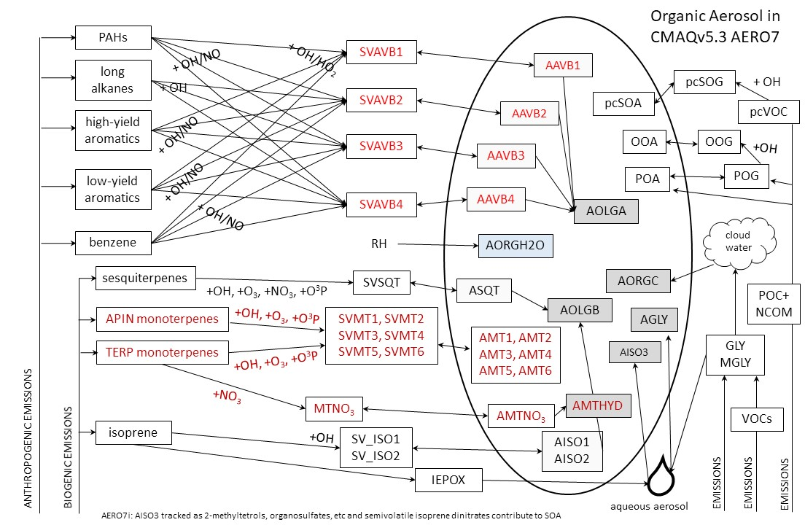
The F0AM-CMAQ Aerosol model Scheme

Slide 7
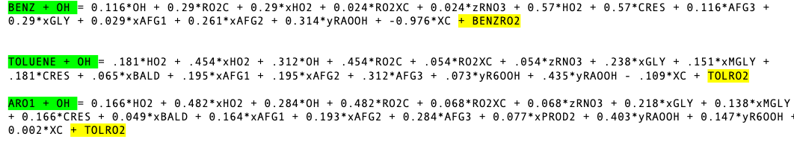
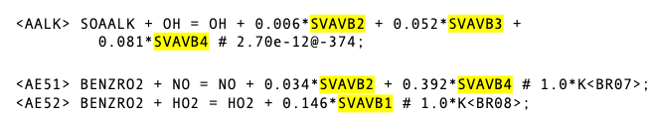
The F0AM-CMAQ Aerosol model Scheme: Linking Gas-Phase mechanism to SOA model
Reaction encounters are added to volatile organic compound (VOC) oxidation reaction which is passed on to the SOA model-
The concentration of product is directly passed on to the SOA model-

Slide 8
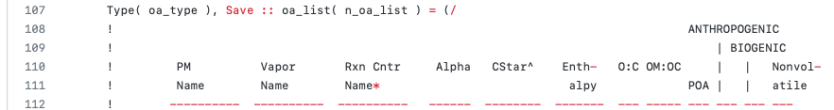
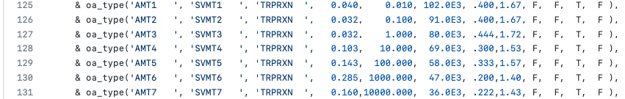
The F0AM-CMAQ Aerosol model Scheme: SOA partitioning model parameters
The parameters in SOA-partitioning model requires- alpha, cstar, enthalpy, molecular weight of the model species.

Slide 9


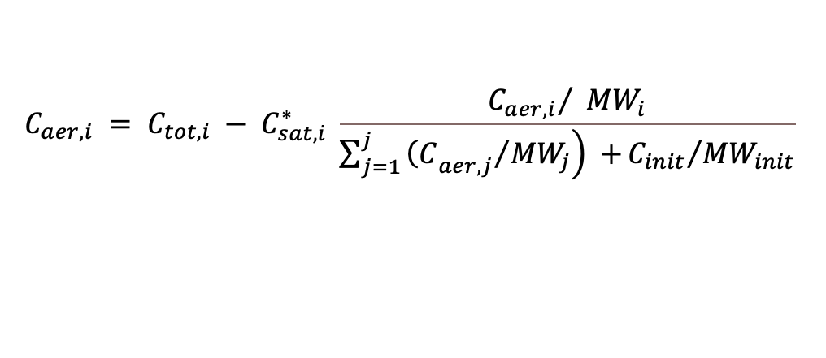




SOA-Partitioning Model
$$VOC+OH= α_{1} P_{1}+ α_{2} P_{2}+…+α_{n}P_{n}$$
$$C_{aer,i}= C_{tot,i}−C_{sat,i}^{∗} \frac{{C_{aer,i}}/{{MW}_{i}}}{N}$$
SVLIM1, SVLIM2..
$$C_{tot,i}= α_{1 }\frac{{MW}_{i}}{{MW}_{VOC}} ∆VOC$$
$$C_{tot,i}= C_{aer,i}+ C_{sat,i}^{∗} \frac{{C_{aer,i}}/{{MW}_{i}}}{N}$$
TRPRXN
APINRXN
$$C_{tot,i} = C_{aer,i} + C_{gas,i}$$
$$C_{tot,i}= C_{aer,i}\left( 1+\frac{{C_{sat,i}^{∗}}/{{MW}_{i}}}{N}\right)$$
$$C_{aer,i} = C_{tot,i} − C_{gas,i}$$
$$C_{aer,i}= C_{tot,i} \left(\frac{N × {MW}_{i}}{N × {MW}_{i}+ C_{sat,i}^{∗} }\right)$$
$$C_{gas,i} = C_{sat,i} = C_{sat,i}^{∗} × X_{i,om}$$
$$C_{aer,i} = C_{tot,i} − C_{sat,i}^{∗} \frac{{C_{aer,i}}/ {MW}_{i}}{\sum_{j=1}^{j}{\left.{{\left(C\right.}_{aer,j}}/{{MW}_{j}}\right) +}{C_{init}}/{{MW}_{init}}}$$
$$\frac{C_{aer,i}}{{MW}_{i}}= C_{tot,i} \left(\frac{N}{N × {MW}_{i}+ C_{sat,i}^{∗} }\right)$$
N

Slide 10
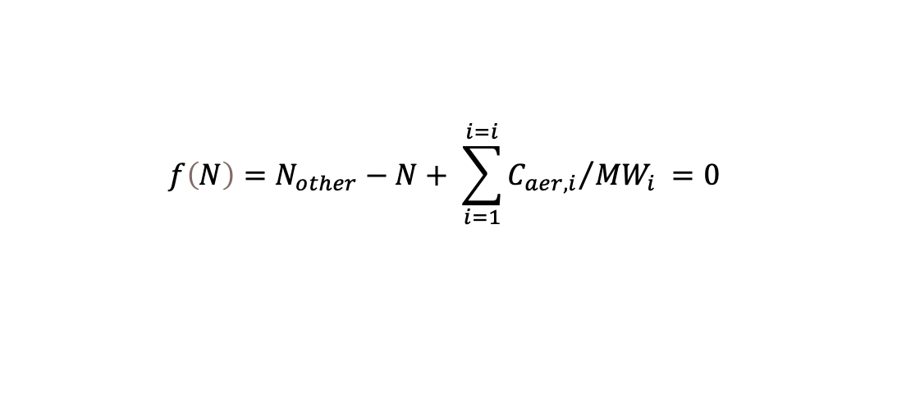
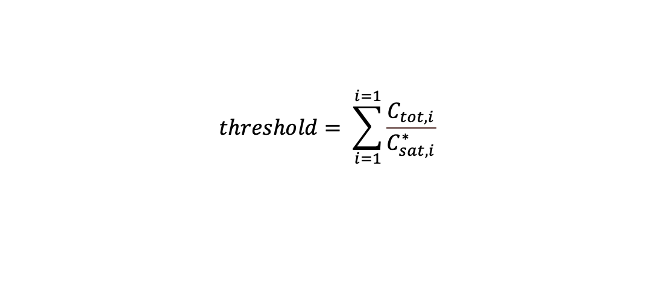
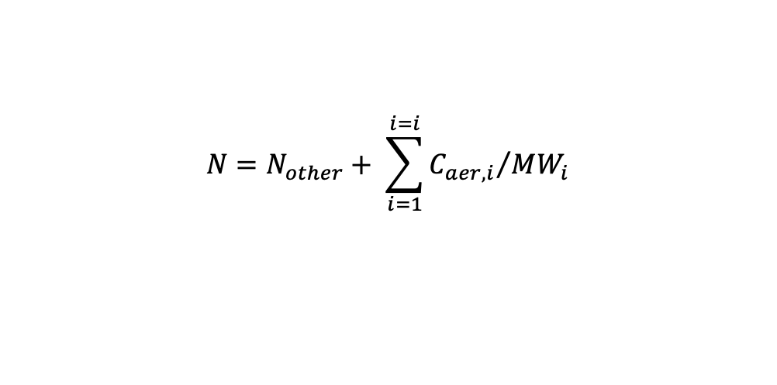
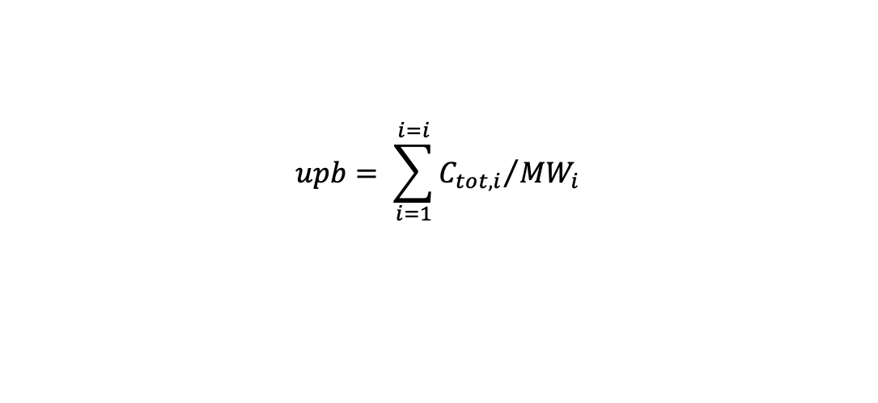
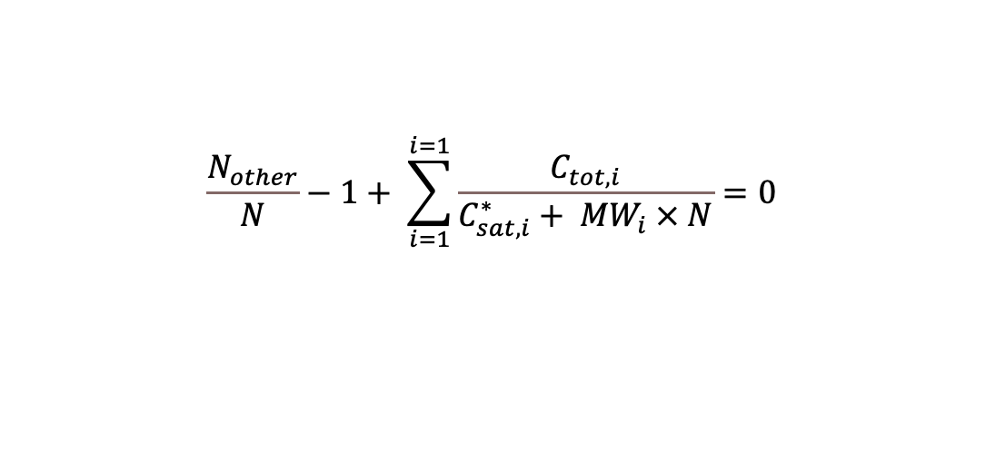
SOA-Partitioning Model
$$N=N_{other}+ \sum_{i=1}^{i=i}{{C_{aer,i}}/{{MW}_{i}}}$$
$$upb= \sum_{i=1}^{i=i}{{C_{tot,i}}/{{MW}_{i}}}$$
$$f\left(N\right)=N_{other}−N+ \sum_{i=1}^{i=i}{{C_{aer,i}}/{{MW}_{i}}} =0$$
$$lwb= Nonvolatile moles$$
$$\frac{N_{other}}{N}−1+ \sum_{i=1}^{i=1}{\frac{C_{tot,i}}{C_{sat,i}^{∗}+ {MW}_{i} × N}}=0$$
$$threshold= \sum_{i=1}^{i=1}{\frac{C_{tot,i}}{C_{sat,i}^{∗}}}$$

Slide 11
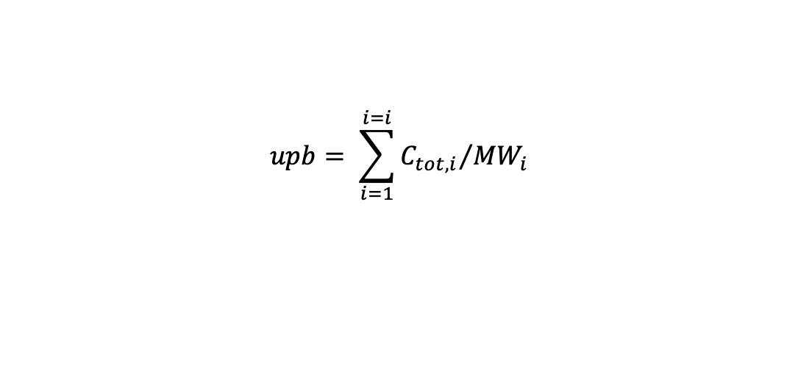

SOA-Partitioning Model
$$\frac{N_{other}}{N}−1+ \sum_{i=1}^{i=1}{\frac{C_{tot,i}}{C_{sat,i}^{∗}+ {MW}_{i} × N}}=0$$
$$upb= \sum_{i=1}^{i=i}{{C_{tot,i}}/{{MW}_{i}}}$$
Y
$$lwb= Nonvolatile moles$$
N1 = (lwb + upb)/2
if f(N1) +ve:
N2 = (N1 + upb) /2
If f(N1) –ve:
N2 = (N1 + lwb) /2
upb
F(N1)
X
lwb
N1

Slide 12
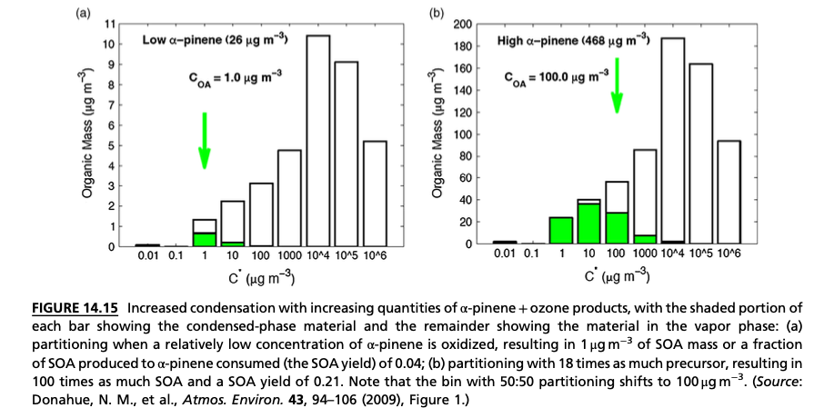
SOA Model verification

Slide 13
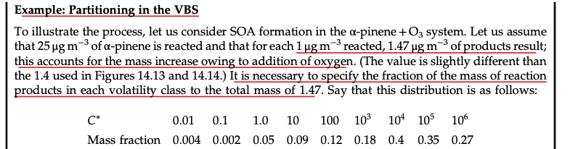
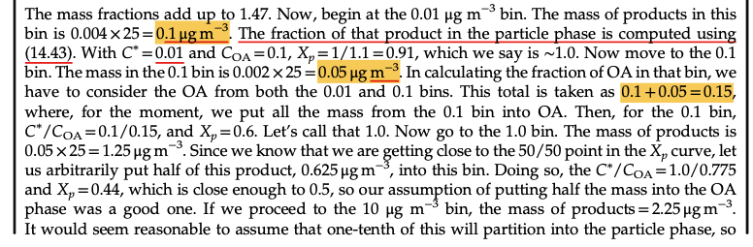
SOA Model verification

Slide 14
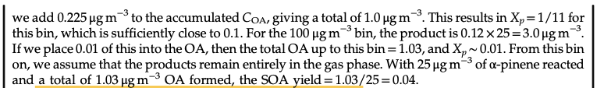
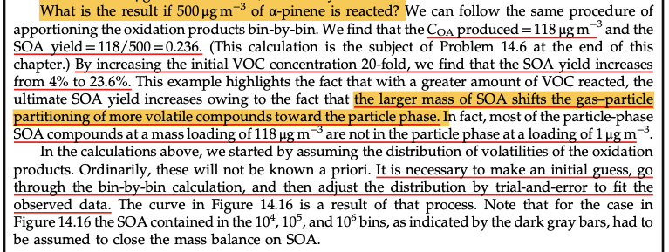
SOA Model verification

Slide 15
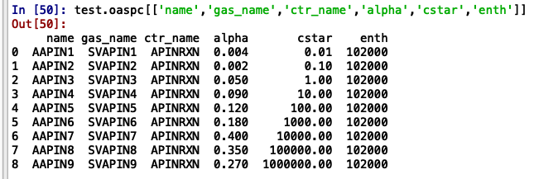
SOA Model verification
The VBS in SOA model. The enthalpy value is assumed.

Slide 16
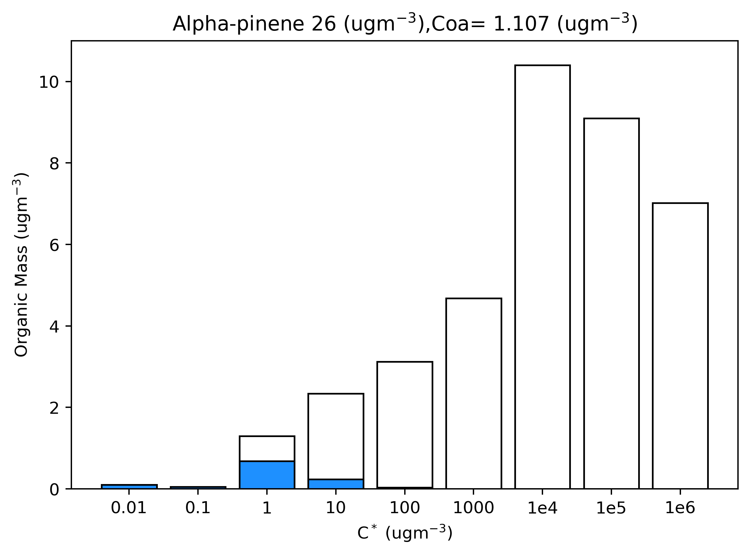
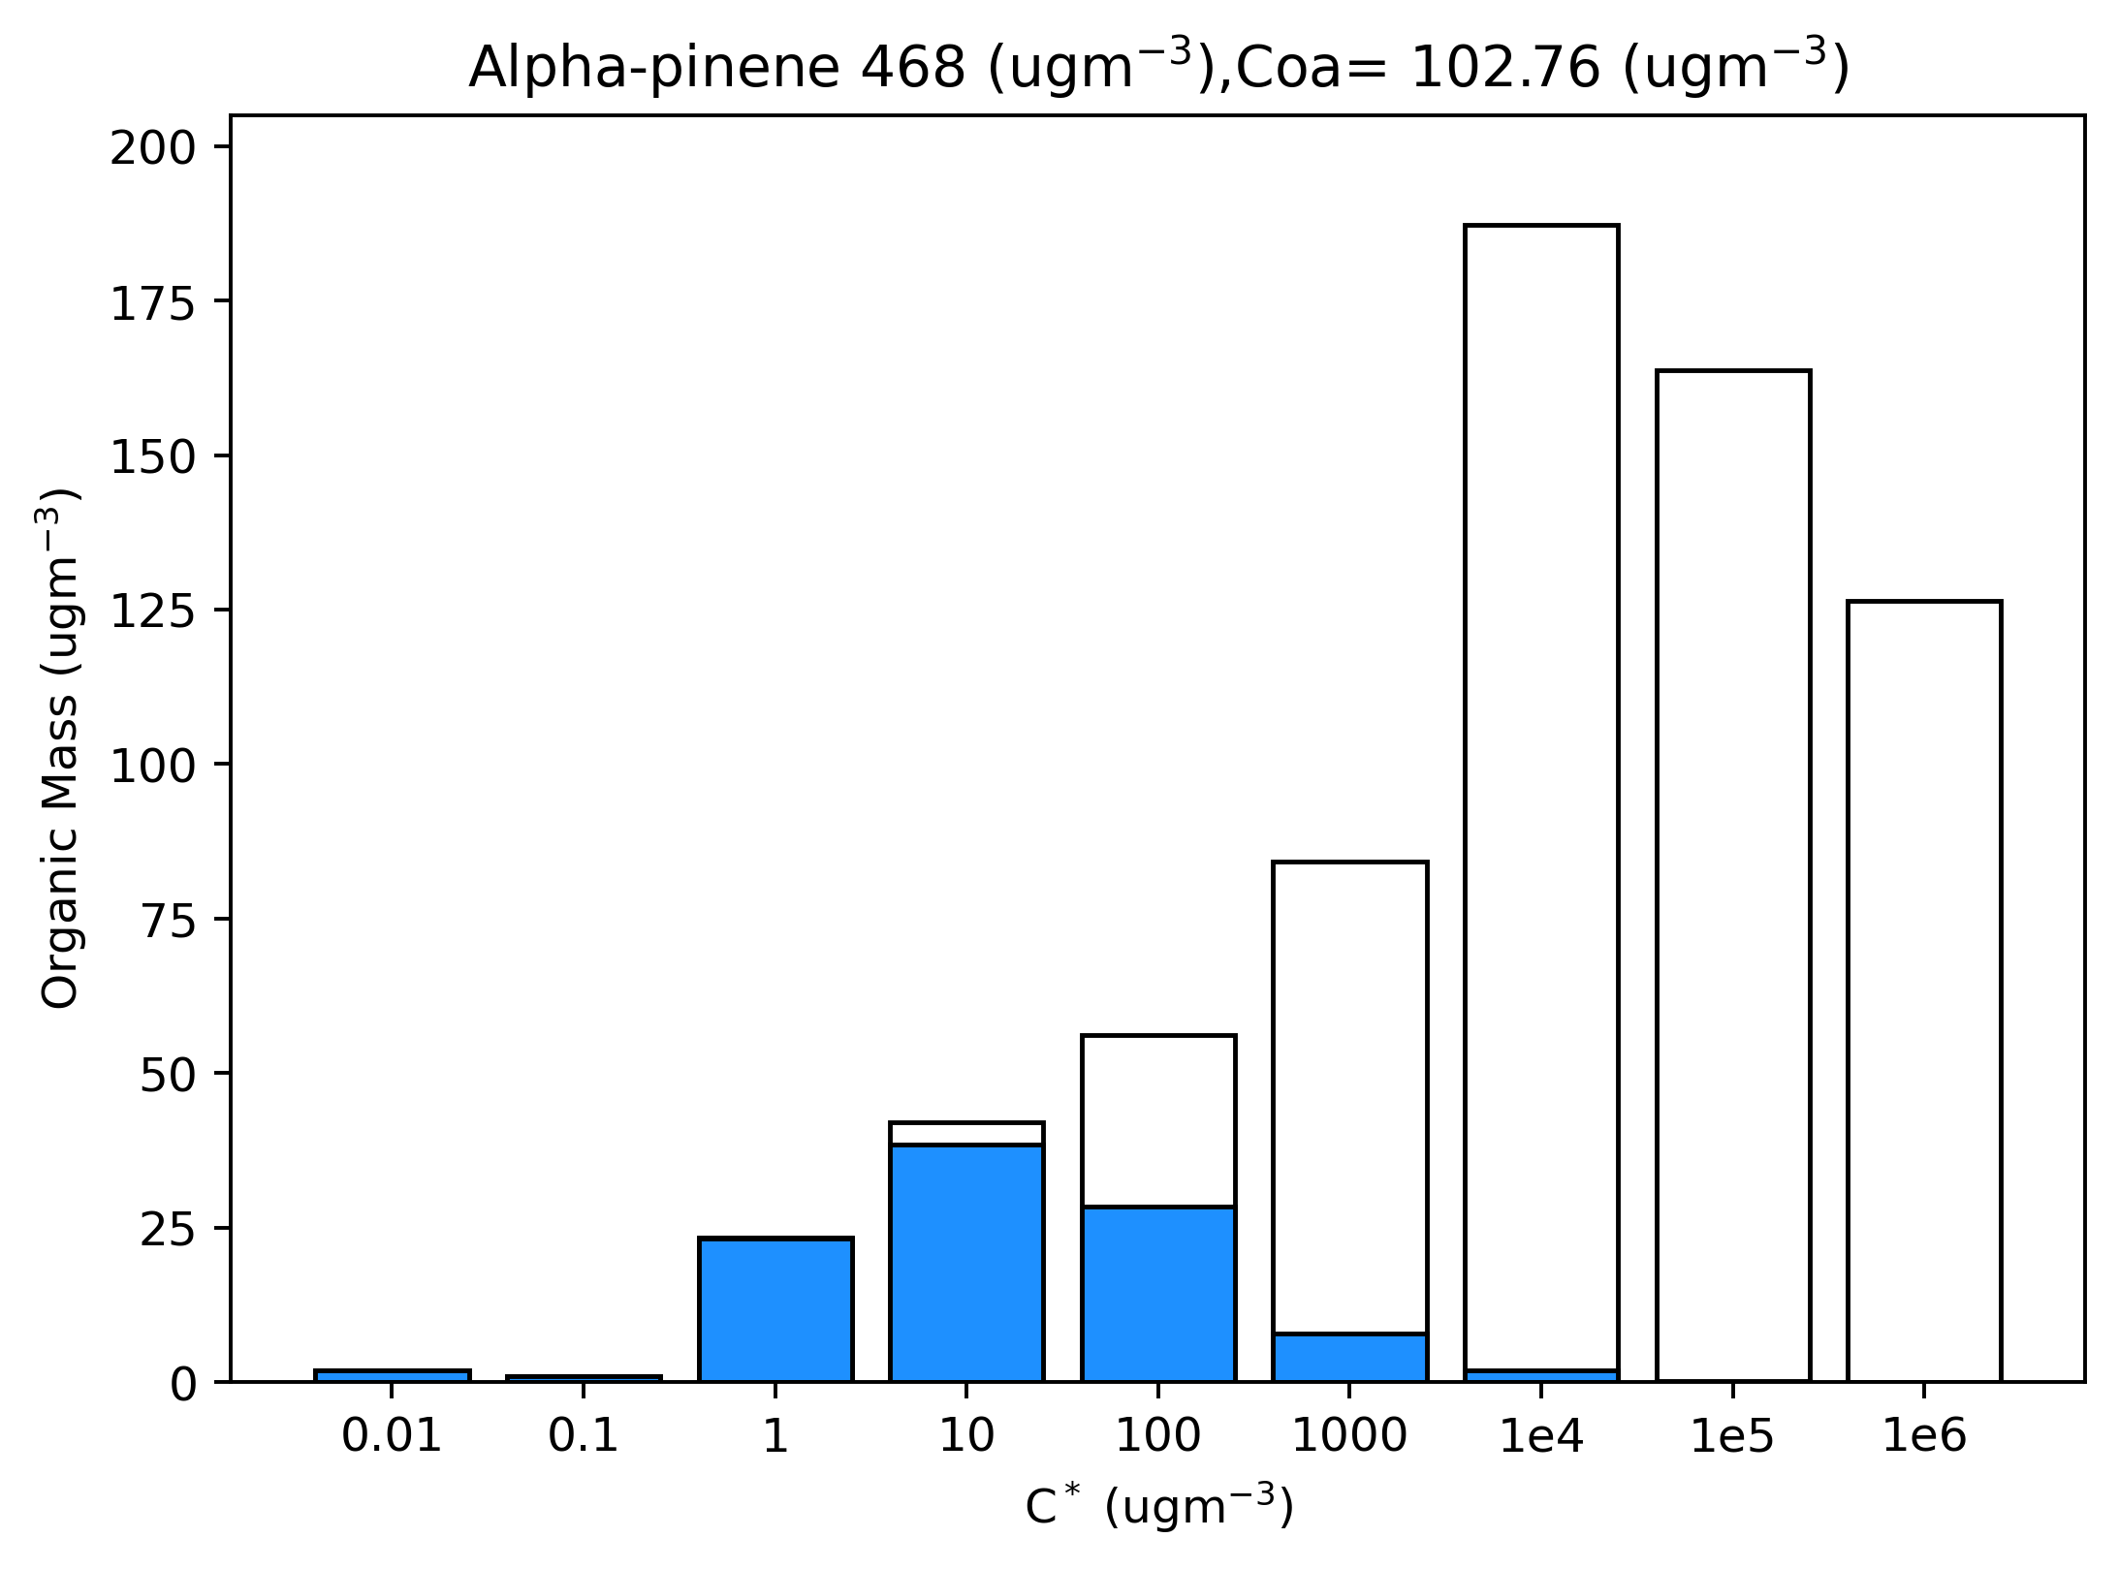
SOA Model verification
Output from SOA model

Slide 17
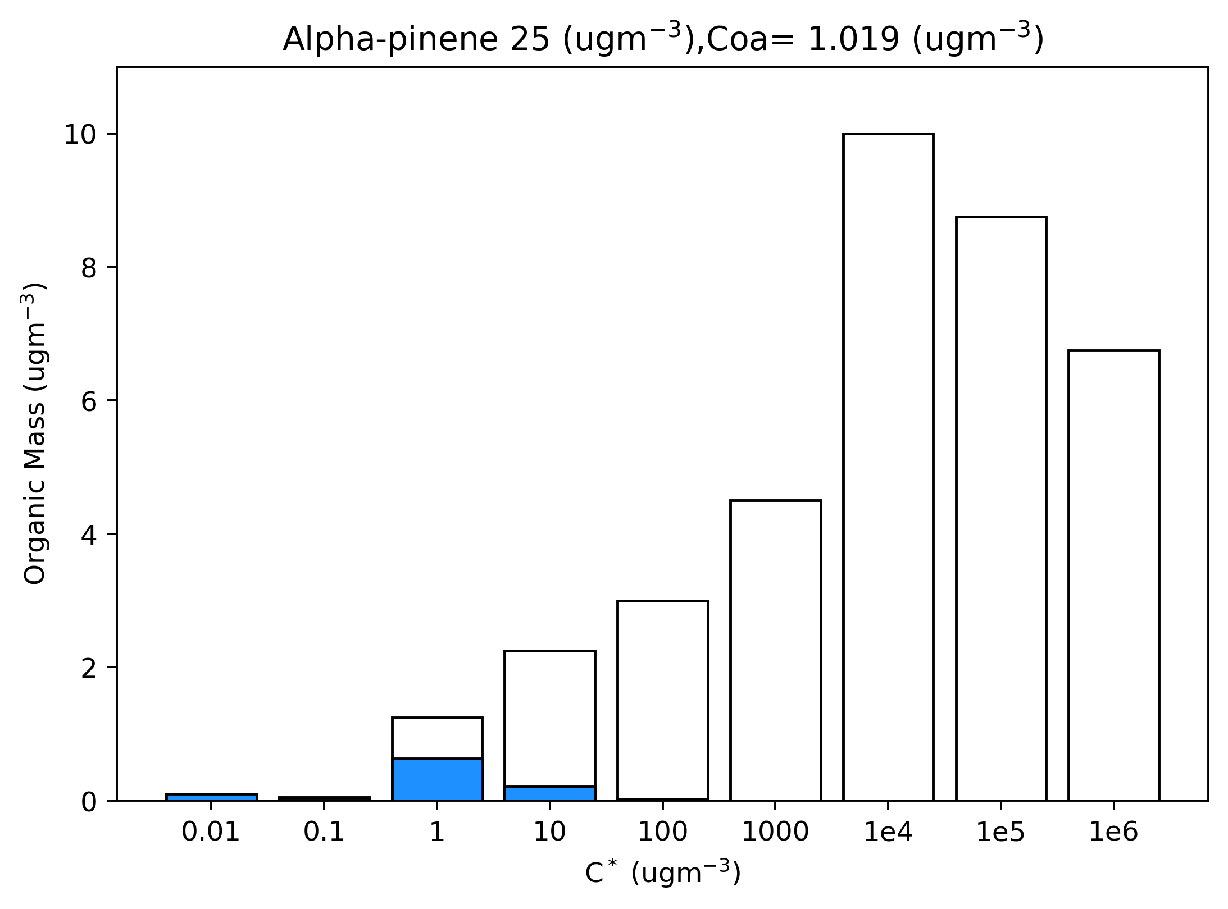
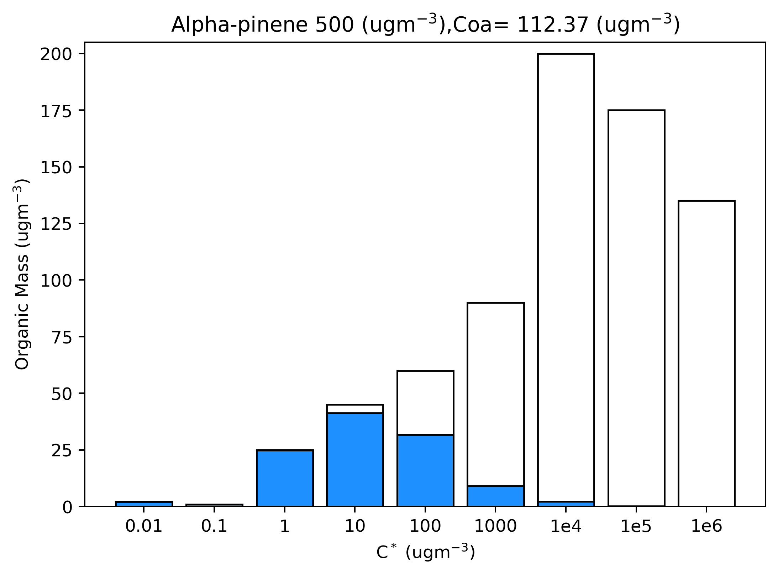
SOA Model verification
Output from SOA model

Slide 18
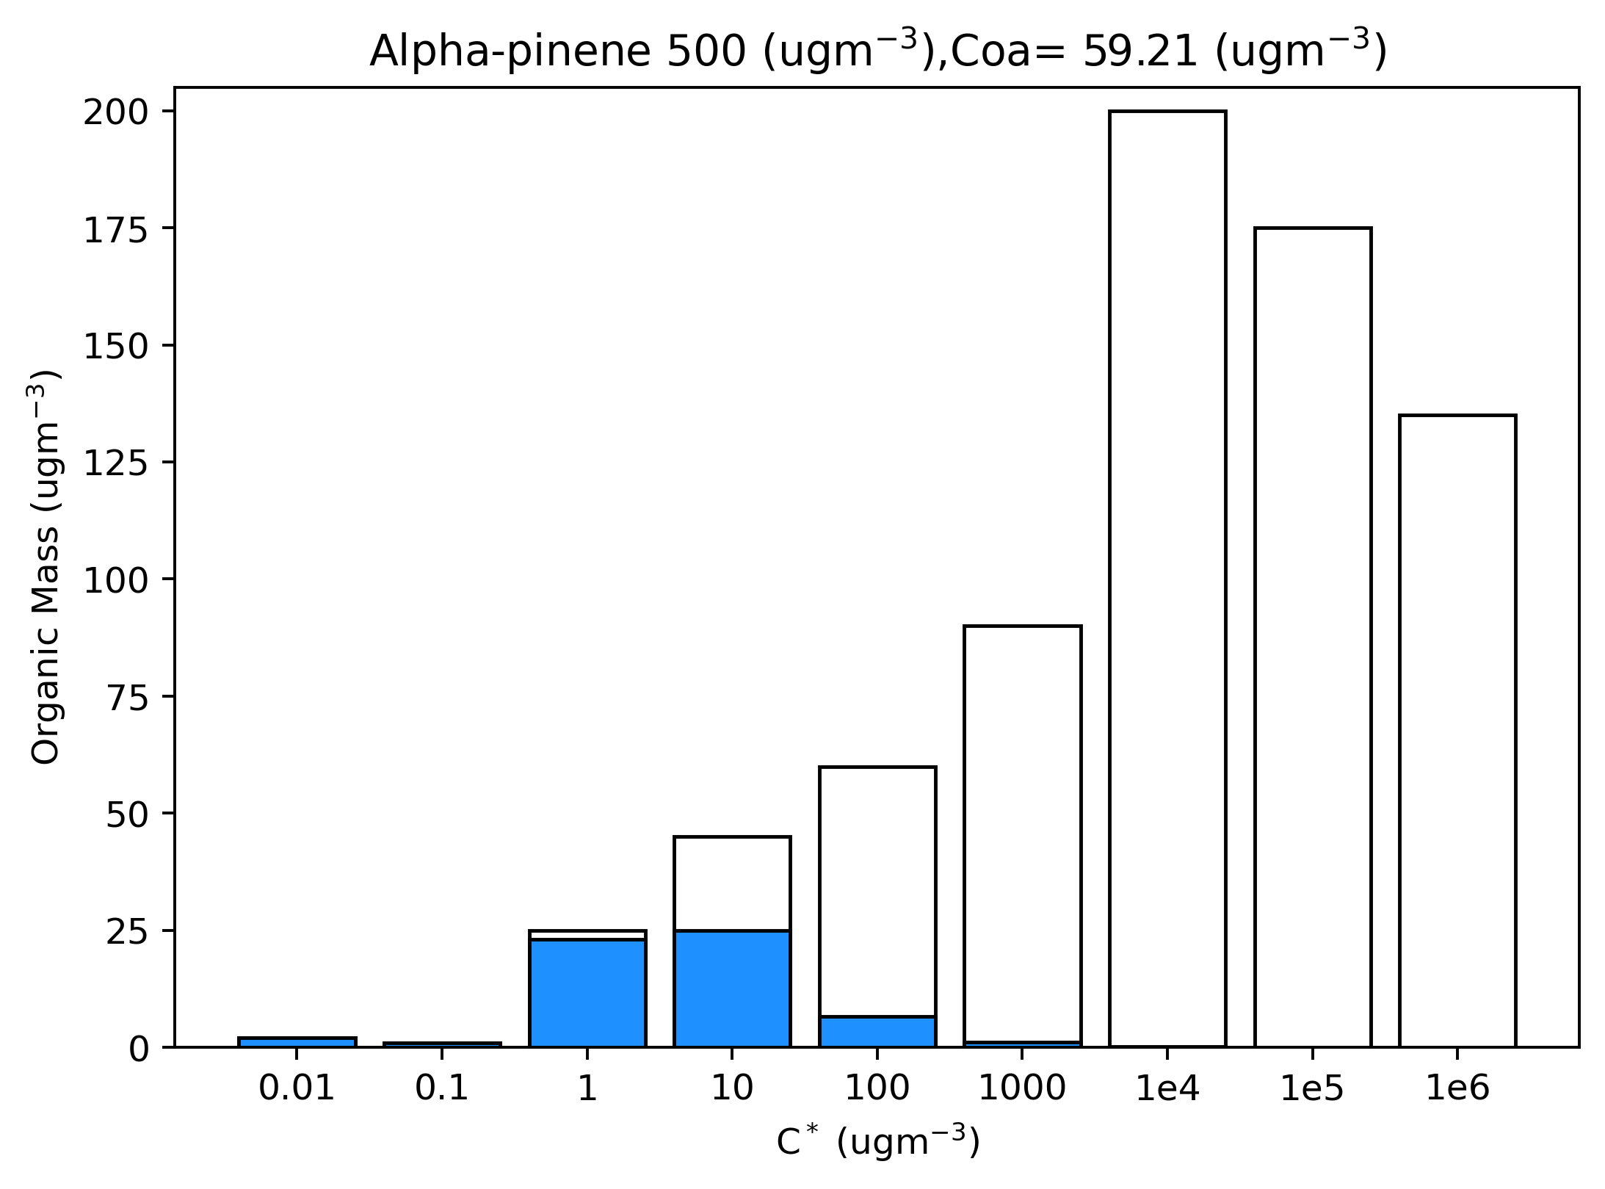
SOA Model verification
Output from SOA model: Temperature sensitivity test
T= 298 K
T= 310 K

Slide 19
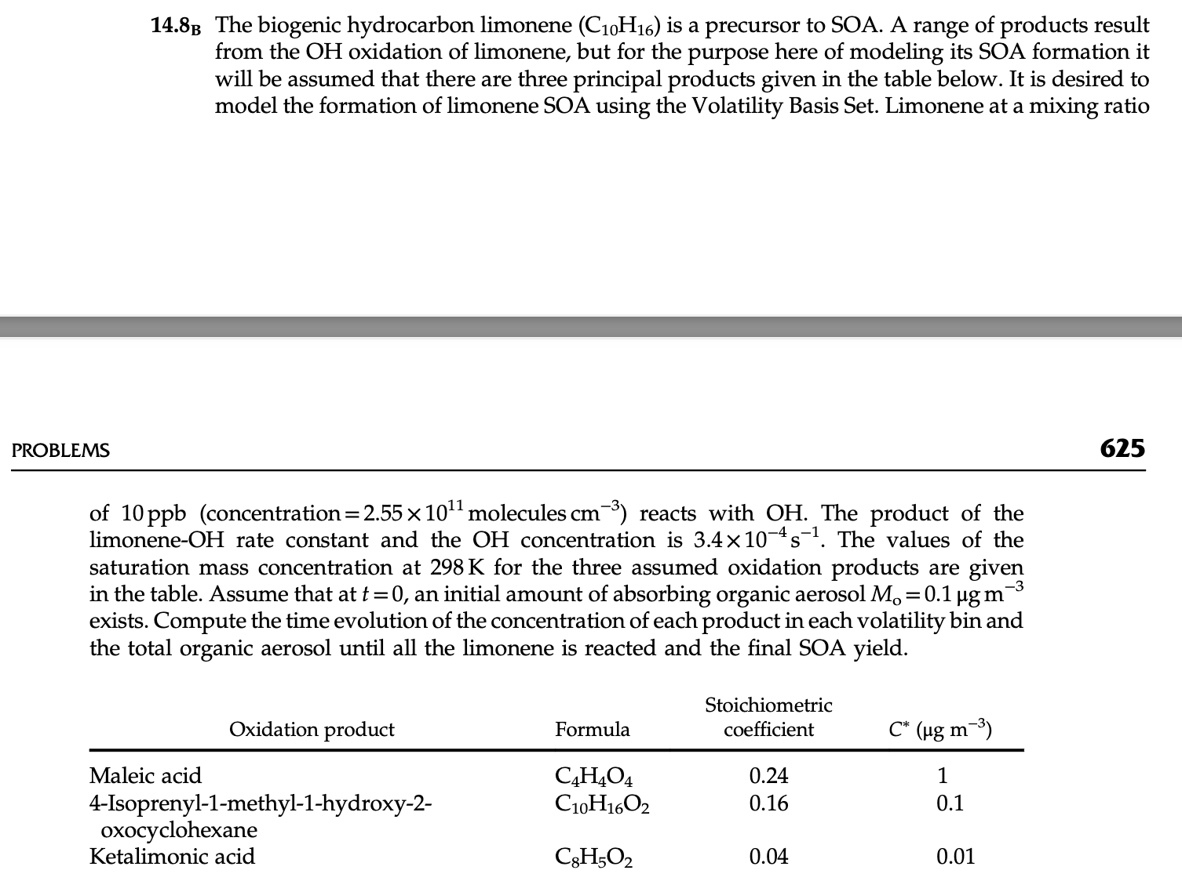
SOA Model verification

Slide 20
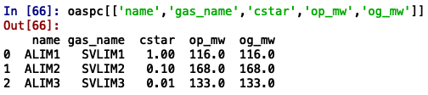
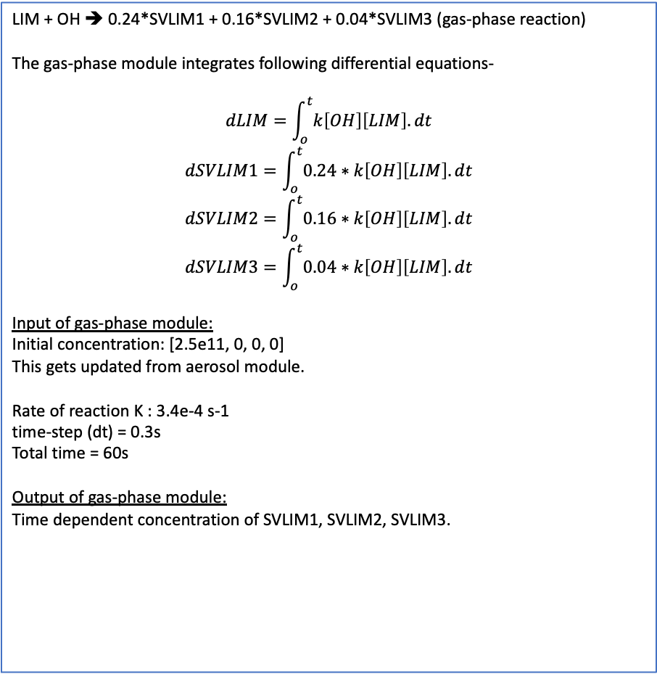
SOA Model verification
input in SOA model
Gas-phase module
Aerosol module
LIM + OH ➔ 0.24*SVLIM1 + 0.16*SVLIM2 + 0.04*SVLIM3 (gas-phase reaction)
The gas-phase module integrates following differential equations-
$$dLIM=\int_{o}^{t}{k\left[OH\right]\left[LIM\right].dt}$$
$$dSVLIM1=\int_{o}^{t}{0.24∗k\left[OH\right]\left[LIM\right].dt}$$
$$dSVLIM2=\int_{o}^{t}{0.16∗k\left[OH\right]\left[LIM\right].dt}$$
$$dSVLIM3=\int_{o}^{t}{0.04∗k\left[OH\right]\left[LIM\right].dt}$$
Input of gas-phase module:
Initial concentration: [2.5e11, 0, 0, 0]
This gets updated from aerosol module.
Rate of reaction K : 3.4e-4 s-1
time-step (dt) = 0.3s
Total time = 60s
Output of gas-phase module:
Time dependent concentration of SVLIM1, SVLIM2, SVLIM3.
SVLIM1 ➔ ALIM1
SVLIM2 ➔ ALIM2
SVLIM3 ➔ ALIM3
Initial concentration:
Output from gas-phase module SVLIM1, SVLIM2, SVLIM3
Initial aerosol concentration: 1e-23 ug/m3
Parameter dataset:
og_mw is molecular weight of gas-phase species (SVLIM1, SVLIm2, SVLIM3)
op_mw is molecular weight of aerosol-phase species (ALIM1, ALIM2, ALIM3)
Meteorology:
T=298 K
P = 101325 pa
Output:
Concentration of ALIM1, ALIM2, ALIM3 in ug/m3
Updates SVLIM1, SVILIM2 and SVLIM3 concentration which is passed on to gas-phase module.

Slide 21
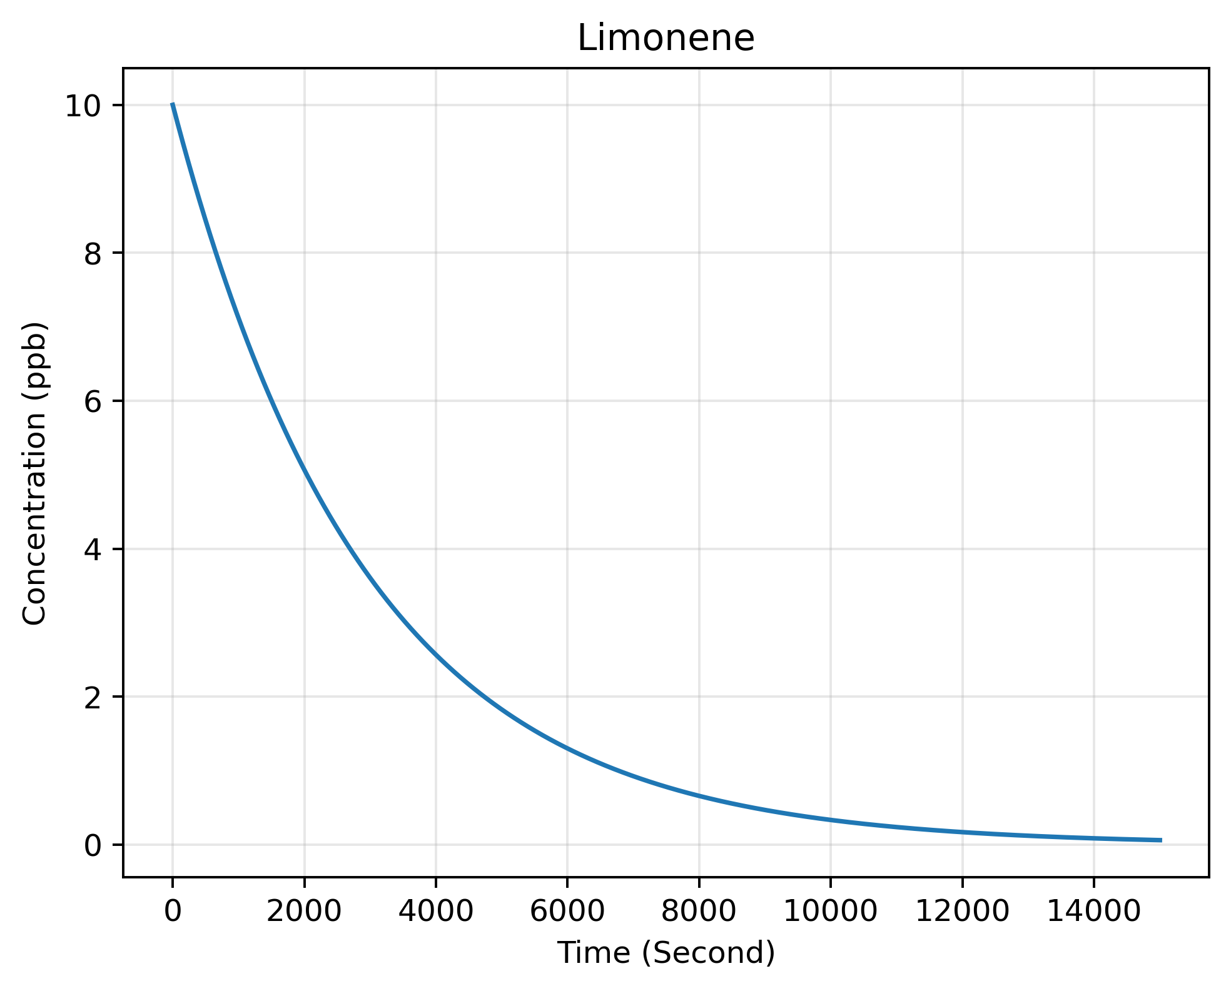
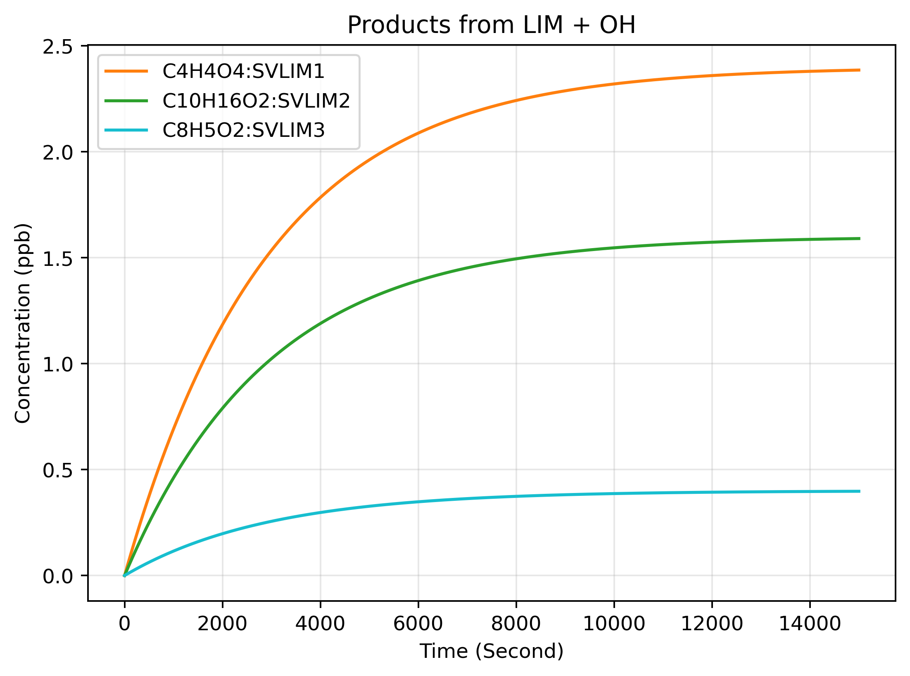
SOA Model verification
Output from SOA model
Output form the gas-phase reaction solver. This figures show as limonene decays the products are forming. This figure doesn’t show the updated concentration of the gas-phase products from the aerosol module.

Slide 22
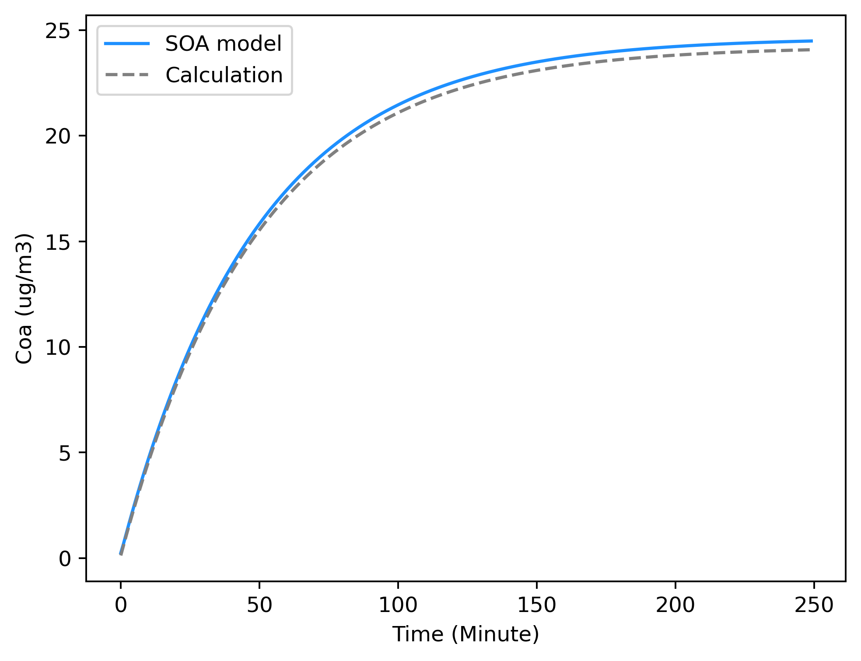
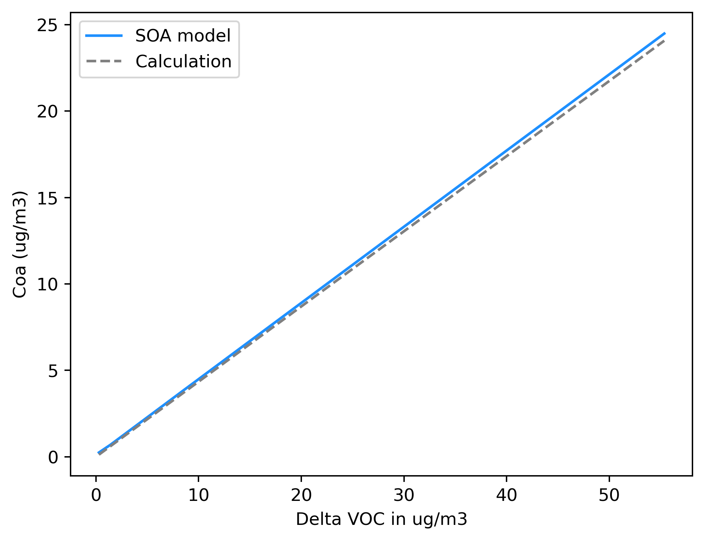
SOA Model verification
Output from SOA model

Slide 23
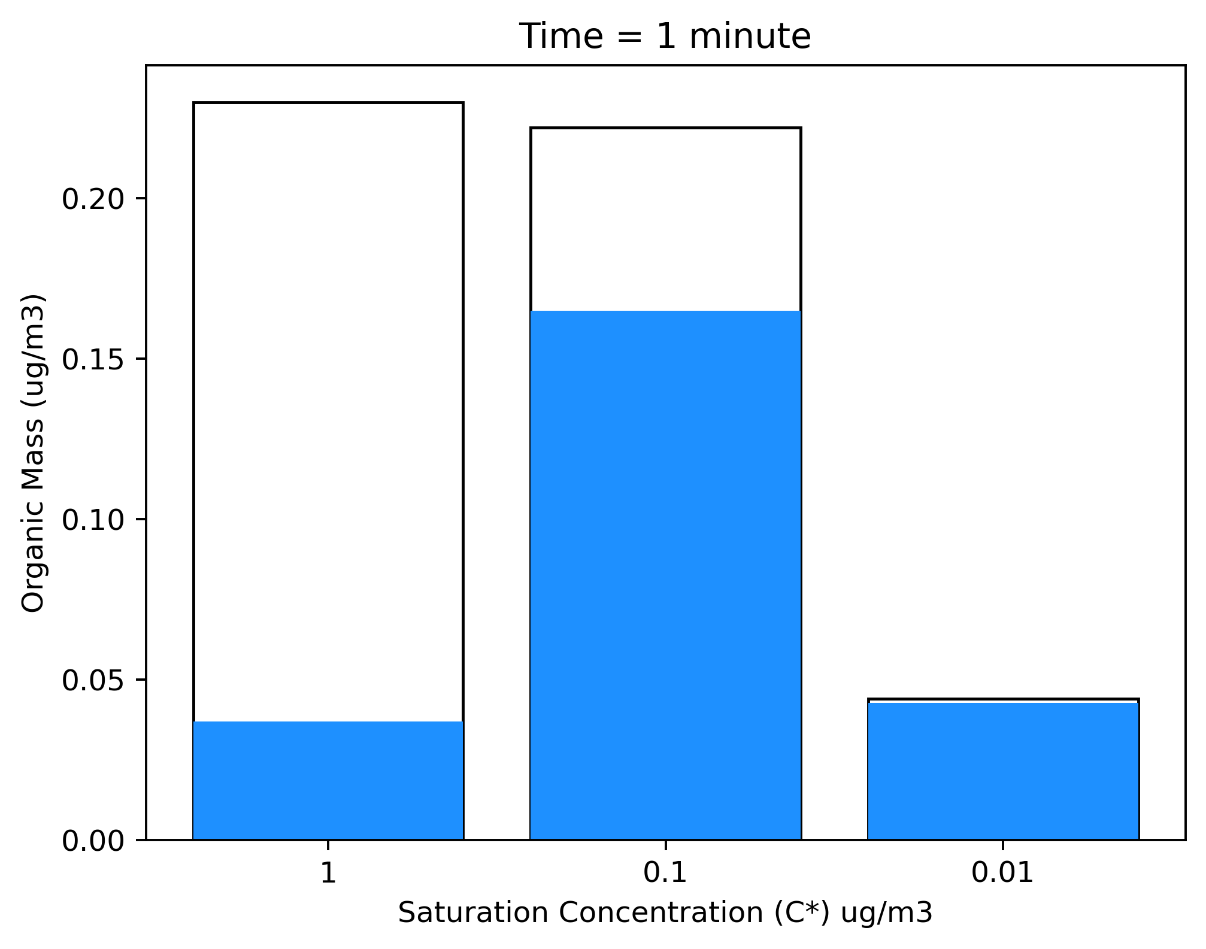
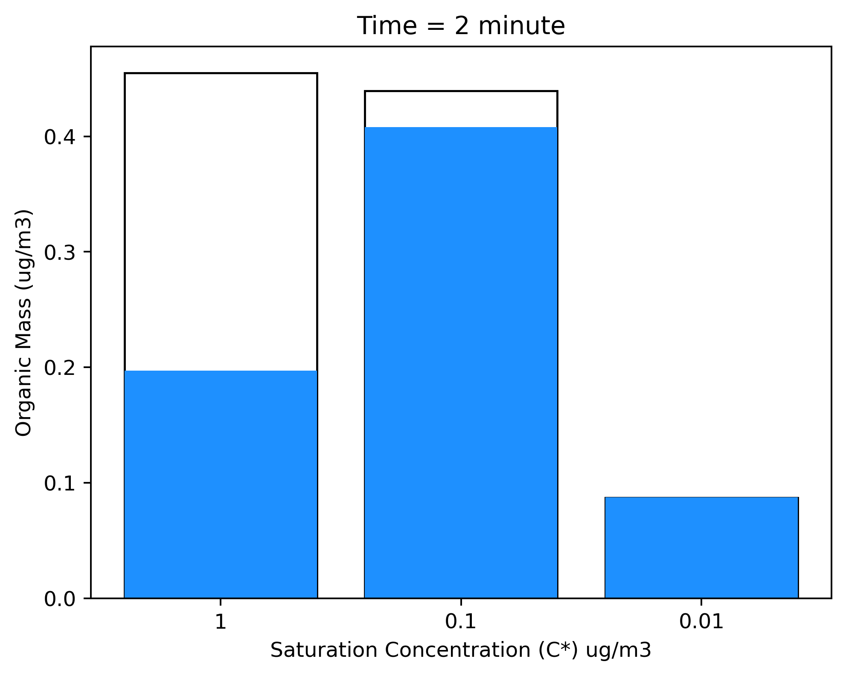
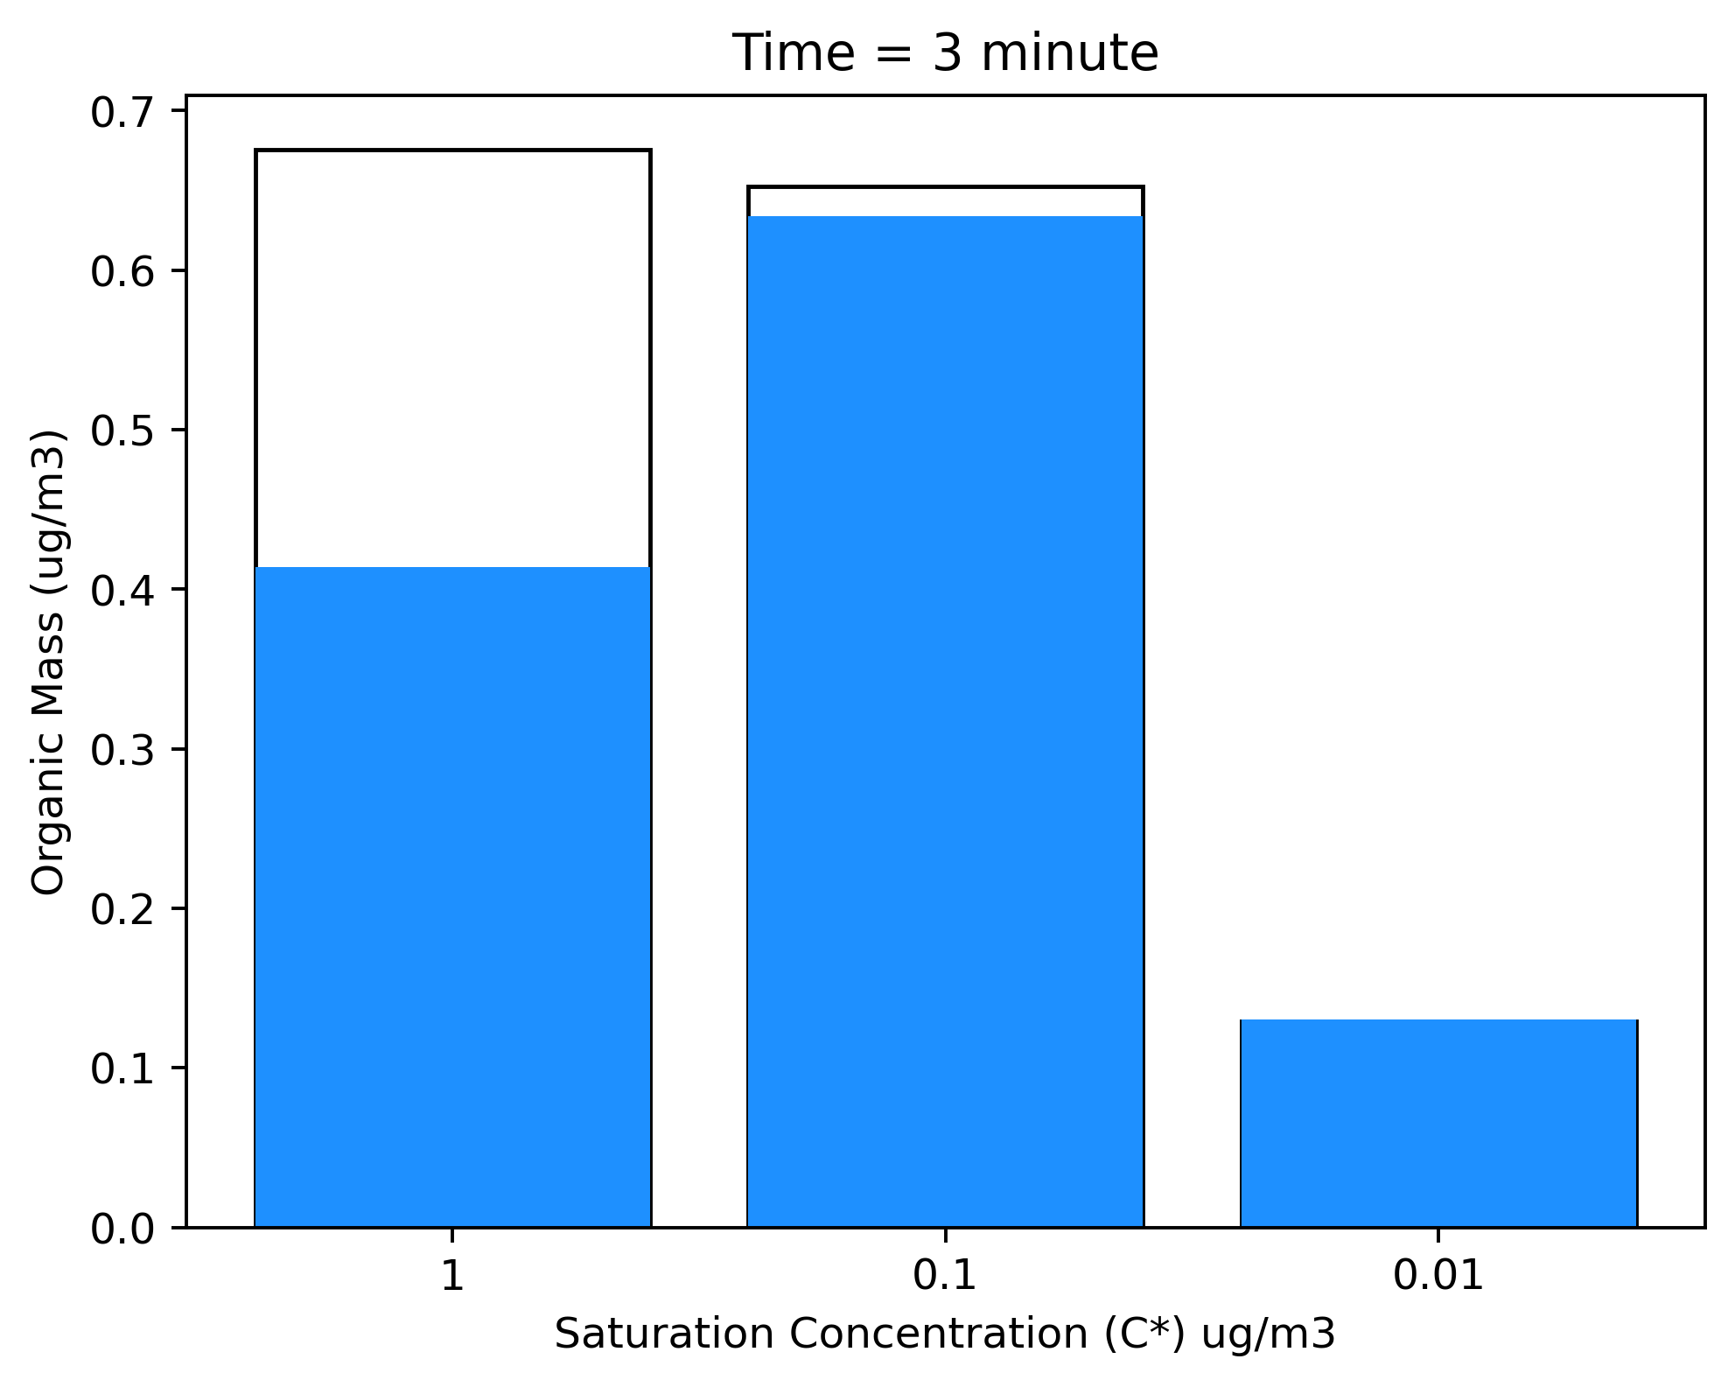
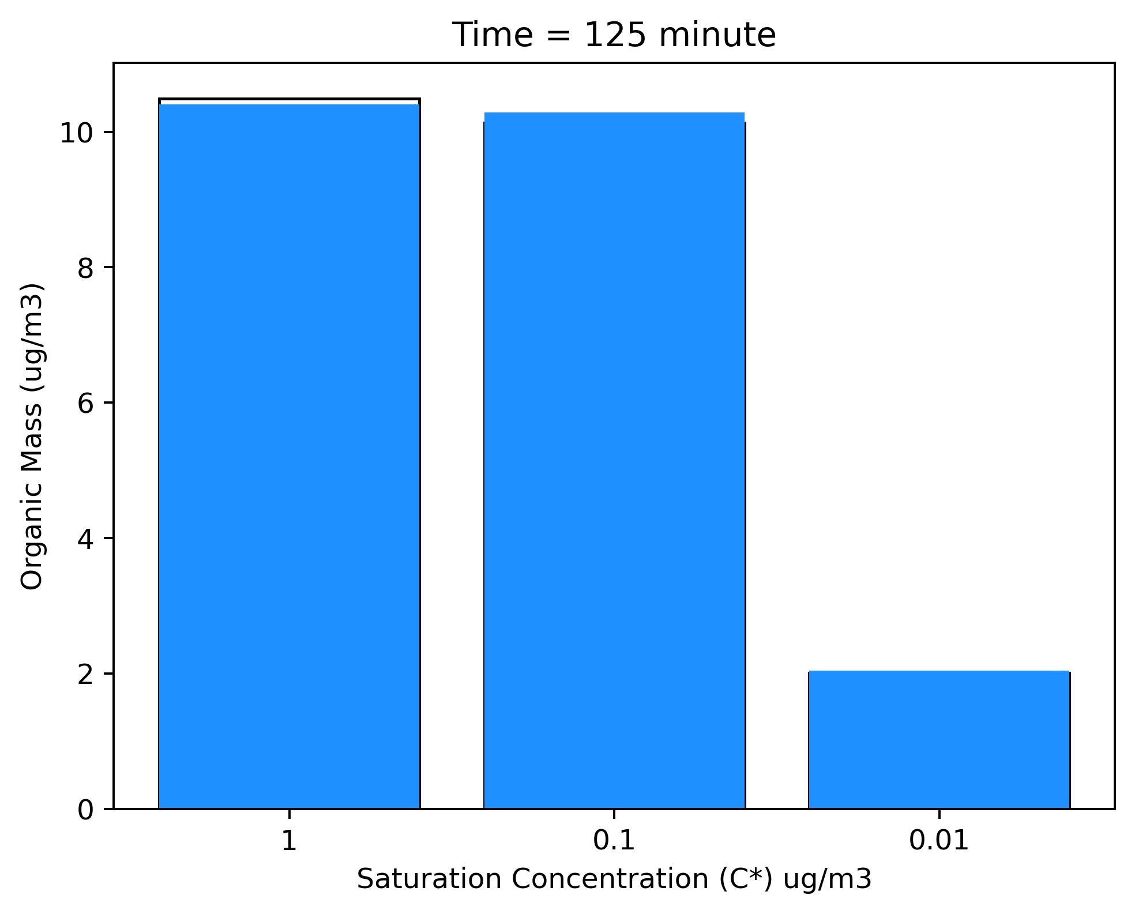

SOA Model verification
Output from SOA model

Slide 24
Thank you

