Slide 1
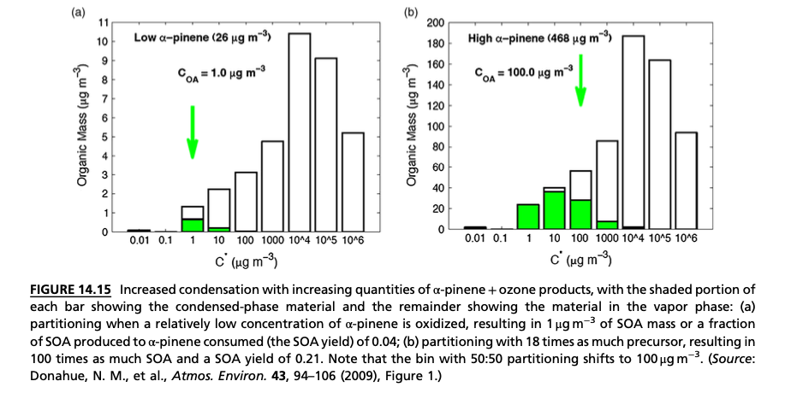

Slide 2
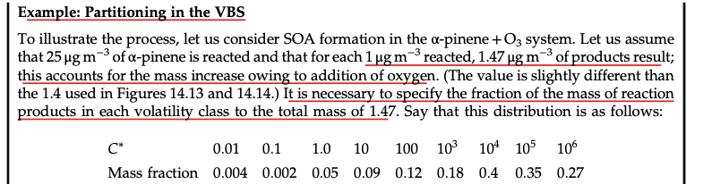
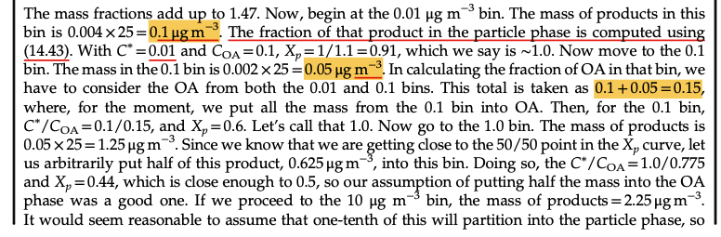

Slide 3
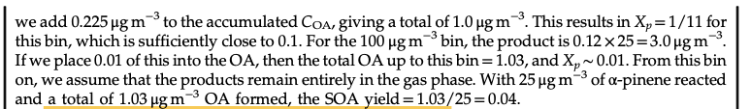
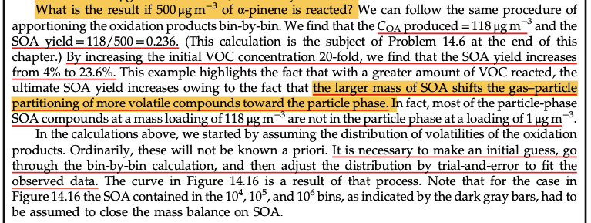

Slide 4
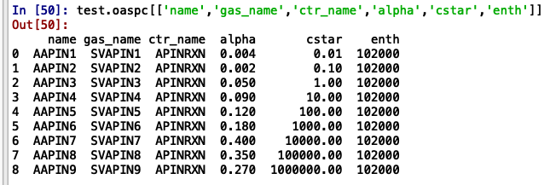
The VBS in SOA model. The enthalpy value is assumed.

Slide 5
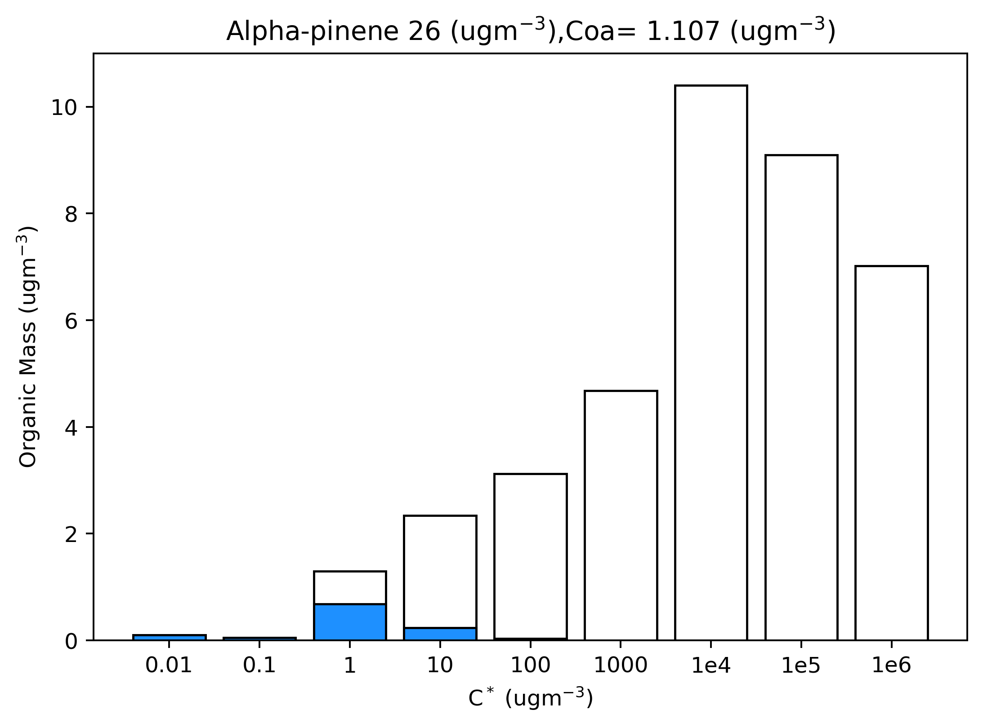
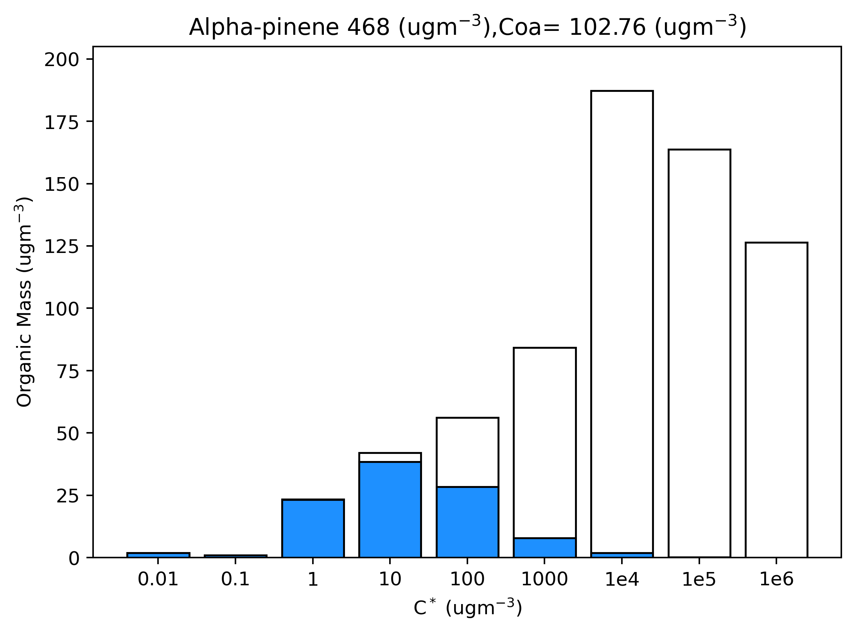
Output from SOA model

Slide 6
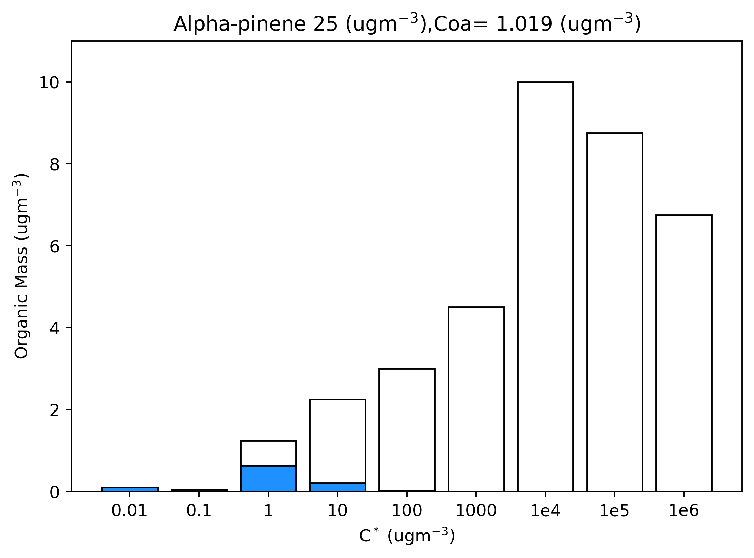
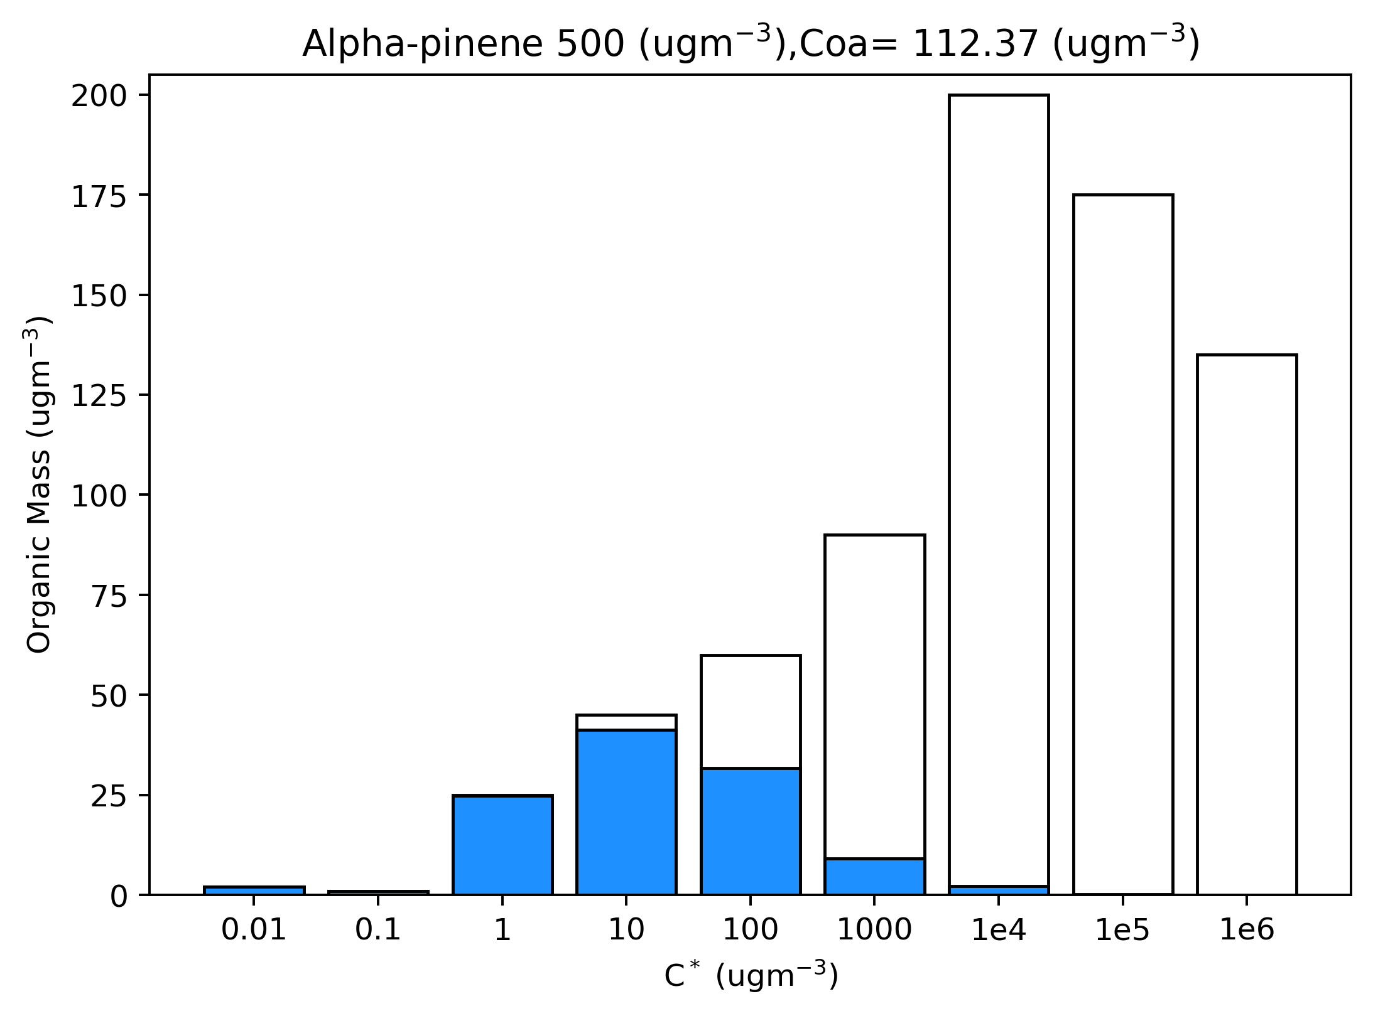
Output from SOA model

Slide 7
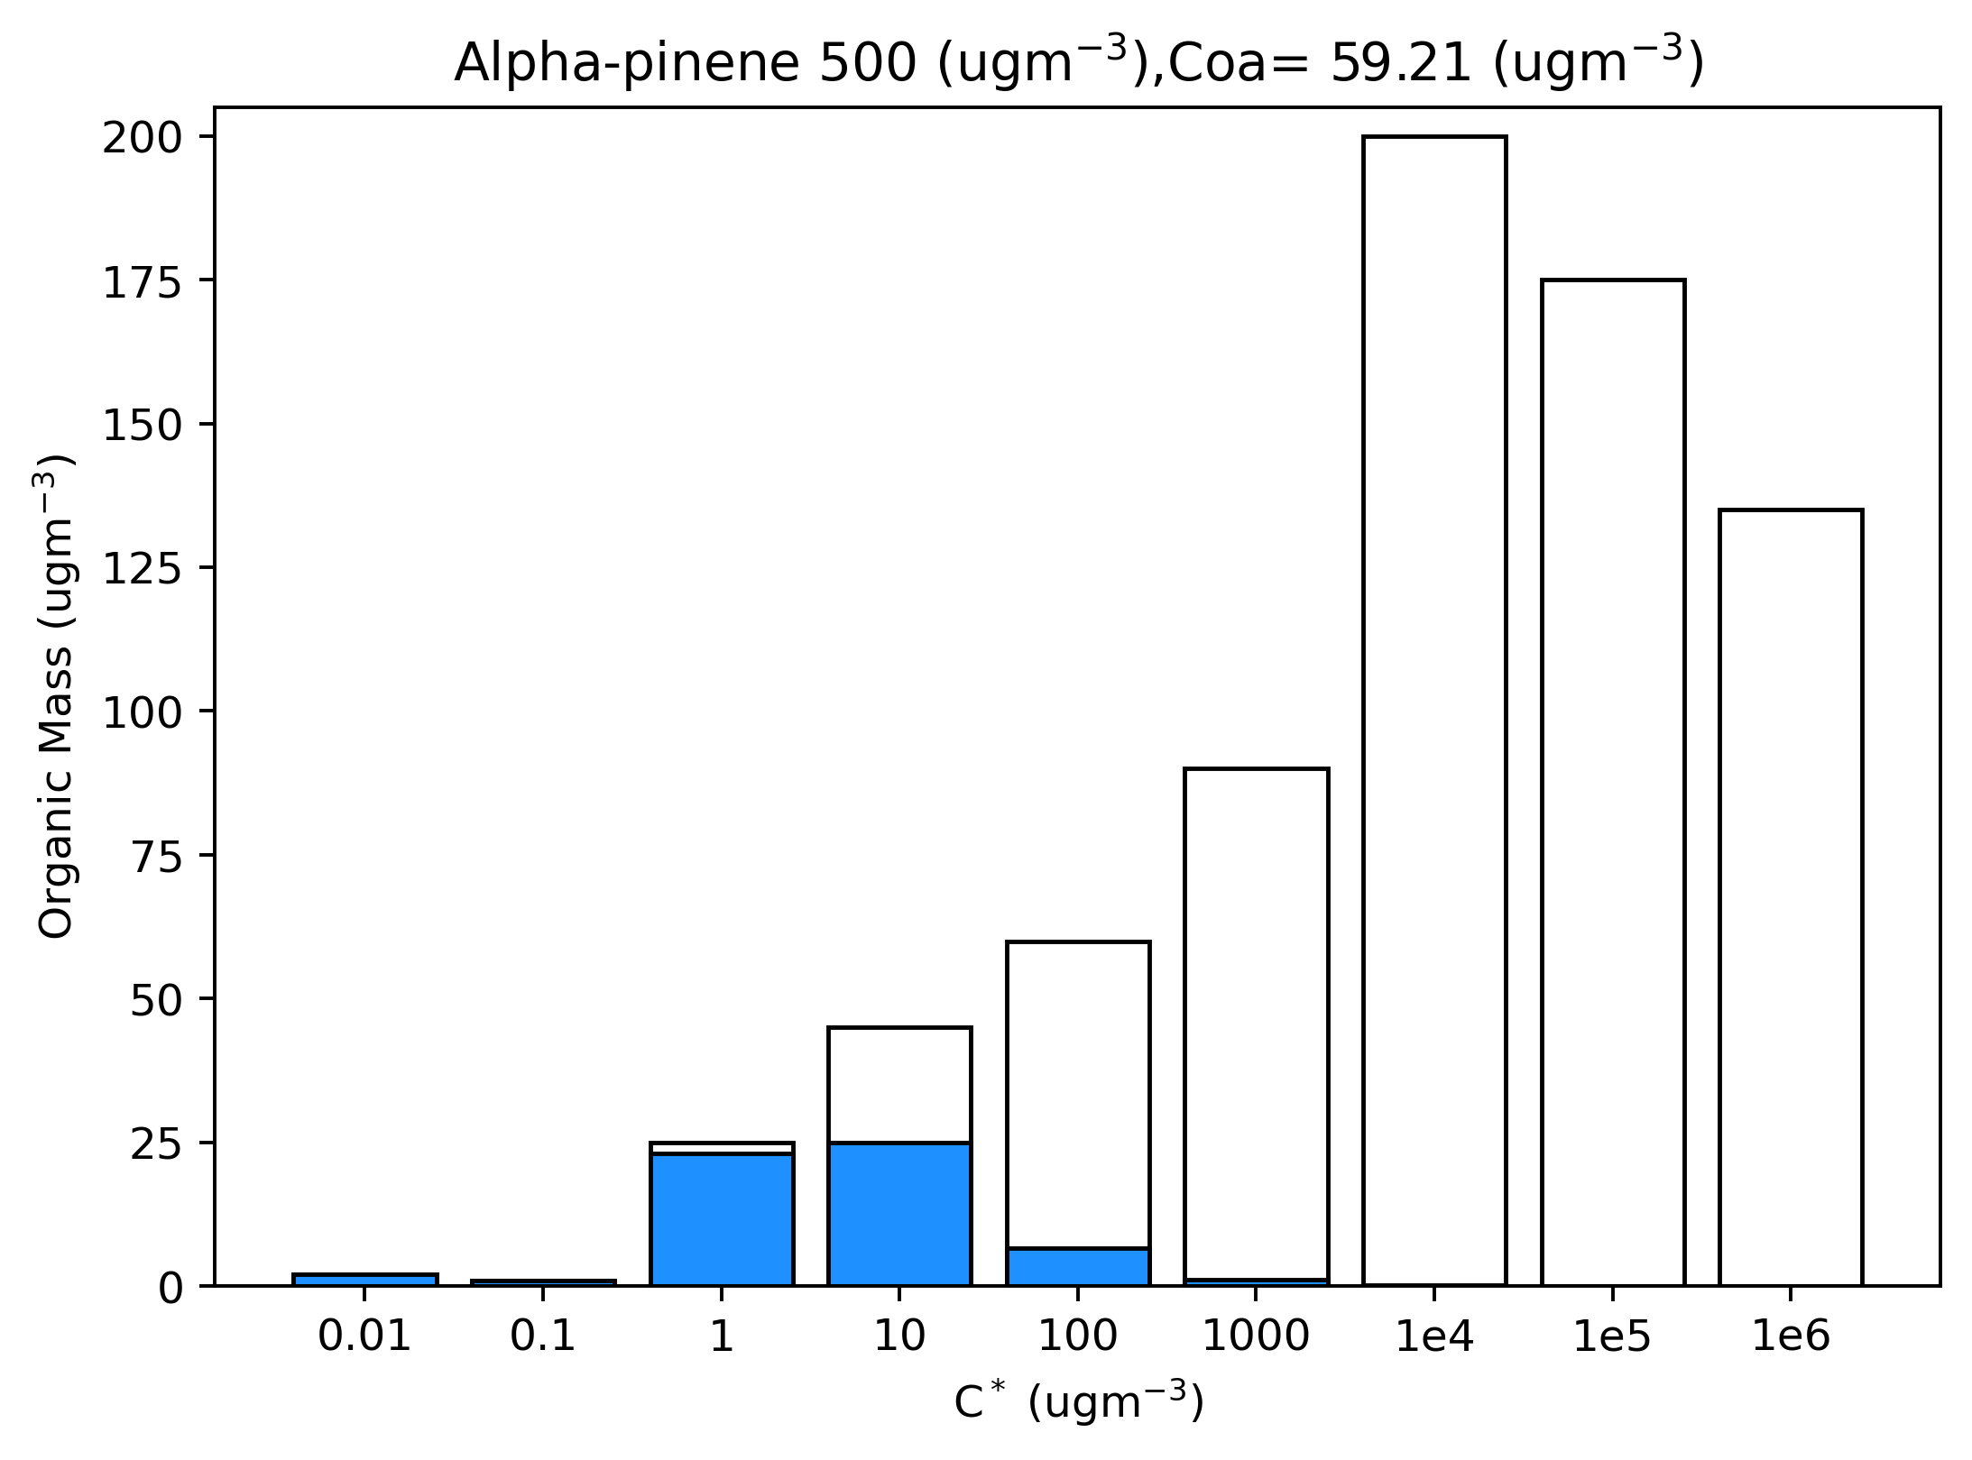
Output from SOA model: Temperature sensitivity test
T= 298 K
T= 310 K

Slide 8
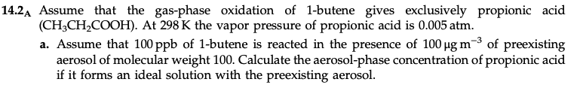
Solution:
BUTENE + OH ➔ 1*CH3CH2COOH
Alpha = 1
Po = 0.005 atm
Mi = 74.08 g/mol
Mvoc = 56 g/mol
Ctot = alpha * Mi/Mvoc * delta(VOC)
= 1 * 74.08/56 * 100 ppb
= 132.14 ppb
= 400.27 ug/m3
Cgas = Ceq = Po*Mi/R*T
= Po * Mi/R*T
= 0.005 * 101325 * 74.08 / (8.314 * 298)
= ﻿15.148 ug/m3
Ctot = Ceq + Cp
Cp = Ctot – Ceq
= 400.27 – 15.148
= ﻿385.121 ug/m3

Slide 9
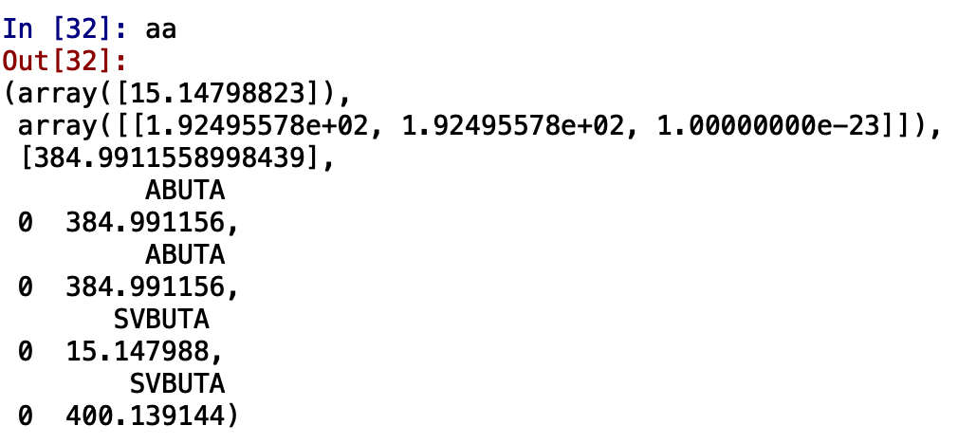
Input of SOA model
Output from SOA model
BUTENE + OH ➔ SVBUTA (gas-phase reaction)
SVBUTA ➔ ABUTA (aerosol module)
Initial concentration:
SVBUTA : 132 ppb
aerosol concentration : 1e-23 ug/m3
Parameter dataset:
Gas-phase species: SVBUTA PM species : ABUTA
C* : 15.14 ug/m3
Molecular weight of gas-species: 74.08 g/mol
Molecular weight of pm-species: 74.08 g/mol
Meteorology:
T=298 K
P = 101325 pa
The model is run for one time-step

Slide 10
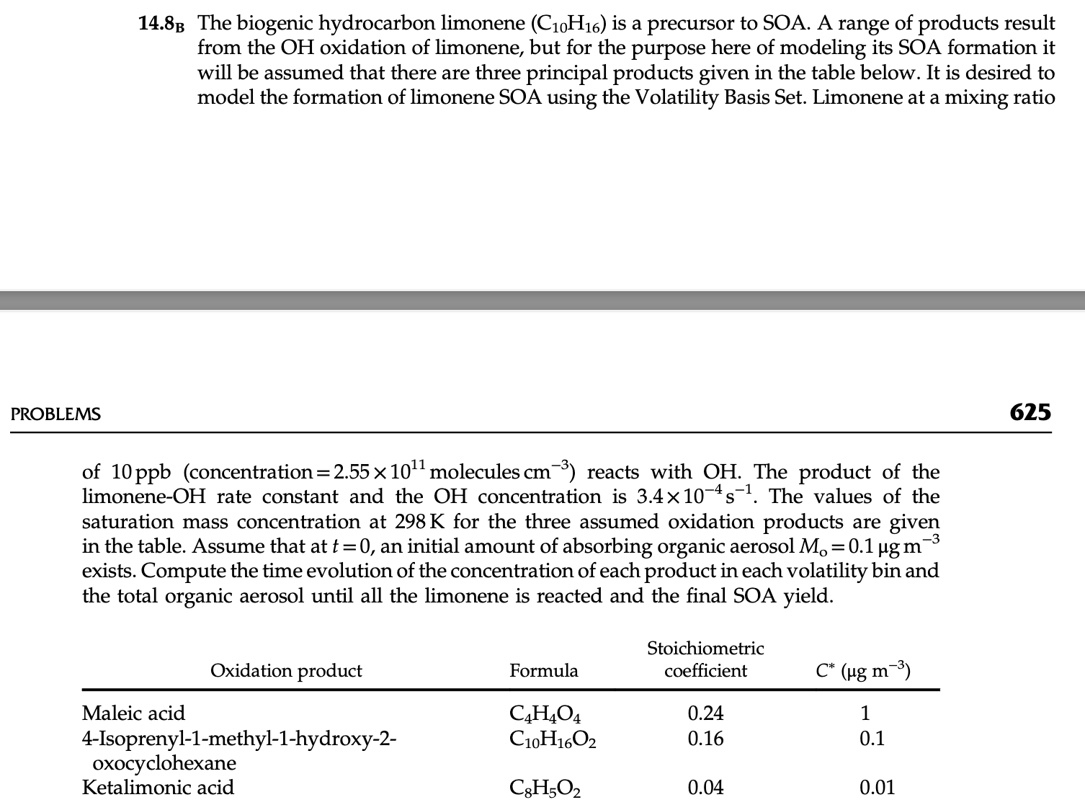

Slide 11
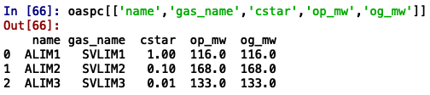
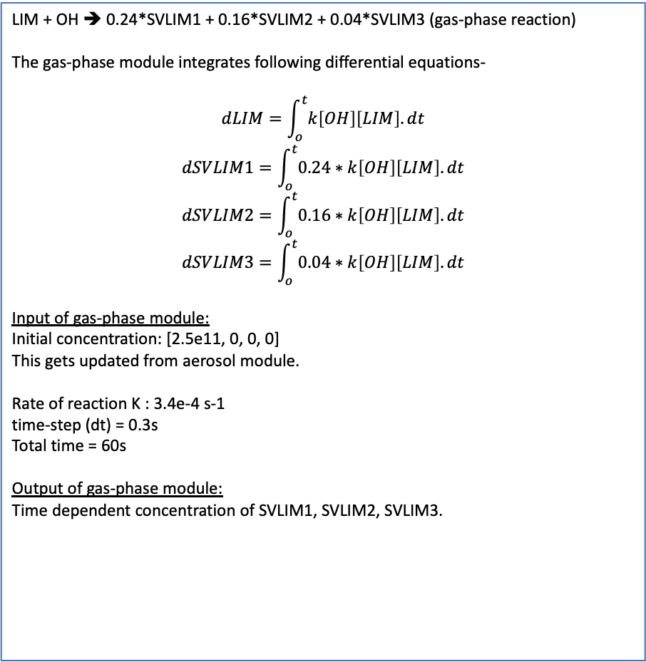
input in SOA model
Gas-phase module
Aerosol module
LIM + OH ➔ 0.24*SVLIM1 + 0.16*SVLIM2 + 0.04*SVLIM3 (gas-phase reaction)
The gas-phase module integrates following differential equations-
$$dLIM=\int_{o}^{t}{k\left[OH\right]\left[LIM\right].dt}$$
$$dSVLIM1=\int_{o}^{t}{0.24∗k\left[OH\right]\left[LIM\right].dt}$$
$$dSVLIM2=\int_{o}^{t}{0.16∗k\left[OH\right]\left[LIM\right].dt}$$
$$dSVLIM3=\int_{o}^{t}{0.04∗k\left[OH\right]\left[LIM\right].dt}$$
Input of gas-phase module:
Initial concentration: [2.5e11, 0, 0, 0]
This gets updated from aerosol module.
Rate of reaction K : 3.4e-4 s-1
time-step (dt) = 0.3s
Total time = 60s
Output of gas-phase module:
Time dependent concentration of SVLIM1, SVLIM2, SVLIM3.
SVLIM1 ➔ ALIM1
SVLIM2 ➔ ALIM2
SVLIM3 ➔ ALIM3
Initial concentration:
Output from gas-phase module SVLIM1, SVLIM2, SVLIM3
Initial aerosol concentration: 1e-23 ug/m3
Parameter dataset:
og_mw is molecular weight of gas-phase species (SVLIM1, SVLIm2, SVLIM3)
op_mw is molecular weight of aerosol-phase species (ALIM1, ALIM2, ALIM3)
Meteorology:
T=298 K
P = 101325 pa
Output:
Concentration of ALIM1, ALIM2, ALIM3 in ug/m3
Updates SVLIM1, SVILIM2 and SVLIM3 concentration which is passed on to gas-phase module.

Slide 12
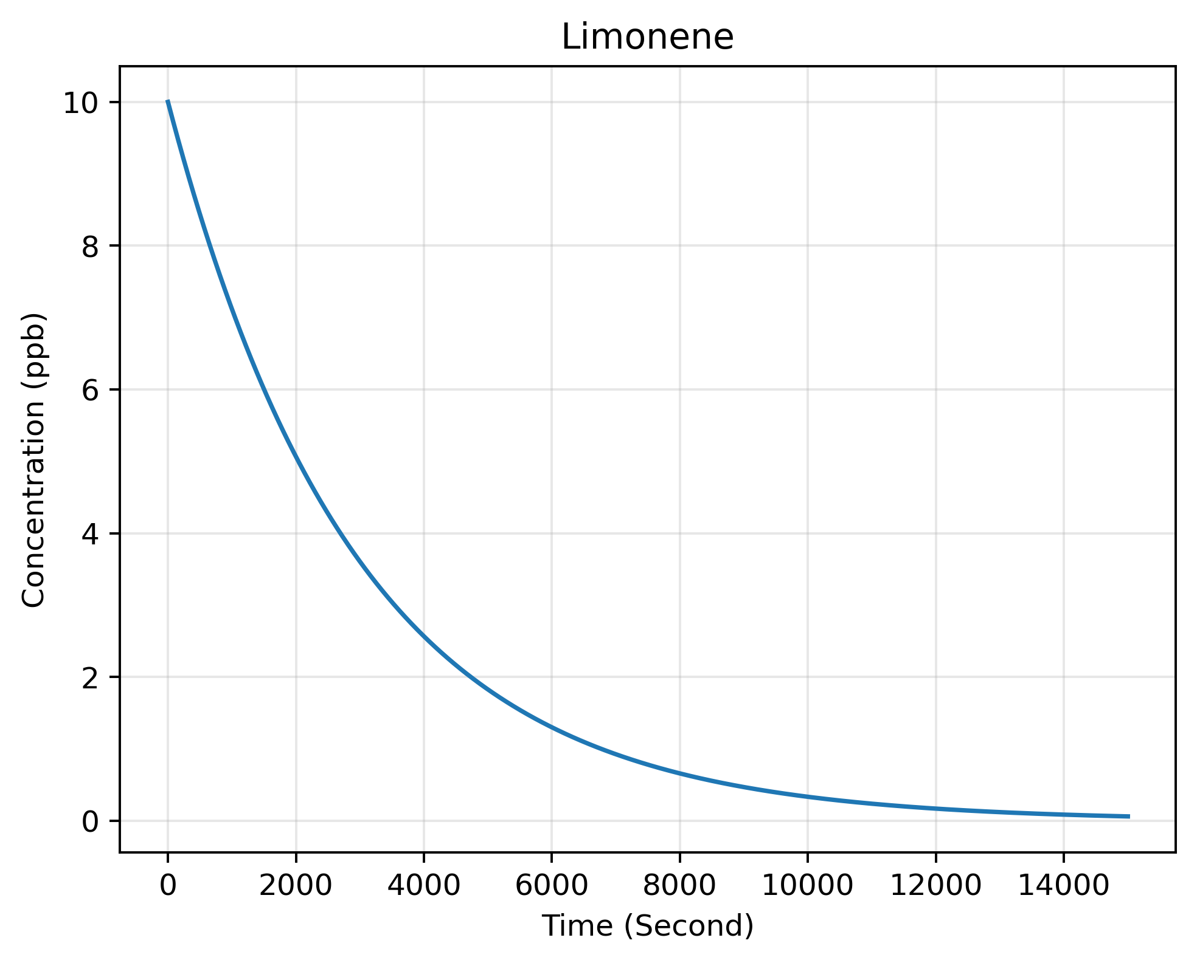
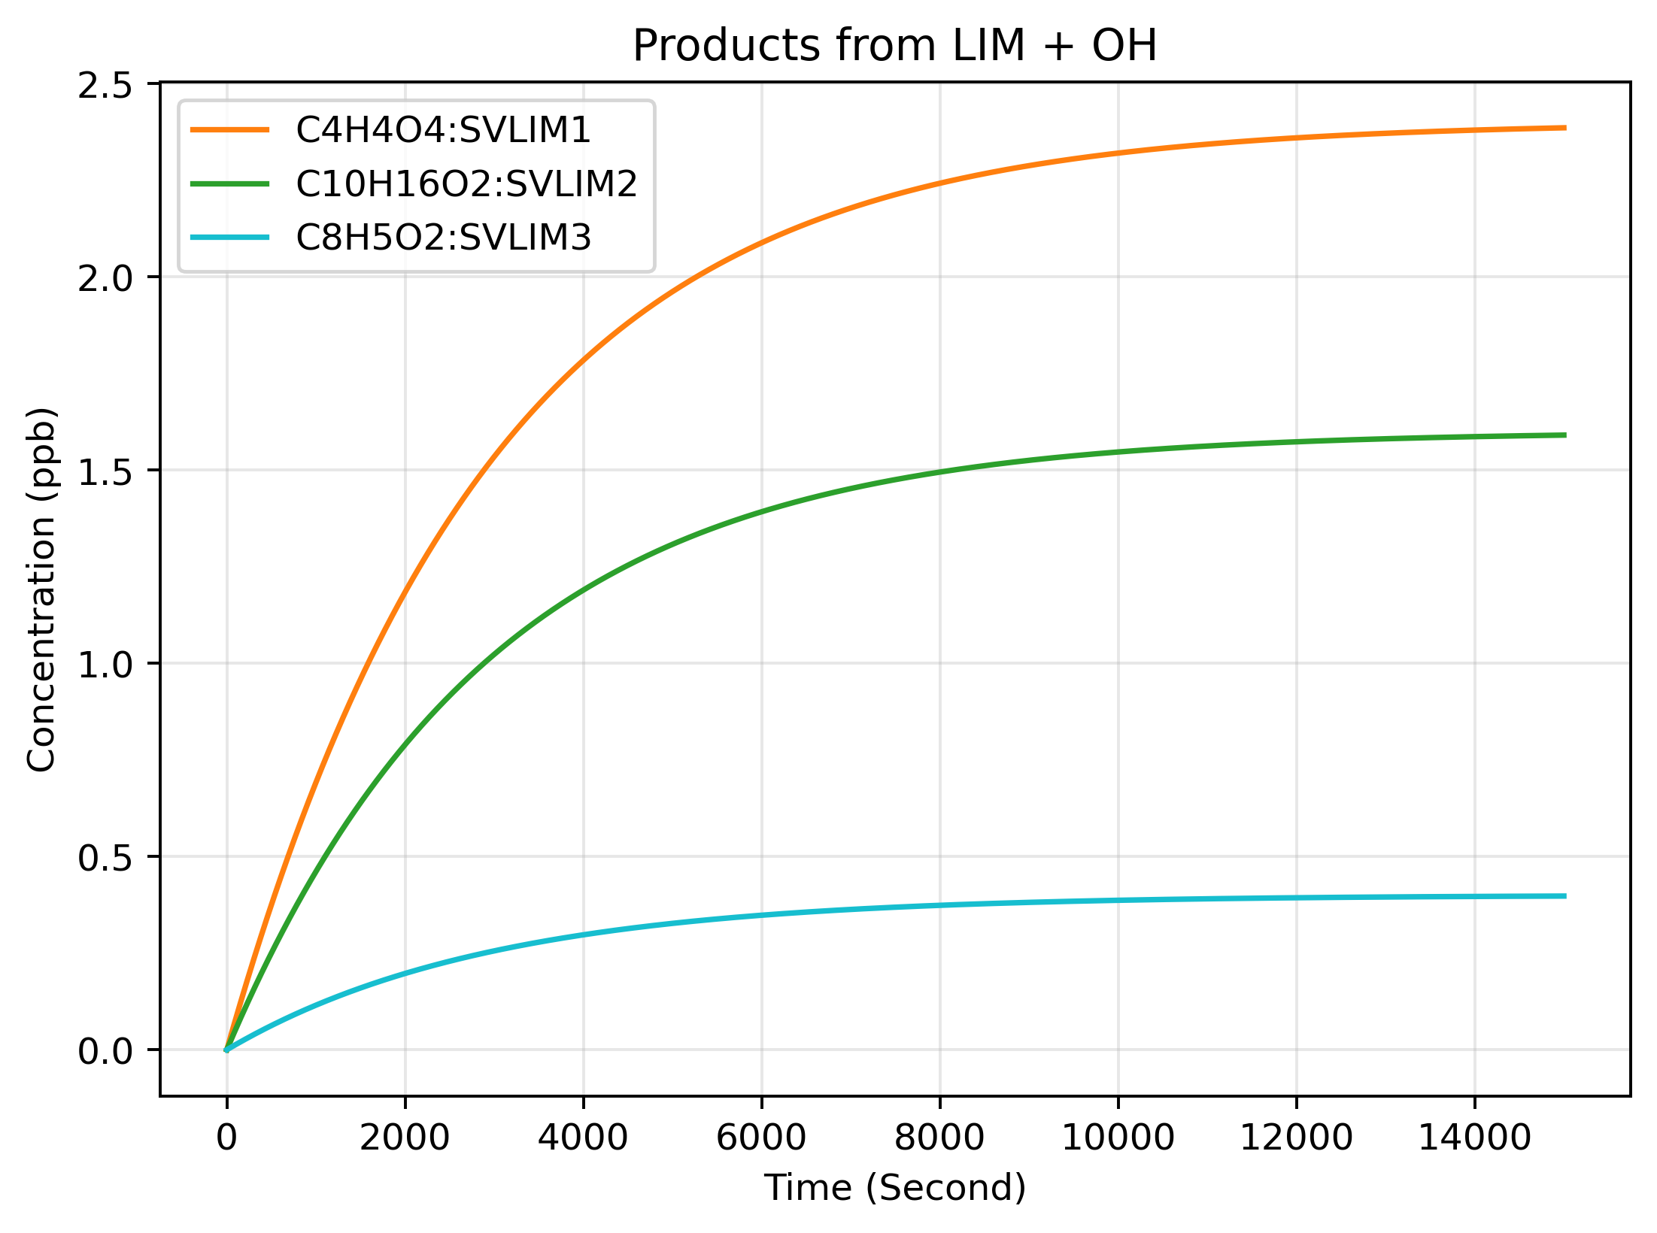
Output from SOA model
Output form the gas-phase reaction solver. This figures show as limonene decays the products are forming. This figure doesn’t show the updated concentration of the gas-phase products from the aerosol module.

Slide 13
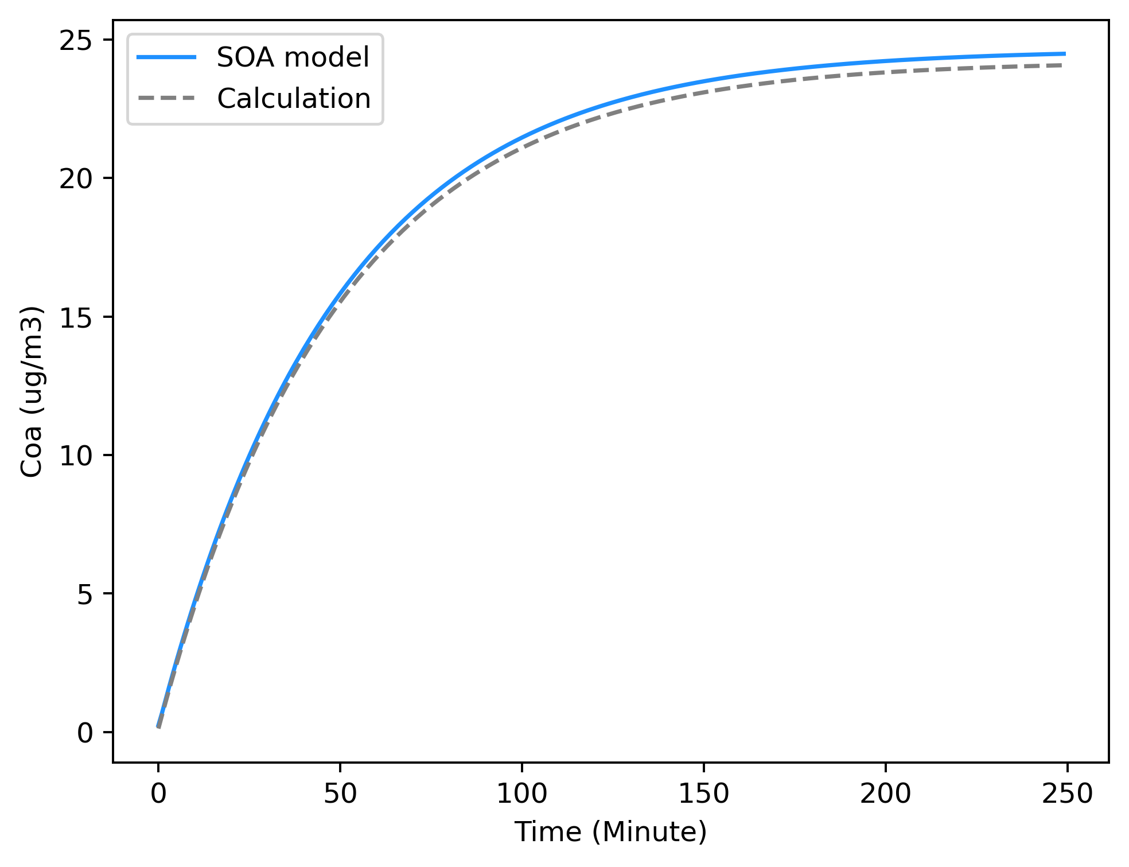
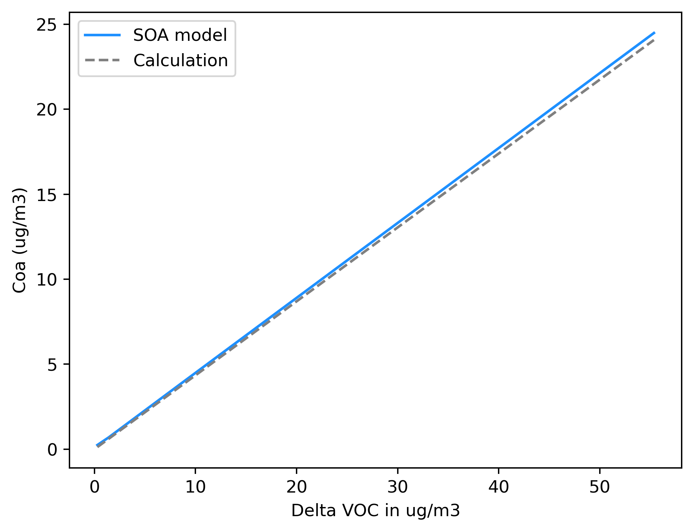
Output from SOA model

Slide 14
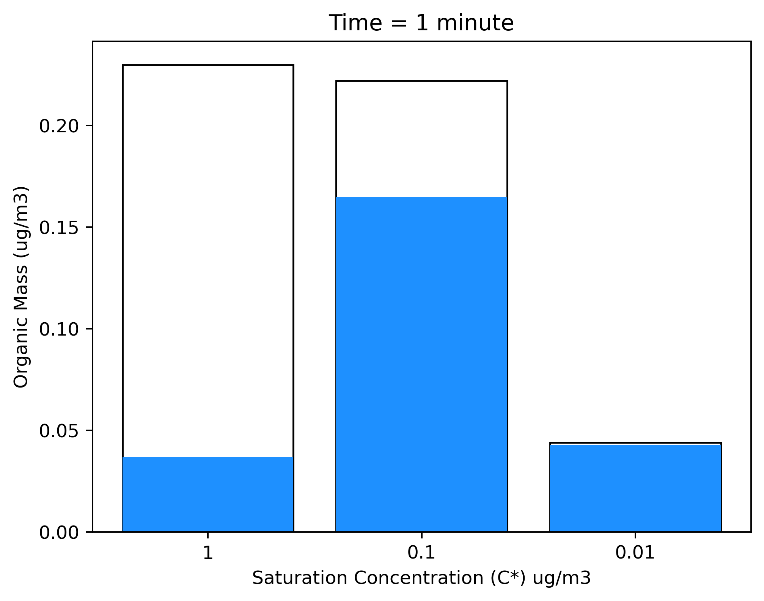
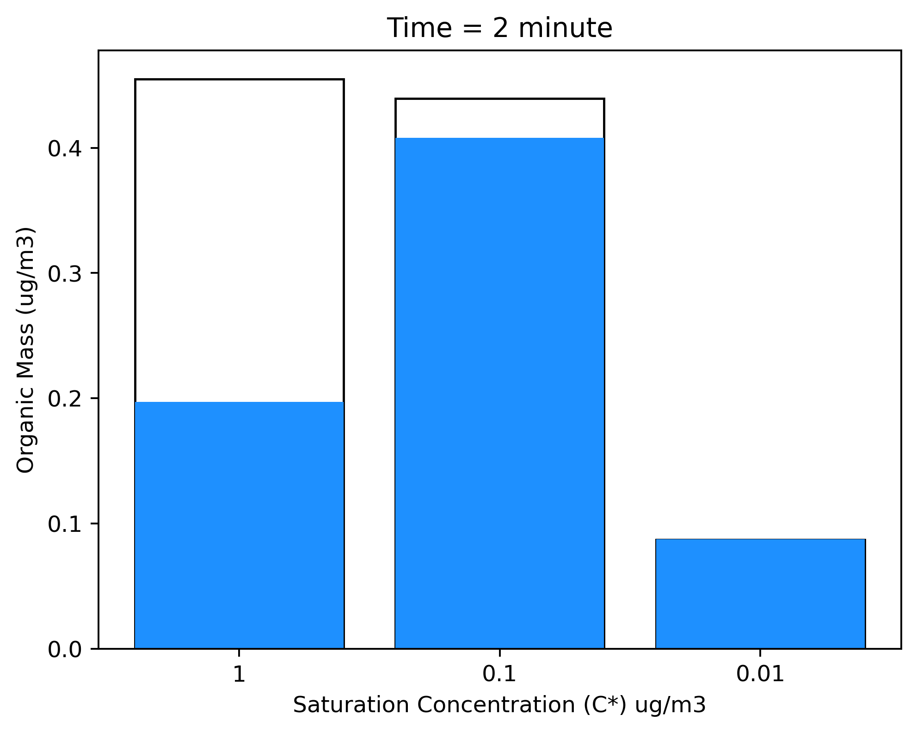
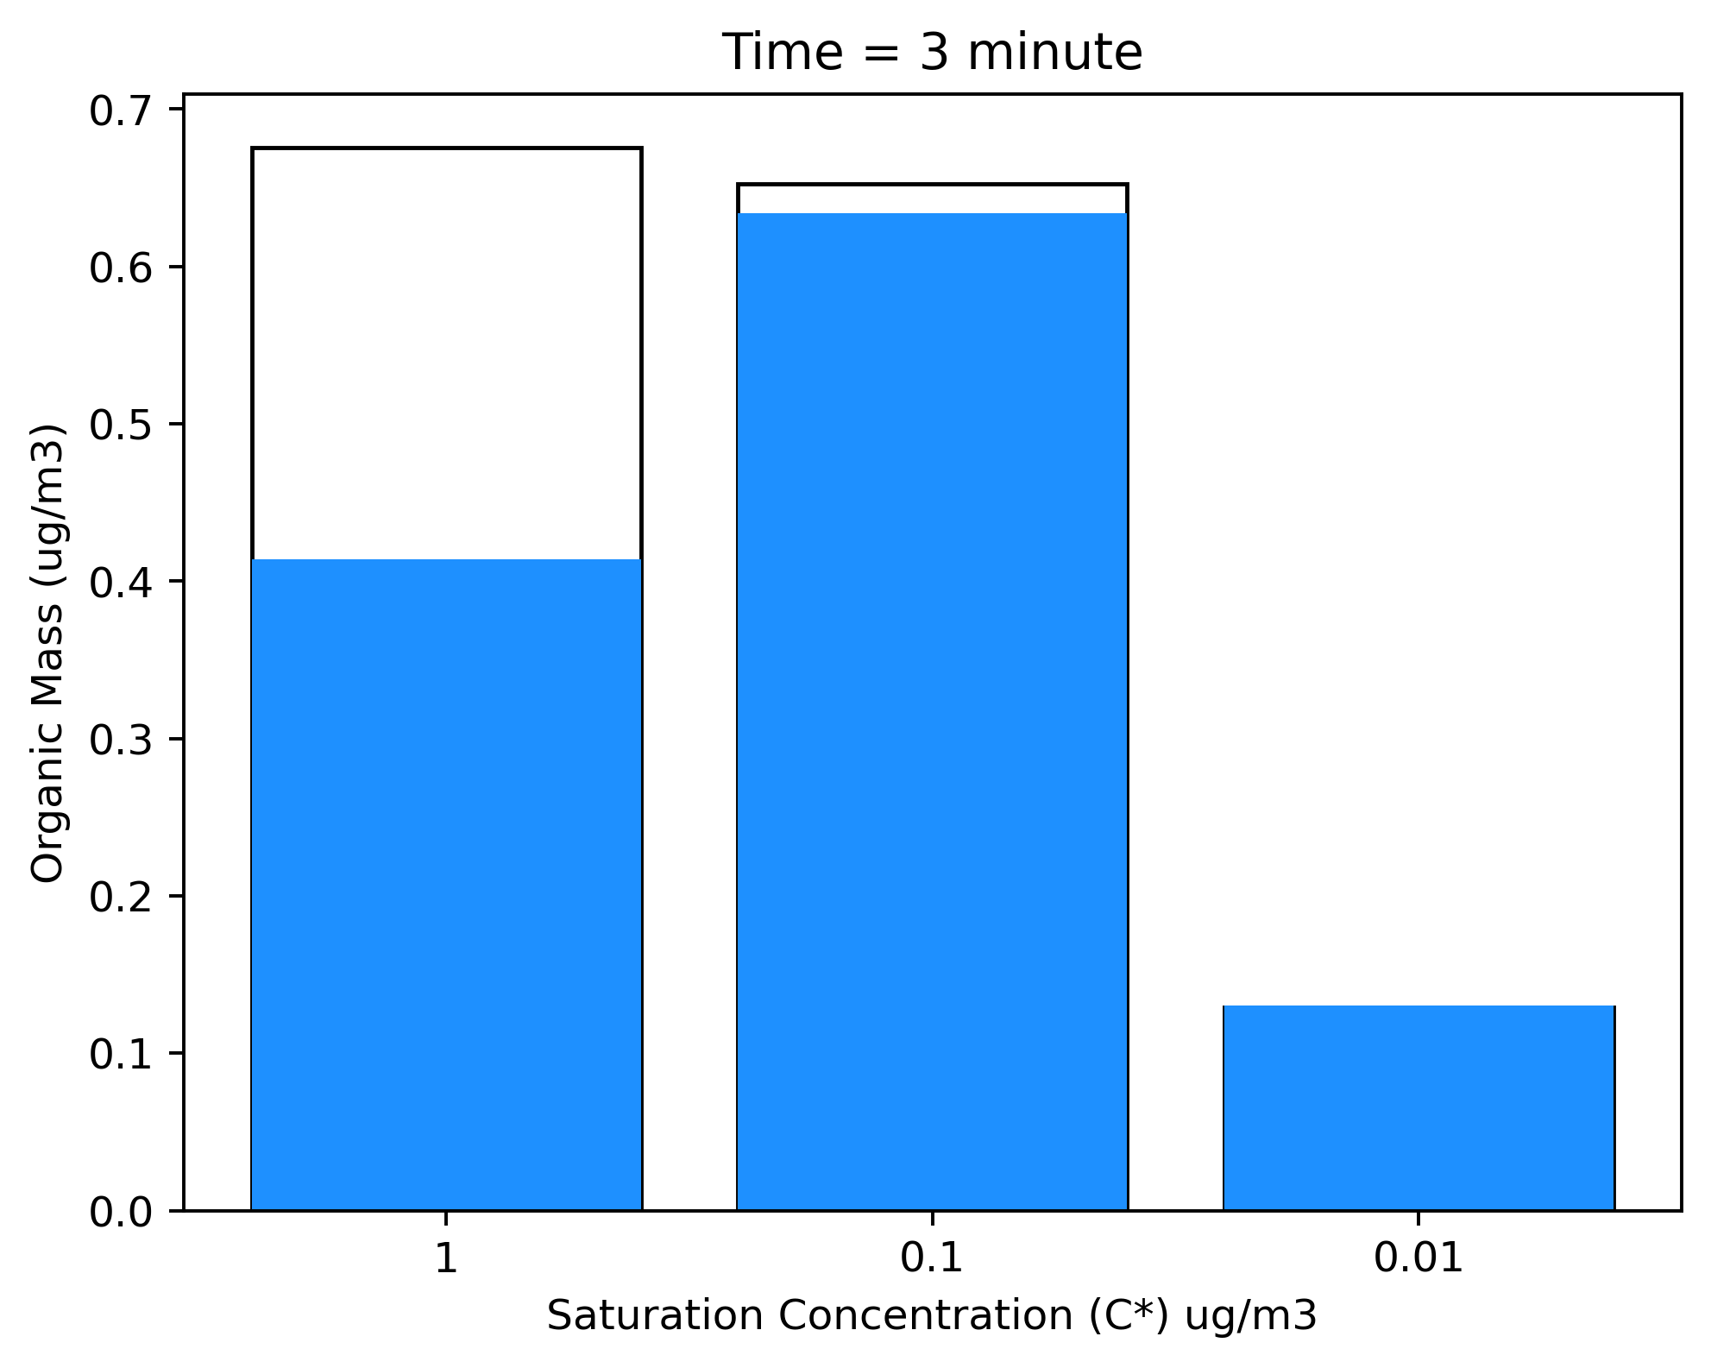
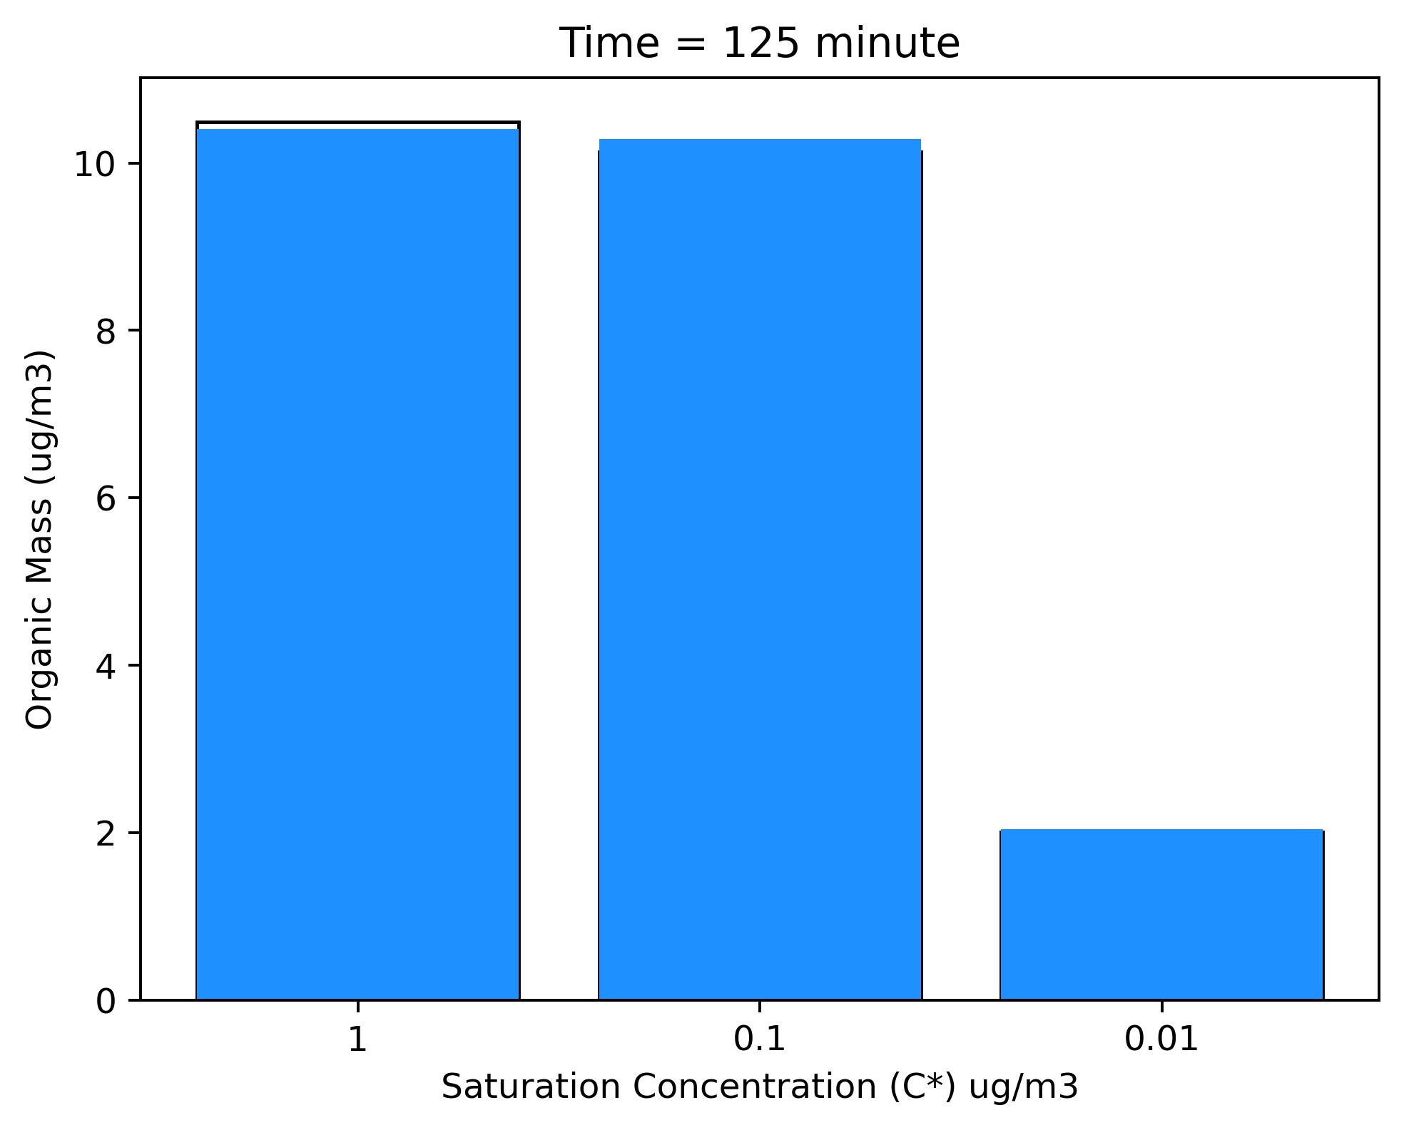

Output from SOA model

Slide 15


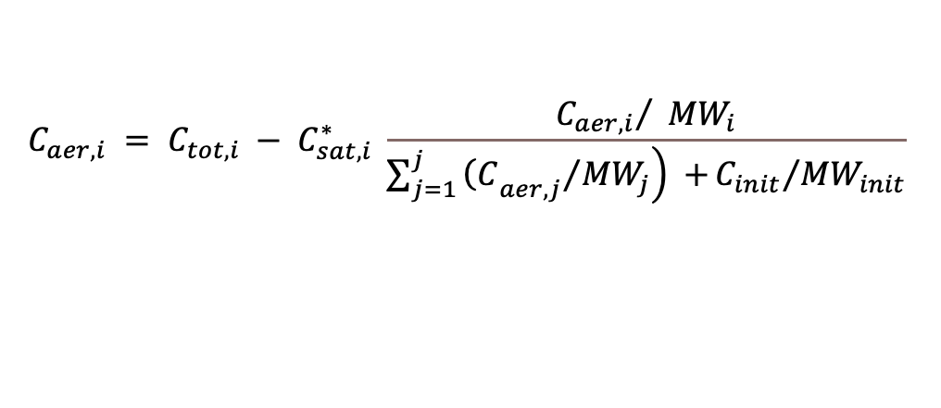




$$VOC= α_{1} P_{1}+ α_{2} P_{2}+…+α_{n}P_{n}$$
$$C_{aer,i}= C_{tot,i}−C_{sat,i}^{∗} \frac{{C_{aer,i}}/{{MW}_{i}}}{N}$$
SVLIM1, SVLIM2..
$$C_{tot,i}= α_{1 }\frac{{MW}_{i}}{{MW}_{VOC}} ∆VOC$$
$$C_{tot,i}= C_{aer,i}+ C_{sat,i}^{∗} \frac{{C_{aer,i}}/{{MW}_{i}}}{N}$$
TRPRXN
APINRXN
$$C_{tot,i} = C_{aer,i} + C_{gas,i}$$
$$C_{tot,i}= C_{aer,i}\left( 1+\frac{{C_{sat,i}^{∗}}/{{MW}_{i}}}{N}\right)$$
$$C_{aer,i} = C_{tot,i} − C_{gas,i}$$
$$C_{aer,i}= C_{tot,i} \left(\frac{N × {MW}_{i}}{N × {MW}_{i}+ C_{sat,i}^{∗} }\right)$$
$$C_{gas,i} = C_{sat,i} = C_{sat,i}^{∗} × X_{i,om}$$
$$C_{aer,i} = C_{tot,i} − C_{sat,i}^{∗} \frac{{C_{aer,i}}/ {MW}_{i}}{\sum_{j=1}^{j}{\left.{{\left(C\right.}_{aer,j}}/{{MW}_{j}}\right) +}{C_{init}}/{{MW}_{init}}}$$
$$\frac{C_{aer,i}}{{MW}_{i}}= C_{tot,i} \left(\frac{N}{N × {MW}_{i}+ C_{sat,i}^{∗} }\right)$$
N

Slide 16
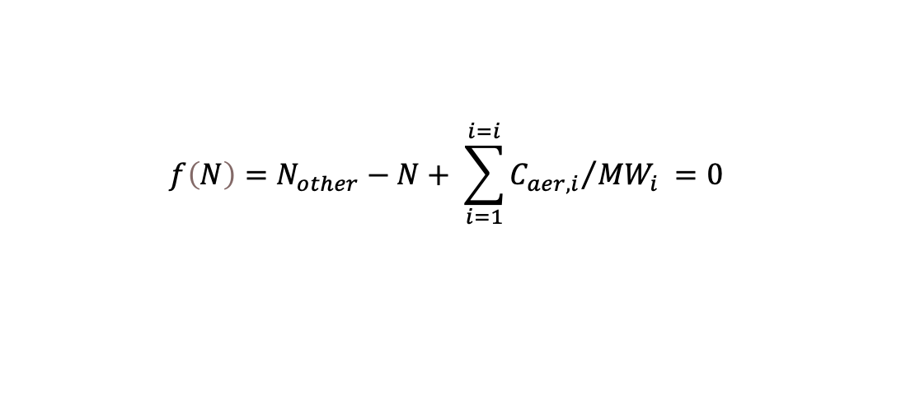
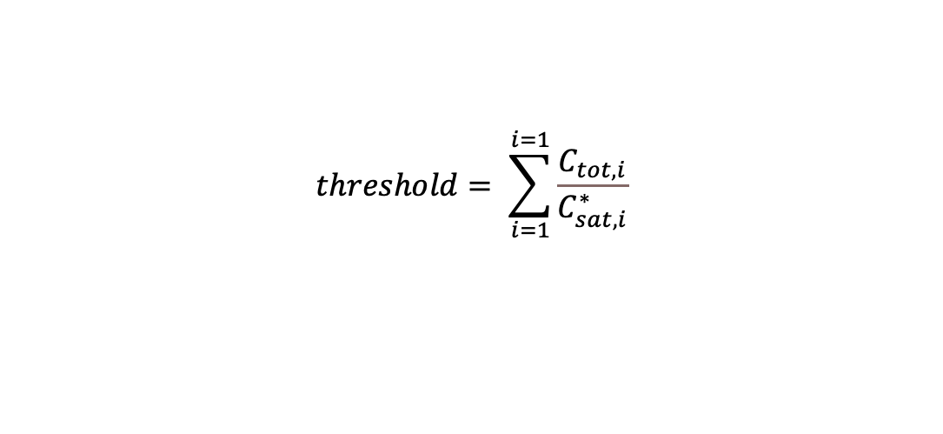
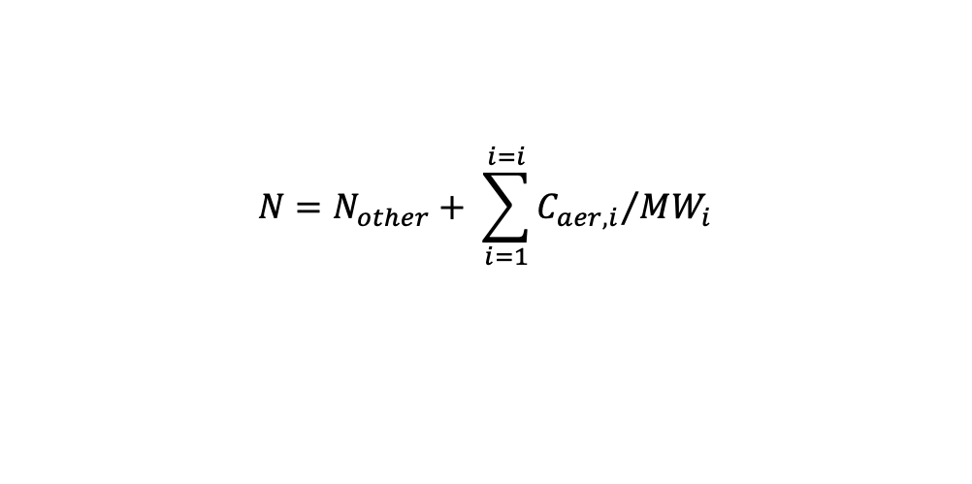
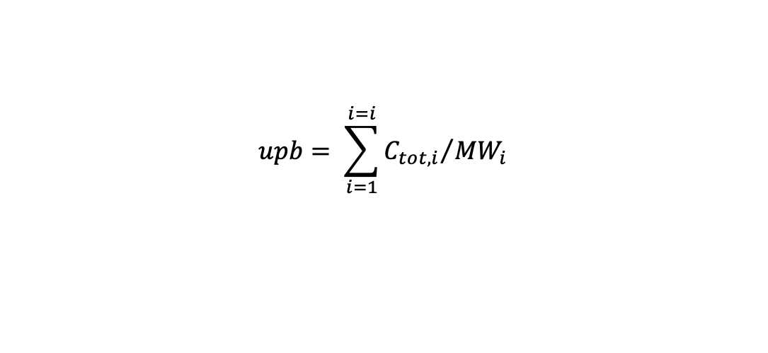
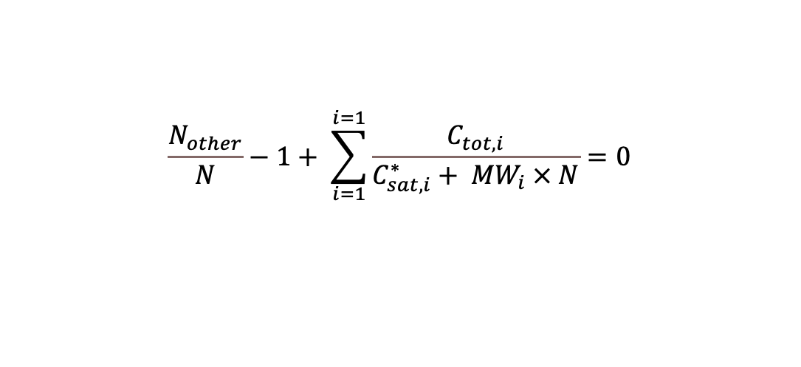
$$N=N_{other}+ \sum_{i=1}^{i=i}{{C_{aer,i}}/{{MW}_{i}}}$$
$$upb= \sum_{i=1}^{i=i}{{C_{tot,i}}/{{MW}_{i}}}$$
$$f\left(N\right)=N_{other}−N+ \sum_{i=1}^{i=i}{{C_{aer,i}}/{{MW}_{i}}} =0$$
$$lwb= Nonvolatile moles$$
$$\frac{N_{other}}{N}−1+ \sum_{i=1}^{i=1}{\frac{C_{tot,i}}{C_{sat,i}^{∗}+ {MW}_{i} × N}}=0$$
$$threshold= \sum_{i=1}^{i=1}{\frac{C_{tot,i}}{C_{sat,i}^{∗}}}$$

Slide 17
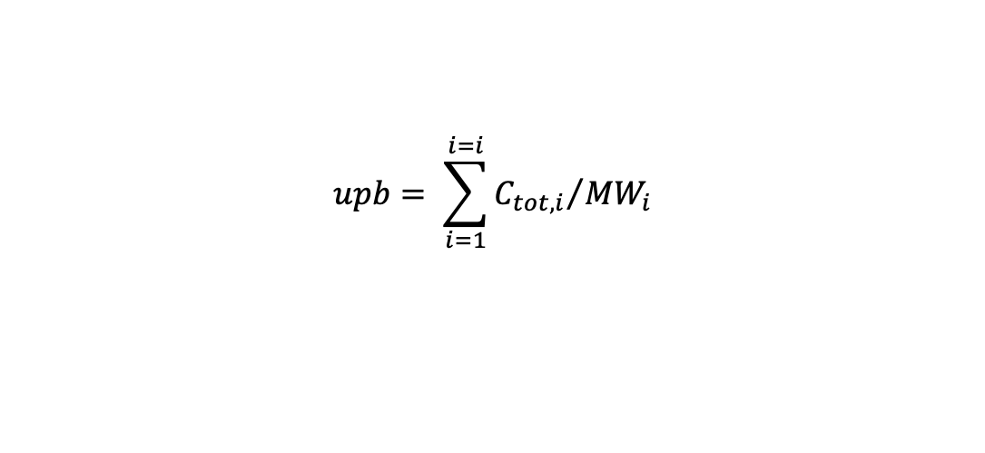
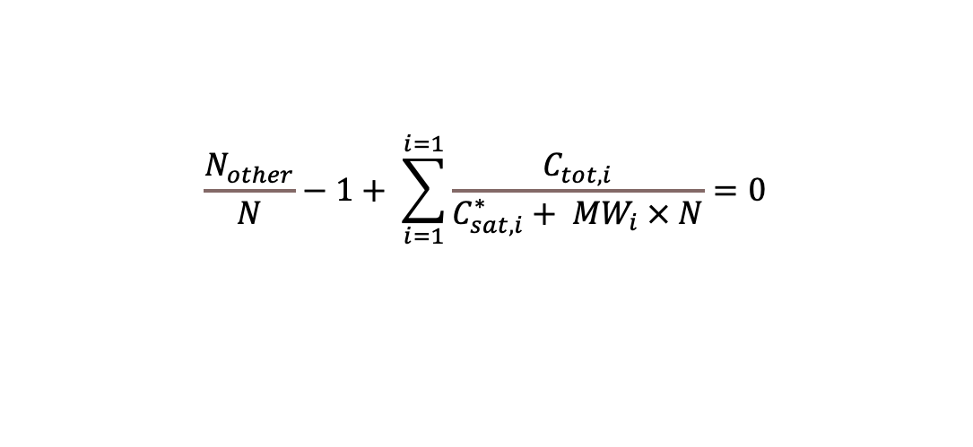
$$\frac{N_{other}}{N}−1+ \sum_{i=1}^{i=1}{\frac{C_{tot,i}}{C_{sat,i}^{∗}+ {MW}_{i} × N}}=0$$
Y
$$upb= \sum_{i=1}^{i=i}{{C_{tot,i}}/{{MW}_{i}}}$$
$$lwb= Nonvolatile moles$$
F(N1)
upb
X
lwb
N1
N1 = (lwb + upb)/2
if f(N1) +ve:
N2 = N1 + upb /2
If f(N1) –ve:
N2 = N1 + lwb /2

Slide 18
The Gas-phase and SOA module framework
SOA module adopted from AERO
Unit conversion of concentration of semi-volatile model species : molecule/cm3 to ug/m3
Gas-phase solver
Read parameter table: Cstar, alpha, molecular weight, enthalpy
The Chem output:
cc: The initial concentration of model species
k: Computed rate constants considering solar zenith angle, pressure and temperature .
f: sociometric co-efficient from chemical mechanism file
iG: index of reactants
Temperature correct Cstar
Numerically solve the gas-particle partitioning equation: Bisection method. This outputs the total moles in aerosol phase.
The concentration of aerosol phase and gas phase of a model species is computed.
The gas-phase concentration is converted to molecule/cm3

Slide 19
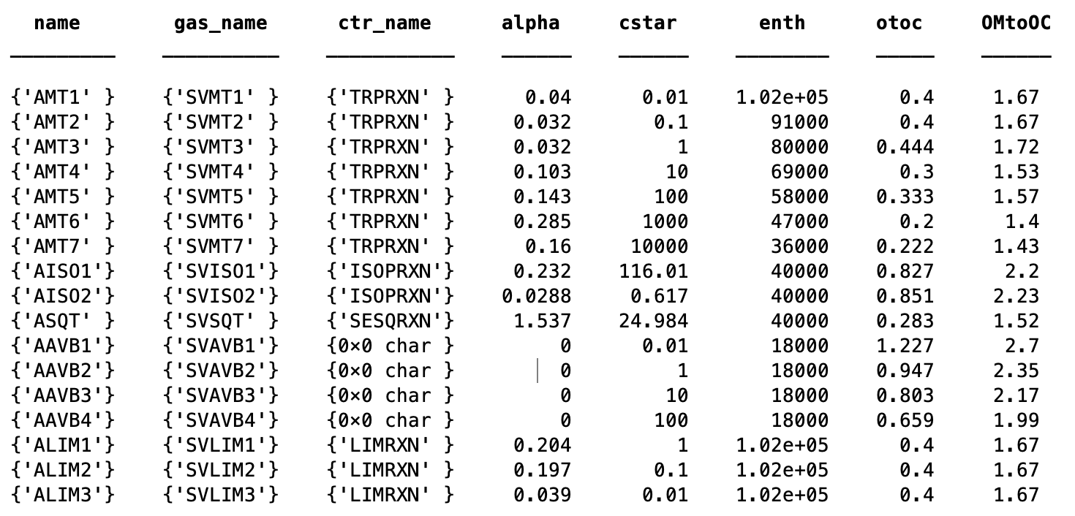

Slide 20
