Slide 1
Samiha amin
DisCovery Challenge: Trip Advisor

Slide 2
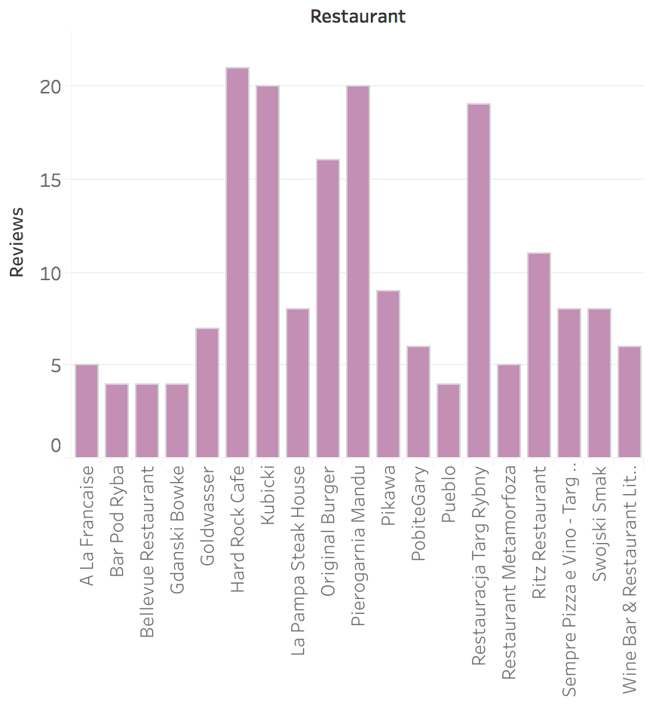
User Bias
Some users post reviews of the same restaurants, resulting in higher averages for the restaurants.
The bar chart shows restaurants that has users posting biased reviews and the number of these reviews.
SQL Query:
select RESTAURANT, user_name, avg(review_stars) as Stars
from TRIPADVISOR
group by user_name, restaurant
having count(*)>1;

Slide 3
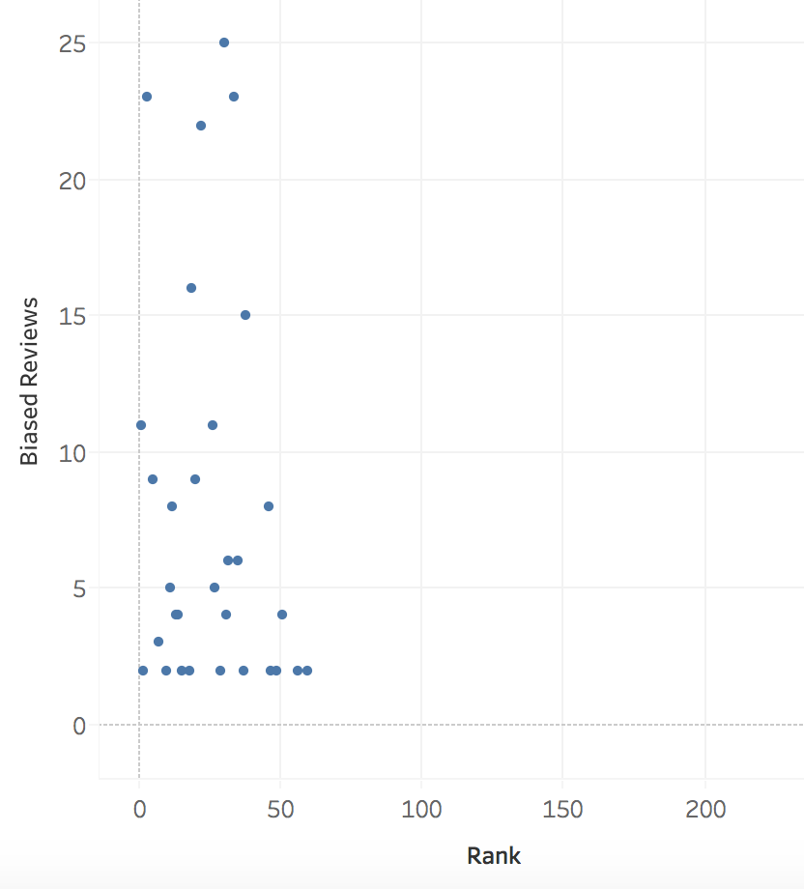
This graph shows how the number of
biased reviews correspond to ranks.
Note that all restaurants with most biased reviews (above 5) are all within top 50 restaurants.
Additionally, lower ranked (numerically higher) restaurants have no biased reviews, whether positive or negative.
SQL query:
select restaurant, count(user_name) AS Biased_Reviews, rank
FROM TripAdvisor
where user_name!=''
group by rank, user_name
having count(*)>1;

Slide 4
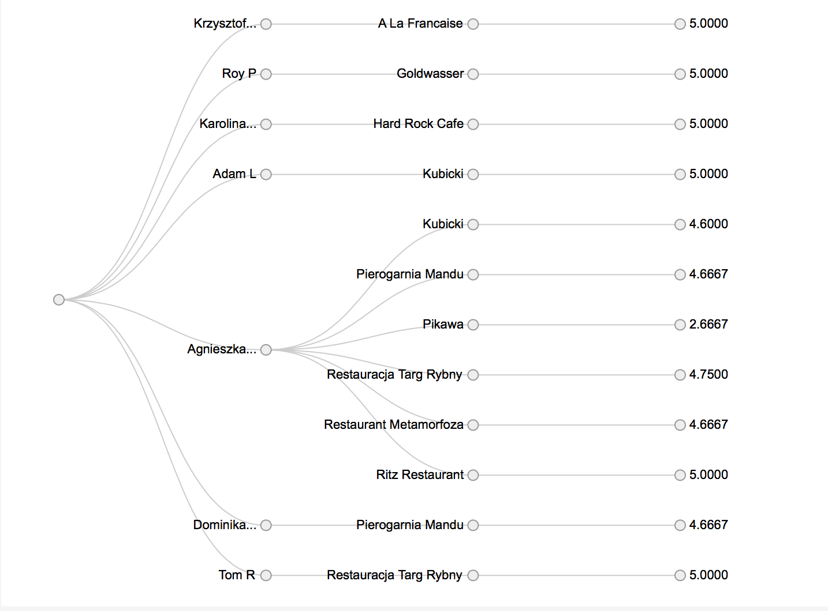
Users who have posted 3 or more reviews to the same restaurants.
Note: Biased reviews are usually 5 (averages being above 4.5) or very low (e.g Pikawa)

Slide 5
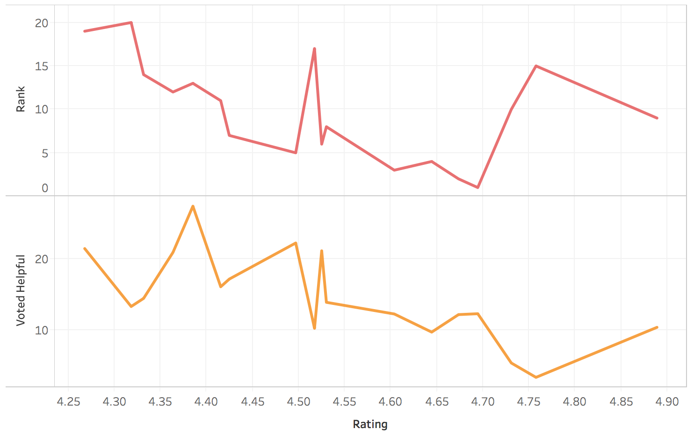
Review Helpfulness
The Average Users Helpful Votes for a restaurant seems to have an inverse relationship with the rank of the restaurant. Its possible that higher votes influence users to visit restaurants, which in turn contributes to higher rank (numerically smaller).
As a Restaurant’s Rating (Average Review Stars) changes, Rank and average votes changes similarly.

Slide 6
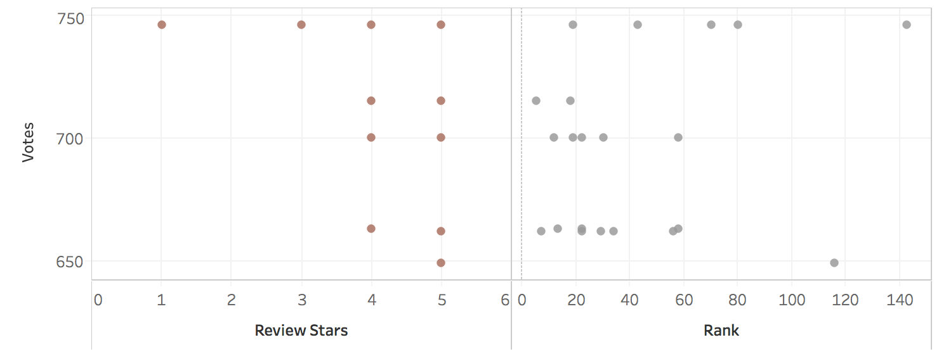
SQL query:
SELECT Rank, avg(REVIEW_STARS) AS Rating,
avg(USER_HELPFUL_VOTES) As Voted_Helpful
FROM DiscoveryChallenge.TRIPADVISOR
WHERE rank<=30
GROUP BY restaurant;
SQL query:
SELECT REVIEW_STARS As ReviewStars,
USER_HELPFUL_VOTES As Votes
FROM DiscoveryChallenge.TRIPADVISOR
where user_helpful_votes>600;
Highly voted reviews (>600 votes) seem to correspond to higher Review Stars (4 and 5) and top restaurants (numerically ranked low).
Note that the 1-star highly voted review corresponds to the restaurant ranked above 140, which shows that highly-voted reviews impact restaurants both positively and negatively.

