Slide 1
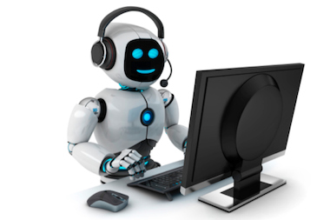
PRESENTATION ON COMPUTER
Topic: Generation And Types Of Computers
PREPARED BY:
Samikshya Timalsina

Slide 2
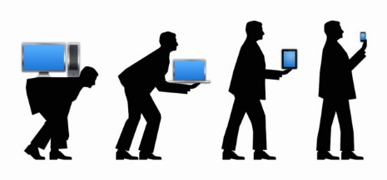
GENERATION OF COMPUTERS
The development of computer took place in five distinct phases known as computer generation. The development of computer had passed many stages from 1943 AD to till now. The generations of computer are listed below:
First Generation
Second Generation
Third Generation
Fourth Generation
Fifth Generation

Slide 3
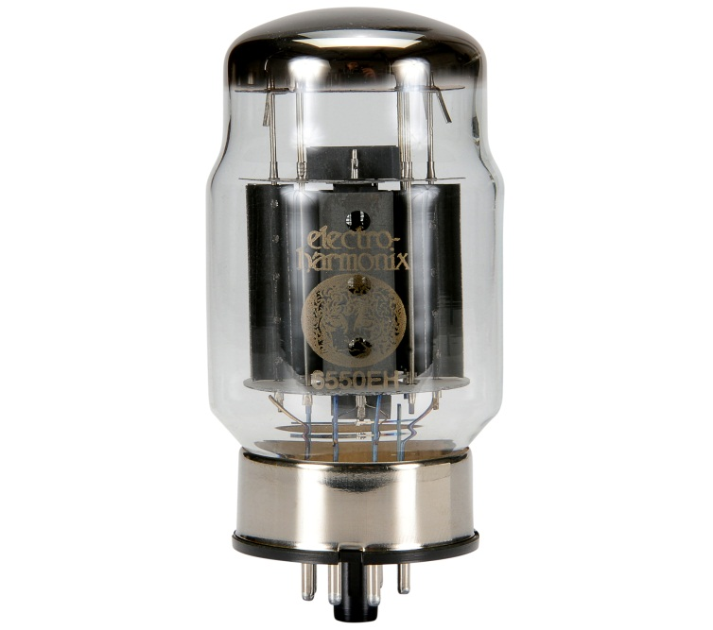
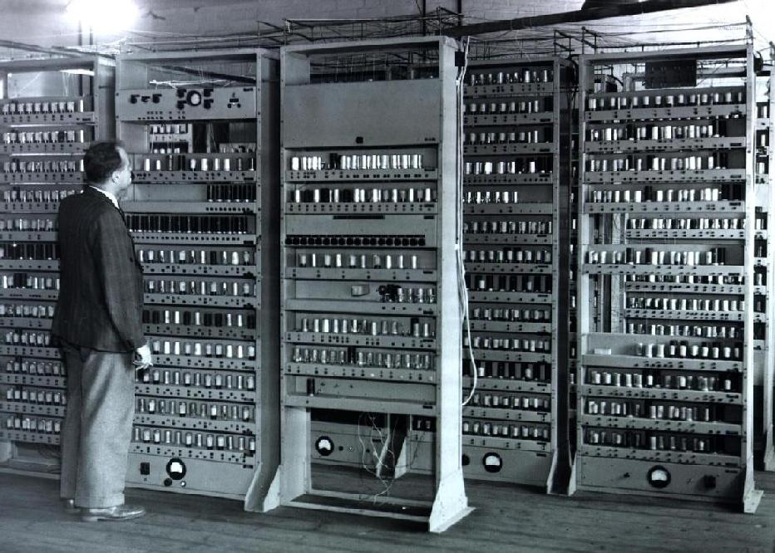
First Generation
The first generation computers were developed during 1943 AD to 1958 AD.
Vacuum tubes were used as their main electronic components.
They were slow and their speed was measured in millisecond.
They used machine level language for writing programs.
They consumed huge amount of electric power.
ENIAC, EDVAC, EDSAC, UNIVAC, etc. are some examples of it.
VACUUM TUBE
EDSAC

Slide 4
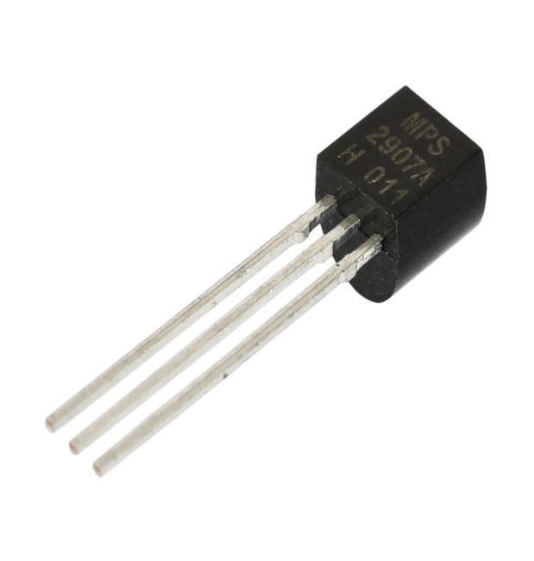
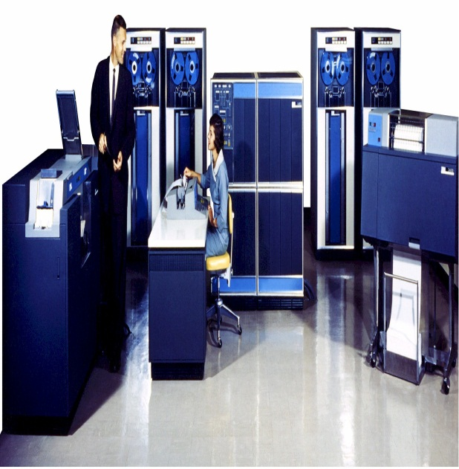
Second Generation
The second generation computers were developed during 1959 AD to 1964 AD.
Transistors were used as their main electronic components.
They could perform tasks in microseconds.
They used machine language, assembly language and high language for writing programs.
Magnetic tapes were used as secondary storage memory.
UNIVAC-II, IBM 1401 etc. are some examples of it.
TRANSISTOR
IBM 1401

Slide 5
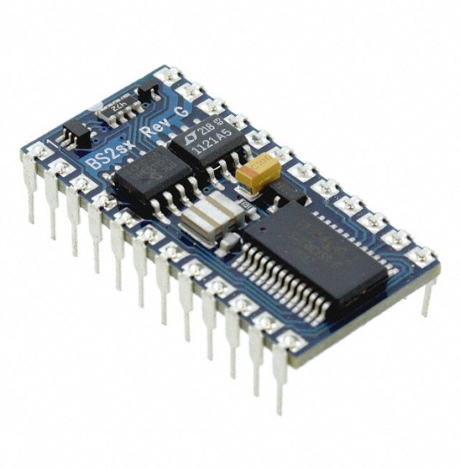
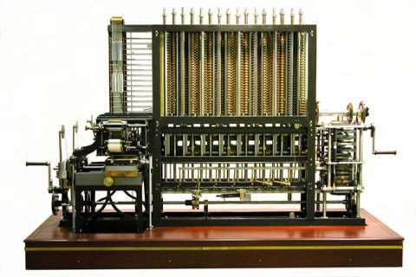
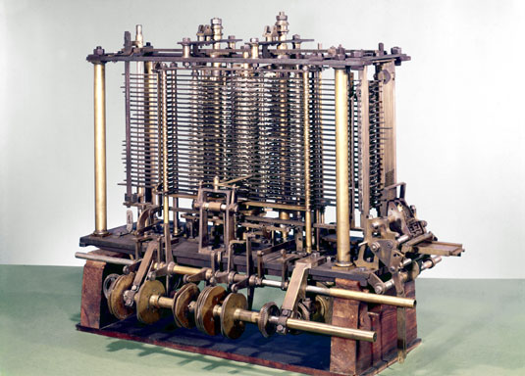
Third Generation
The third generation computers were developed during 1965 AD to 1974 AD.
IC(Integrated Circuit) were used as their main electronic components.
They could perform tasks in nanoseconds.
They used high language for writing programs.
Keyboards and monitors were introduced for input and output devices.
Analytical engine, difference engine, etc. are some examples of it.
IC
Difference & Analytical Engine

Slide 6
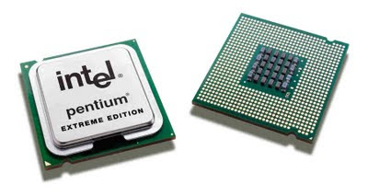
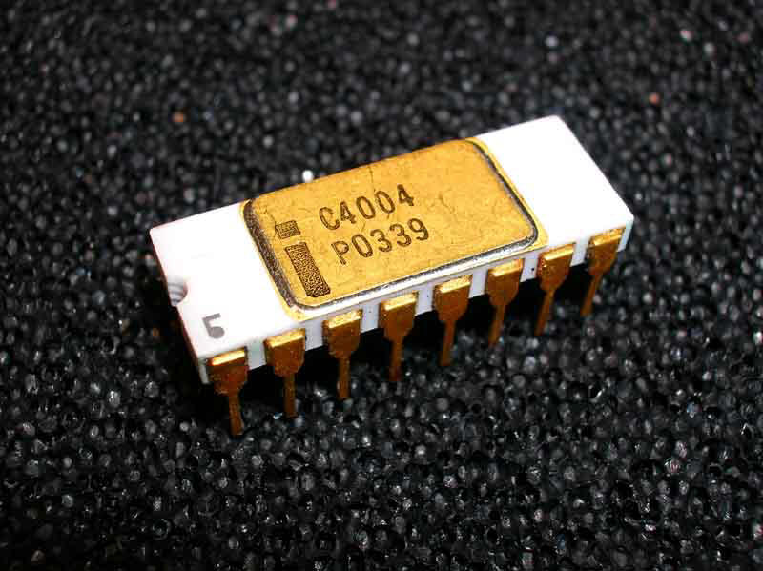
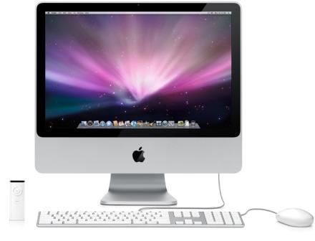
Fourth Generation
The fourth generation computers are developed after 1975AD.
Microprocessor are used as their main electronic components. The first microprocessor ‘Intel 4004’ was developed in 1971 AD.
They can perform tasks in picosecond.
Programs are written in high language.
They are totally generally purpose and user friendly.
Macintosh, IT system, etc. are some examples of it.
Microprocessor & Intel 4004
Macintosh

Slide 7
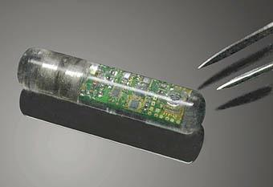
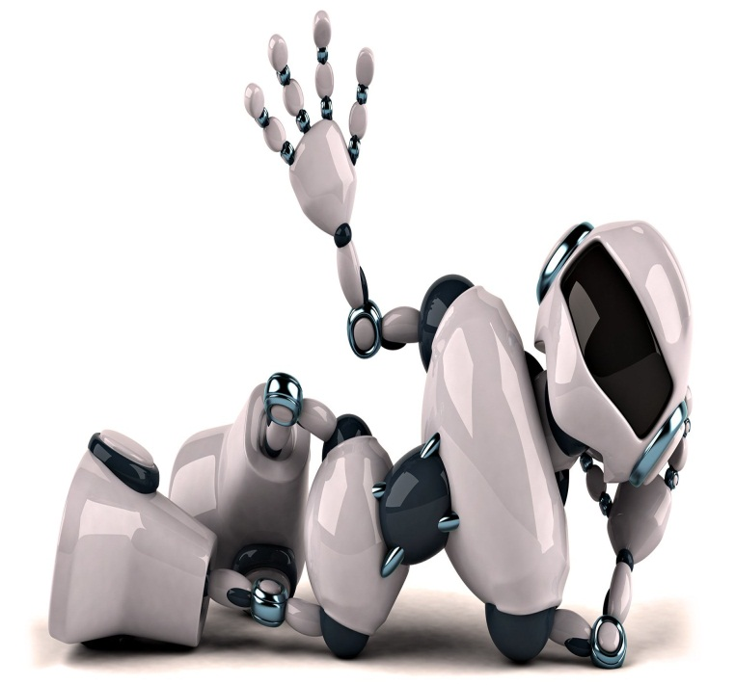
Fifth Generation
The fifth generation computers are still in the development stage.
They will be based on bio-chips.
They could perform tasks in femtoseconds.
They used artificial language and able to understand human language.
They will have multiprocessor and parallel processing capacity.
Biochip
Robot

Slide 8

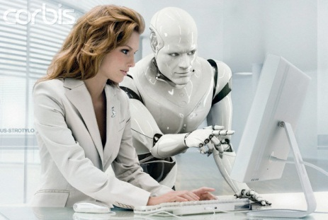

Artificial Intelligence
Artificial intelligence is the ability that understand natural language and capable of thinking itself. It is the technique or software that enables computer to mimic human behavior in many ways. It makes computer capable of reasoning capabilities through a problem to reach a conclusion. AI is also known as rule based system. Robots are well known forms of AI.

Slide 9

Generation | Speed | Electronic component | Storage device | Computer language
First | Millisecond | Vacuum tubes | Punched Cards | Machine Language
Second | Microsecond | Transistors | Magnetic tapes | Assembly language
Third | Nanosecond | ICs | Magnetic disks | High level language
Fourth | Picosecond | Microprocessors | Magnetic, optical, flash disks | High level language
Fifth | Femtosecond | Bio chips | Super conductor | Natural language

Slide 10
Conclusion
In this presentation, we discussed about generation of computer. With the passage of time, different inventions were made on the computers. The computers are now made more advanced with the accessibility of different facilities in it. Their size are also decreased. Now, we can get different computers of different companies with many advanced facilities.
I hope, you understood much more regarding the topic. And thank you for all for your support & cooperation during this presentation.

Slide 11


Slide 12


