Slide 1
Password manager
Sami Peltola

Slide 2
Project
The aim was to produce a secure password manager.
Implemented features (everything that was planned)
User creation.
User login.
CRUD for vaults.
CRUD for items (i.e passwords) inside vaults.
Logging.
Extra
Encrypted logging with ability for user to set encryption key.
This work is not based on any previous work.

Slide 3
Tech
Python backend
Flask
Cryptography is implemented using python library called ”cryptography.”
https://cryptography.io/en/latest/.
This library uses OpenSSL for cryptographic operations.
Random data is generated with os.urandom
This function uses random bytes from an OS-specific randomness source.
Mongo

Slide 4
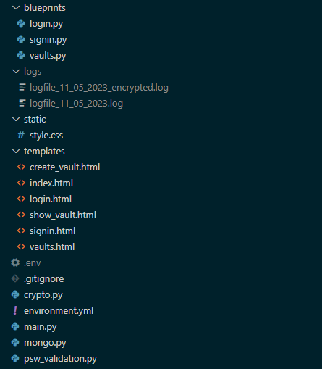
Structure
Program is run by running main.py
Every file inside blueprints is a flask blueprint implementing routing and functionalities corresponding to its filename.
Other .py files:
Mongo functionalities are inside mongo.py
Connection initialization
Queries
Password validation is inside psw_validation.py
Cryptographic functions are inside crypto.py
.env file can contain encryption key used for logging.
Mongo credentials to be implemented.
Logs folder stores logs.
HTML files are inside templates folder.
Stylesheet inside static folder.

Slide 5
More about cryptography
Key derivation
PBKDF2 is used to derive keys.
https://en.wikipedia.org/wiki/PBKDF2
Hashing
SHA256 is used for hashing
Randomness
Implemented using os.urandom()
On windows uses https://learn.microsoft.com/en-us/windows/win32/api/bcrypt/nf-bcrypt-bcryptgenrandom.

Slide 6
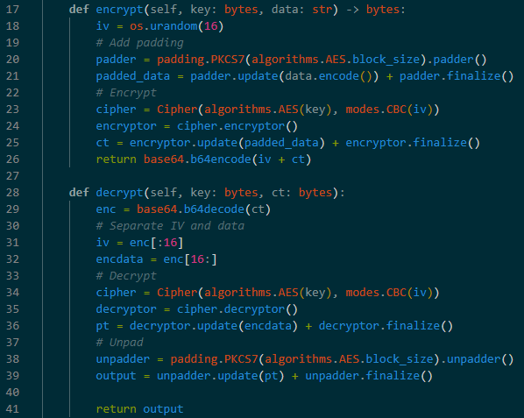
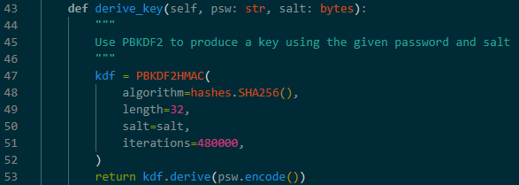
Cryptographic functions 1/2

Slide 7
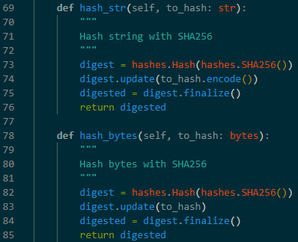
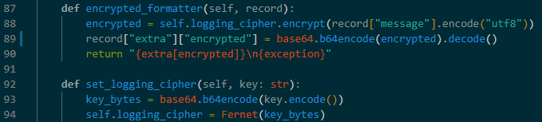
Cryptographic functions 2/2

Slide 8
OWAS TOP 10
Logging
System logging is implemented. Every POST method functionality is thoroughly logged.
Mongo actions are logged as well.
Encryption for log files is implemented.
Vulnerable and Outdated Components
Checked that libs are up to date and tried to find security flaws from used libraries.
Injections
Hashes used as identifiers removing user plaintext inputs from mongo queries.
Cryptographic failures
HTTPS is used.
No deprecated algorithms.
Randomness is cryptographically safe.
No keys in source code.
All stored data is encrypted and keys are stored as byte arrays.

Slide 9
Other security related things
CSRF prevention is implemented.
Sessions
Stored and encrypted server-side. Client only has session key.
Max length is set to 30 mins.
Session is deleted when browser is closed.

Slide 10
Testing
Tests with pytest to be implemented before due date.
Manual testing has been done during development
Tested CSRF library.
Tested password validation.
Tested mongo connections and application’s reaction to mongo shutting down during run-time.

Slide 11
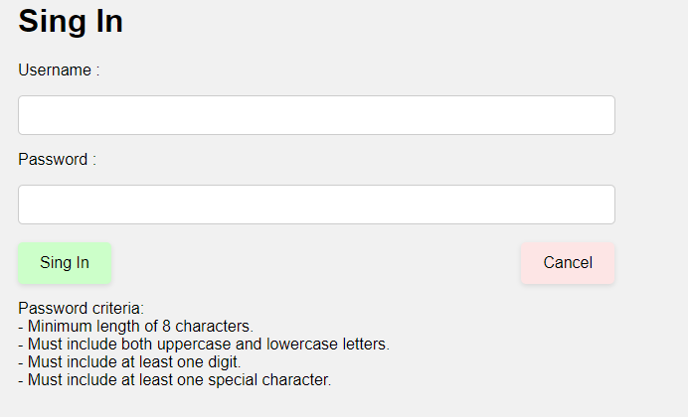
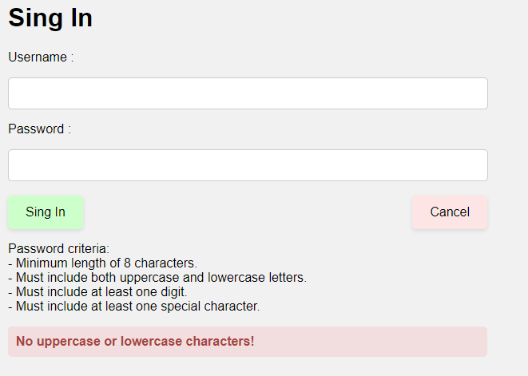
Sing In

Slide 12
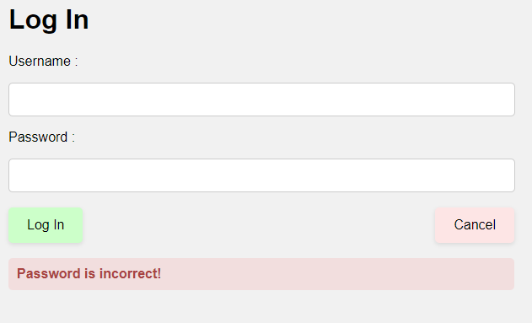
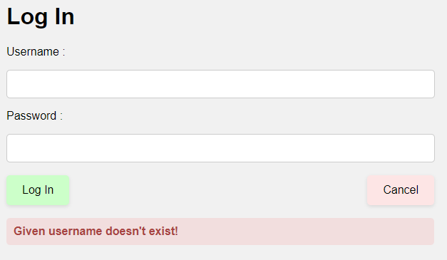
Log In

Slide 13
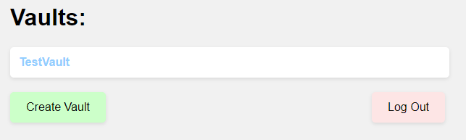
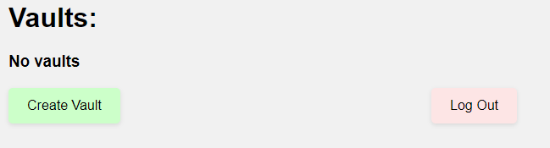
Successful login

Slide 14
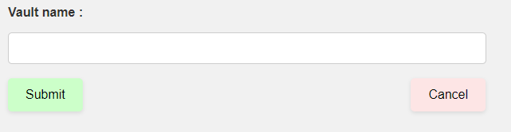
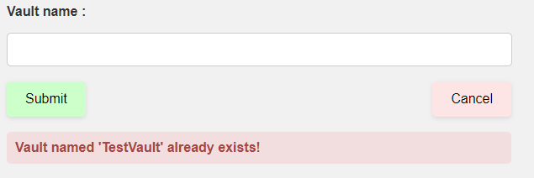
Vault creation

Slide 15
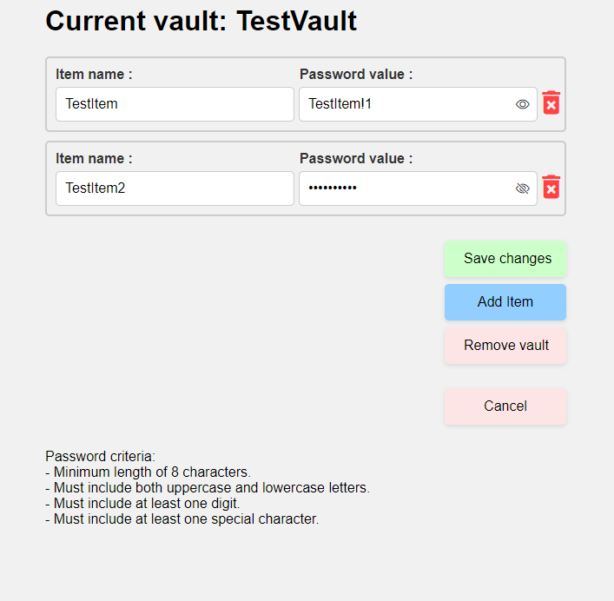
Password creation

Slide 16
Possible improvements / vulnerabilities
No ability set mongo credentials. This will be done before due date.
Brute force prevention.

