Slide 1
Digital Stopwatch Project
Design and Implementation using Counters, TTL Gates, and Seven-Segment Displays

Slide 2
Project Execution: Requirements
• Objective: Design stopwatch measuring up to 99.99 sec
• Components: Decade counters, TTL logic, 7-segment display
• Additional: Debounce circuit, 1 MHz crystal oscillator
• Platform: Breadboard prototype, Veroboard final assembly

Slide 3
Circuit Design
• Clock Generation with 1 MHz crystal oscillator
• Frequency Division to obtain 1/100 sec resolution
• Counting Section using Decade Counters
• Display Section with BCD to 7-Segment Decoders
• Control Section with debounced Start/Stop/Reset

Slide 4
Simulation
• Designed circuit in Proteus/Multisim
• Verified:
- Clock pulse generation
- Counter increment/reset
- Correct seven-segment mapping

Slide 5
Hardware Implementation
• Breadboard Testing:
- Clock → Counter → Display stepwise
- Debugged wiring & connections
• Veroboard Assembly:
- Permanent soldering
- Decoupling capacitors
- IC sockets for reliability

Slide 6
Testing and Validation
• Accuracy checked against reference stopwatch
• Stability ensured for long runs
• Button operations validated with debounce circuit

Slide 7
Outcome
• Stopwatch measures up to 99.99 seconds
• Stable & accurate readings
• Demonstrates counters, decoders, debounce logic

Slide 8
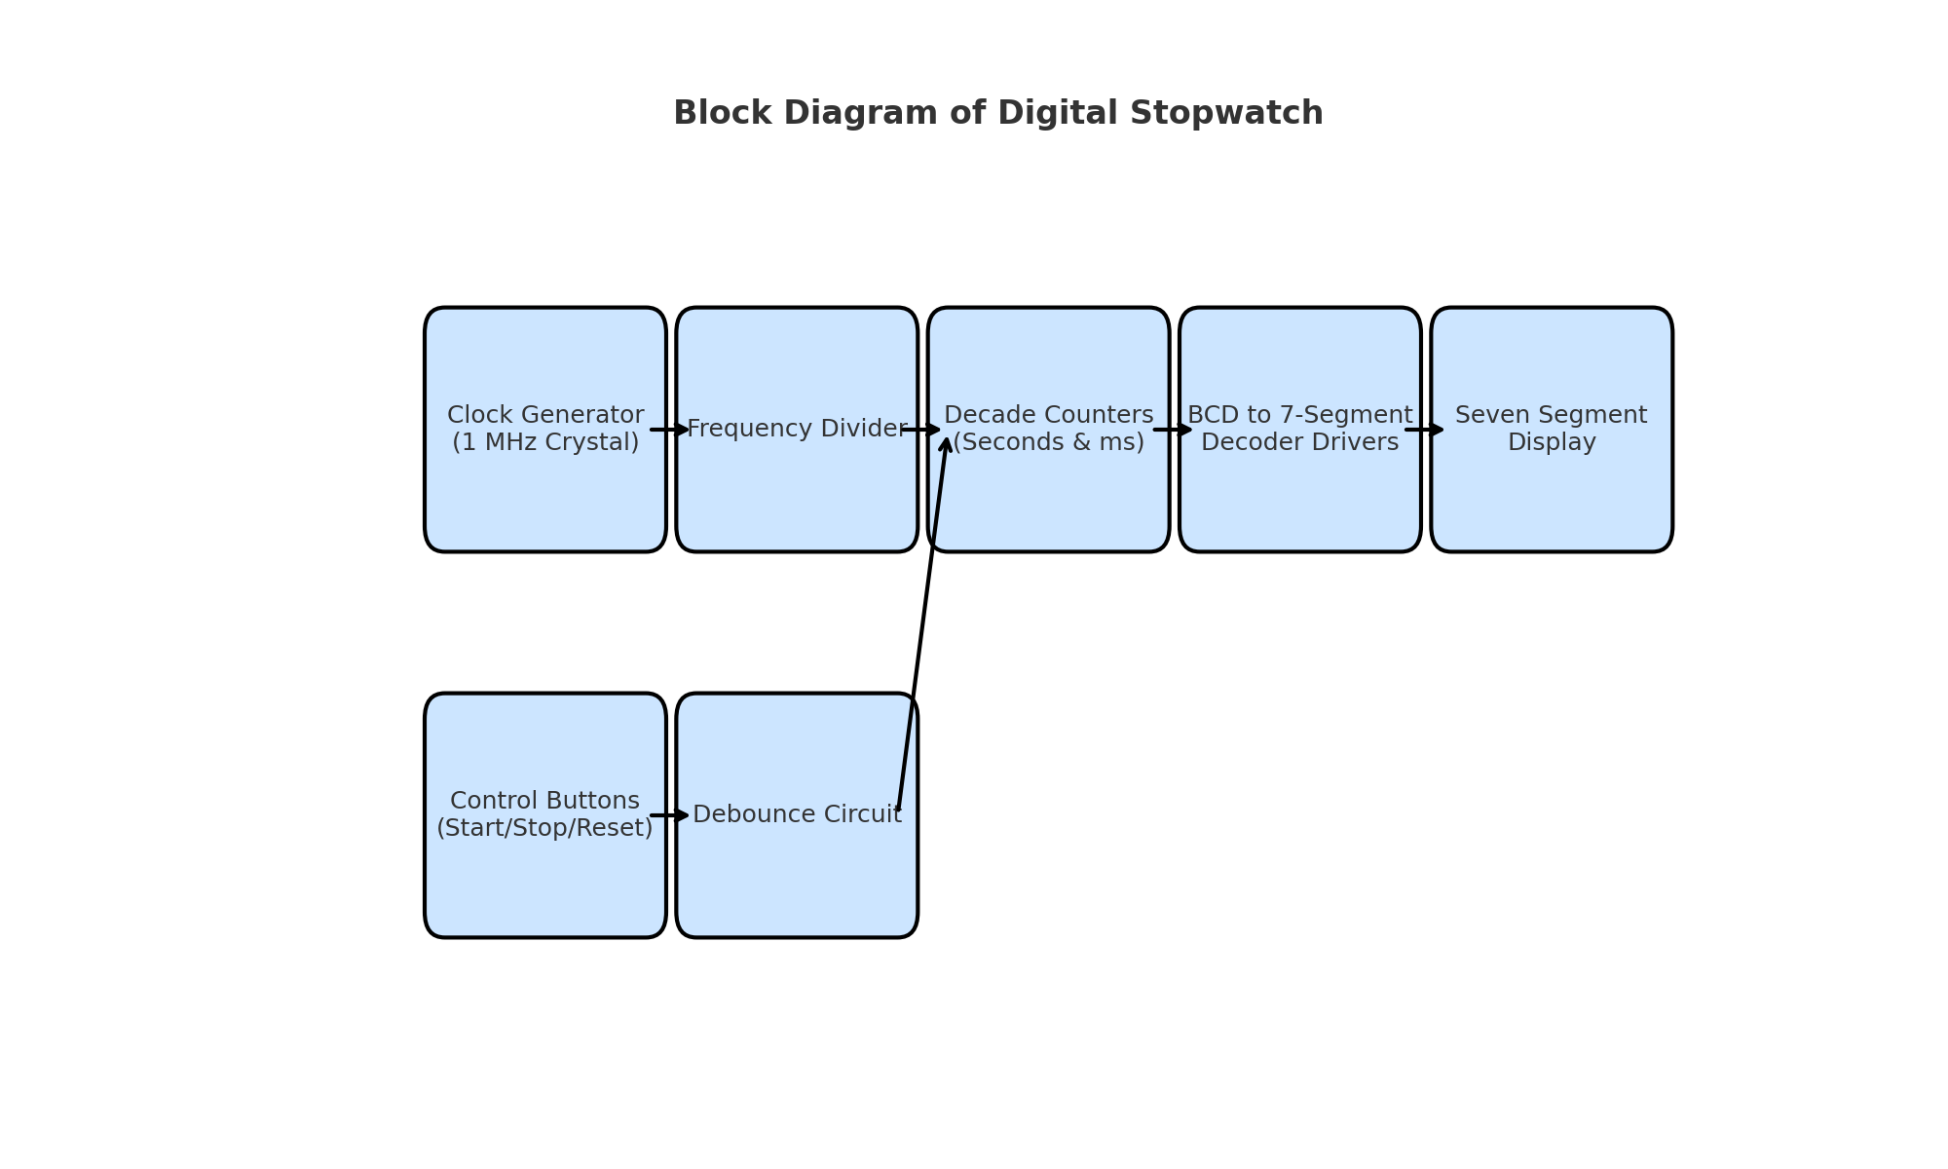
Block Diagram of Digital Stopwatch

