Slide 1

Apache

Slide 2
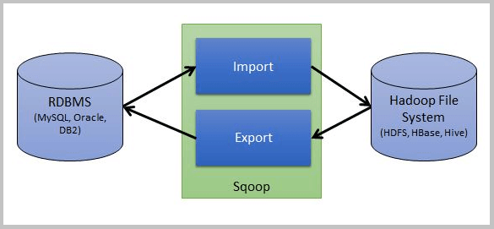
What is Sqoop?
Sqoop is a tool designed to import data from a relational database management system (RDBMS) such as MySQL or Oracle into the Hadoop Distributed File System (HDFS), transform the data in Hadoop MapReduce, and then export the data back into an RDBMS.

Slide 3
Sqoop Import:-
The import tool imports individual tables from RDBMS to HDFS. Each row in a table is treated as a record in HDFS. All records are stored as text data in text files or as binary data in Avro and Sequence files.
Sqoop Export:-
The export tool exports a set of files from HDFS back to an RDBMS. The files given as input to Sqoop contain records, which are called as rows in table. Those are read and parsed into a set of records and delimited with user-specified delimiter.

Slide 4
How to install Sqoop?
“Sqoop Installation” explains all the steps to install Sqoop on Ubuntu and we know Sqoop is Hadoop’s sub-project.
Prerequisites
Verifying Java installation.
Verifying Hadoop installation.

Slide 5
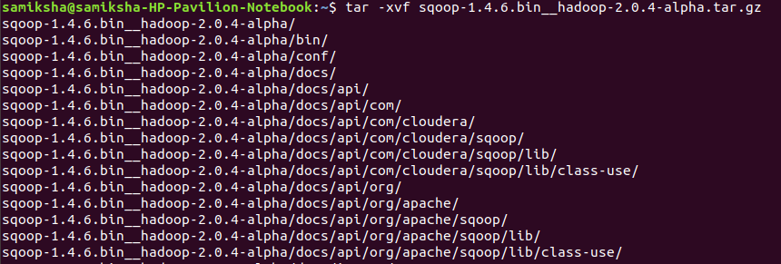
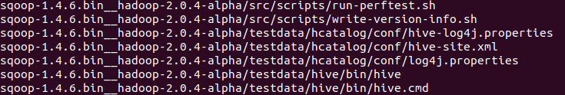
Step by step installation:-
You can download the latest version of Sqoop from the following link For this tutorial, we are using version 1.4.5, that is, sqoop-1.4.5.bin__hadoop-2.0.4-alpha.tar.gz.
Step1:- Extract the Sqoop tar ball.
|

Slide 6
Step2:- Configuring bashrc
Step3:- Configuring Sqoop:- To configure Sqoop with Hadoop, you need to edit the sqoop-env.sh file, which is placed in the $SQOOP_HOME/conf directory. First of all, Redirect to Sqoop config directory and copy the template file using the following command −
Step4:- Download and Configure mysql-connector-java
We can download mysql-connector-java-5.1.30.tar.gz file from the following link.
The following commands are used to extract mysql-connector-java tarball and move mysql-connector-java-5.1.30-bin.jar to /sqoop/lib directory.

Slide 7
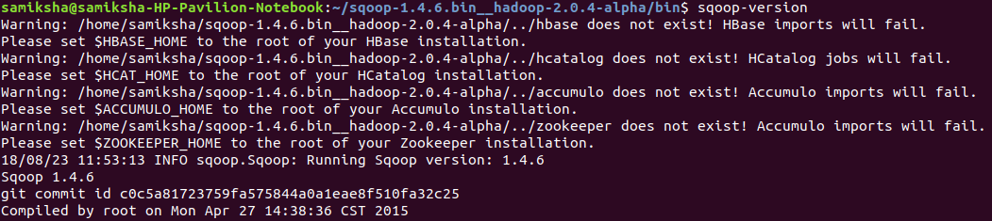
Step5:- Verifying Sqoop
Sqoop installation is complete.

Slide 8
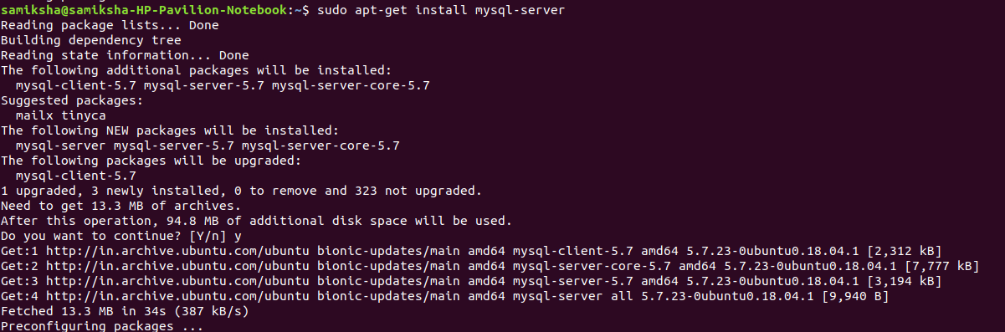
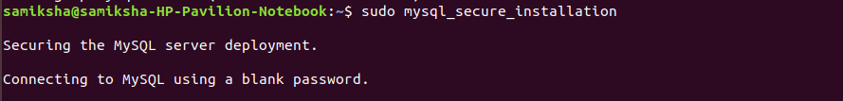
Installation of Mysql in Ubuntu:-
To install it, simply update the package index on your server and install the default package with apt-get.
Configuring MySQL
There will be some query:-
1. VALIDATE PASSWORD PULGIN :- Press(y)
This allows the user to set only those passwords which are secure enough.

Slide 9
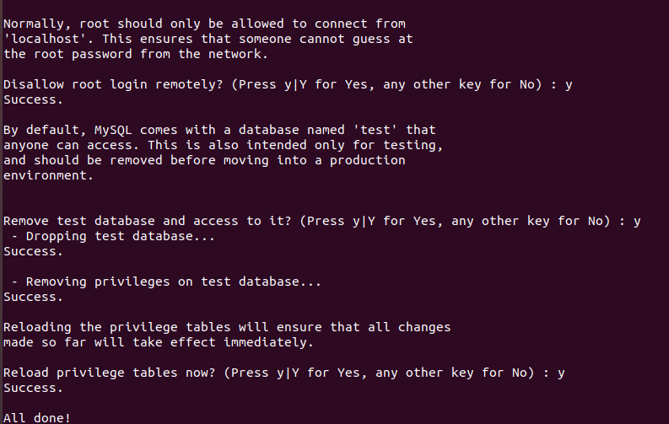
Then enter 0 for LOW
New Password:-
R-enter-Password:-
Remove anonymous users – press(no)
Disallow root login remotely? :- press(no)
Remove the test database:- press(yes)
Reload the privileges tables:- press(yes)

Slide 10
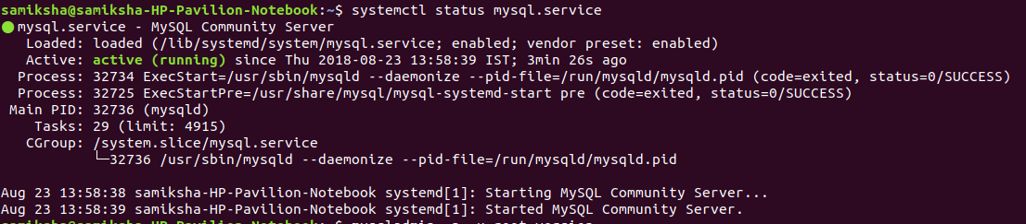
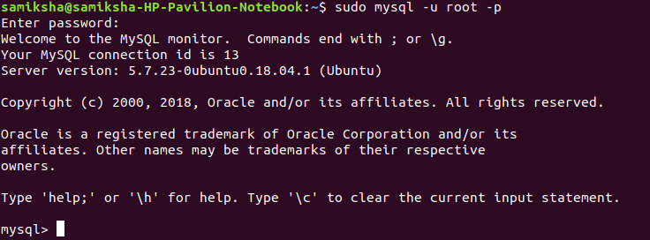
Testing MySQL
Start Mysql:- -u (user), -p (password)

Slide 11
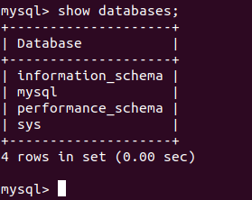
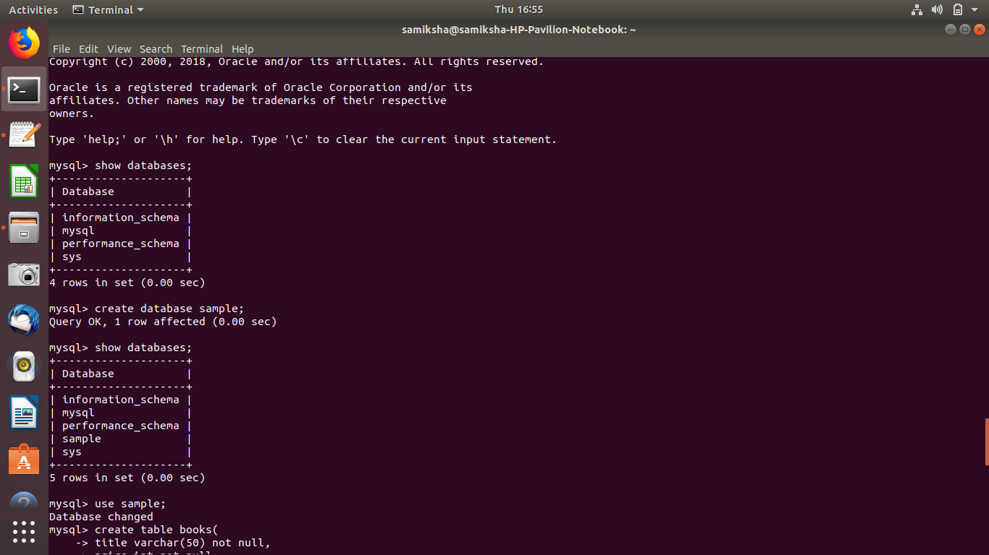
Example :- For importing Mysql data to HDFS
First create a database to mysql
In mysql write Command:- show databases;
Command:- create database sample;
Command:- show databases;

Slide 12
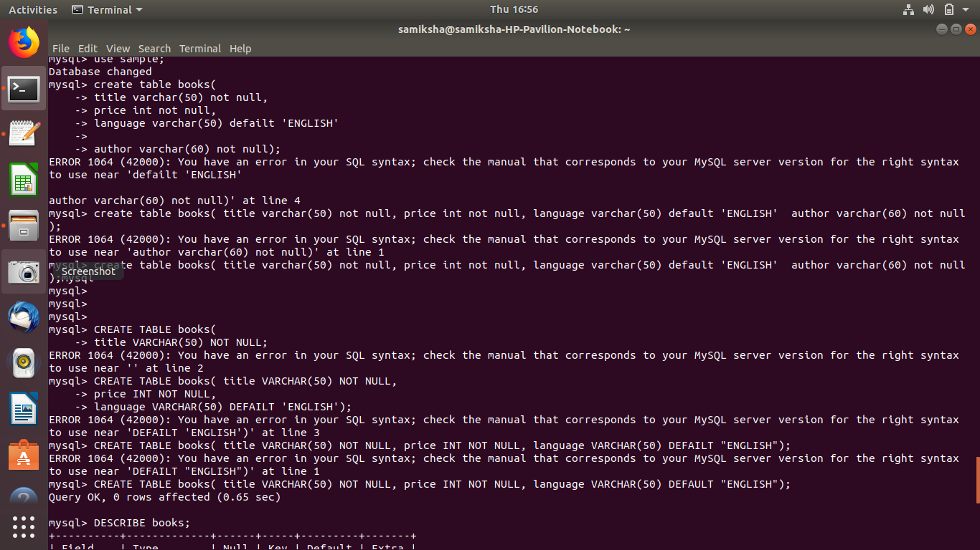
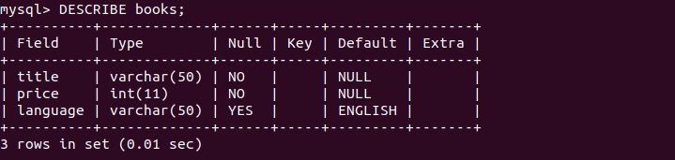
Command:- use sample;
Now, create table books
Command:- DESCRIBE books;

Slide 13
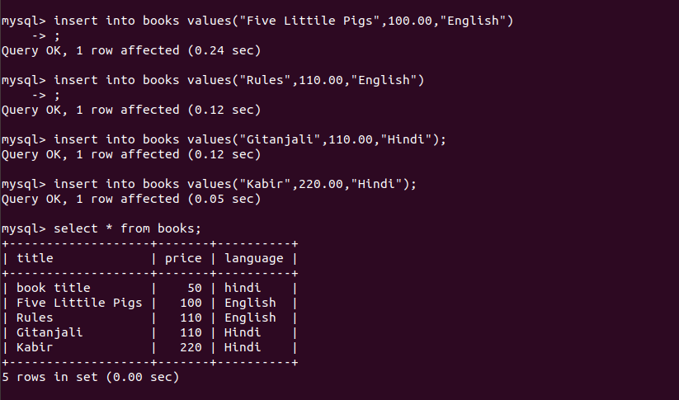
Now, insert the data into books

Slide 14
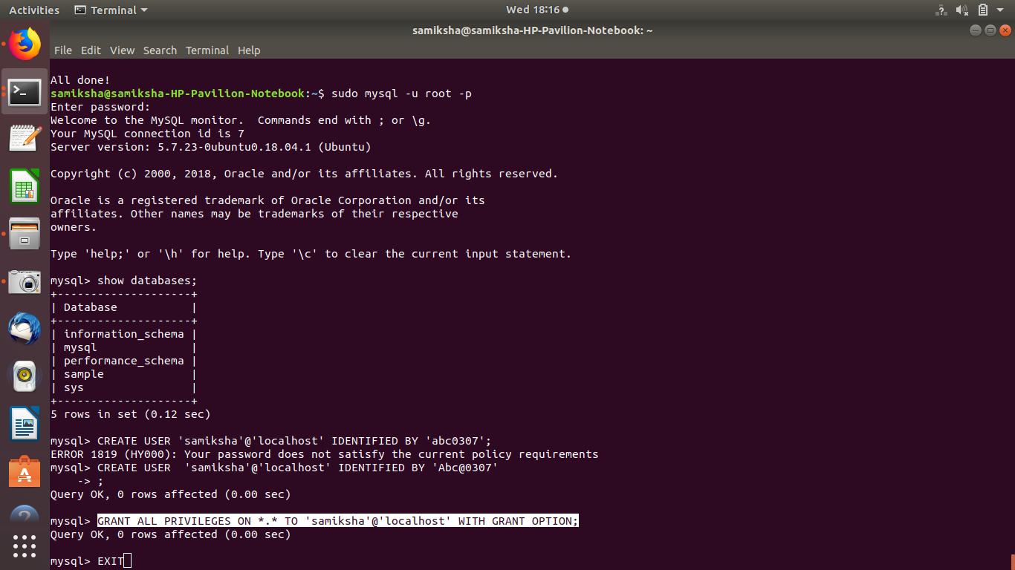
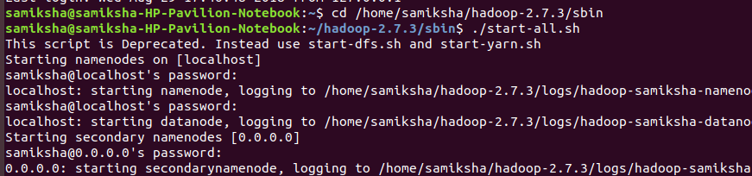
Create user on localhost
Grant all the privileges
Command:- ssh localhost
Start Hadoop by Command :- ./start-all.sh

Slide 15
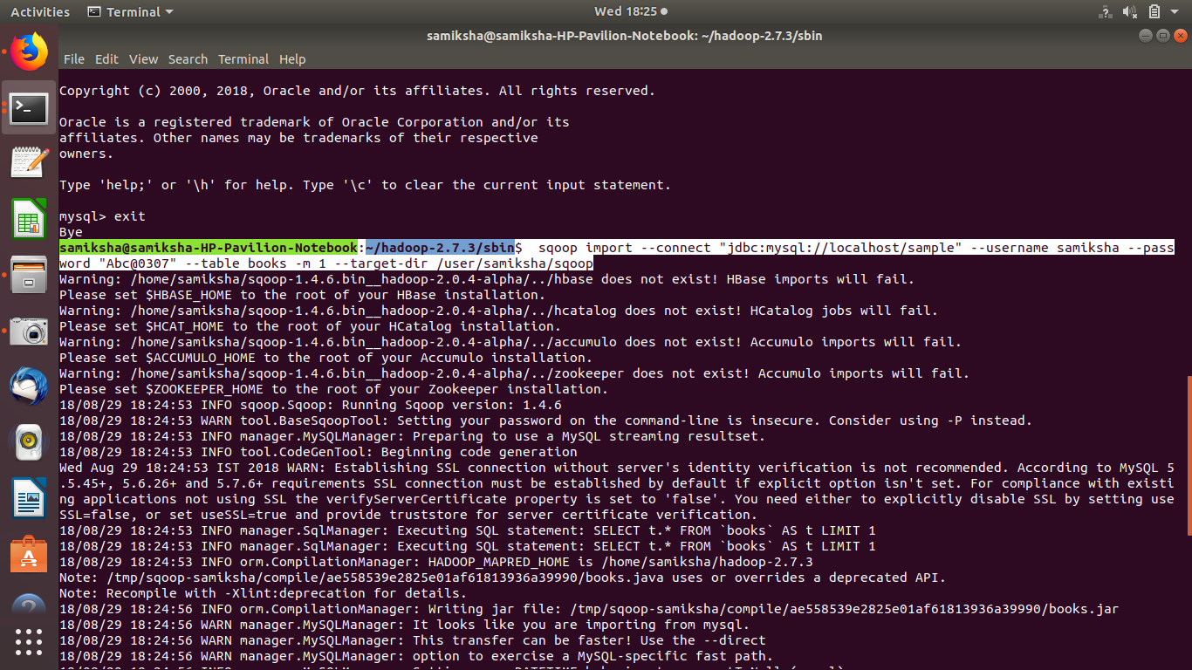
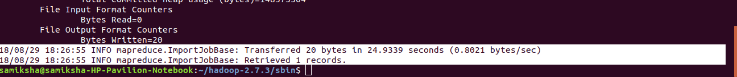
Import data to HDFS
As we created database sample and in that database we created table books now, we will import this table to hdfs

Slide 16
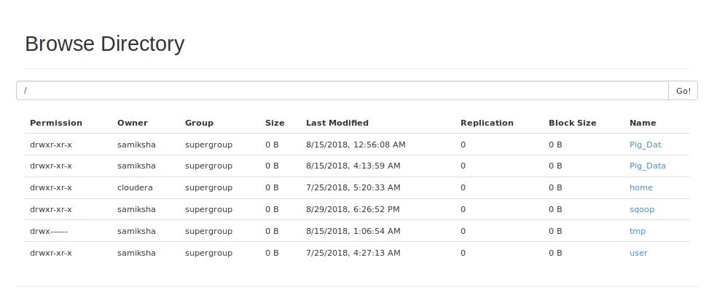
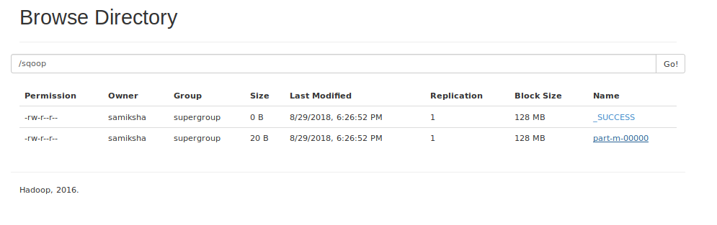
You can see the output
Here, you can download and check the output

Slide 17
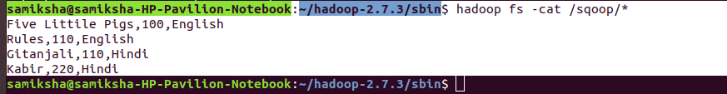
Or, you can check like this also
So, we successfully import the data into HDFS.
THANK YOU

