Slide 1

SQL SERVER · SSMS · GROUP PROJECT
Public Library Consortium
Database Management System — Project Presentation
A 3-member backend database project built entirely in on SQL Server Management Studio — schema design, constraints, stored procedures, transactions, views, and reporting queries.
Member 1
Member 2
Member 3
M. Waqar Altaf F20242661130
Moarij Irfan F2024266190
M. Sami Ullah Yousaf F2024266119
Notes:
Welcome the class. Introduce the project as a pure backend SQL Server database — no app layer — built collaboratively by three members, each owning a distinct part of the schema.

Slide 2




INTRODUCTION
Project Overview & Objectives
The Public Library Consortium system models a small library's day-to-day operations — cataloguing books, tracking physical copies, registering members, and recording every checkout and return — entirely as a backend SQL Server database.
Data Integrity
Core SQL Skills
Business Logic
Reporting
PK, FK, UNIQUE and CHECK constraints enforce valid data at the database level.
CRUD operations, INNER/LEFT JOINs, subqueries, and aggregate functions with GROUP BY/HAVING.
Stored procedures wrapped in transactions safely handle checkouts and returns.
Views surface overdue loans and per-book circulation statistics on demand.
2
Notes:
Walk through the four objectives. Emphasize that this is a pure T-SQL project — every requirement (constraints, joins, procedures, views) maps to a real database skill being demonstrated.

Slide 3




DATABASE DESIGN
Four Tables, One Connected Schema
Books
Book_Copies
Book_Loans
Day-1 Agreement
snake_case names
INT surrogate keys
VARCHAR lengths fixed
DATE for all loan dates
book_id (PK)
isbn, title, author,
genre, publish_year
copy_id (PK), book_id (FK)
barcode, condition,
availability_status
loan_id (PK)
copy_id (FK), member_id (FK)
loan/due/return dates
Members
member_id (PK)
name, email, phone,
member_status
Books (1) → Book_Copies (Many) → Book_Loans (Many) ← Members (1)
3
Notes:
Explain the one-to-many chain: Books to Copies, Copies and Members both feed into Loans. Mention the group agreed on naming and type conventions on Day 1 before writing any code, to avoid merge conflicts later.

Slide 4
TEAM STRUCTURE
Work Division Among 3 Members
MEMBER 1
Constraints · CRUD · JOINs
No FK dependencies on other members — built first, independently.
Books, Book_Copies
MEMBER 2
Stored Procedures · Transactions
Also independent of Books/Copies — built in parallel with Member 1.
Members
MEMBER 3
Views · Subqueries · Integration
Depends on both other tables — naturally starts last, owns final merge.
Book_Loans
4
Notes:
Explain the dependency logic: Member 1 and 2 work in parallel from Day 1 since neither depends on the other. Member 3's table depends on both, so that work starts last and Member 3 naturally becomes the integration owner who merges everything by Day 5.

Slide 5


MEMBER 1
Schema Foundation, Constraints, CRUD & JOINs
Constraints Enforced
CRUD Demonstrated
PRIMARY KEY, FOREIGN KEY (ON DELETE NO ACTION), UNIQUE on isbn, and CHECK constraints on copy_condition and availability_status.
INSERT, SELECT, UPDATE, and DELETE operations on Books and Book_Copies, including 30 rows of realistic seed data in each table.
JOIN Queries
Integrity Testing
INNER JOIN to list every copy with its book title; LEFT JOIN across Copies, Loans and Members to show current borrowers without dropping unloaned copies.
Deliberately tested a duplicate ISBN insert and a delete on a book with active copies — both correctly rejected by SQL Server.
5
Notes:
Member 1 covers the schema foundation. Highlight that no foreign keys point INTO other members' tables, which is exactly why this work could start immediately on Day 1.

Slide 6
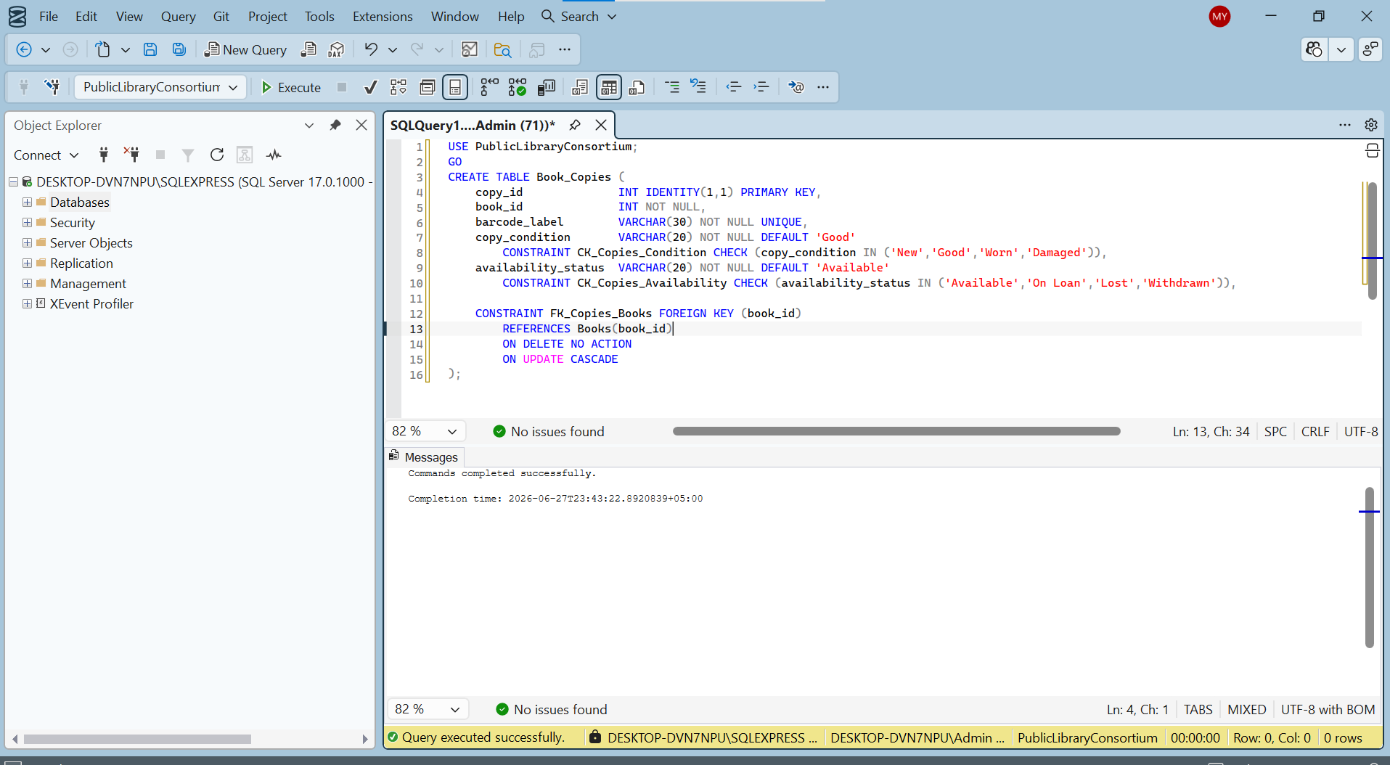

MEMBER 1 — IN SSMS
Book_Copies Table: Foreign Key & CHECK Constraints
Why ON DELETE NO ACTION?
If a Book is deleted while copies still reference it, SQL Server blocks the delete instead of silently removing related rows.
This protects circulation history — a librarian cannot accidentally wipe out a book's copy records.
Verified with a deliberate DELETE test — rejected as expected.
6
Notes:
Show the live CREATE TABLE statement for Book_Copies. Point out the FK constraint and the two CHECK constraints. Mention this was verified later by deliberately trying to break it.

Slide 7

MEMBER 2
Members Table, Stored Procedures & Transactions
Members Table
sp_CheckoutBookCopy
CHECK constraint restricts member_status to Active, Suspended, or Expired — the exact values the checkout logic depends on.
Validates the member is Active and the copy is Available, then inserts a loan and flips the copy to On Loan — all in one transaction.
sp_ReturnBookCopy
Transaction Safety
Validates the loan exists and isn't already returned, then sets return_date and flips the copy back to Available.
SET XACT_ABORT ON guarantees a full ROLLBACK on any unexpected error — never a half-completed checkout or return.
7
Notes:
Member 2 is the business-logic layer. Emphasize that procedures could only be FULLY tested once Book_Loans existed — so this work depended partly on Member 3's table being ready.

Slide 8
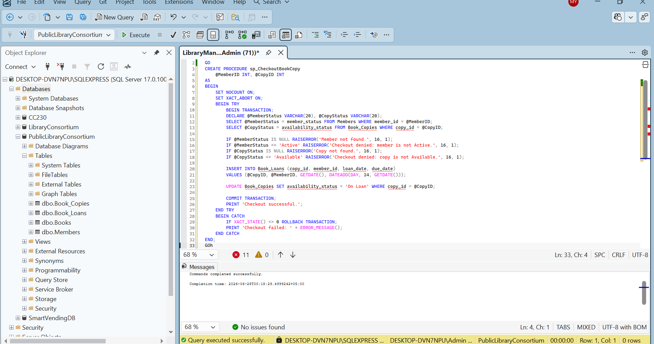

MEMBER 2 — IN SSMS
sp_CheckoutBookCopy: Transaction-Safe Checkout
Tested Scenarios
Active member + Available copy → loan inserted
Suspended member → checkout denied
Copy already On Loan → checkout denied
8
Notes:
Walk through the procedure logic: check member status, check copy availability, raise an error and roll back if either fails, otherwise insert the loan and update the copy — all inside one transaction.

Slide 9

MEMBER 3
Book_Loans, Views, Subqueries & Integration
Book_Loans Table
Two Reporting Views
Depends on both Book_Copies and Members — built last, with 30 seed loans covering returned, overdue, and active cases.
vw_OverdueLoanFulfillment surfaces late returns; vw_CatalogCirculationSummary gives per-book circulation stats.
Subqueries
Final Integration
A standard subquery finds members who never borrowed; a correlated subquery counts loans per member, row by row.
Merged all three members' scripts into one master script, fixed alias mismatches, and ran the full suite on a fresh database.
9
Notes:
Member 3 has the heaviest load — not just the Loans table, but the views, subqueries, and the responsibility of merging everyone's SQL into one final script.

Slide 10
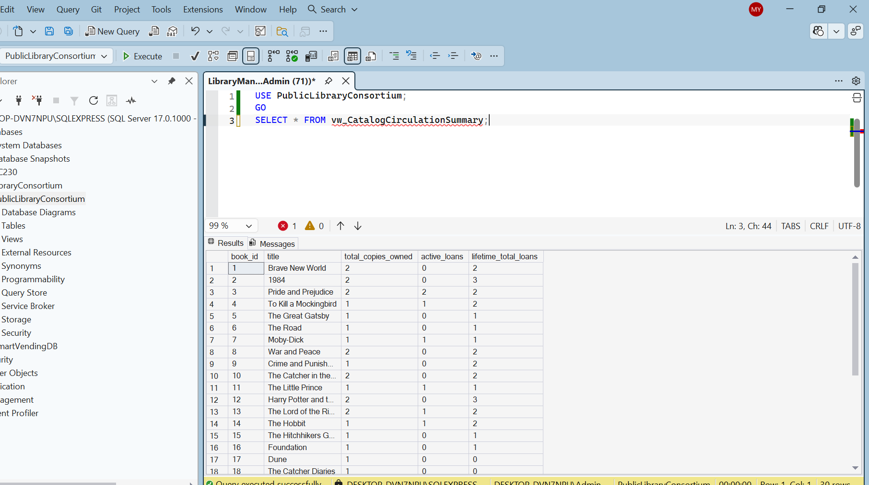
MEMBER 3 — IN SSMS
vw_CatalogCirculationSummary: Live Output
What the View Shows
One row per book:
• total_copies_owned
• active_loans (currently out)
• lifetime_total_loans
LEFT JOINs keep books with zero copies or loans visible — showing 0 instead of disappearing.
10
Notes:
A view is a saved, reusable SELECT — querying it re-runs the underlying logic every time. Point out why LEFT JOIN was chosen here over INNER JOIN.

Slide 11
LESSONS LEARNED
Problems Faced During Integration
ISBN Truncation Error
FK Violation on Book_Copies
Placeholder ISBNs exceeded the VARCHAR(20) limit on insert. Fixed by using properly-sized, real-format ISBN strings.
A rolled-back insert had already consumed IDENTITY values, so book_id no longer started at 1. Fixed with DBCC CHECKIDENT RESEED.
"31 Loans Instead of 30"
Alias Mismatches on Merge
Not a bug — a real checkout test correctly inserted one extra, genuine loan row. Kept as proof the procedure works.
Each member's file used slightly different table aliases. The integration owner standardized them in the final master script.
11
Notes:
Key takeaway to say out loud: IDENTITY columns never reuse consumed values, even after a rolled-back statement — always check MIN/MAX id before writing dependent inserts that hardcode foreign keys.

Slide 12
CONCLUSION
Fully Tested, Fully Integrated
16
4
2
120
Test Cases — All Passed
Tables, Fully Normalized to 3NF
Stored Procedures + 2 Views
Seed Rows Across All Tables
The Public Library Consortium database was designed, built, and tested entirely in T-SQL — demonstrating constraints, CRUD, joins, transactional stored procedures, views, subqueries, and aggregate reporting, all merged into one verified master script.
ER Diagram & full schema with constraints
Aggregate functions (GROUP BY/HAVING)
Normalization write-up (1NF/2NF/3NF)
2 transactional stored procedures
CRUD + INNER/LEFT JOIN queries
2 reporting views
2 subqueries incl. 1 correlated subquery
Testing results — all cases marked Pass
Thank You — Questions?
Notes:
Close with the summary stats, then run through the final checklist quickly. Invite questions — be ready to explain PK/FK/UNIQUE, ACID & transactions, and the difference between a view and a correlated subquery, per the viva-prep split by member.

