Slide 1

SMARTVISIONAGRI 🌿
Plant Leaf Disease Classification Using Deep Learning
Samiksha Kodgire
AAI-521 – Computer Vision Applications
(University of San Diego)

Slide 2
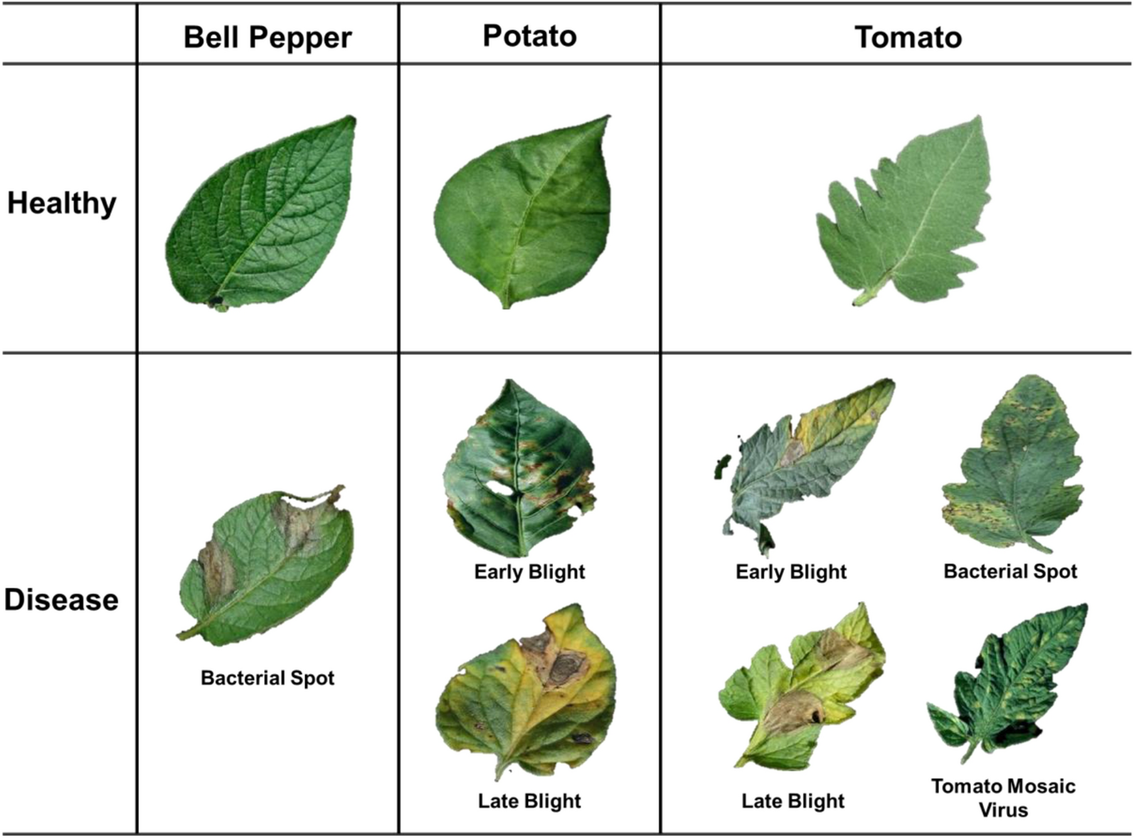
Problem Motivation
Plant diseases = major global cause of crop loss
Manual diagnosis is slow, subjective, not scalable
Computer vision offers automated early detection
Goal: Build ML model to classify 15 disease classes

Slide 3
Research Objectives
Build custom baseline CNN
Implement & fine-tune transfer learning models
MobileNetV2
EfficientNetB0
MobileNetV3-Large
Compare accuracy, robustness, training stability
Perform error analysis & interpret model behavior
Document practical issues (GPU limits, Grad-CAM failures)

Slide 4
Dataset Overview
PlantVillage dataset - https://www.kaggle.com/datasets/emmarex/plantdisease
Original: 20,000+ images
Working set created for feasibility
Capped at 500 images/class
Final dataset: 7,025 images, 15 classes
Unified resolution: 128×128

Slide 5
Preprocessing Pipeline
Resized all images once (OpenCV)
Augmentation: rotation, shift, zoom, flip
Training/validation using ImageDataGenerator
20% validation split
Maintained class balance

Slide 6
Models Trained
1. Baseline CNN (Custom)
2. MobileNetV2 — Full fine-tuning
3. EfficientNetB0 — Frozen base
4. MobileNetV3-Large — Frozen base

Slide 7
Architecture Deep Dive (CNN)
Baseline CNN
3 Conv blocks (32→64→128)
MaxPooling
Dense(128) + Dropout
~3.3M parameters
Best performer: 87.96% accuracy

Slide 8
Transfer Learning Models (Performance Discussion)
MobileNetV2 — 24.14%
Expects 224×224 → failed at 128×128
Full fine-tuning destabilized weights
EfficientNetB0 — 7.12%
Highly resolution-sensitive
Incorrect preprocessing hurts performance
MobileNetV3-Large — 32.19%
Better robustness
Still constrained by low resolution

Slide 9
Model Comparison Table
Model | Parameters | Best Val Accuracy
Baseline CNN | 3,306,575 | 0.8796
MobileNetV2 | 2,589,775 | 0.2414
EfficientNetB0 | 4,381,362 | 0.0712
MobileNetV3-Large | 3,246,223 | 0.3219

Slide 10
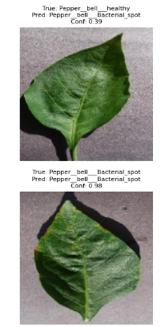
Random Predictions Visualization
Samples of correct & incorrect predictions
Confidence scores highlight:
correct-high confidence
wrong-low confidence
wrong-high confidence (danger cases!)

Slide 11
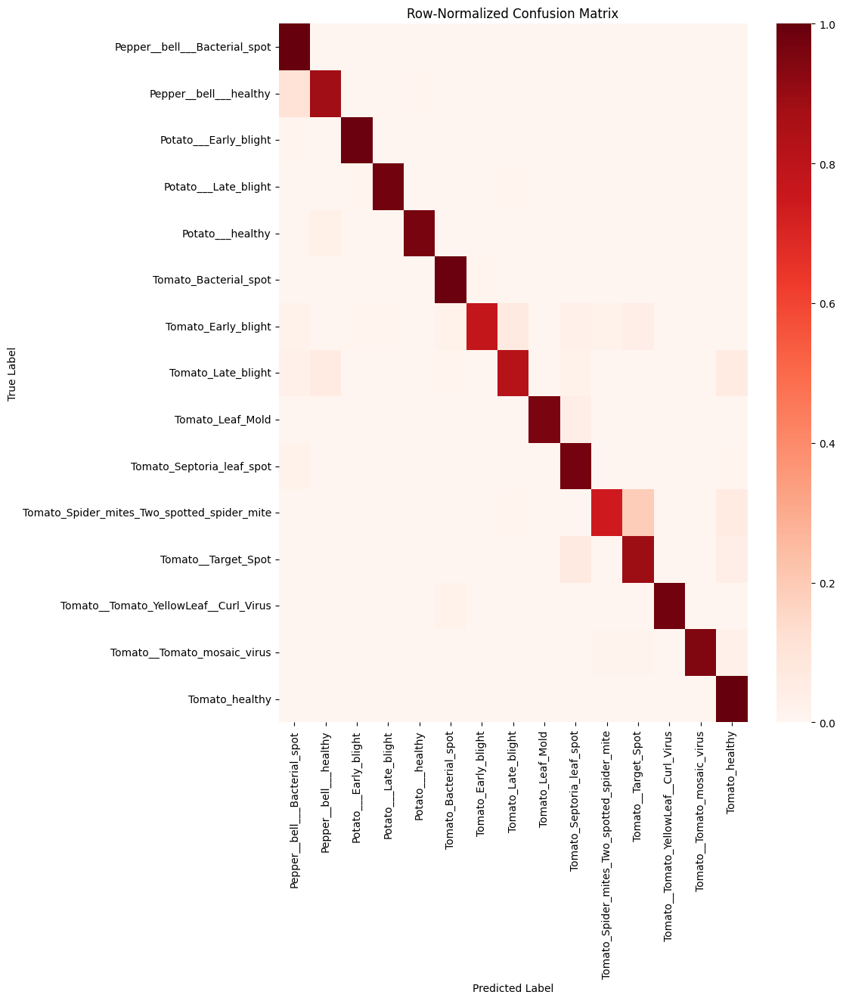
Row-Normalized Confusion Matrix
Shows per-class recall
Highlights ambiguous disease pairs
Identifies classes needing more data

Slide 12
Limitations
Low-resolution constraint (128×128)
GPU quota exhaustion on Colab
Transfer-learning failures
Grad-CAM instability
Limited dataset diversity

Slide 13
Future Work
Train at 224×224 resolution
Progressive layer unfreezing
Learning rate warmup
SHAP explainability
Deploy baseline CNN via TFLite
Collect real-world leaf images

Slide 14
Conclusion
End-to-end plant disease pipeline built
Baseline CNN unexpectedly dominated
Transfer learning constrained by resolution
Strong foundation for deployment & extension

