Slide 1

Department of Computer Science &Engineering Artificial Intelligence & Machine Learning
A.P. Shah Institute of Technology G.B.Road,Kasarvadavli, Thane(W), Mumbai-400615
UNIVERSITY OF MUMBAI
Academic Year 2023-2024

Slide 2
CALORIE TRACKER
Computer Science & Engineering Artificial Intelligence and Machine Learning By
Aditya Sawant (22106084)
Rohan Patil (22106044)
Ankit Pawar (22106111)
Under the Guidance of Prof. Taruna Sharma

Slide 3

Index
INTRODUCTION
OBJECTIVE
BLOCK DIAGRAM
TOOLS/SOFTWARE and languages uesd
IMPLEMENTATION
CONCLUSION
REFERENCES

Slide 4
Introduction
Empowering Nutrition Management
Your Digital Nutrition Companion
Simplifying Calorie Tracking
Meeting Modern Health Challenges

Slide 5
Objective
Develop an User-Friendly Platform: Create a user-friendly web application that simplifies calorie and
macronutrient tracking for individuals.
Accurate Nutrient Calculations: Ensure precise calculation of calories and macronutrients in various food items to empower users with accurate dietary information.
Personalized Health Goals: Enable users to set and manage personalized macronutrient goals, offering tailored recommendations for a healthier lifestyle.
Comprehensive Food Database: Build an extensive database of food items, categorized and searchable, to
enhance the ease of use for tracking meals.
Data Visualization: Implement dynamic charting with ChartJS to visually represent weight history and macronutrient tracking, aiding users in monitoring progress.
Historical and Modern Relevance: Bridge the historical significance of calorie tracking with contemporary health challenges, providing a holistic solution for users' nutritional needs.

Slide 6
BLOCK DIAGRAM

Slide 7
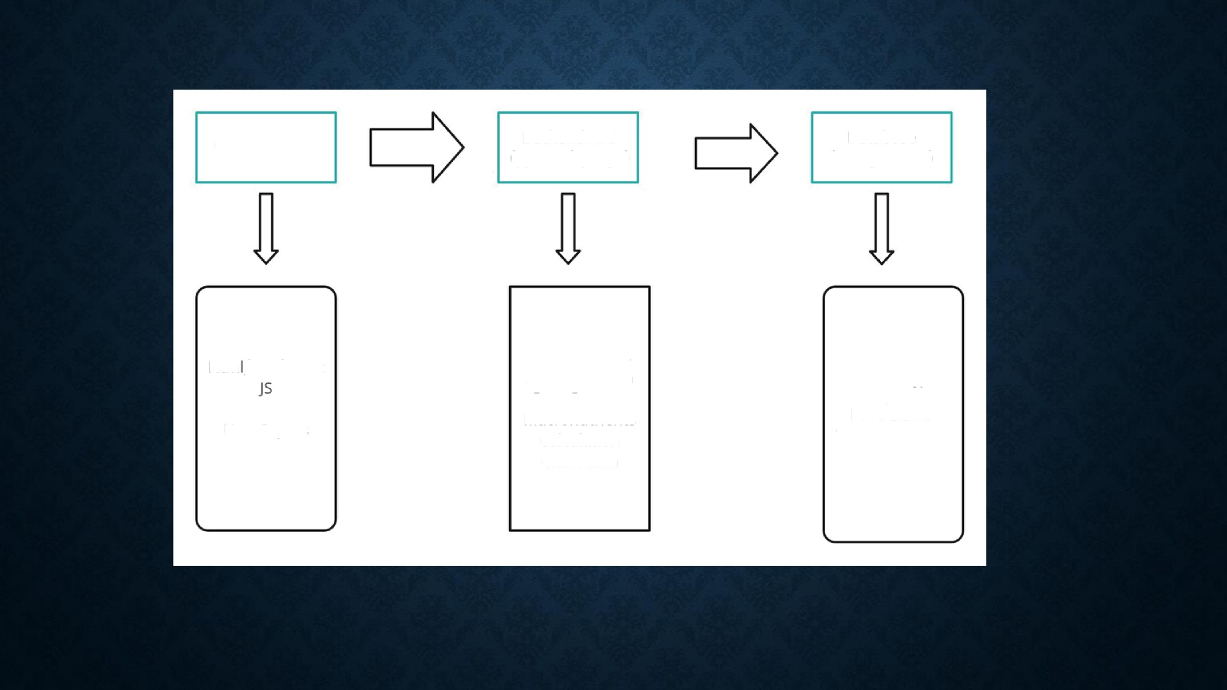
User Interface
Backend API
(python/ django)
Database
(PostgresSQL)
Htm /CSS/Chart
API Endpoints
Authentication
Data Process Macronutrients Calculation Chart data
User profiles Food Items
Wei gnt Reco rds
Use r In puts

Slide 8






Tools/softwares, Languages used
HTML
CSS
DJANGO/PYTHON
CHARTJS
POSTGRESQL DATABASE
BOOTSTRAP
VS CODE Compiler

Slide 9
PROJECT WORK

Slide 10
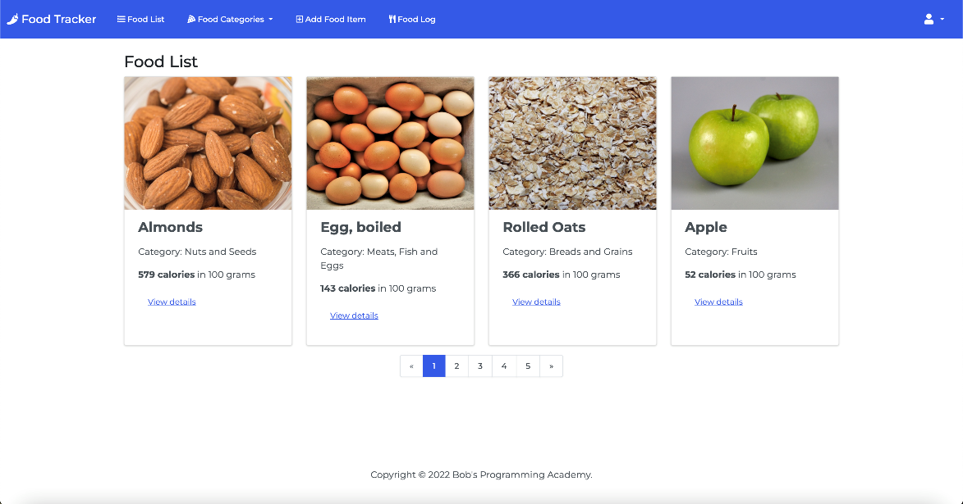
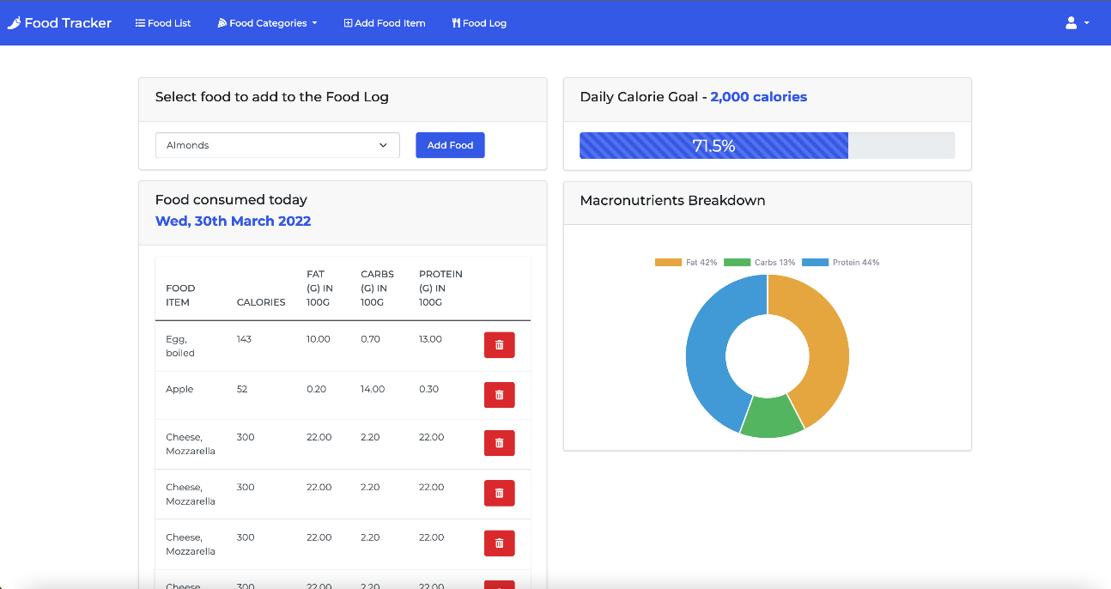
Implementation

Slide 11
Conclusion
Empowers users to effortlessly track and understand their daily calorie and macronutrient intake.
Delivers precise nutrient calculations and personalized goal setting for tailored dietary guidance.
Leverages a rich, searchable food database and dynamic ChartJS visualizations to simplify meal logging and progress monitoring.
Combines the legacy of calorie tracking with modern health insights to offer a comprehensive, user-centric nutrition solution.

Slide 12
References
Smith, J. (2021). "Nutritional Tracking Apps: A Comparative Study." Journal of Health and
Technology, 23(4), 567-578.
Davis, M. et al. (2020). "The Impact of Nutrition Tracking on Dietary Habits: A Longitudinal Analysis." International Journal of Health and Nutrition, 12(2), 123-137.
MyFitnessPal. (https://www.myfitnesspal.com/) Lose It! (https://www.loseit.com/)
Django Documentation. (https://docs.djangoproject.com/en/3.2/) Chart.js Documentation. (https://www.chartjs.org/docs/latest/) PostgreSQL Documentation. (https://www.postgresql.org/docs/) Bootstrap Documentation. (https://getbootstrap.com/docs/5.0/)
3.
4.
5.
6.
7.
8.
"Nutrition and Dietetics in Modern Health." (2021). International Conference on Health and
Wellness, Proceedings, 45-58.
Johnson, L. et al. (2019). "The Role of Technology in Promoting Healthy Eating Habits." International Journal of Digital Health, 7(3), 210-224.

Slide 13



