Slide 1


Bangalore Institute of Technology
K.R. Road, V.V. Pura, Bengaluru.-560004.
Department of Computer Science & Engineering
2024-25
“INTELLIGENT QUIZ GENERATOR”
Presentation by
1BI23CS069 - Deeksha H
1BI23CS123 – Madhurya AK
1BI23CS169 – Rajatha Prasad
1BI23CS189 – Samiksha P
Under the Guidance of
Dr. Madhuri J
Associate Professor
Department of CSE, BIT

Slide 2
Bangalore Institute of Technology
K.R. Road, V.V. Pura, Bengaluru.-560004.
Department of Computer Science & Engineering
INTRODUCTION
In today’s fast-paced academic environment, students struggle to effectively review vast amounts of study material. Traditional methods of creating practice quizzes are manual, time-consuming, and often fail to provide personalized learning experiences.
StudyBuddy leverages Generative AI and Natural Language Processing (NLP) to automatically analyze uploaded study materials and create context-aware, personalized quizzes — making exam preparation intelligent, adaptive, and time-efficient.
Developed using the MERN stack (MongoDB, Express.js, React.js, Node.js), the system seamlessly integrates AI/ML models for real-time question generation, text understanding, and quiz evaluation — ensuring both performance and scalability.

Slide 3
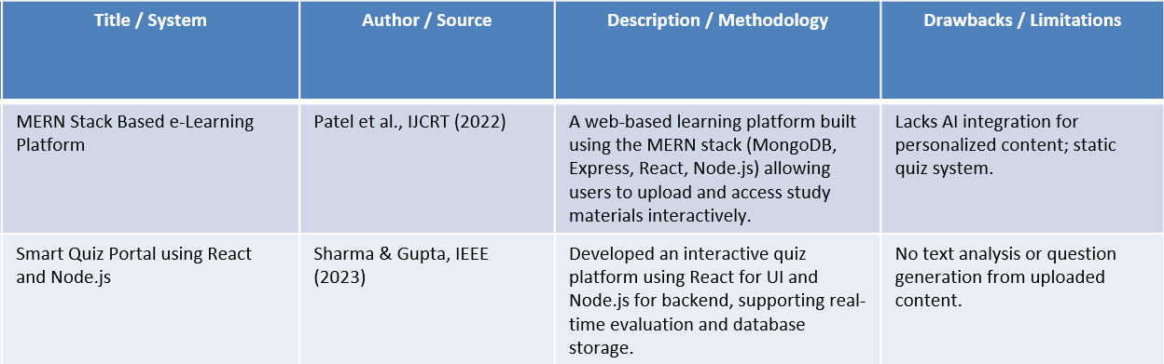
Bangalore Institute of Technology
K.R. Road, V.V. Pura, Bengaluru.-560004.
Department of Computer Science & Engineering
EXISTING SYSTEMS

Slide 4
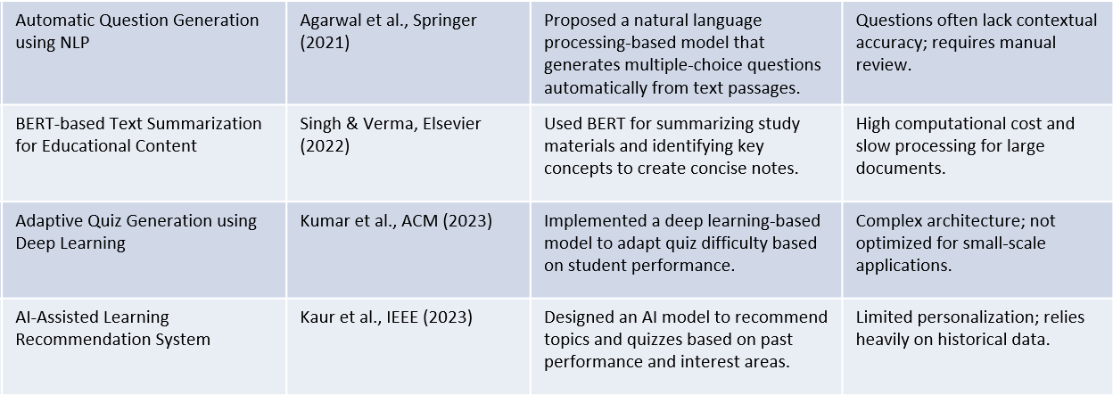
Bangalore Institute of Technology
K.R. Road, V.V. Pura, Bengaluru.-560004.
Department of Computer Science & Engineering

Slide 5
Bangalore Institute of Technology
K.R. Road, V.V. Pura, Bengaluru.-560004.
Department of Computer Science & Engineering
PROBLEM STATEMENT
PrepAI leverages Generative AI and MERN stack to automatically generate context-based questions from uploaded study material.
Input : Uploaded study material (PDF, DOCX,HTML)
Output : Summarized key points extracted from the material ,automatically generated quiz questions which includes MCQs , true/false, and short answer types , Interactive quiz interface for students to test their understanding.

Slide 6
Bangalore Institute of Technology
K.R. Road, V.V. Pura, Bengaluru.-560004.
Department of Computer Science & Engineering
OBJECTIVES
To accomplish automated generation of quizzes from uploaded study materials using Generative AI.
To minimize manual effort and time required for students to create practice questions.
To build a scalable, web-based platform using MERN stack for seamless user experience.
To design a seamless file upload and AI processing pipeline that converts learning materials into structured assessments.
To implement efficient data handling, real-time quiz generation, and dynamic UI updates for an interactive user experience.

Slide 7
Bangalore Institute of Technology
K.R. Road, V.V. Pura, Bengaluru.-560004.
Department of Computer Science & Engineering
TOOLS AND TECHNOLOGIES
Frontend | React.js, Tailwind css, Axios
Backend | Node.js, Express.js, cors, dotenv
File Processing | pdfplumber, PyMuPDF (for text extraction)
LLM, Prompt template, RAG pipeline | langchain.chains.RetrievalQA, langchain.prompts.PromptTemplate, HuggingFaceHub(repo_id="mistralai/Mistral-7B-Instruct-v0.3"),

Slide 8
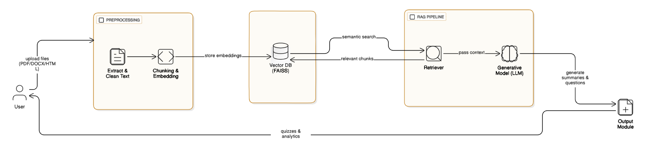
Bangalore Institute of Technology
K.R. Road, V.V. Pura, Bengaluru.-560004.
Department of Computer Science & Engineering
ARCHITECTURAL DIAGRAM

Slide 9
Bangalore Institute of Technology
K.R. Road, V.V. Pura, Bengaluru.-560004.
Department of Computer Science & Engineering
MODULES DESCRIPTION
User Module: Allows users to upload study materials in PDF, DOCX, or HTML format for processing.
Preprocessing Module: Extracts and cleans the raw text from uploaded files for further analysis.
Chunking & Embedding Module: Breaks the text into smaller chunks and converts them into semantic embeddings.
Vector Database (FAISS):Stores embeddings and supports fast semantic searches to find relevant content.
Generative Model (LLM) : Uses a large language model (like Gemini, Mistral, LLaMA, or GPT) to combine the user’s query or instruction, and the retrieved chunks (factual context).The model then generates summaries, questions, or answers that are both accurate and context-aware.
Output Module: include quiz questions with answers , Summaries of uploaded content ,analytics (difficulty levels, topic coverage, etc.)and sends the results back to the user interface.

Slide 10
Bangalore Institute of Technology
K.R. Road, V.V. Pura, Bengaluru.-560004.
Department of Computer Science & Engineering
MODULES DESCRIPTION
RAG Pipeline (Retrieval-Augmented Generation):combines information retrieval and generative AI to produce accurate and context-aware results.
Consists of two core components a Retriever and a Generative Model (LLM).
The Retriever searches the Vector Database (FAISS) to fetch the most relevant text chunks.
These chunks provide context for the Generative Model to generate summaries and topic-based questions.
Ensures outputs are factually grounded, reducing hallucinations and improving accuracy.
In PrepAI, it serves as the core AI engine, converting study materials into personalized quizzes and summaries.

Slide 11
Bangalore Institute of Technology
K.R. Road, V.V. Pura, Bengaluru.-560004.
Department of Computer Science & Engineering
IMPLEMENTATION
Frontend
The PrepAI frontend is built using React and provides a simple two-step workflow: upload → generate → view quiz.
Users can upload PDF, DOCX, TXT, or URL inputs.
A FormData object is created and sent to the backend.
Uses the browser Fetch API to call :
    POST /upload → starts quiz generation.
After uploading, the frontend receives a file_id.
A polling loop runs every few seconds using:
    GET /quiz/<file_id>
Displays dynamic progress updates (pending → running → done).
    POST /upload → starts quiz generation.

Slide 12
Bangalore Institute of Technology
K.R. Road, V.V. Pura, Bengaluru.-560004.
Department of Computer Science & Engineering
Once generation is complete, the quiz JSON is rendered into:
  MCQ questions , short answers, fill in the blanks , True or False
  Options
  Correct answers
  Explanations
React components:
  UploadForm-handles file selection, upload requests, and showing real-time progress.
  Quiz-renders the final quiz (questions, options, answers) once generation is complete
Each component is modular and maintains its own state using React hooks.
The entire workflow (upload → progress → quiz display) happens on a single page.
React’s state updates automatically trigger UI re-renders.

Slide 13
Bangalore Institute of Technology
K.R. Road, V.V. Pura, Bengaluru.-560004.
Department of Computer Science & Engineering
Backend
A. Document Ingestion Module
Accepts multiple formats: PDF, DOCX, TXT, and Web URLs, ensuring real-world flexibility.
PDF extraction via pdfplumber with page-by-page, layout-aware text retrieval.
DOCX parsing through python-docx, preserving paragraph structure and readability.
TXT files ingested through standard Python I/O.
Web scraping using Requests + BeautifulSoup, removing scripts, navigation bars, ads, and boilerplate elements.
B. Text Cleaning & Preprocessing
Module Removes noisy artifacts such as: Page numbers (“Page 1”, “pg 2”), Headers and footers, Citations (e.g., [12]), Inline URLs
Uses regex patterns to normalize and sanitize content.
Fixes broken formatting, line breaks, and excessive whitespace.
Ensures text is consistent, structured, and semantically clean before embedding and reduces hallucination during generation

Slide 14
Bangalore Institute of Technology
K.R. Road, V.V. Pura, Bengaluru.-560004.
Department of Computer Science & Engineering
C. Semantic Chunking Module
Handles long documents by splitting them into manageable segments.
Uses sliding-window chunking with: 600-word chunks and 120-word overlap for continuity
Maintains semantic boundaries (avoids splitting mid-sentence or mid-paragraph).
Ensures the model always receives context-rich input for question generation.
D. SBERT Embedding Module
Converts chunks into dense 768-dimensional SBERT embeddings using all-mpnet-base-v2.
Captures deep semantic meaning rather than surface-level similarity.
Embeddings are L2-normalized, enabling cosine/IP similarity in FAISS.
Produces vector representations suitable for fast, accurate retrieval.
Forms the mathematical backbone of the entire RAG retrieval pipeline.

Slide 15
Bangalore Institute of Technology
K.R. Road, V.V. Pura, Bengaluru.-560004.
Department of Computer Science & Engineering
E. FAISS Vector Indexing & Retrieval Module
Stores all embeddings in a FAISS IndexFlatIP index optimized for cosine similarity.
Enables extremely fast Top-K retrieval, even on thousands of chunks.
Query embeddings are compared to indexed vectors to find the most relevant content.
Efficiently narrows down large documents into only the most useful segments.
Provides the first stage of the retrieval pipeline before cross-encoder refinement.
F. Cross-Encoder Semantic Reranking Module
Refines FAISS results using a deep contextual model: ms-marco-MiniLM-L-6-v2
Cross-encoder evaluates (query + chunk) pairs jointly with attention.
Produces a relevance score capturing deep semantic relationships.
Significantly reduces hallucinations and improves factual correctness in generated questions.

Slide 16
Bangalore Institute of Technology
K.R. Road, V.V. Pura, Bengaluru.-560004.
Department of Computer Science & Engineering
G. Keyword & Distractor Candidate Module (KeyBERT + spaCy)
KeyBERT extracts key concepts from retrieved context using embedding similarity.
spaCy NLP extracts: Noun chunks, Named entities (people, organizations, locations), Multi-word phrases
Filters out noise such as stopwords, symbols, and irrelevant tokens.
Creates a strong candidate pool for: MCQ answer selection and High-quality distractors
Ensures distractors are meaningful, context-aligned, and challenging.
I. Output Validation & JSON Structuring Module
Cleans raw LLM output by removing markdown formatting and irrelevant tokens
Extracts or repairs JSON using regex-based parsing and error correction.
Validates MCQ rules: Exactly four options, Correct answer must match one option, No empty fields
Produces final, validated JSON consumed by the frontend.

Slide 17
Bangalore Institute of Technology
K.R. Road, V.V. Pura, Bengaluru.-560004.
Department of Computer Science & Engineering
H. Gemini-Based Question Generation Module
Uses Gemini 2.5 Flash Lite for AI-driven question generation.
Input includes:
  FAISS + Cross-Encoder refined context
  Extracted keywords
  Distractor candidates
Uses strict prompt engineering with:
  JSON schema enforcement
  Separate templates for MCQ, short answer, T/F, and fill-in-the-blank
  Explanation generation
Produces high-quality, structured questions grounded in source content.
Includes fallback prompts for robustness and formatting reliability.

Slide 18
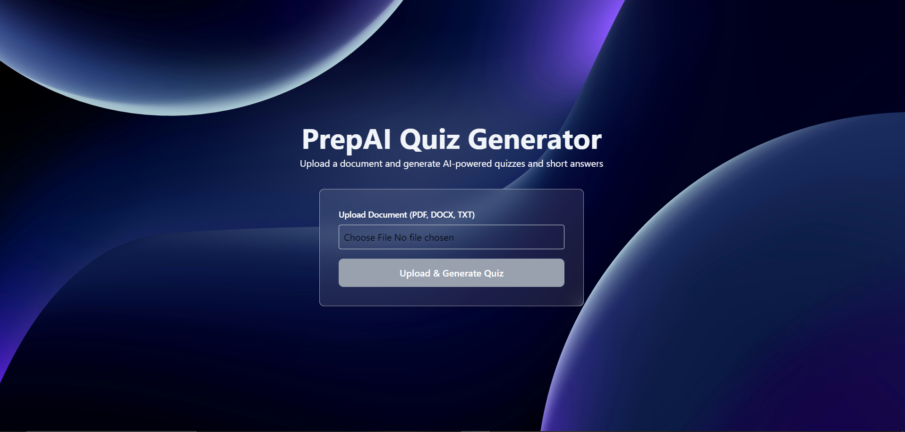
Bangalore Institute of Technology
K.R. Road, V.V. Pura, Bengaluru.-560004.
Department of Computer Science & Engineering
RESULTS

Slide 19
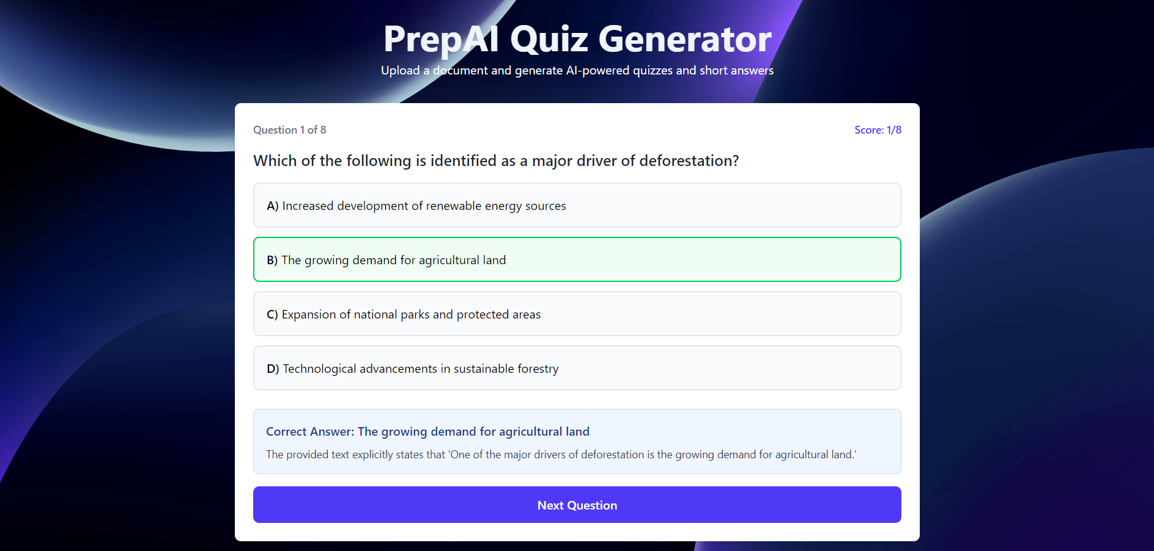
Bangalore Institute of Technology
K.R. Road, V.V. Pura, Bengaluru.-560004.
Department of Computer Science & Engineering

Slide 20
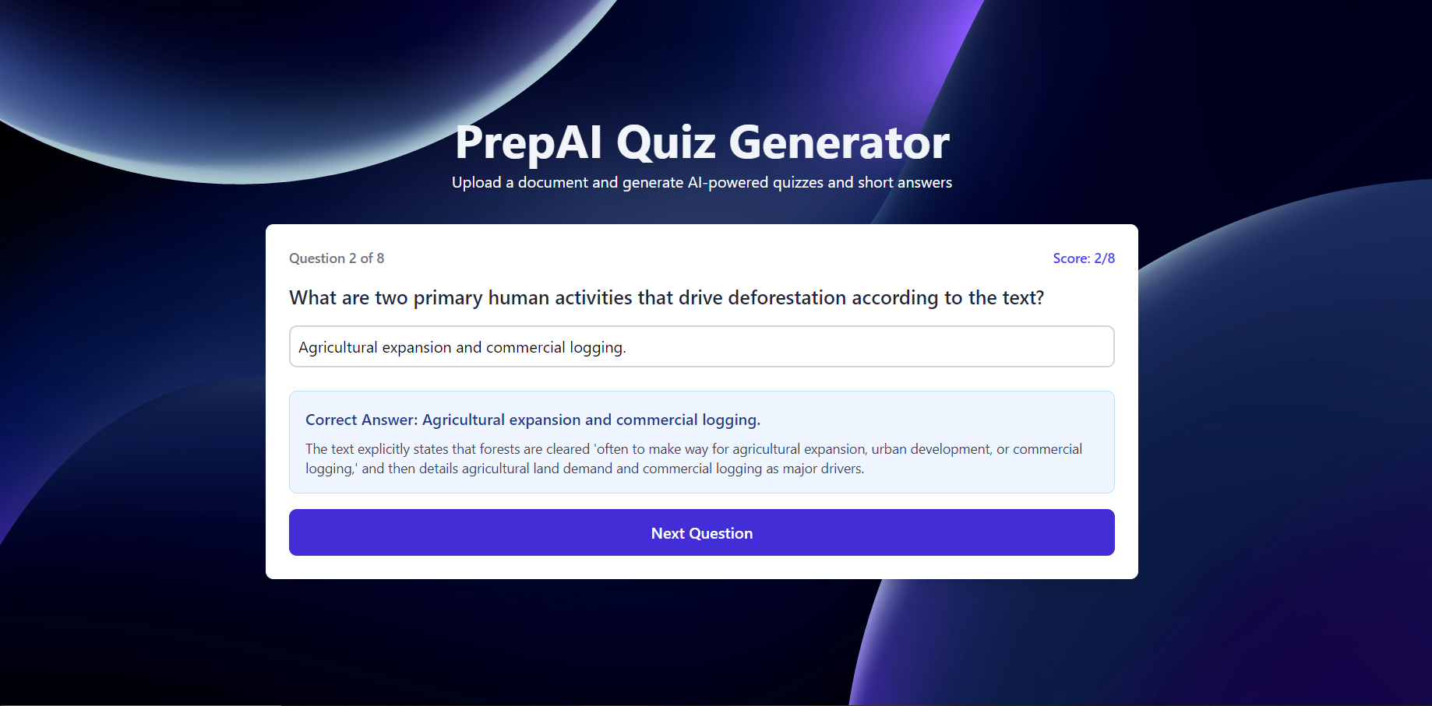
Bangalore Institute of Technology
K.R. Road, V.V. Pura, Bengaluru.-560004.
Department of Computer Science & Engineering

Slide 21
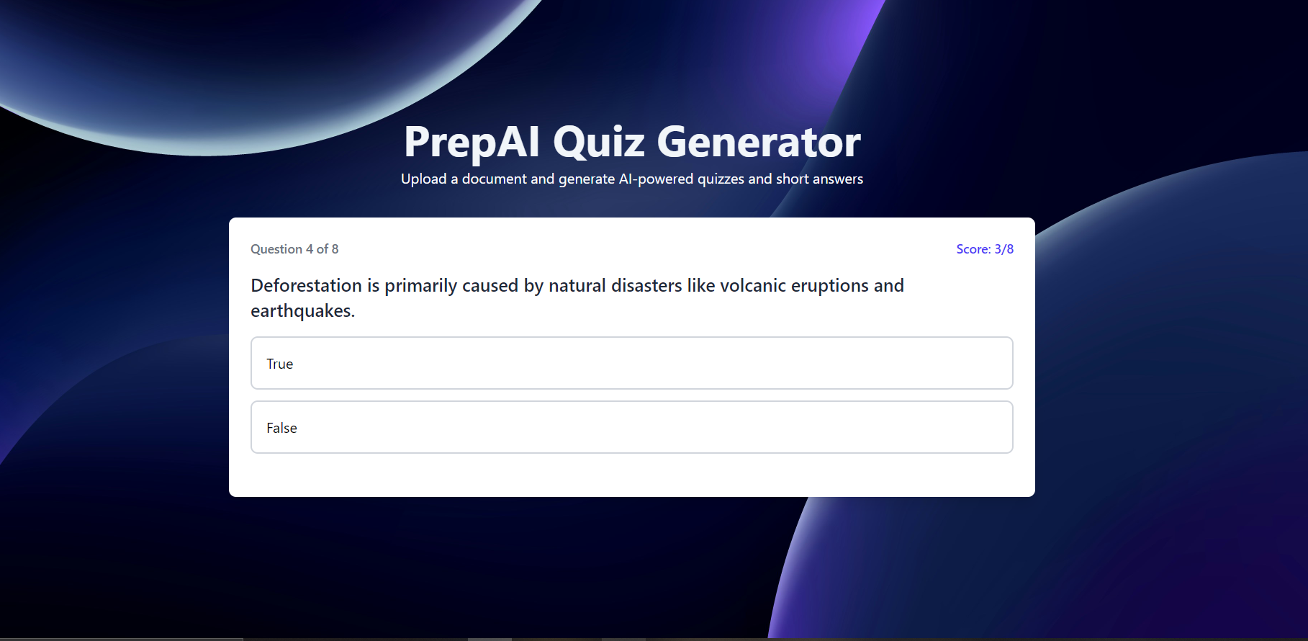
Bangalore Institute of Technology
K.R. Road, V.V. Pura, Bengaluru.-560004.
Department of Computer Science & Engineering

Slide 22
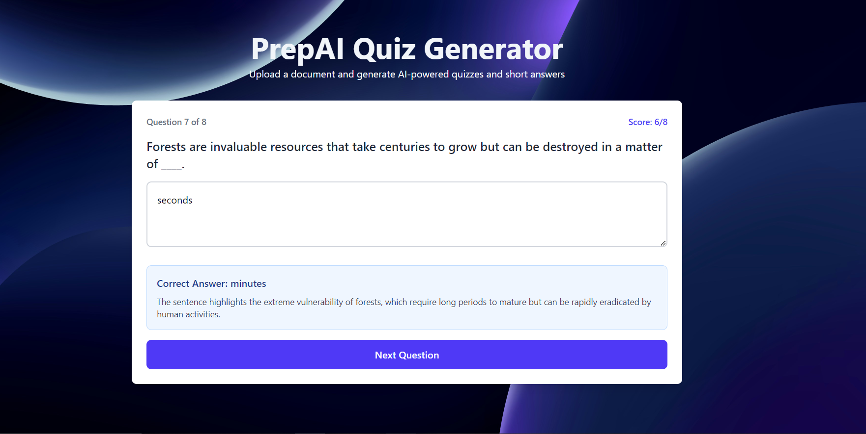
Bangalore Institute of Technology
K.R. Road, V.V. Pura, Bengaluru.-560004.
Department of Computer Science & Engineering

Slide 23
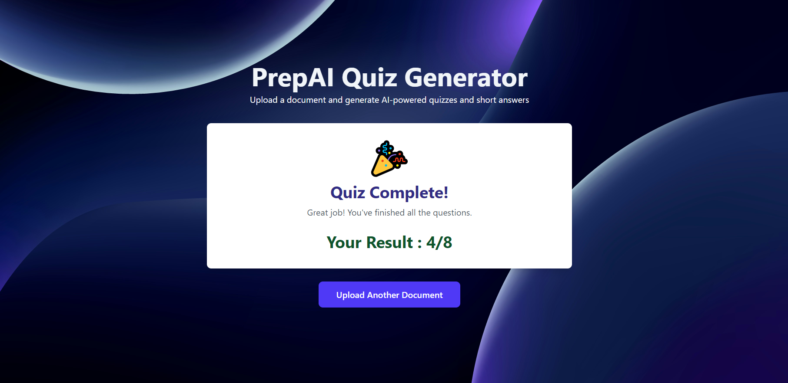
Bangalore Institute of Technology
K.R. Road, V.V. Pura, Bengaluru.-560004.
Department of Computer Science & Engineering

Slide 24
Bangalore Institute of Technology
K.R. Road, V.V. Pura, Bengaluru.-560004.
Department of Computer Science & Engineering
APPLICATIONS
Educational Institutions: Automates quiz creation for teachers and students.
Self-Learning Platforms: Helps learners test themselves using their own notes.
Corporate Training: Generates quick assessments from internal learning documents.
E-Learning Apps: Enhances interactivity by dynamically generating quizzes from uploaded study content.
Online Exam Preparation: Assists students preparing for competitive exams with smart practice tests.

Slide 25
Bangalore Institute of Technology
K.R. Road, V.V. Pura, Bengaluru.-560004.
Department of Computer Science & Engineering
CONCLUSION AND FUTURE SCOPE
To develop a RAG based Generative AI–driven system that automatically creates quizzes from uploaded study materials.
To enhance the learning experience by reducing manual work and enabling smarter revisions.
To build a web-based platform using the MERN stack for scalability and seamless performance.
To design a seamless file upload and AI processing pipeline that converts learning materials into structured assessments.
To implement efficient data handling, real-time quiz generation, and dynamic UI updates for an interactive user experience.

Slide 27
Bangalore Institute of Technology
K.R. Road, V.V. Pura, Bengaluru.-560004.
Department of Computer Science & Engineering
IMPLEMENTATION
APIs Used:
Google Gemini API – Generates quiz questions, summaries, explanations.
SentenceTransformers API (SBERT) – Converts text into embeddings for similarity search.
CrossEncoder API – Re-ranks retrieved chunks and improves distractor quality.
FAISS API – Fast vector search for context retrieval (RAG pipeline).
spaCy NLP API– Extracts key phrases for distractor generation.
Requests + BeautifulSoup – Webpage text scraping for URL inputs.
GET Request – Retrieves quiz data, view generated quiz results, read-only operations
POST Request – Uploads PDF/DOCX/TXT/URL, triggers RAG processing pipeline, sends user inputs for quiz generation, saves quiz results

Slide 28
Bangalore Institute of Technology
K.R. Road, V.V. Pura, Bengaluru.-560004.
Department of Computer Science & Engineering
def generate_quiz(document, max_questions):
text = extract_and_clean(document)
chunks = chunk_text(text)
vectordb = build_vector_db(chunks) # Build RAG components
reranker = load_cross_encoder()
questions = []
for chunk in chunks:
if len(questions) >= max_questions:
return questions
retrieved = vectordb.search(chunk) # Step 1: Retrieve relevant chunks
context = reranker.top(retrieved) # Step 2: Re-rank using cross-encoder
for qtype in ["mcq", "short", "fillblank", "tf"]: # Step 3: Generate 4 question types
if len(questions) >= max_questions:
return questions
q = generate_question(context, qtype)
questions.append(q)
return questions
Algorithm:

