Slide 1


Bangalore Institute of Technology
K.R. Road, V.V. Pura, Bengaluru.-560004.
Department of Computer Science & Engineering
2024-25
“INTELLIGENT LEARNING SYSTEM USING GEN AI”
Presentation by
1BI23CS069 - Deeksha H
1BI23CS123 – Madhurya AK
1BI23CS169 – Rajatha Prasad
1BI23CS189 – Samiksha P
Under the Guidance of
Dr. Madhuri J
Associate Professor
Department of CSE, BIT

Slide 2
Bangalore Institute of Technology
K.R. Road, V.V. Pura, Bengaluru.-560004.
Department of Computer Science & Engineering
Agenda
  Introduction
  Existing Systems
  Problem Statement
  Objectives
  Tools and Technologies
  Architectural Diagram
  Modules Description
  Applications

Slide 3
Bangalore Institute of Technology
K.R. Road, V.V. Pura, Bengaluru.-560004.
Department of Computer Science & Engineering
INTRODUCTION
In today’s fast-paced academic environment, students struggle to effectively review vast amounts of study material. Traditional methods of creating practice quizzes are manual, time-consuming, and often fail to provide personalized learning experiences.
StudyBuddy leverages Generative AI and Natural Language Processing (NLP) to automatically analyze uploaded study materials and create context-aware, personalized quizzes — making exam preparation intelligent, adaptive, and time-efficient.
Developed using the MERN stack (MongoDB, Express.js, React.js, Node.js), the system seamlessly integrates AI/ML models for real-time question generation, text understanding, and quiz evaluation — ensuring both performance and scalability.

Slide 4
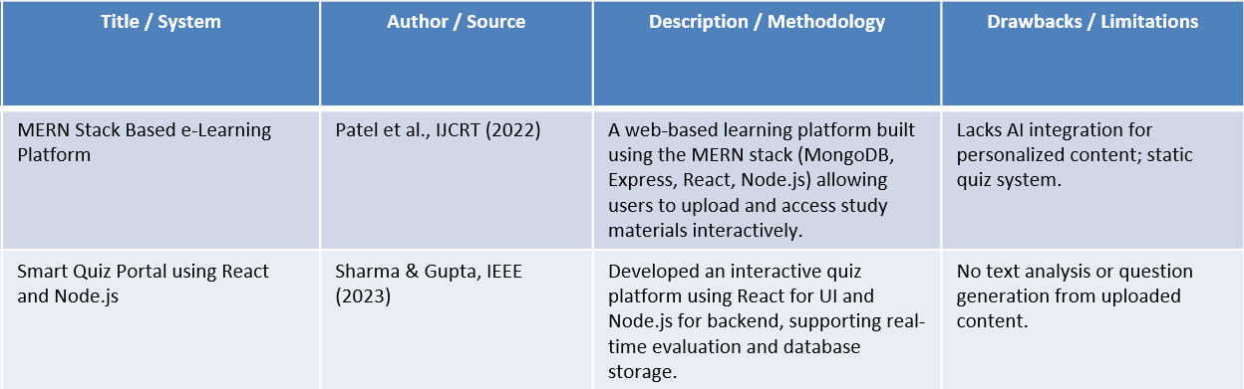
Bangalore Institute of Technology
K.R. Road, V.V. Pura, Bengaluru.-560004.
Department of Computer Science & Engineering
EXISTING SYSTEMS

Slide 5
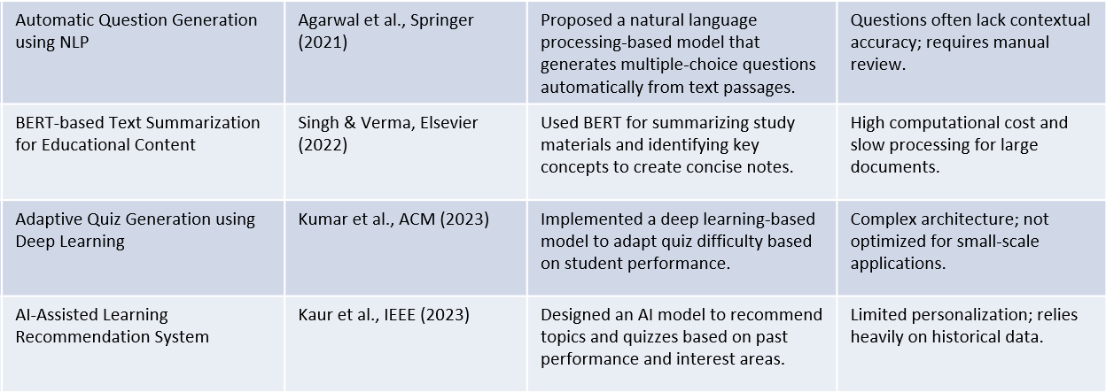
Bangalore Institute of Technology
K.R. Road, V.V. Pura, Bengaluru.-560004.
Department of Computer Science & Engineering
EXISTING SYSTEMS

Slide 6
Bangalore Institute of Technology
K.R. Road, V.V. Pura, Bengaluru.-560004.
Department of Computer Science & Engineering
PROBLEM STATEMENT
PrepAI leverages Generative AI and MERN stack to automatically generate context-based questions from uploaded study material.
Input : Uploaded study material (PDF, DOCX,HTML)
Output : Summarized key points extracted from the material ,automatically generated quiz questions which includes MCQs , true/false, and short answer types , Interactive quiz interface for students to test their understanding.

Slide 7
Bangalore Institute of Technology
K.R. Road, V.V. Pura, Bengaluru.-560004.
Department of Computer Science & Engineering
OBJECTIVES
To accomplish automated generation of quizzes from uploaded study materials using Generative AI.
To minimize manual effort and time required for students to create practice questions.
To build a scalable, web-based platform using MERN stack for seamless user experience.
To design a seamless file upload and AI processing pipeline that converts learning materials into structured assessments.
To implement efficient data handling, real-time quiz generation, and dynamic UI updates for an interactive user experience.

Slide 8
Bangalore Institute of Technology
K.R. Road, V.V. Pura, Bengaluru.-560004.
Department of Computer Science & Engineering
TOOLS AND TECHNOLOGIES
Frontend | React.js, Tailwind css, Axios
Backend | Node.js, Express.js, cors, dotenv
File Processing | pdfplumber, PyMuPDF (for text extraction)
LLM, Prompt template, RAG pipeline | langchain.chains.RetrievalQA, langchain.prompts.PromptTemplate, HuggingFaceHub(repo_id="mistralai/Mistral-7B-Instruct-v0.3"),

Slide 9
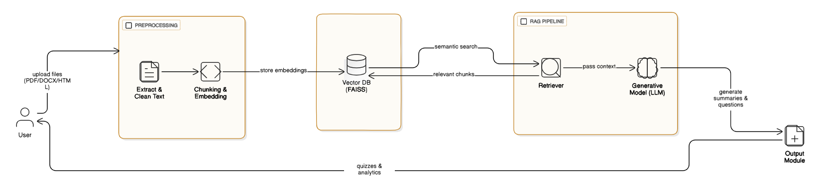
Bangalore Institute of Technology
K.R. Road, V.V. Pura, Bengaluru.-560004.
Department of Computer Science & Engineering
ARCHITECTURAL DIAGRAM

Slide 10
Bangalore Institute of Technology
K.R. Road, V.V. Pura, Bengaluru.-560004.
Department of Computer Science & Engineering
MODULES DESCRIPTION
User Module: Allows users to upload study materials in PDF, DOCX, or HTML format for processing.
Preprocessing Module: Extracts and cleans the raw text from uploaded files for further analysis.
Chunking & Embedding Module: Breaks the text into smaller chunks and converts them into semantic embeddings.
Vector Database (FAISS):Stores embeddings and supports fast semantic searches to find relevant content.
Generative Model (LLM) : Uses a large language model (like Gemini, Mistral, LLaMA, or GPT) to combine the user’s query or instruction, and the retrieved chunks (factual context).The model then generates summaries, questions, or answers that are both accurate and context-aware.
Output Module: include quiz questions with answers , Summaries of uploaded content ,analytics (difficulty levels, topic coverage, etc.)and sends the results back to the user interface.

Slide 11
Bangalore Institute of Technology
K.R. Road, V.V. Pura, Bengaluru.-560004.
Department of Computer Science & Engineering
MODULES DESCRIPTION
RAG Pipeline (Retrieval-Augmented Generation):combines information retrieval and generative AI to produce accurate and context-aware results.
Consists of two core components a Retriever and a Generative Model (LLM).
The Retriever searches the Vector Database (FAISS) to fetch the most relevant text chunks.
These chunks provide context for the Generative Model to generate summaries and topic-based questions.
Ensures outputs are factually grounded, reducing hallucinations and improving accuracy.
In PrepAI, it serves as the core AI engine, converting study materials into personalized quizzes and summaries.

Slide 12
Bangalore Institute of Technology
K.R. Road, V.V. Pura, Bengaluru.-560004.
Department of Computer Science & Engineering
APPLICATIONS
Educational Institutions: Automates quiz creation for teachers and students.
Self-Learning Platforms: Helps learners test themselves using their own notes.
Corporate Training: Generates quick assessments from internal learning documents.
E-Learning Apps: Enhances interactivity by dynamically generating quizzes from uploaded study content.
Online Exam Preparation: Assists students preparing for competitive exams with smart practice tests.

Slide 13
Bangalore Institute of Technology
K.R. Road, V.V. Pura, Bengaluru.-560004.
Department of Computer Science & Engineering

