Slide 1

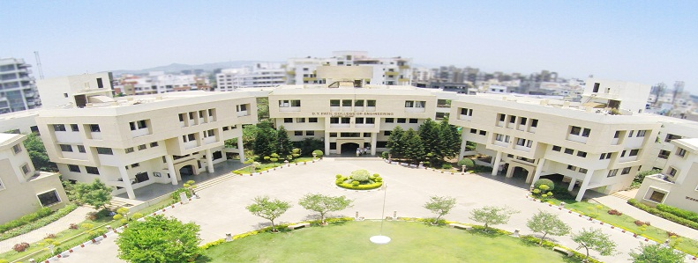
Cardiovascular Disease Prediction Using Machine Learning
B.E. Project Phase-I Presentation
on
Student Name :
Aman Jee(B1900803007)
Samiksha Anand(B1900803102)
Prathamesh Bale(B1900803013)
Guide Name : Mrs. Manisha Rajput
Department of Electronics and Telecommunication Engineering,
D. Y. Patil College of Engineering, Akurdi, Pune
2024-2025

Slide 2
Outline:
Objective of Project
Literature Survey(In Table)
Block diagram of Project
Circuit diagram of Project
Design steps
System Specifications
Selection of components
Simulation results
PCB artwork
Test results
Application
Future Scope
References
Notes:
,

Slide 3
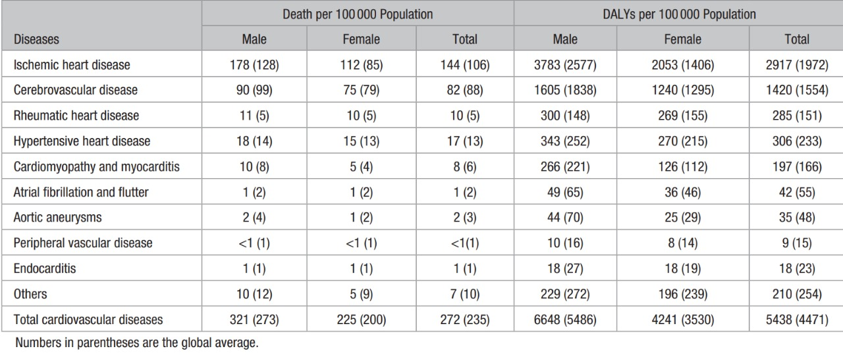
Introduction
Cardiovascular diseases (CVDs) are the leading cause of death globally, responsible for around 17.9 million deaths annually. Traditional diagnosis methods rely on clinical examinations and risk factors like age, blood pressure, and cholesterol levels. However, these methods often fail to account for complex interactions between risk factors, leading to misclassifications or delayed diagnoses. This project, "Cardiovascular Diseases Prediction using Machine Learning," aims to improve the accuracy and timeliness of CVD diagnosis. By utilizing machine learning algorithms, it will analyze large datasets, including lifestyle choices, physiological data, and genetics, to offer more precise, personalized early diagnoses, improving treatment plans and reducing healthcare costs.

Slide 4
Objective of Project
The aim of this model to predict cardiovascular disease (CVD) risk in individuals at an early stage, enabling timely intervention and treatment and provide personalized prediction by considering various factors such as age, gender, cholesterol levels, and lifestyle habits to better assess the risks of developing cardiovascular diseases. And by using machine learning algorithms to enhance the accuracy and reliability of cardiovascular disease prediction.
The system aims to achieve the following:
Early Detection of Cardiovascular Risk: The model can help identify individuals at high risk of cardiovascular diseases (CVD) even before symptoms appear, allowing for early intervention and preventive measures.
Improved Accuracy in Diagnosis: By analyzing vast amounts of patient data, the model can provide more accurate predictions than traditional methods, reducing the chances of misdiagnosis or delayed diagnosis of CVD.

Slide 5
Literature Survey
Sr.No | Author And Year | Journal / Conference | Paper Title | Method Use | Remark and Performance
1 | Ahmad Ayid Ahmad and Huseyin Polat Published: 17 Juy 2023 | IEEE | Prediction of Heart Disease Based on Machine Learning | Jellyfish Optimization Algorithm | It aims to enhance prediction accuracy through this nature-inspired metaheuristic algorithm.
2 | Mohammad Hasan Imam , Md. Rasedul Islam, Shadman Nashif Published: November 22, 2018 | IEEE | Heart Disease Detection by Using Machine Learning Algorithms and a Real-Time Cardiovascular Health Monitoring System | Random Forest Algorithm | By using machine learning algorithms to enhance the accuracy and reliability of cardiovascular disease prediction .

Slide 6
Sr.No | Author And Year | Journal / Conference | Paper Title | Method Use | Remark and Performance
3 | S.K Gupta , A. Aggrarwal, N. Verma | IEEE | Deep learning-based model for predicting cardiovascular disease risk | Deep Learning Algorithm | This study demonstrates the effectiveness of deep learning in identifying cardiovascular risk factors and suggests its potential for application in large-scale health data analysis.
4 | Ranjan and Srinivas | Springer | comparative study on predicting cardiovascular disease using various machine learning algorithms | Logistic Regression, Random Forest, Support Vector Machine (SVM), and Neural Networks. | They applied these models to datasets that included patient medical history, lifestyle factors, and clinical measurements

Slide 7
Sr.No | Author And Year | Journal / Conference | Paper Title | Method Use | Remark and Performance
5 | Kumar et al | Springer | proposed a machine learning-based framework for predicting cardiovascular disease risk | Decision Trees, Random Forest, Gradient Boosting Machines, and K-Nearest Neighbors (KNN). | They applied models to a dataset with factors like age, gender, cholesterol, blood pressure, smoking, and physical activity.
6 | Khan and Yadav | IEEE | Predicting cardiovascular disease using machine learning algorithms, focusing on the strengths and limitations of various approaches. | Machine learning algorithms | They reviewed datasets, features, and metrics in cardiovascular disease prediction, noting challenges and machine learning techniques' effectiveness.

Slide 8
Sr.No | Author And Year | Journal / Conference | Paper Title | Method Use | Remark and Performance
7 | Dinesh and Bhatt | IEEE | Comparative study on heart disease prediction | Support Vector Machine (SVM) and Random Forest | The study emphasizes feature selection and dataset balancing to tackle class imbalances, showing their impact on heart disease prediction accuracy.
8 | Polaraju | IEEE | Demonstrated that Multiple Linear Regression is an effective method for predicting heart disease | Linear Regression | The study shows this regression model is effective for predicting cardiovascular risk, confirming its suitability for heart disease prediction in machine learning.

Slide 9
Sr.No | Author And Year | Journal / Conference | Paper Title | Method Use | Remark and Performance
9 | Ali et al | IEEE | Evolved a model with two SVM to diagnose heart disease effectively | Hybrid gird search algorithm (HGSA) , SVM | Unnecessary features were eliminated with the first SVM, and prediction was done with the second. The hybrid grid search algorithm (HGSA) improved accuracy by 3.3% over the traditional SVM model.
10 | Santhana Krishnan. J | IEEE | Decision trees and Nave Bayes machine learning algorithms, to predict heart attacks | Nave Bayes, Decision Tree Model | The Decision Tree model achieved 91% precision, while Naive Bayes reached 87% accuracy. They concluded that the Decision Tree was the best algorithm for handling datasets.

Slide 10
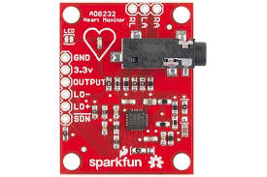
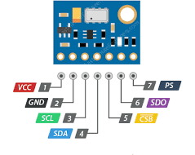
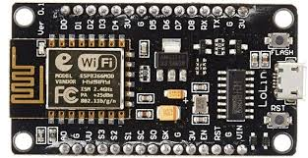
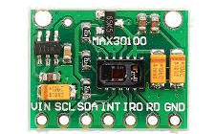
COMPONENTS
AD8232 (ECG Sensor)
MS5611
SensorMAX30100 (Heart Rate and Pulse Oximeter Sensor)
ESP8266 (Microcontroller)

Slide 11



COMPONENTS
Frontend-Backend Technology
DATABASE
Machine Learning

Slide 12
SPECIFICATIONS
AD8232(ECG Sensor)
Low supply current: 170 µA (typical)
Single-supply operation: 2.0 V to 3.5 V
2-pole adjustable high-pass filter and
3-pole adjustable low-pass filter with adjustable gain
High signal gain (G = 100) with dc blocking capabilities
MS5611
Pressure Range: 10 to 1200 mbar (hPa)
Temperature Range: -40°C to +85°C
Supply voltage: 1.8 to 3.6 V
Very low current consumption: Standby max. 0.14 μA4-wire SPI or 2-wire I²C interface
Pressure Accuracy: ±0.03 hPa
Temperature Accuracy: ±0.8°C
Heart Rate Sensor
(Heart Rate and Pulse Oximeter Sensor)
Supply Voltage-1.7- 2.0 V
Supply Current-600 -1200 µa
Storage Temperature Range -40°C to +105°C
LED Supply Voltage-3.1- 5.0 V
Supply Current in Shutdown-0.7 10 µA
Microcontroller(ESP8266)
17 GPIO pins
32 KB instruction RAM
I²C (software implementation)
I²S interfaces with DMA (sharing pins with GPIO)
10 bit ADC

Slide 13

DATABASE
It is a data repository of all recorded data from sensors as well as manual inputs.
It creates a rich dataset, which feeds to the ML model. The repository of data enables the system
to collect data very rapidly and train and predict the model to make the system work with all
the given information.
ML
This is the heart and sole predictive part of the system, a machine learning
model. It tends to use the gathered data from the database in the prediction of risk, which
proceeds with cardiovascular disease. The model goes by historical data and applies algorithms
to identify the pattern of specific indicators that may constitute a probable heart condition based
on the given inputs of the user and sensor readings

Slide 14
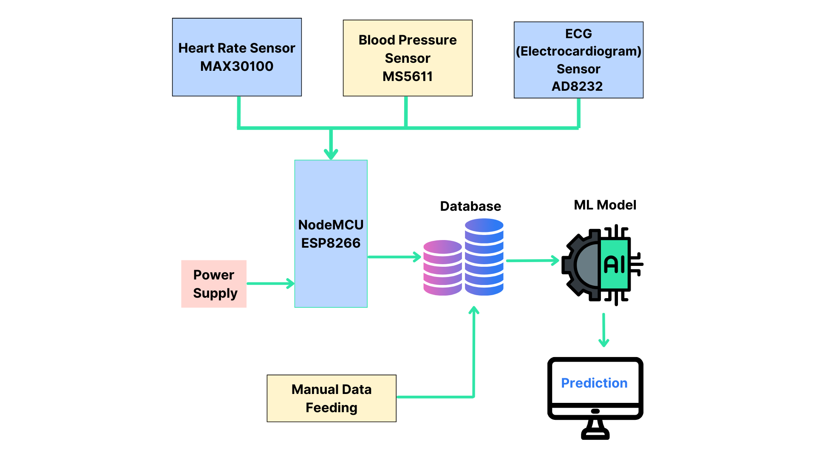
BLOCK DIAGRAM

Slide 15
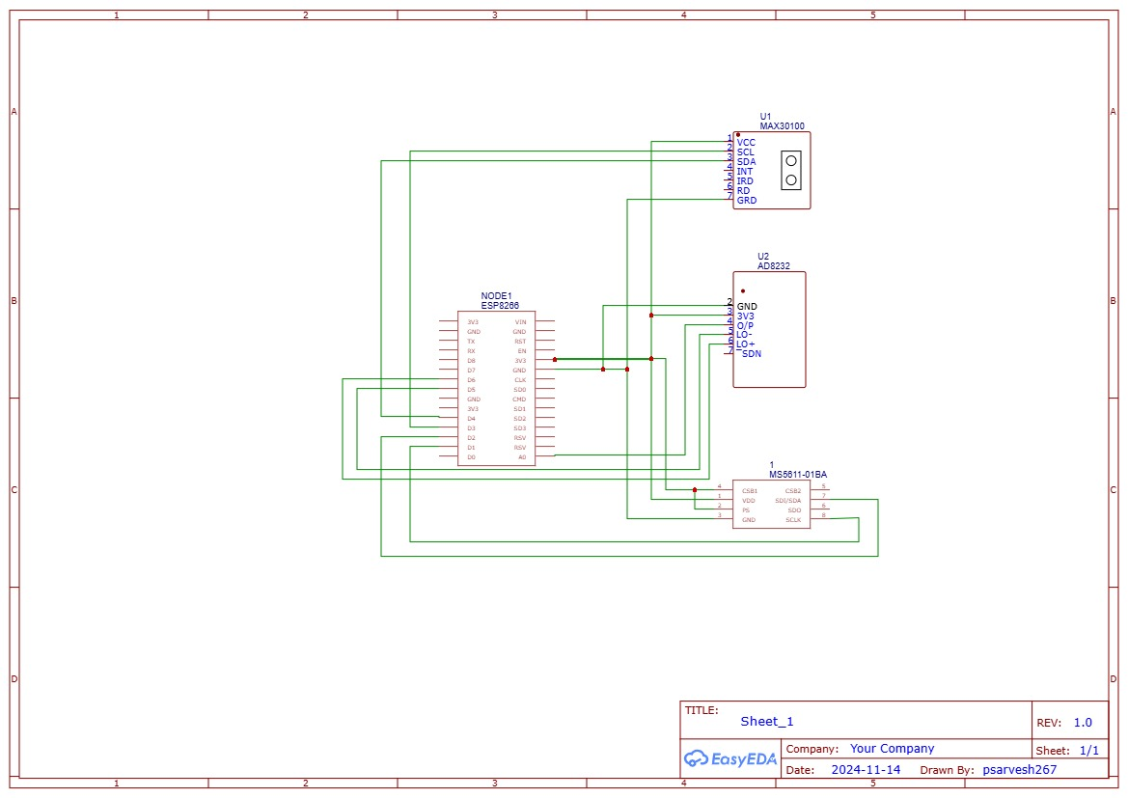
CIRCUIT DIAGRAM

Slide 16
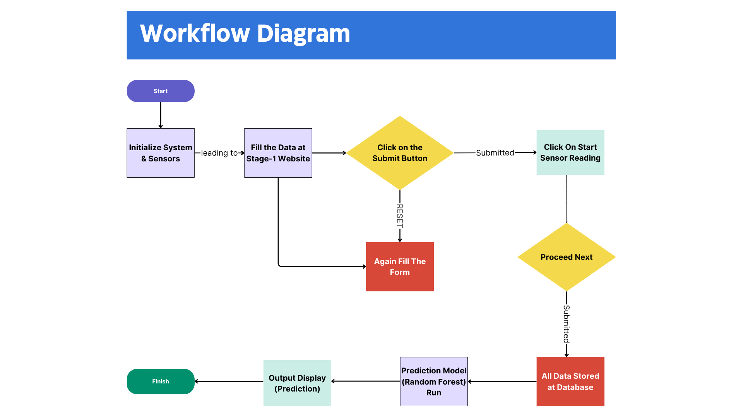
Design Steps

Slide 17
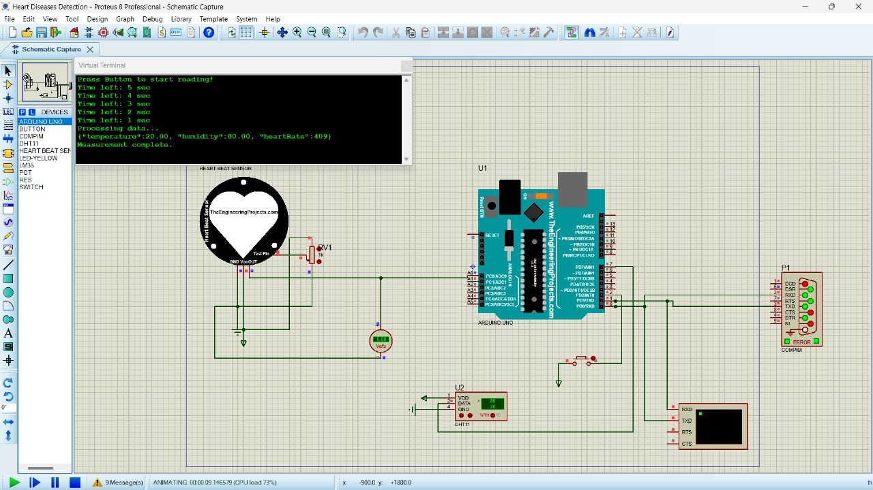
Simulation Result

Slide 18
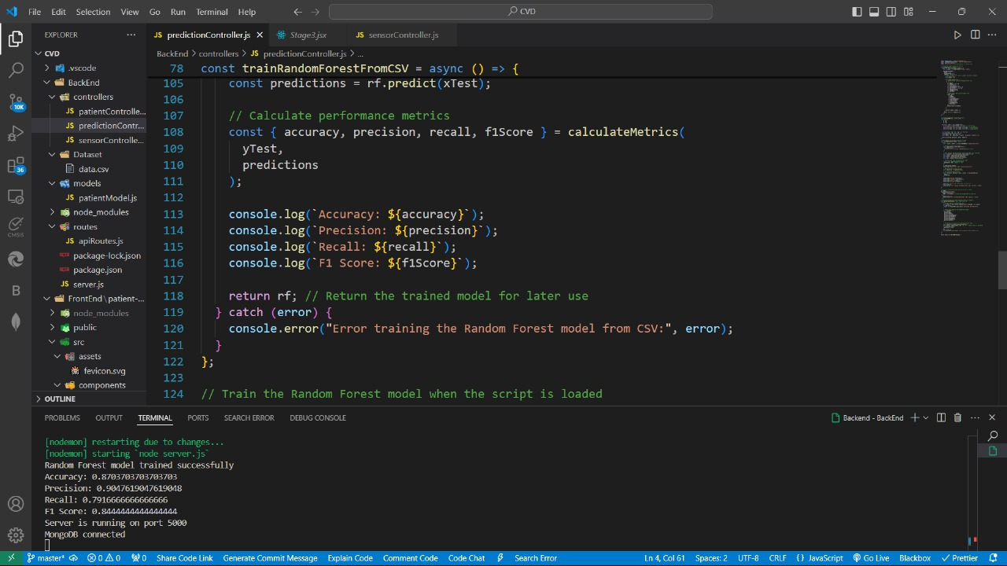
IMPLEMENTED MODEL

Slide 19
FINAL TEST RESULT
1. Comparative Analysis of Tested Models:
Sr. No | Model | Accuracy (%)
1 | Logistic Regression (LR) | 78.69
2 | Support Vector Machine (SVM) | 80.33
3 | K-Nearest Neighbors (KNN) | 73.77
4 | Decision Tree (DT) | 75.41
5 | Random Forest (RF) | 85.25
6 | Gradient Boosting (GB) | 80.33

Slide 20
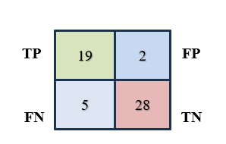
FINAL TEST RESULT
2. Detailed Test Results of the Selected Model (Random Forest)
A) Confusion Matrix
B) Other Parameters
Accuracy | Precision | Recall | F1 Score
0.870 | 0.904 | 0.791 | 0.844

Slide 21
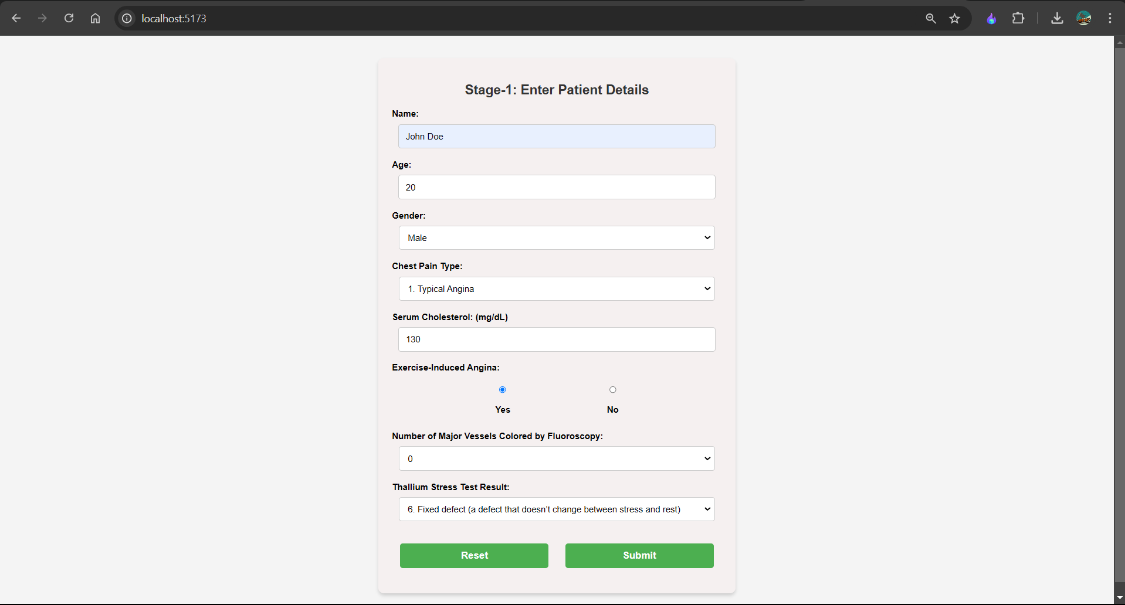
FINAL TEST RESULT
3. System Testing and Validation:

Slide 22

FINAL TEST RESULT
3. System Testing and Validation:

Slide 23

FINAL TEST RESULT
3. System Testing and Validation:

Slide 24
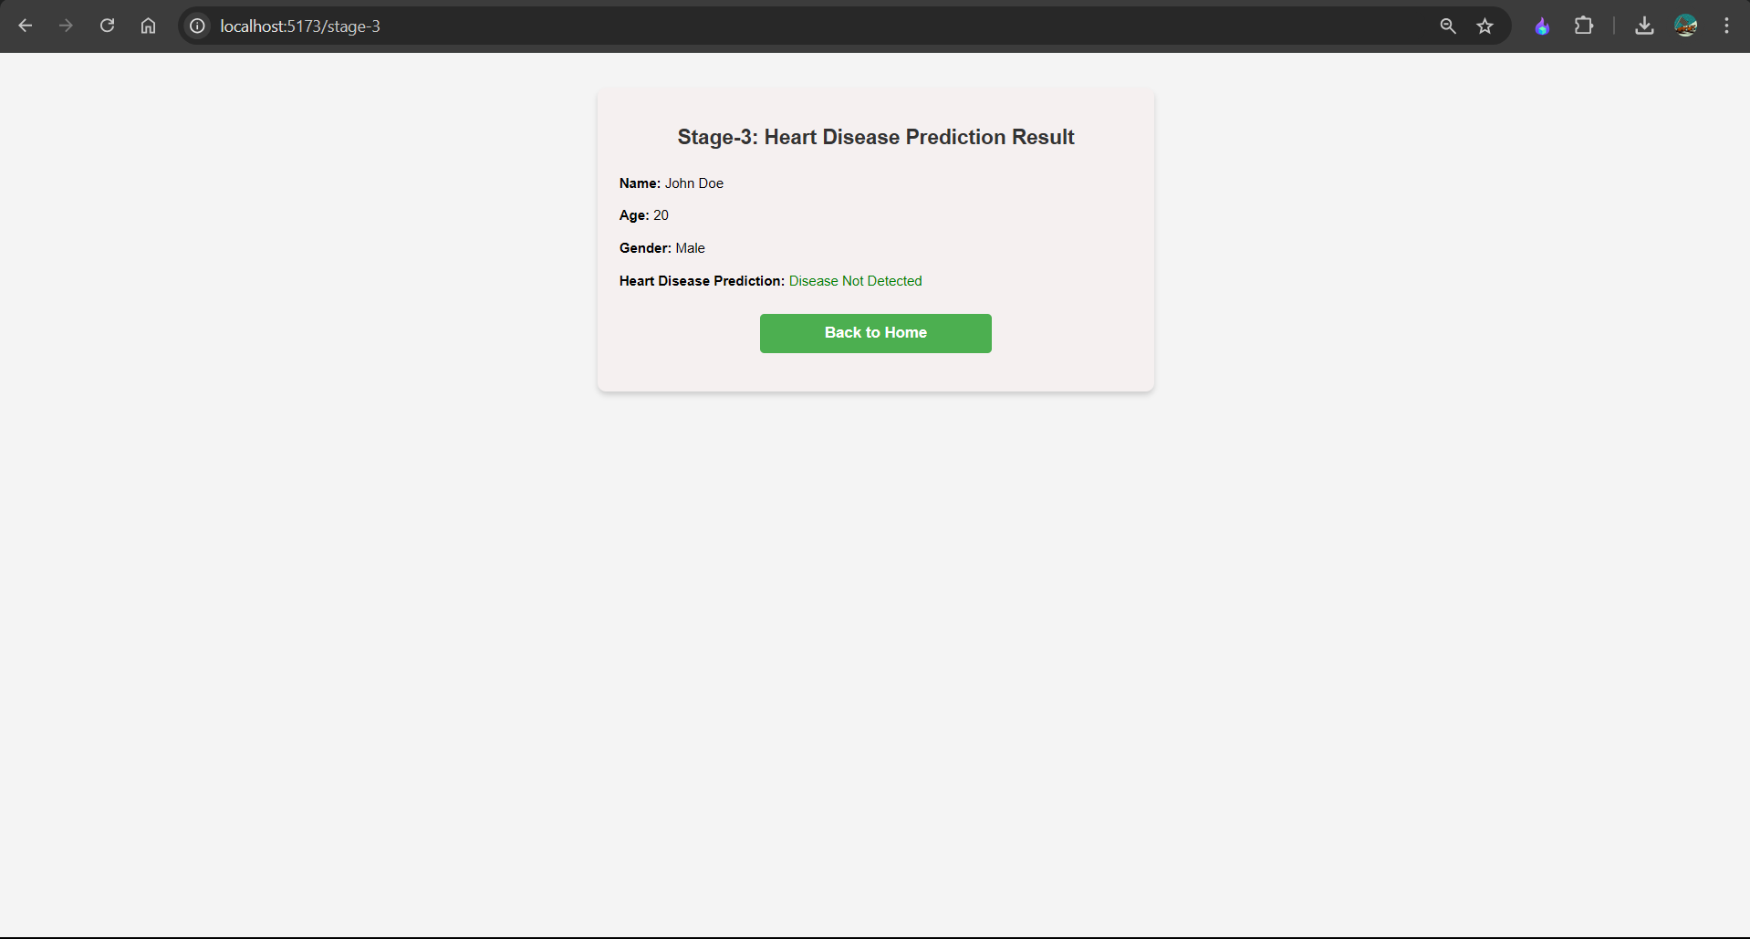
FINAL TEST RESULT
3. System Testing and Validation:

Slide 25
Application
Healthcare Systems: Doctors and medical staff can use it as a decision-support tool to assess cardiovascular risk based on patients’ health data, aiding in personalized treatment plans and preventive care.
Electronic Health Records (EHR) Integration: Hospitals can incorporate it into EHR systems for real-time cardiovascular risk assessment, enabling seamless tracking and monitoring for high-risk patients.
Health and Fitness Apps: Integrated into health monitoring apps, it allows users to track cardiovascular risk, receive personalized health insights, and adopt healthier habits based on data trends.
Telemedicine: During remote consultations, it assists in quickly analyzing patient data for cardiovascular risk, providing doctors with valuable insights without an in-person visit.
Wearable Technology: Machine learning models can be embedded in wearable devices to analyze user data continuously, alerting them to potential cardiovascular risk changes over time.

Slide 26
Future Scope
Integration of Multimodal Data: Combining data from various sources, such as genetic information, imaging, electronic health records, and lifestyle data, to improve prediction accuracy.
Personalized Prediction Models: Developing models tailored to individual risk factors, such as age, gender, genetics, and lifestyle, for more precise predictions and personalized treatment plans.
Real-Time Monitoring with IoT: Using IoT devices, like wearable ECGs and blood pressure monitors, to gather continuous data and provide real-time CVD risk assessments.
Explainable AI in CVD Prediction: Focusing on explainable AI methods to help healthcare providers and patients understand the decision-making process behind model predictions, increasing trust and transparency in AI.

Slide 27
REFERENCES
[1] Hazra, A., Mandal, S., Gupta, A. and Mukherjee, A. (2017) Heart Disease Diagnosis
and Prediction Using Machine Learning and Data Mining Techniques: A Review. Advances in
Computational Sciences and Technology, 10, 2137-2159.
[2] Patel, J., Upadhyay, P. and Patel, D. (2016) Heart Disease Prediction Using Machine
learning and Data Mining Technique. Journals of Computer Science & Electronics, 7, 129-137.
[3] Chavan Patil, A.B. and Sonawane, P. (2017) To Predict Heart Disease Risk and
Medications Using Data Mining Techniques with an IoT Based Monitoring System for Post-
Operative Heart Disease Patients. International Journal on Emerging Trends in Technology
(IJETT), 4, 8274-8281.
[4] Weng, S.F., Reps, J., Kai, J., Garibaldi, J.M. and Qureshi, N. (2017) Can Machine-
Learning Improve Cardiovascular Risk Prediction Using Routine Clinical Data? PLoS ONE,
12, e0174944. https://doi.org/10.1371/journal.pone.0174944
[5] Zhao, W., Wang, C. and Nakahira, Y. (2011) Medical Application on Internet of
Things. IET International Conference on Communication Technology and Application
(ICCTA 2011), Beijing, 14-16 October 2011, 660-665

Slide 28
REFERENCES
[6] Chiuchisan, I. and Geman, O. (2014) An Approach of a Decision Support and Home
Monitoring System for Patients with Neurological Disorders Using Internet of Things
Concepts. WSEAS Transactions on Systems, 13, 460-469.
[7] Soni, J., Ansari, U. and Sharma, D. (2011) Intelligent and Effective Heart Disease
Prediction System Using Weighted Associative Classifiers. International Journal on Computer
Science and Engineering (IJCSE), 3, 2385-2392.
[8] Yuce, M.R. (2010) Implementation of Wireless Body Area Networks for Healthcare
Systems. Sensor and Actuators A: Physical, 162, 116-129.
https://doi.org/10.1016/j.sna.2010.06.004
[9] Singh, M., Martins, L.M., Joanis, P. and Mago, V.K. (2016) Building a Cardiovascular
Disease Predictive Model Using Structural Equation Model and Fuzzy Cognitive Map. IEEE
International Conference on Fuzzy Systems (FUZZ), Vancouver, 24-29 July 2016, 1377-1382.
https://doi.org/10.1109/FUZZ-IEEE.2016.7737850
[10] Ghadge, P., Girme, V., Kokane, K. and Deshmukh, P. (2016) Intelligent Heart Attack
Prediction System Using Big Data. International Journal of Recent Research in Mathematics
Computer Science and Information Technology, 2, 73-77.

Slide 29
Thank You
😊

