Slide 1
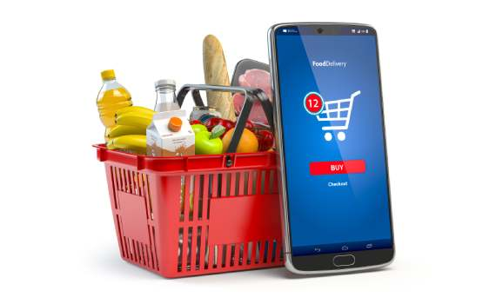

Slide 2

A Project Report On Grocery Delivery App By Samiksha Harish Chaudhari
Batch: 2021 – 6520
Center: Pimpari Chinchwad
Under the Guidance of,
Chitranjan Ghosh
Technical Trainer

Slide 3
Introduction:
Our project explains about the Online Grocery App.This project mainly explains the various actions related to online shoping. You can search various products and shuffle according to category. Our Project Include
Modules:-
• Admin Module
• User Module
• Cart Module

Slide 4
I have developed this Application in Java, JSP, Servlets, Hibernate and MySQL. It’s a web-based projects so I have used HTML, CSS, JavaScript and Bootstrap also. The main feature of the project is to make shopping easier. You can access this website from anywhere and everywhere. In Admin module, admin can add the Category and Products in the specific category. He can also view the total number of users at present in the website. And category and product details also. Admin can only see the admin page and cart if he wants to order something. In User module, user can access the website and buy products and products to cart and buy and shuffle by category. New user can register and login after that to shop. In Cart, admin and user both can access, they can add the products and buy if they want.

Slide 5
Software Requirements:
Front end: Java/J2EE technologies (Servlet, JSP), HTML, CSS, JavaScript, Bootstrap, Hibernate.
Back end: MySQL workbench 8.0.23CE.
Middleware/Server: Apache Tomcat v8.5.
IDE: Eclipse IDE for Java EE Developers Browser: Best result on Google Chrome
Operating System: Window 10.

Slide 6
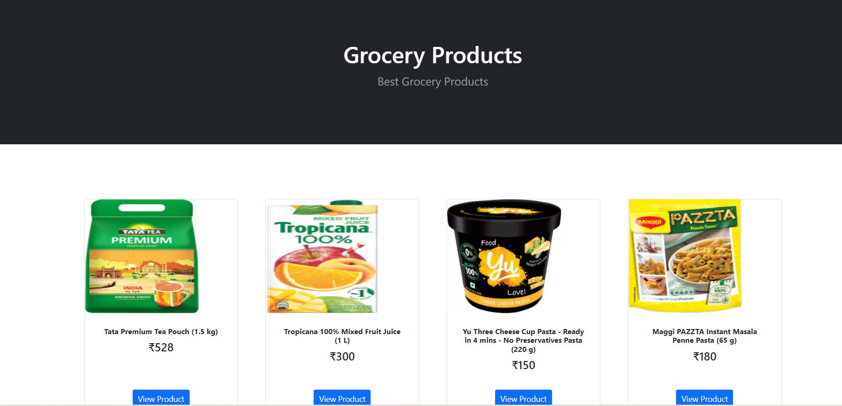
Screenshots:- Home Page:

Slide 7
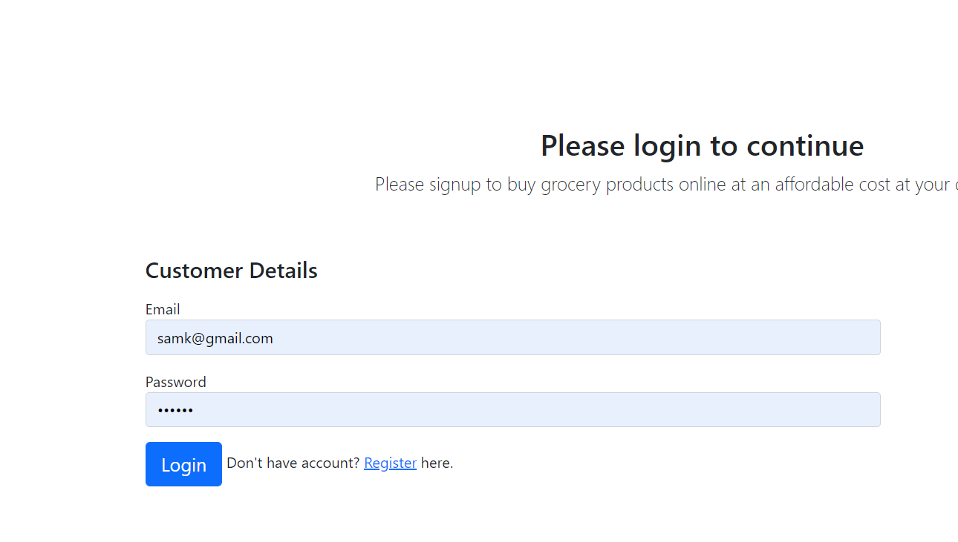
Login Page :-

Slide 8
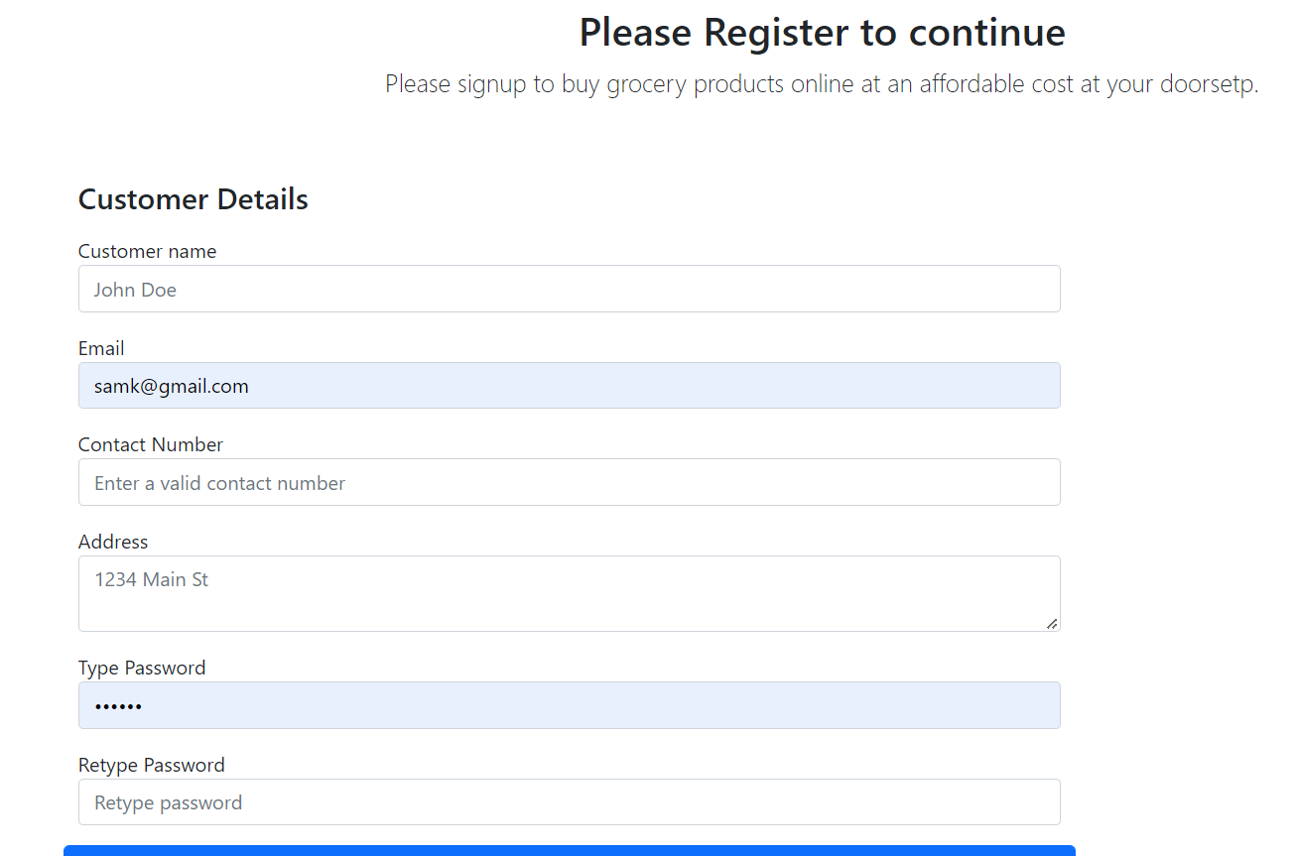
Register Page :-

Slide 9
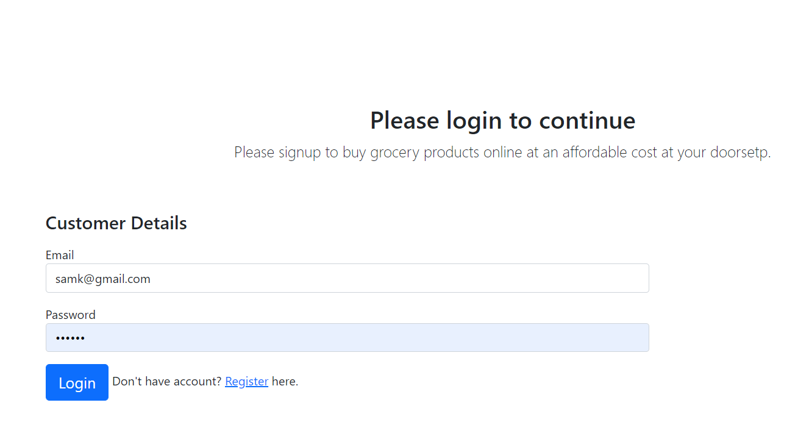
Sucessful Registration Done :

Slide 10
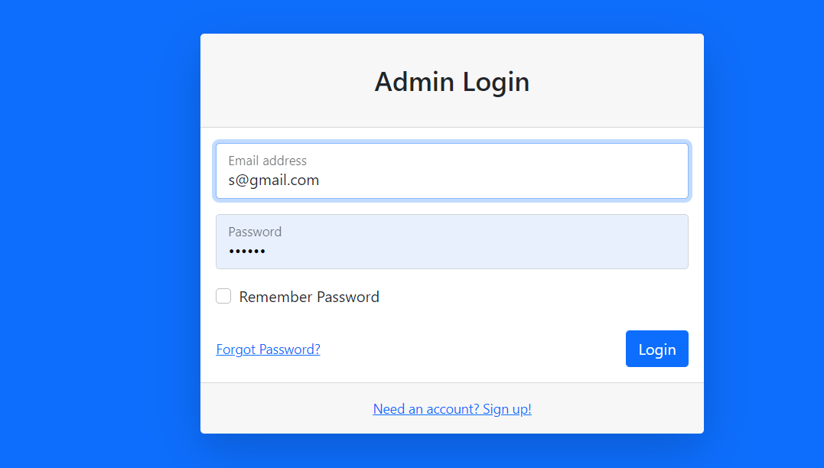
Admin Login Page:

Slide 11
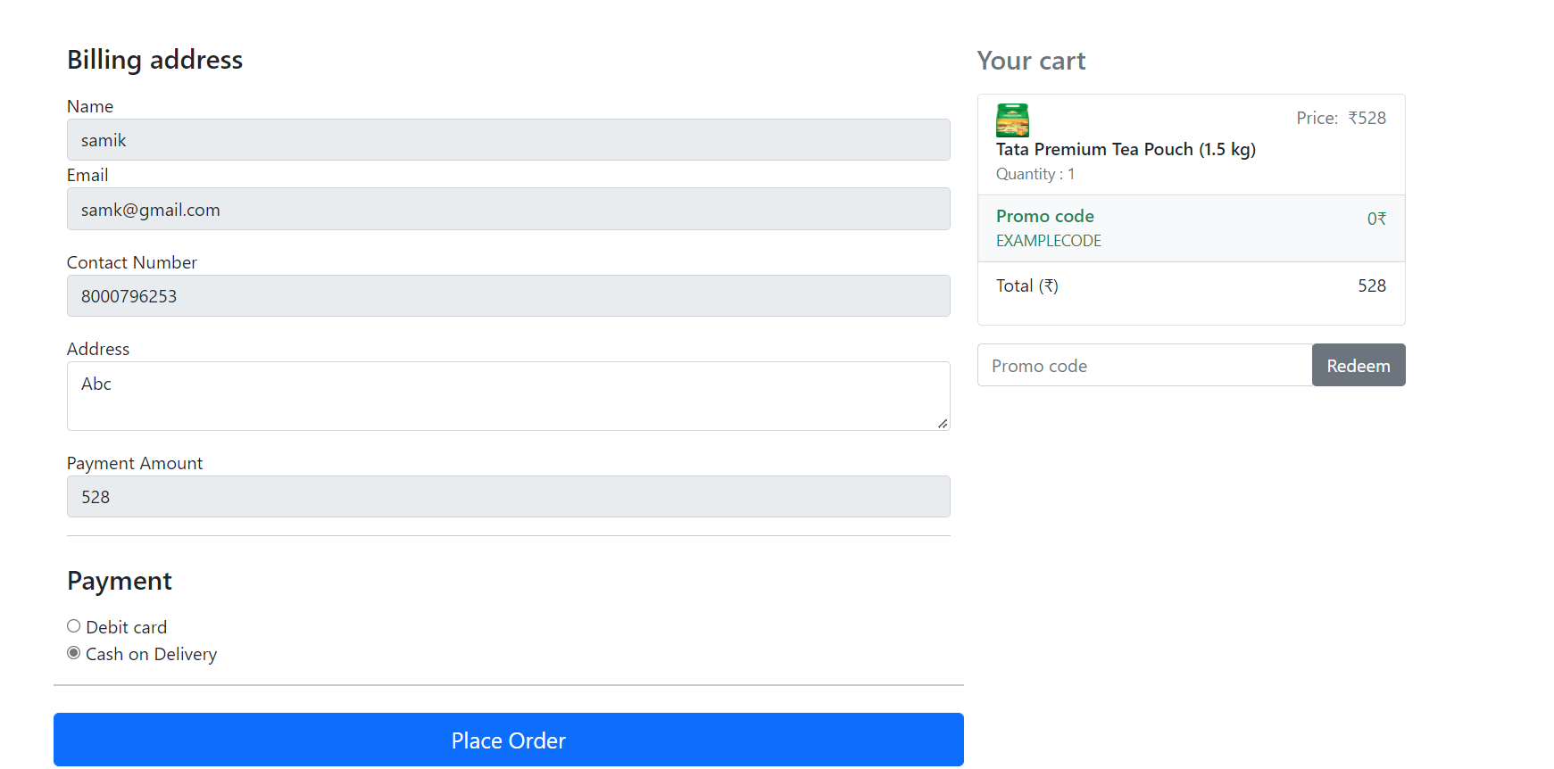
Billing :-

Slide 12
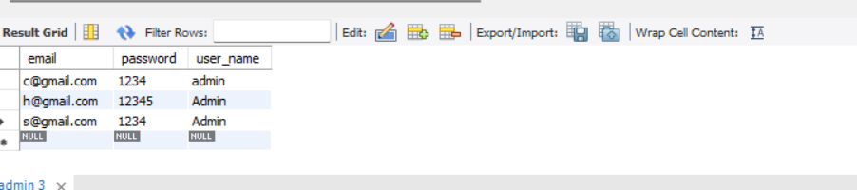
Data Added in Database:

Slide 13
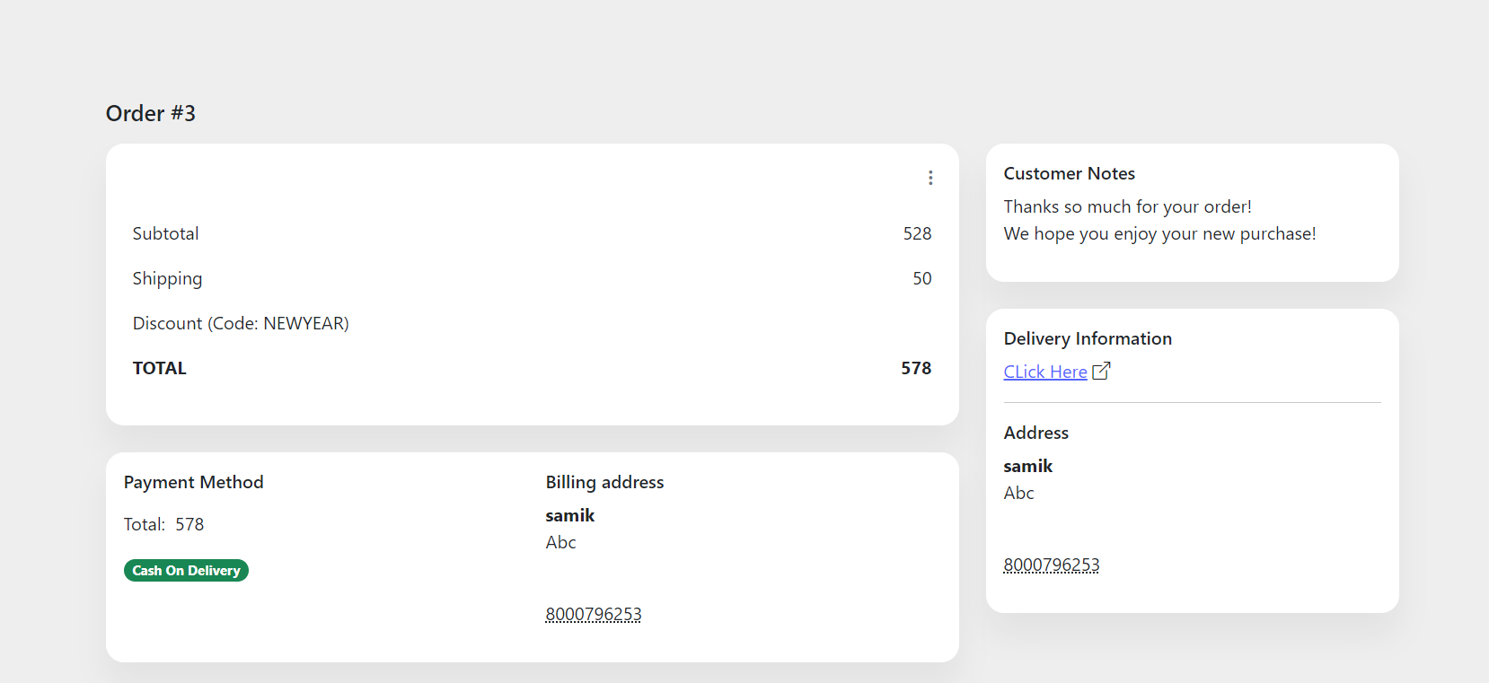
Order:

