Slide 1
Project Presentation of CO-OP Project at Industry (Module-2) (22CS421)
On
Advantages and Disadvantages of Modern Language Models
Bhuvain Jhamb | Samiksha | Daksh Chawla
Faculty Mentor: Monika Aggarwal
Supervised By
Department of Computer Science and Engineering
Department of Computer Science and Engineering,
Chitkara University, Punjab

Slide 2
Introduction
LLMs have transformed how computers process and generate language across diverse domains
Scaling model size improves benchmark performance, but real-world deployment faces physical and economic limits
Memory bandwidth, energy consumption, and infrastructure costs constrain large-scale deployment
Two key architectural paradigms: Retrieval-Augmented Generation (RAG) and Extended-Context Transformers
This study evaluates both using the Token Economics framework across multiple deployment environments
2

Slide 3
Objectives
Compare RAG and extended-context transformer architectures under real-world deployment constraints
Introduce and apply the Token Economics framework for principled efficiency evaluation
Assess productivity, energy, infrastructure scalability, and labour-market implications of LLMs
Identify optimal deployment strategies for different task types and resource environments
Provide architectural recommendations for sustainable and responsible LLM deployment
3

Slide 4
Hardware & Infrastructure Context
Memory bandwidth -- not raw compute -- is the primary performance bottleneck for LLMs in production
70B-parameter models require ~8 GPUs per rack consuming 40-60 kW, far above standard 10-20 kW infrastructure
Extended-context systems reach 95-100% memory bandwidth utilisation vs. 60-70% in conventional systems
Three deployment environments: high-performance cloud (A100/H100), edge hardware, and serverless
Infrastructure upgrade costs significantly influence which architectural paradigm is viable at scale
4

Slide 5
Architectural Paradigms: RAG vs. Extended-Context
RAG: queries external knowledge bases at inference time, reducing need to encode all knowledge in parameters
Extended-Context Transformers: expand internal context windows (up to 1M+ tokens) for in-context reasoning
RAG advantages: smaller model size, updatable knowledge, lower memory footprint, energy efficiency
Extended-context advantages: no retrieval latency, better coherent long-range reasoning on static data
Both require dedicated software stacks, GPU drivers, and inference engines for production deployment
5

Slide 6
Methodology: Token Economics Framework
Five cost dimensions: Token Processing Cost (FLOPS/token), Memory Transfer Cost (HBM accesses), Context Management Cost (KV-cache), Retrieval Cost (RAG only), Energy Cost (joules/token)
FlashAttention IO-complexity evaluation supplements FLOP counting for Memory Transfer Cost dimension
Benchmarks: MMLU for static reasoning, knowledge-intensive NLP benchmarks for dynamic knowledge tasks
Output quality measured through human preference ratings and factual accuracy assessments
Statistical analyses use generalised linear mixed models accounting for repeated measures across configurations
6

Slide 7
Experimental Design
Model scales evaluated: 7B, 13B, 30B, and 70B parameters -- covering edge to data-centre deployments
RAG experiments vary corpus size (1M-100M docs), retrieval type (dense vs. sparse), and top-K (5-10)
Extended-context experiments vary sequence length from 8K up to 1M tokens with different attention mechanisms
Active engagement: GitHub Copilot study with 95 professional developers
Passive engagement: global study with 844 participants across 48 countries using Alternate Uses Task
7

Slide 8
Tools & Technologies
Original Transformer (Vaswani et al.): self-attention enables parallel sequence processing -- foundation of all LLMs
RAG (Lewis et al.): external retrieval augments generation; smaller models match larger parametric ones
Longformer (Beltagy et al.): sparse attention for efficient long-document processing
Infini-attention: integrates compressive memory for effectively infinite context with bounded memory usage
Ring Attention (Liu et al.): distributed blockwise computation enabling 500K+ token sequences across devices
8

Slide 9
Implementation Results: Memory & Energy
KV-cache for a 70B model at 1M tokens requires approximately 150 GB of GPU memory
Extended-context models consume 3-5x more energy per token than RAG on equivalent long-sequence tasks
Infini-attention achieves 114x compression ratio vs. Memorizing Transformers with bounded memory
FlashAttention reduces memory IO complexity, enabling longer effective sequences at lower bandwidth cost
Ring Attention extends effective context to 1M+ tokens for 7B models on 32-node A100 clusters
9

Slide 10
Architecture Performance Comparison
Static reasoning (MMLU): 13B extended-context transformer matches performance of a 70B standard model
Dynamic knowledge: 7B RAG model achieves within 2% accuracy of 70B parametric model using 90% less memory
Hybrid (13B, 32K context + RAG): 95% reasoning, 98% knowledge task performance, 50% memory reduction
Hybrid architecture achieves 80% energy efficiency improvement over pure extended-context approach
RAG retrieval latency: 10-20 ms per query over 100M documents (5-10% of total inference time)
10

Slide 11
Major Findings: Productivity & Labour Impact
GitHub Copilot study: 95 developers completed tasks 55.8% faster with AI assistance
Global passive exposure study: AI-generated ideas boosted collective creativity diversity across 48 countries
LLMs demonstrated multilingual utility: translation of scientific articles into 28 languages preserving JATS XML structure
Observed exposure rates: Computer Programmers (75%), Customer Service Reps (71%), Data Entry Keyers (67%), Financial Analysts (61%)
A hiring chill observed in highly exposed occupations -- practical automation is outpacing theoretical predictions
11

Slide 12
Major Findings: Environmental & Economic Sustainability
Transitioning to RAG and hybrid architectures can reduce per-query energy consumption by up to 80%
Policy mechanisms: carbon pricing, mandatory energy-use transparency reporting, sustainable procurement in government contracts
Current LLM deployments realise only 15-30% of theoretical automation capability (Observed-Exposure Gap)
Gap between infrastructure investment and observed automation raises fundamental return-on-investment concerns
Efficient architectures reduce resource dependency, enabling wider deployment and mitigating capability concentration risks
12

Slide 13
Quality, Reliability & Systemic Risk
LLMs generate fabricated or inaccurate citations at rates of 47-73% in medical and academic contexts
RAG systems structurally reduce hallucination by grounding generation in retrieved, verifiable documents
Concentration of LLM infrastructure in resource-rich entities creates systemic risks and capability monopolisation
RAG and hybrid architectures are more distributable, reducing single-point-of-failure risk in AI systems
Quality challenges remain severe for high-stakes domains: medicine, law, scientific communication, and education
13

Slide 14
Conclusion
Token Economics framework reveals that the practical performance ceiling is determined more by hardware than architecture
RAG architectures are superior for dynamic, knowledge-intensive tasks under bandwidth and energy constraints
Extended-context transformers excel at static reasoning tasks requiring persistent long-range context coherence
Hybrid architectures (32K-100K context + RAG) offer the best overall efficiency profile across diverse task types
Responsible, efficient architectural design is as critical as raw model capability for sustainable AI deployment
14

Slide 15
Future Scope & Limitations
Adaptive architectures dynamically selecting between extended-context and retrieval based on per-query task requirements
Co-design of hardware and LLM architectures targeting memory bandwidth efficiency at silicon level
Real-time RAG with sub-millisecond retrieval for latency-critical production deployments
Study excludes trillion-parameter models; generalisation to those architectures requires further investigation
Future directions: training efficiency, multi-modal extensions, quantisation impact on Token Economics metrics
15

Slide 16
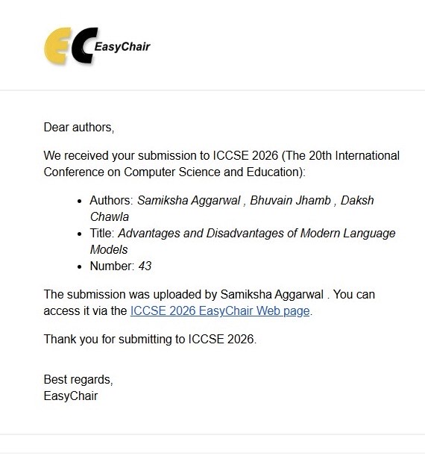
Conference Submission Confirmation
ICCSE 2026 — 20th International Conference on Computer Science and Education — Paper #43
16

Slide 17
Thank You
17

