Slide 1
CR
CreditRisk IQ
Home Credit Default Risk · 307,511 applications
AI-POWERED
Credit Risk Intelligence Platform
Not just a model — a credit decision system: scored, explained, defensible, auditable, and queryable in plain English.
Samiksha Batra
AI Engineer — Candidate Assignment
Live demo https://ai-powered-credit-risk-intelligence-platform-8eftb3rvzqybqg2pj.streamlit.app/
Repository https://github.com/Samikshabatra/AI-Powered-Credit-Risk-Intelligence-Platform

Slide 2
BUSINESS CONTEXT
Faster credit decisions the bank can defend
Lenders must decide quickly and accurately — and, increasingly, explain and audit every decision. The platform targets six real needs in one workflow.
1
Spot risk early
2
Automate scoring
3
Explain decisions
Flag high-risk applicants before approval
Straight-through decisions with a risk band
Principal reasons for every classification
4
Satisfy audit
5
Analysts in plain English
6
Bridge ML & policy
Traceable, regulator-ready decision path
Query the portfolio without SQL
Model insight expressed as credit rules
CreditRisk IQ · NeoStats — AI Engineer Assignment
1

Slide 3
SOLUTION OVERVIEW
One pipeline, end to end
1
Data
2
Preprocess
3
Model
4
Decision
loader + bureau / prev-app aggregates
sentinel repair, 19 engineered features
LightGBM + isotonic calibration
cost-optimal threshold, risk band
5
Explain
6
Rules
7
Talk-to-Data
8
Interface
SHAP → adverse-action reasons
depth-4 surrogate policy
self-correcting NL→SQL agent
orchestrator agent + Streamlit UI
Runs two ways from one image — docker compose up for the local grader, and a deployed public URL. SQLite is read-only at query time.
CreditRisk IQ · NeoStats — AI Engineer Assignment
2

Slide 4
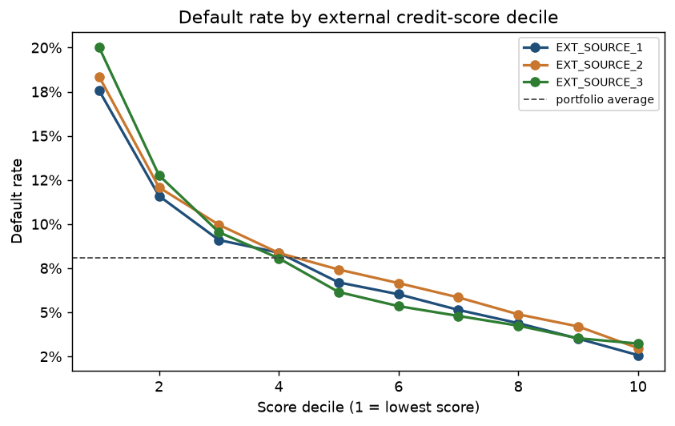
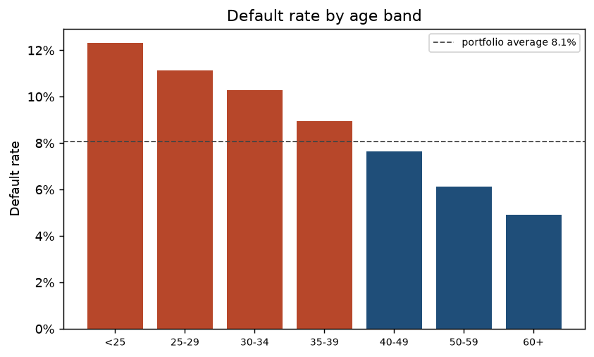
DATA UNDERSTANDING & EDA
Five insights, and one that changes the model
The finding worth reading
DAYS_EMPLOYED = 365243 on 18% of rows is a “not employed” sentinel, not a 1000-year career.
99.96% are pensioners — who default at 5.4%, below the 8.7% employed average.
Repaired in the preprocessor, the semantic layer and the EDA, so it can never leak back.
External bureau scores — the strongest signal
Default rate by age band (monotone)
307,511
8.07%
143
18%
applications
default base rate
features (19 engineered)
sentinel rows repaired
CreditRisk IQ · NeoStats — AI Engineer Assignment
3

Slide 5
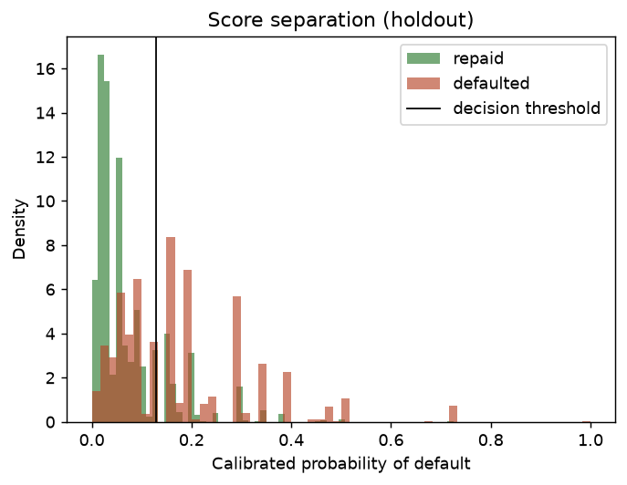
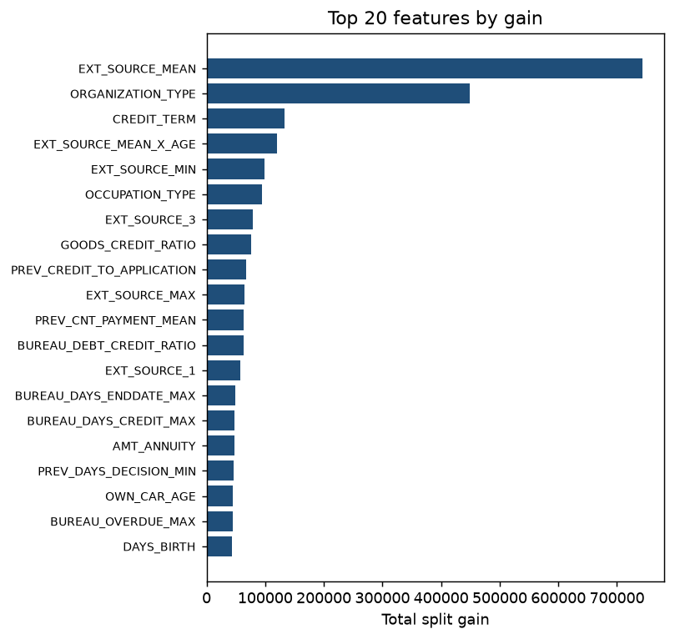
MACHINE LEARNING LAYER
An honest pipeline built for imbalance
LightGBM — native NaN handling (missingness is signal) and native categoricals (no 200-column one-hot); SHAP-friendly.
Class imbalance via scale_pos_weight = 11.39, not SMOTE — synthesising minority rows across categorical codes invents applicants that cannot exist.
Four disjoint stratified splits so no number is reported on data that shaped it.
Missing values kept as NaN — “no bureau record” and “no external score” are themselves predictive.
Split | Share | Used for
Train | 60% | Fit the booster
Valid | 10% | Early stopping
Calib | 10% | Calibrator + threshold
Holdout | 20% | Every headline number
scale_pos_weight 11.39 · 1,190 boosted trees · isotonic calibration
CreditRisk IQ · NeoStats — AI Engineer Assignment
4

Slide 6
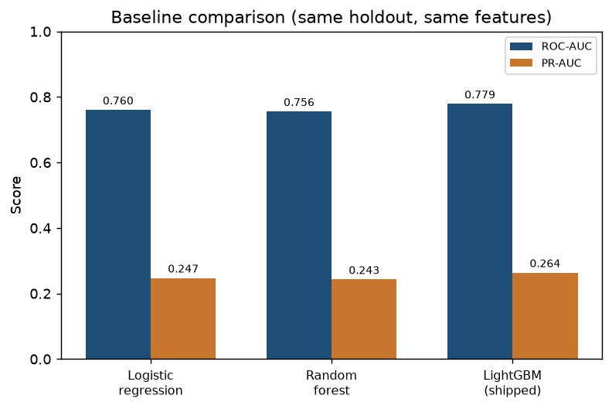
MODEL PERFORMANCE
Measured on 61,503 unseen applicants — and versus baselines
0.7788
0.2637
0.415
3.66×
Holdout ROC-AUC
PR-AUC (8% base rate)
KS statistic
Top-decile lift
Model | ROC-AUC | PR-AUC | KS
Logistic regression (balanced) | 0.7605 | 0.2474 | 0.389
Random forest (balanced) | 0.7557 | 0.2430 | 0.380
LightGBM (shipped) | 0.7788 | 0.2637 | 0.415
Same holdout, same features, same seed — LightGBM wins both metrics; the linear model reaching 0.76 shows the signal is largely additive.
Holdout ROC-AUC & PR-AUC by model
CreditRisk IQ · NeoStats — AI Engineer Assignment
5

Slide 7
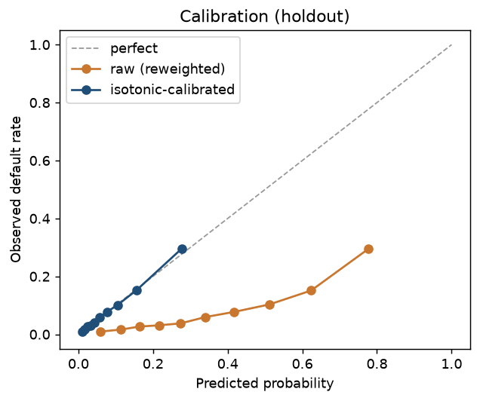
CALIBRATION
Probabilities you can price a portfolio on
Imbalance reweighting fixes the ranking but wrecks the probabilities — the raw model predicts ~46% average risk against an actual 8.1%.
Isotonic regression, fitted on a split used for nothing else, restores them without reordering a single applicant.
Now “0.30” means 30 defaults per 100 — the number a lender prices against.
0.160 → 0.066
0.269 → 0.004
Brier score
Expected calibration error
Reliability curve — raw vs isotonic-calibrated (holdout)
CreditRisk IQ · NeoStats — AI Engineer Assignment
6

Slide 8
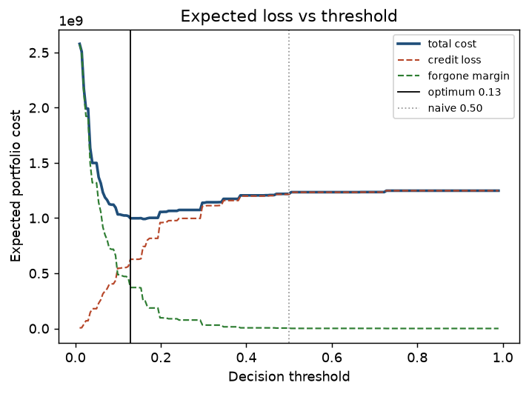
COST-SENSITIVE DECISIONING
The threshold is 0.129, not 0.50
A false negative costs 45% of the loan (loss given default); a false positive 8% (forgone margin) — each weighted by that applicant’s exposure.
The threshold that minimises expected loss is 0.129, approving 81.4% of applicants.
Policy | Expected loss | Saving
Approve everyone | $1.25 B | $250 M
Naive 0.50 threshold | $1.22 B | $221 M
Cost-optimal 0.129 | $998 M | —
Expected portfolio loss vs decision threshold
Risk bands anchored on economics: Low < 6.4% Medium 6.4–12.9% High ≥ 12.9%
CreditRisk IQ · NeoStats — AI Engineer Assignment
7

Slide 9
EXPLAINABLE AI
Every decline gets its principal reasons
SHAP TreeExplainer — exact for tree ensembles, milliseconds per applicant.
Adverse-action reason codes under ECOA / Reg-B: SHAP contributions become the plain-English reasons a lender must legally give a declined applicant.
Two layers: deterministic templates first, LLM as a stylist over those facts — it cannot invent a reason the model did not produce.
Protected attributes are suppressed from the notice and reported separately.
SAMPLE ADVERSE-ACTION NOTICE
Decision: Decline
High risk — 38.3% probability of default (threshold 12.9%).
Principal reasons
1. External credit scores are below the approved-applicant average.
2. The implied repayment term is longer than typical.
3. A high share of previous applications were refused.
Gender and age were excluded from these reasons by policy.
CreditRisk IQ · NeoStats — AI Engineer Assignment
8

Slide 10
BUSINESS RULES
The model, expressed as credit policy
A 1,190-tree ensemble is not policy. A depth-4 tree fitted to the model’s own decisions is — its leaves read back as IF-THEN rules, each with support, precision and lift.
Rule (IF … THEN decline) | Support | Default rate | Lift
Avg external score ≤ 0.26 AND weakest ≤ 0.18 | 5.1% | 28.2% | 3.50×
0.26 < avg score ≤ 0.36 AND weakest ≤ 0.18 | 4.5% | 18.7% | 2.33×
Avg score ≤ 0.36 AND weakest > 0.18 AND low down-payment cover | 3.6% | 16.8% | 2.09×
14
81.2%
Numeric only
No protected
IF-THEN rules
Surrogate fidelity
no encoding artefacts
attributes in rules
CreditRisk IQ · NeoStats — AI Engineer Assignment
9

Slide 11
TALK-TO-DATA · NL → SQL
Ask in plain English, get SQL-backed answers
Q. Which 5 occupations have the highest default rate (≥ 1000 applicants)?
SELECT OCCUPATION_TYPE, AVG(TARGET) AS default_rate, COUNT(*)
FROM applications
WHERE OCCUPATION_TYPE IS NOT NULL
GROUP BY OCCUPATION_TYPE
HAVING COUNT(*) >= 1000
ORDER BY default_rate DESC LIMIT 5;
A. Low-skill labourers lead at 17.2%, followed by drivers (11.3%) and waiters/barmen (11.3%).
Self-correcting agent — on a SQL error the message goes back to the model, which rewrites the query.
Semantic layer pins canonical metric definitions so the model never re-invents “default rate”.
Four guardrail layers: SELECT-only allowlist, keyword denylist, table allowlist, read-only connection.
NL→SQL eval (25 cases)
Execution accuracy | 100%
Answer accuracy | 90.5%
Fallback / injection caught | 100%
Retry rate | 0%
CreditRisk IQ · NeoStats — AI Engineer Assignment
10

Slide 12
AGENTIC ORCHESTRATOR
The Decision Trace — every module in one screen
One chat surface routes to six tools. For any applicant the whole chain renders top to bottom — the platform’s answer to “auditable”.
1
Applicant #170169
143 features · 19 engineered · sentinel repaired
2
Risk model
raw score 0.859 (LightGBM, 1,190 trees)
DECISION
DECLINE
Reduced limit
+ collateral only
3
Calibration
38.3% probability of default
4
Decision threshold
decline at or above 12.9% (cost-optimal)
5
Risk band
HIGH
6
Explanation
low external scores · long term · 75% prior refusals
7
Policy rule
avg score ≤ 0.26 → DECLINE (lift 3.50×)
CreditRisk IQ · NeoStats — AI Engineer Assignment
11

Slide 13
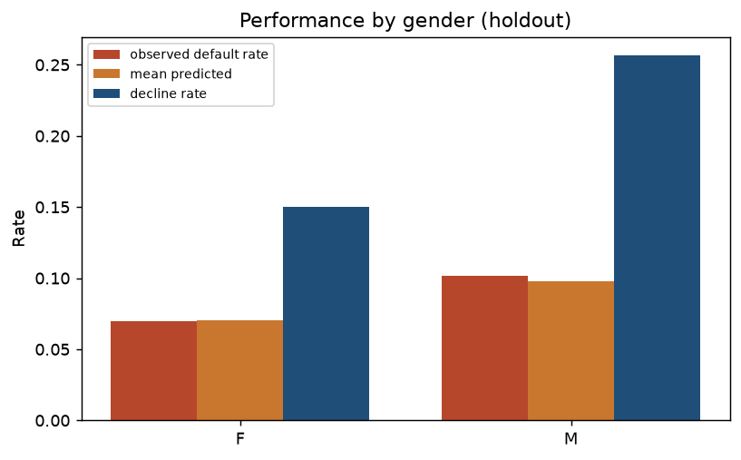
MODEL HEALTH & FAIRNESS
Governance measured, not hidden
Approval-rate gap of 10.7pp by gender and 30.5pp by age band — published on screen, not silently absorbed.
Which parity to equalise is a legal and policy choice, so the platform measures rather than quietly “fixes” it.
Distribution shift is labelled honestly: the dataset has no time axis, so it is a split check, not fake “drift”.
10.7 pp
30.5 pp
Gender approval gap
Age-band approval gap
Group performance by gender (holdout)
CreditRisk IQ · NeoStats — AI Engineer Assignment
12

Slide 14
ENGINEERING QUALITY
Optimised, guarded, tested, containerised
60.6%
124
4-layer
Multi-stage
Input-token saving (prompt caching)
Automated tests passing
SQL guardrails
Docker + compose
Prompt & token optimisation
Reliability & delivery
Stable prefix (schema + metrics + exemplars) cached with cache_control — 72.3% cache-hit rate on the live run.
Cheap model summarises result rows; the strong model’s context never grows by them.
Hallucination control: schema-grounding, semantic layer, and a hard CANNOT_ANSWER fallback.
Tests span guardrails, semantic-layer SQL run against the live database, and compliance checks (no protected attribute ever surfaces as a reason).
Multi-stage build, non-root user, health-check; docker compose up runs the whole app.
Artifacts and dataset are git-ignored — never committed.
CreditRisk IQ · NeoStats — AI Engineer Assignment
13

Slide 15
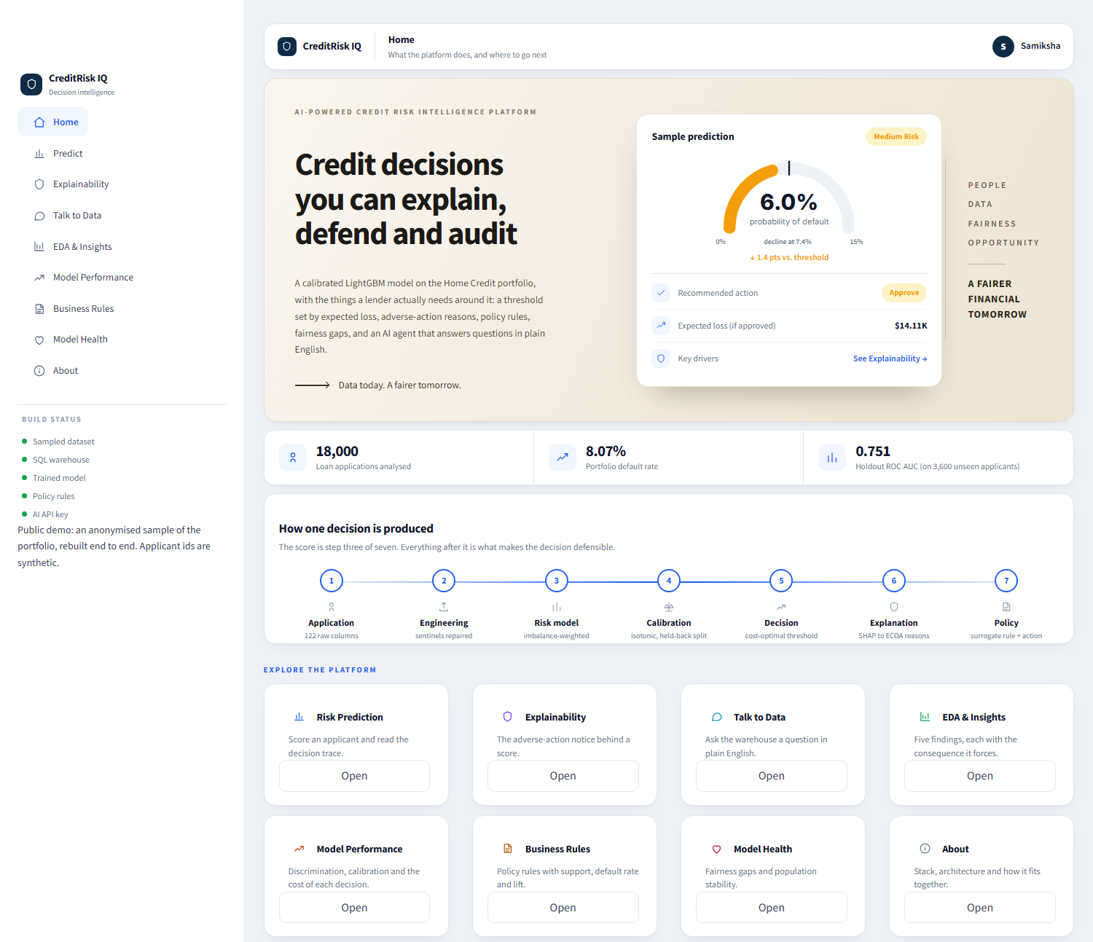
DEPLOYMENT & LIVE DEMO
One image, two ways to run
ai-powered-credit-risk-intelligence-platform-…streamlit.app
Local grader: docker compose up runs the full app from one command.
Public link: deployed on Streamlit Community Cloud, live and shareable.
The API key is injected at runtime as a host secret — never in the image or git.
Public demo runs an anonymised 18k-row sample (ROC-AUC 0.751); the full model scores 0.7788.
LIVE DEMO
https://ai-powered-credit-risk-intelligence-platform-8eftb3rvzqybqg2pj.streamlit.app/
CreditRisk IQ · NeoStats — AI Engineer Assignment
14

Slide 16
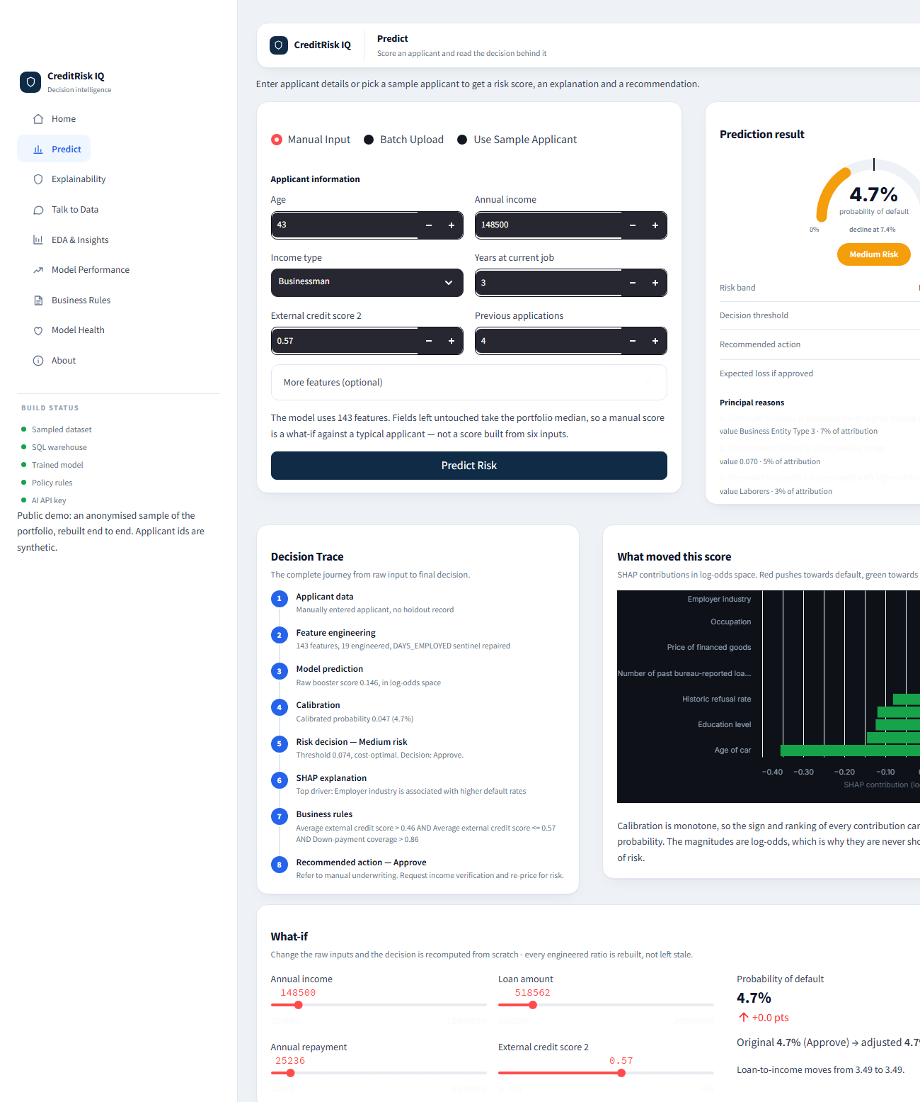
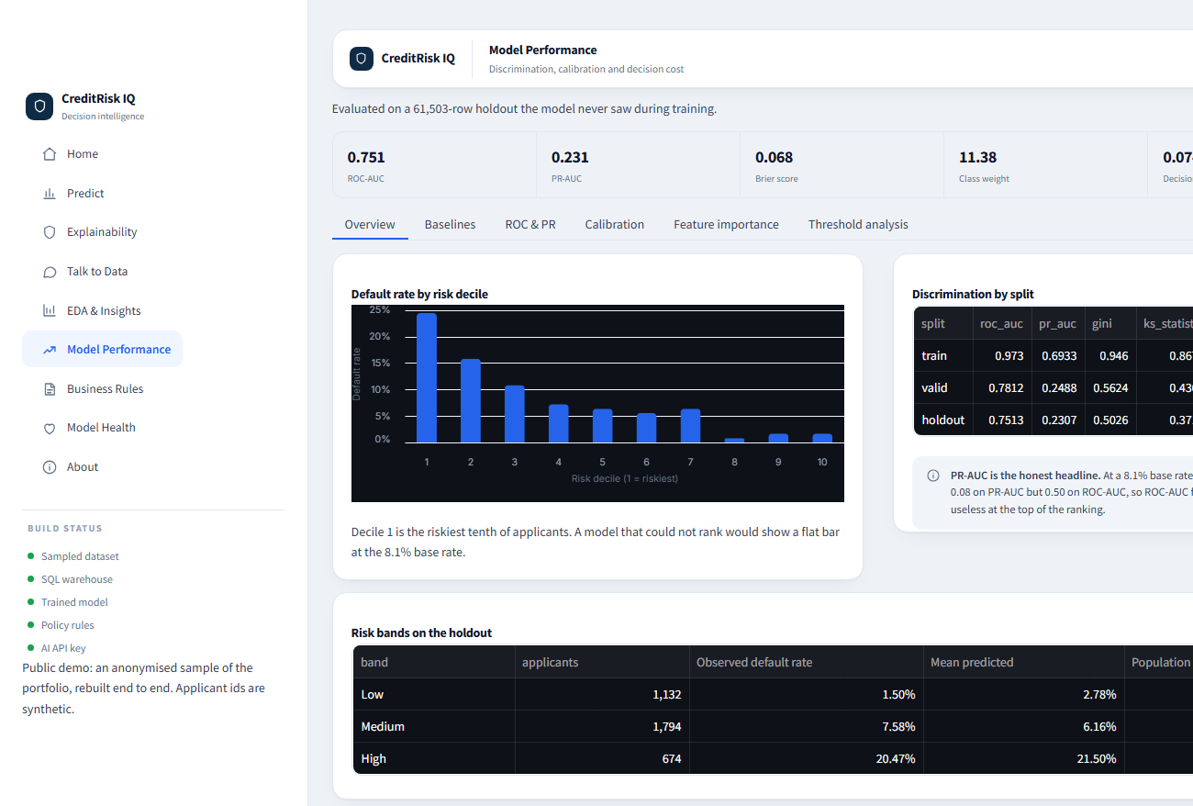
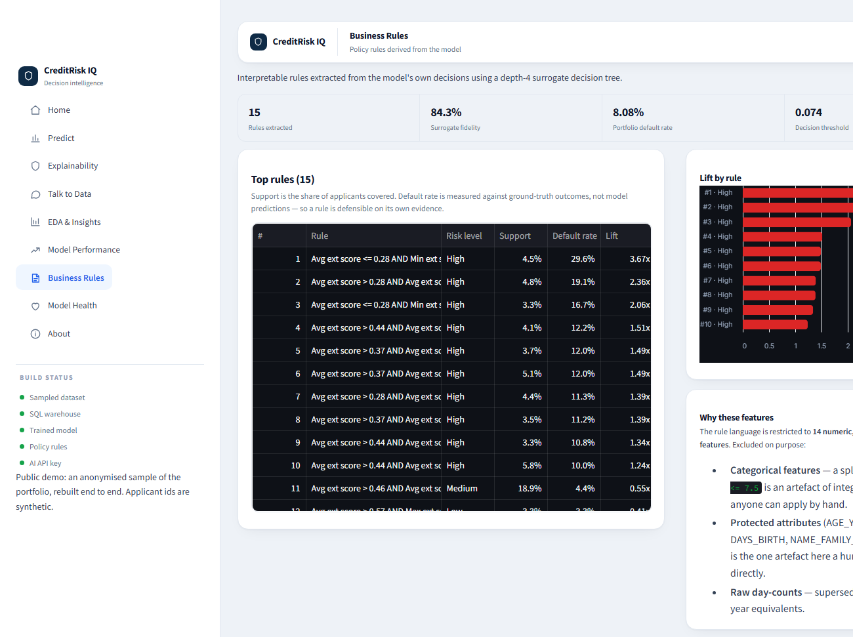
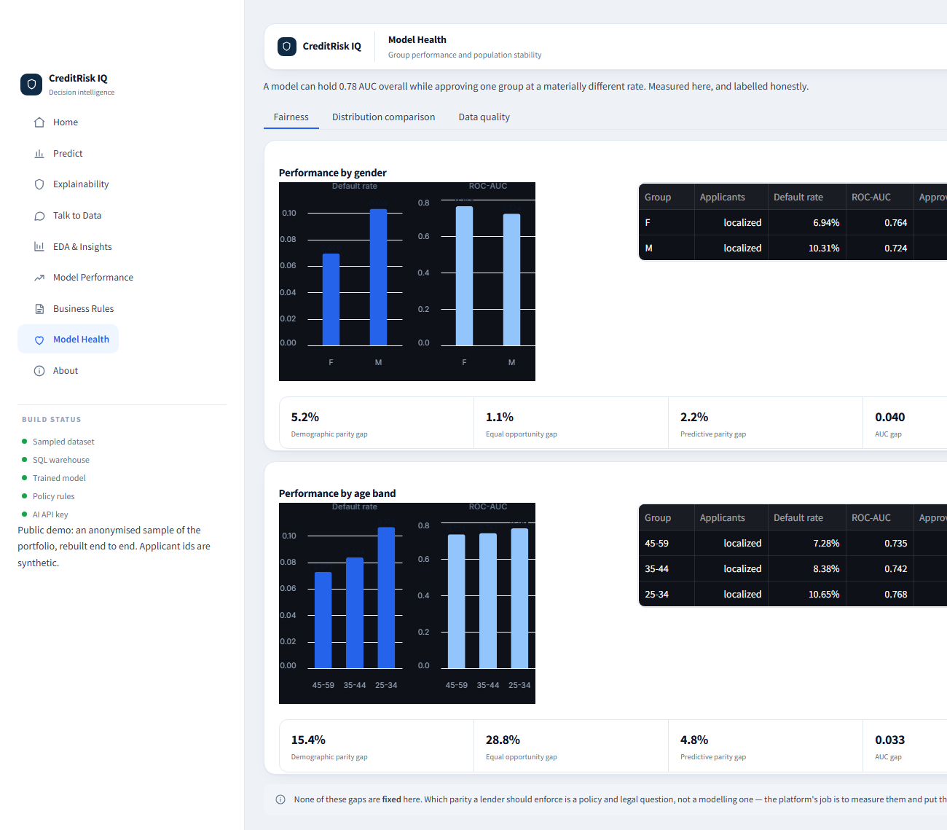
THE PLATFORM IN USE
Real output from the deployed app
Predict — risk gauge, Decision Trace, SHAP and what-if
Model Performance — discrimination, risk bands, splits
Business Rules — derived policy with support and lift
Model Health — fairness gaps measured by group
CreditRisk IQ · NeoStats — AI Engineer Assignment
15

Slide 17
OUTCOME
Results, limitations and what comes next
What was delivered
Known limitations
Future work
Calibrated 0.7788-AUC model
Cost-optimal threshold — $221M saved vs 0.50
SHAP adverse-action reason codes
14 auditable policy rules
Self-correcting NL→SQL agent (100% execution)
Fairness measured and published
Dockerised and deployed live
No temporal validation — one snapshot, no time axis.
Cost matrix (LGD 45% / margin 8%) is assumed, not sourced.
Fairness is measured, not mitigated.
Reason codes need a human / counsel review loop.
AUC ceiling ~0.78 on the three tables used.
Add installments-payment features.
Per-segment thresholds (cash vs revolving).
Reject-inference for survivorship bias.
A real drift monitor once time-ordered data exists.
CreditRisk IQ · NeoStats — AI Engineer Assignment
16

Slide 18
CR
CreditRisk IQ
Thank you
A credit decision system a bank could actually deploy — scored, explained, defensible, auditable.
Samiksha Batra · AI Engineer — NeoStats Assignment
Live demo https://ai-powered-credit-risk-intelligence-platform-8eftb3rvzqybqg2pj.streamlit.app/
Repository https://github.com/Samikshabatra/AI-Powered-Credit-Risk-Intelligence-Platform

