Slide 1

MongoDB vs PostgreSQL
A comprehensive analysis
Samiksha Burkul, Rachel Culbreath, and Krishnasurya Gopalakrishnan

Slide 2

What is MongoDB?
It is an open-source NoSQL (non-relational) database management system
It is a document-oriented database
Designed to store, query, and manage large volumes of data in a flexible and scalable manner
It is schema-less meaning that documents in a collection can have different fields and structures
Notes:
MongoDB is a popular, open-source, NoSQL database that stores data in a flexible, document-based format using JSON-like documents. It's known for its scalability, high performance, and flexibility in handling unstructured or semi-structured data. MongoDB uses a flexible data model, making it suitable for a wide range of applications and allows for easy scalability in distributed environments.

Slide 3

What is PostgreSQL?
It is an open-source Relational Database Management System (RDBMS)
It supports SQL (Structured Query Language) for working with relational databases
Highly scalable allowing clustering, partitioning and replication
Supports a wide range of datatypes from arrays to JSON
Supports foreign keys and constraints

Slide 4
Dataset Overview
Liquor sales in the US by county
Contains over 5 million records with 23 columns
Each row is an invoice record
Columns include information on: invoice details, shops and vendors, specifications of items sold
Notes:
Overview of the Dataset - Liquor Sales in the US by County
Encompasses over 5 million records across 23 columns
Each row represents an invoice record
Columns entail comprehensive details: invoice specifics, shop and vendor information, and item specifications

Slide 5
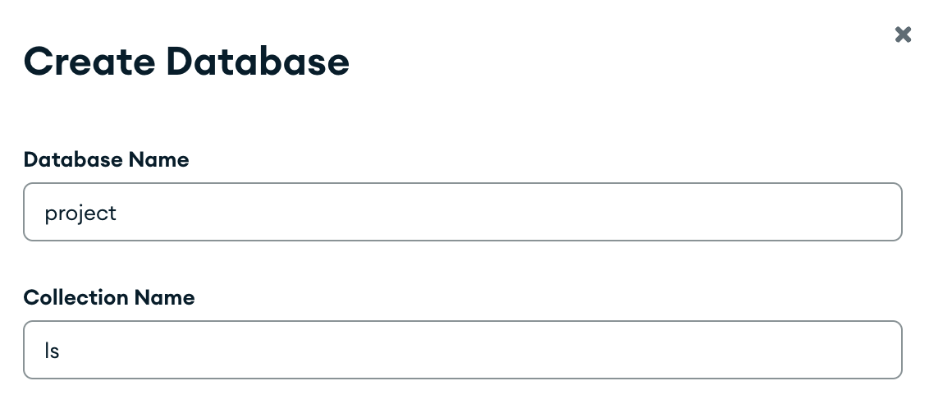
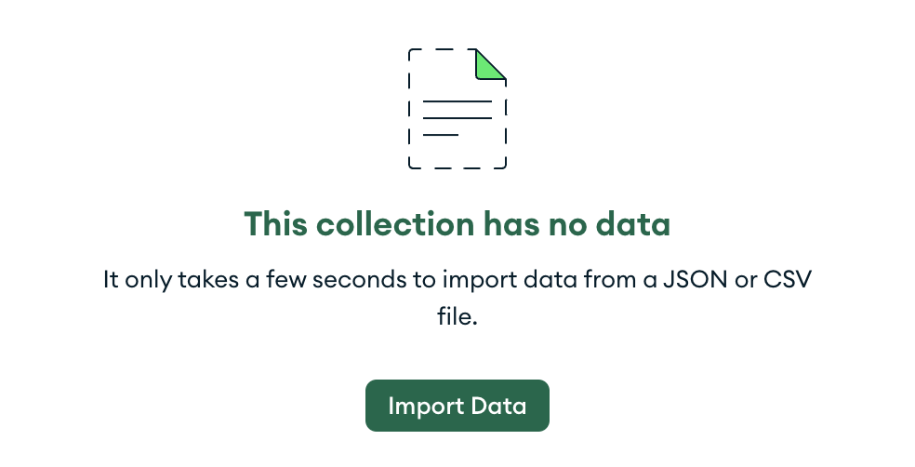
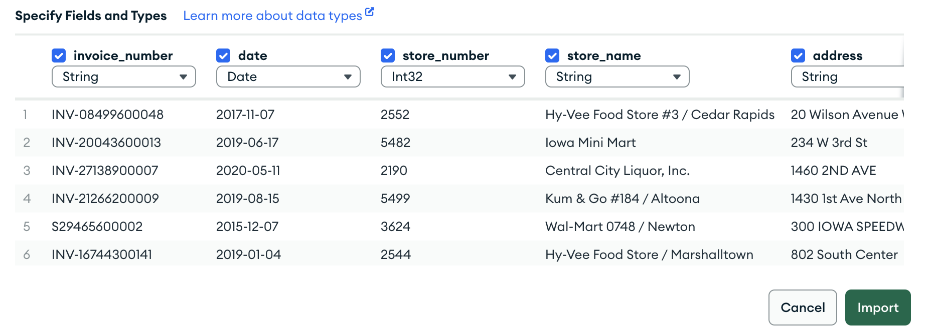
Setting up the database in MongoDB
Manually create a DB in MongoDB using MongoDB Compass
Within the empty collection, click on ‘Import Data’ and choose the file from local computer
Click on import again in the following screen

Slide 6
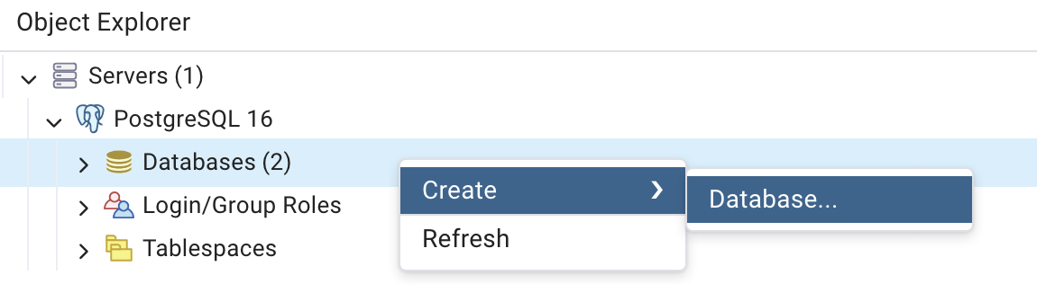
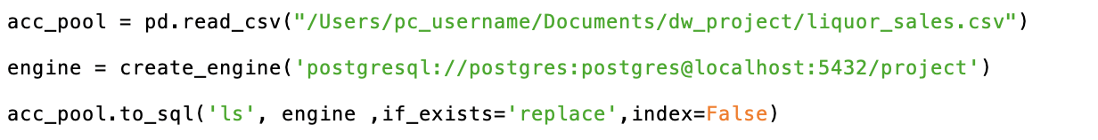

Setting up the database in PostgreSQL
Manually create a DB in Postgres from the ‘Object Explorer’
Run the following python script to load the csv file from local computer to the postgres
Run the following Postgres command to alter the date column type from ‘text’ to ‘date’

Slide 7
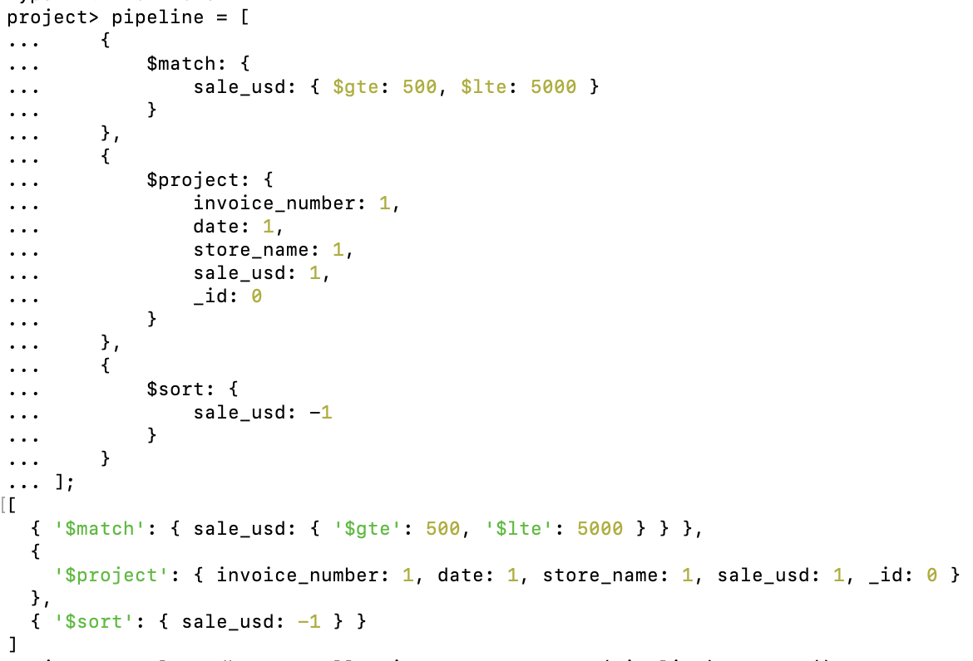
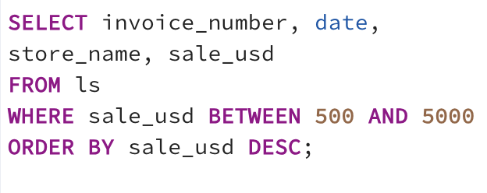
Query 1: What are the sales that are between 500 and 5000 USD?
MongoDB
PostgreSQL

Slide 8
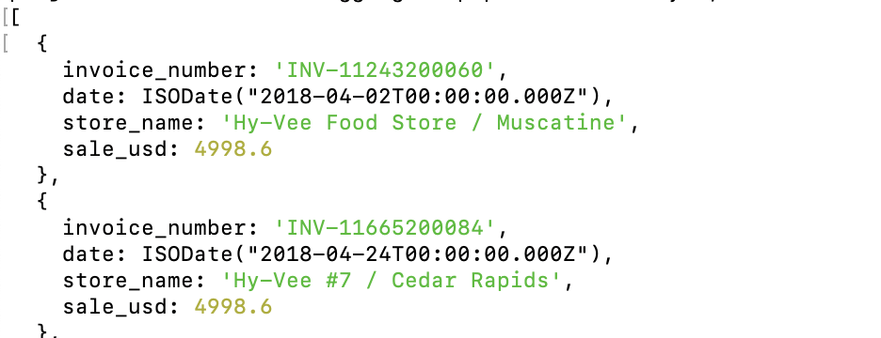
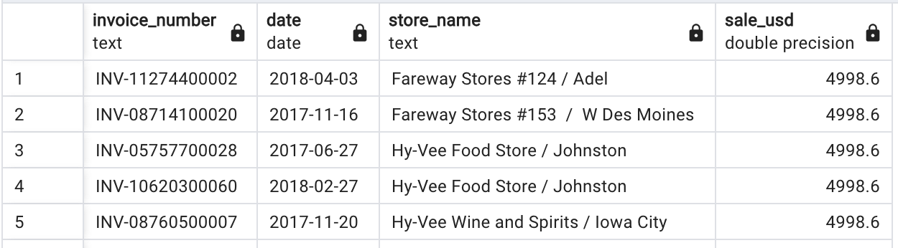
Output 1: Sales between 500 and 5000 USD
MongoDB
PostgreSQL

Slide 9
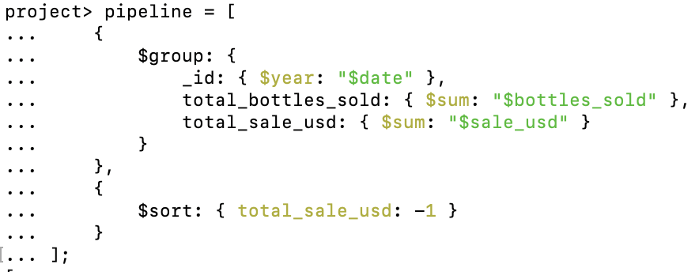
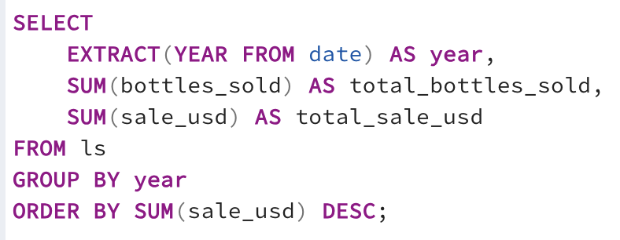
Query 2: Which years made the most profit?
MongoDB
PostgreSQL

Slide 10
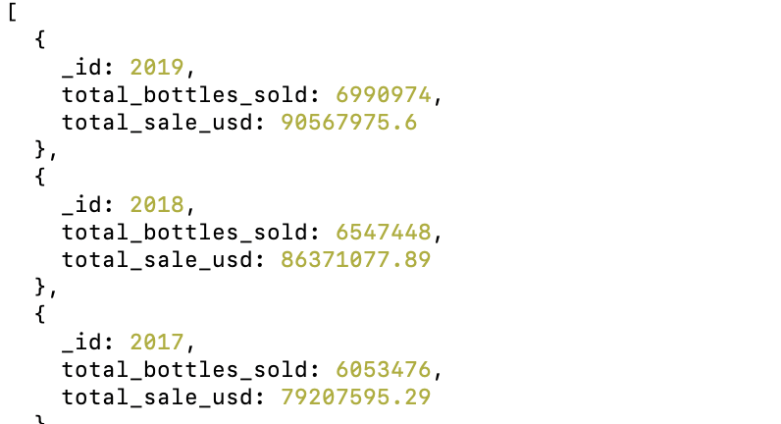
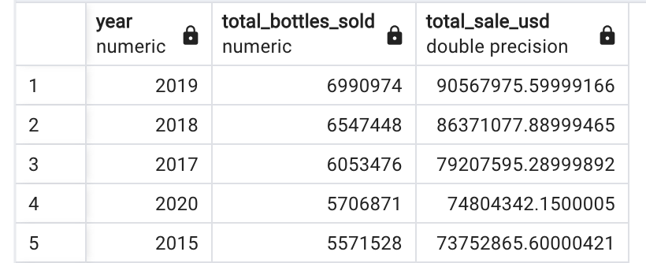
Output 2: Which years made the most profit?
MongoDB
PostgreSQL

Slide 11
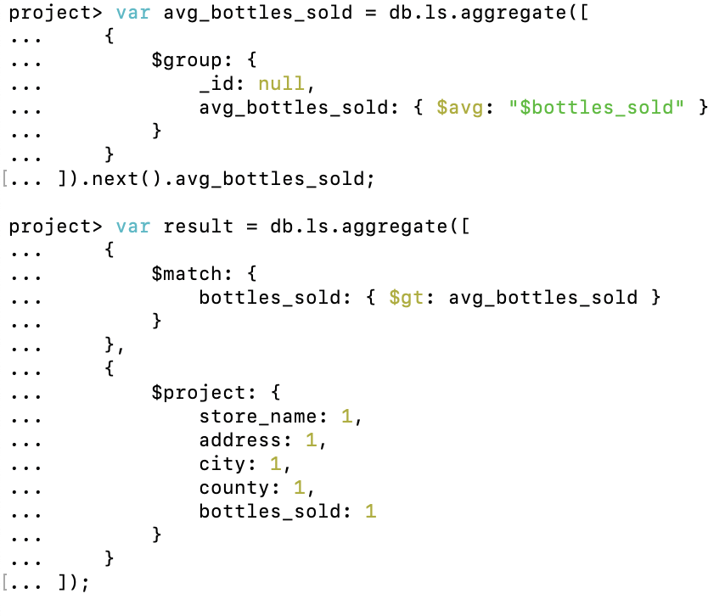
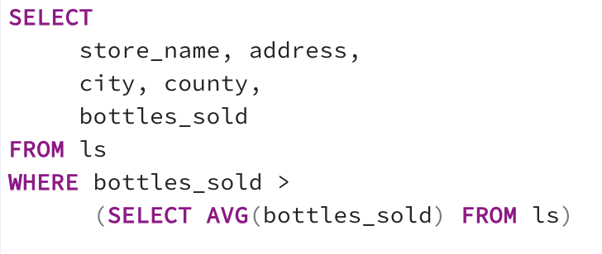
Query 3: Which stores sold more bottles than the average?
MongoDB
PostgreSQL

Slide 12
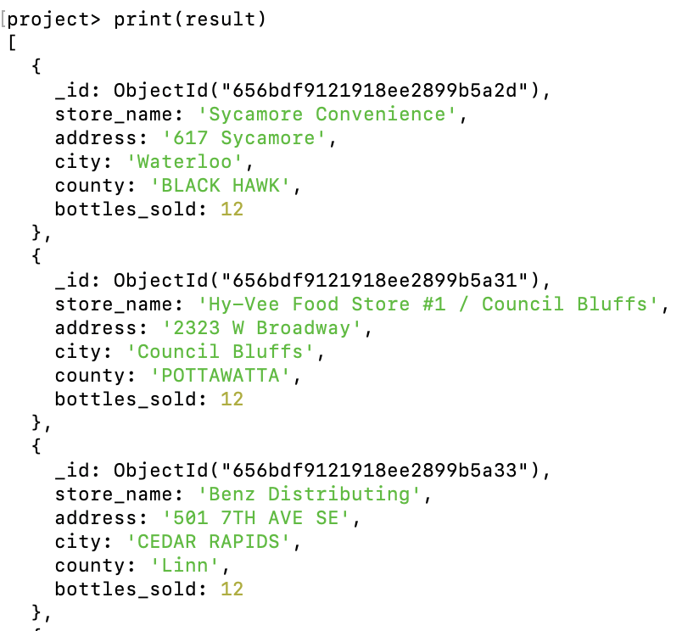
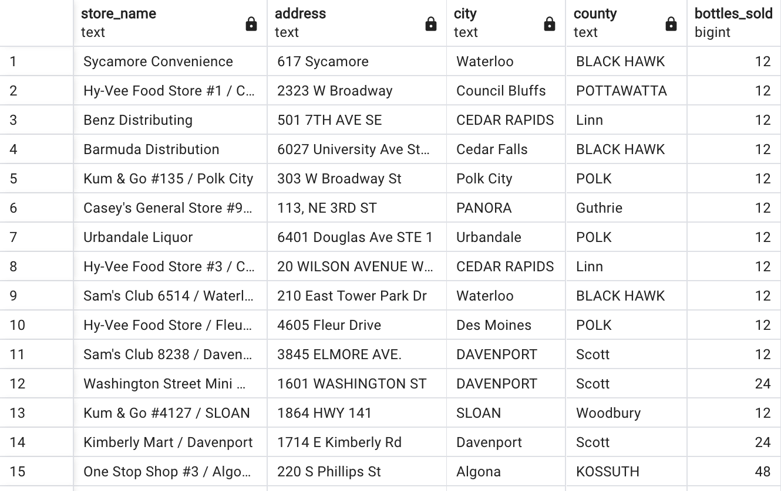
Output 3: Stores with more bottle sales than the average
MongoDB
PostgreSQL

Slide 13
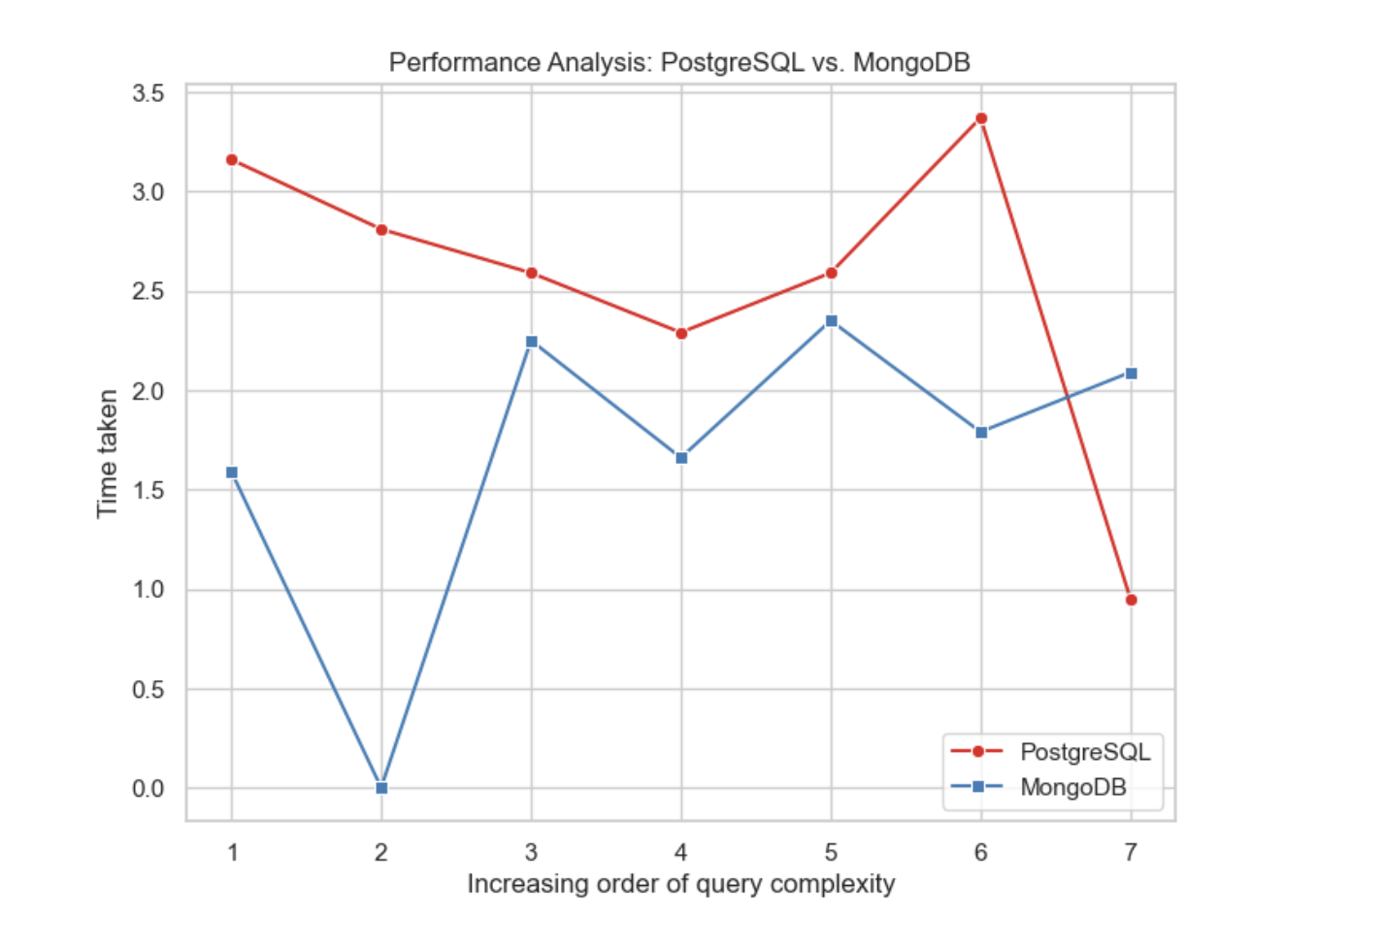
Performance Analysis
PostgreSQL | MongoDB | % comparison
3.16 | 1.59 | 97.8%
2.81 | 0.006 | significantly faster
2.59 | 2.25 | 15.07%
2.29 | 1.66 | 37.67%
2.59 | 2.35 | 10.04%.
3.37 | 1.79 | 87.75%
0.95 | 2.09 | 54.23% (slower)

Slide 14
Thank you!

