Slide 1
Multi-Platform Learning Quiz Application
Presented by:
Samiksha Dhanya G (192321014)
ITA0302 MOBILE COMPUTING FOR 5G TECHNOLOGY
Supervisor: Dr K Ramesh kumar
Department of Nxt-Gen Computing
Date: 14-05-2025

Slide 2
Agenda
INTRODUCTION
LITERATURE REVIEW
OBJECTIVE
METHODOLOGY USED
RESULTS AND DISCUSSION
SAMPLE CODE
SAMPLE OUTPUT SCREEN
CONCLUSION
REFERENCES

Slide 3
Introduction
A cross-platform educational app developed using React Native.
Enables students to practice and test their knowledge through quizzes.
Accessible Android, and iOS – ensuring learning anytime, anywhere.
Cross-platform quiz app built with React Native for iOS & Android
Provides multiple-choice questions with varying difficulty levels
Real-time feedback using vibration on incorrect answers
Minimalist and visually appealing user interface for better UX

Slide 4
Literature Review
Existing educational apps (e.g., Kahoot, Quizizz) focus on engagement but lack offline capabilities or personalization.
Studies show gamified quizzes improve retention and motivation (Smith et al., 2020).
Need identified for a lightweight, responsive quiz app suitable for both Android and IOS use.
Most have static UI and limited difficulty levels
Brain Train fills the gap with dynamic features and engaging UX
Uses modern frameworks like React Native CLI for native performance

Slide 5
Objective
To design and develop a responsive, user-friendly quiz app accessible on multiple platforms.
To promote interactive learning and self-assessment.
Provide questions with categorized difficulty levels
Enhance UX with vibration feedback for wrong answers
Offer an intuitive and visually appealing interface to ensure usability for users of all age groups and technical backgrounds.
Include informative sections like FAQs and About to guide users and improve overall app accessibility and transparency.

Slide 6
Methodology used
Frontend: React Native, JavaScript, TypeScript
Navigation: React Navigation
Feedback: React Native Vibration API
Designed using minimalist UI principles with CSS styling
Modular component-based architecture
State Management with React Hooks.
Asset Management for Screens and Questions.

Slide 7
Result and Discussion
Successfully developed quiz app with splash and loading screens.
Implemented real-time feedback on wrong answers.
Scoreboard dynamically updates after each session.
FAQ and About sections added for better UX.
Positive performance on both Android & iOS platforms.
Implemented Difficulty Levels (Easy, Medium, Hard): This allowed users to choose quizzes based on their comfort and skill level, increasing engagement and replay value across different age groups.

Slide 8
Sample Code
// App.tsx – Entry Point of BrainTrainer App
import React from 'react';
import { SafeAreaView, Text, StyleSheet } from 'react-native';
import HomeScreen from './screens/HomeScreen';
const App = () => {
return (
<SafeAreaView style={styles.container}>
<Text style={styles.title}>BrainTrainer</Text>
<HomeScreen />
</SafeAreaView>
);

Slide 9
};const styles = StyleSheet.create({
container: {
flex: 1,
padding: 20,
justifyContent: 'center',
backgroundColor: '#F5FCFF',},
title: {
fontSize: 28,
fontWeight: 'bold',
color: '#333',
textAlign: 'center',
marginBottom: 20,
},
});
export default App;

Slide 10
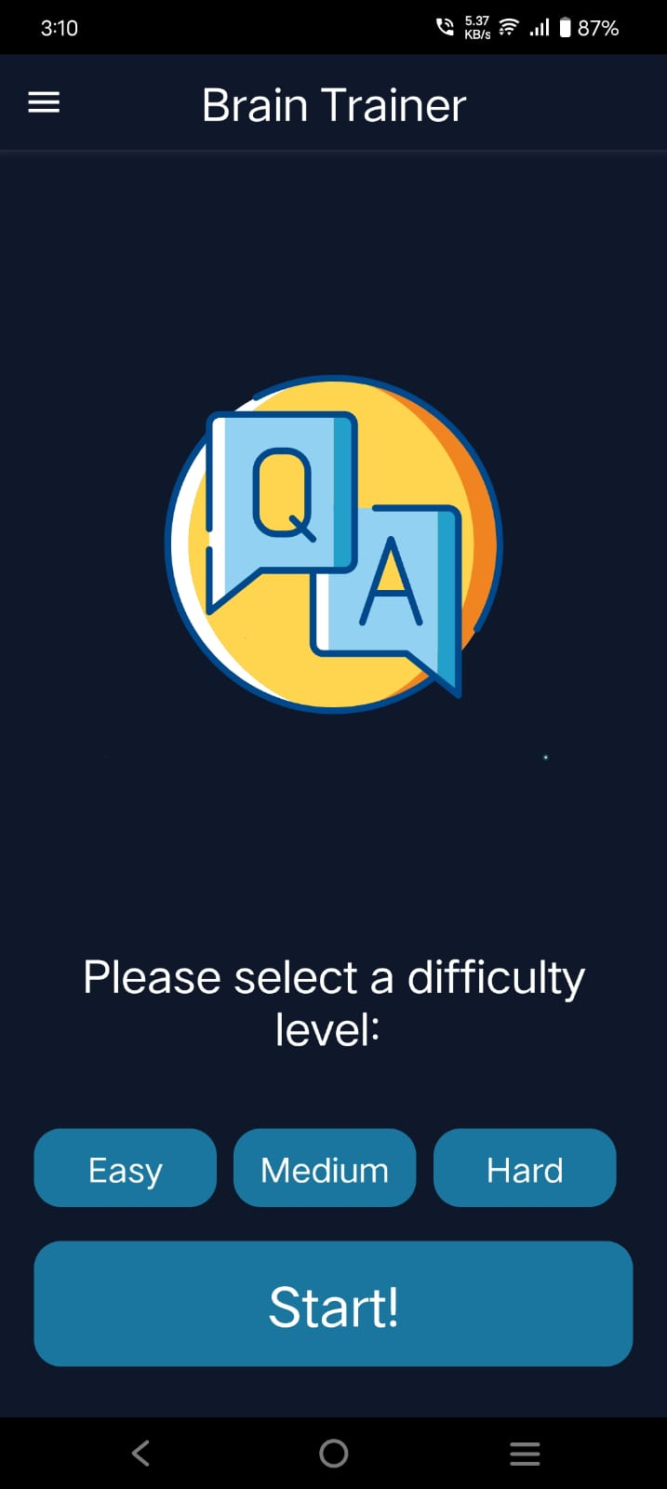
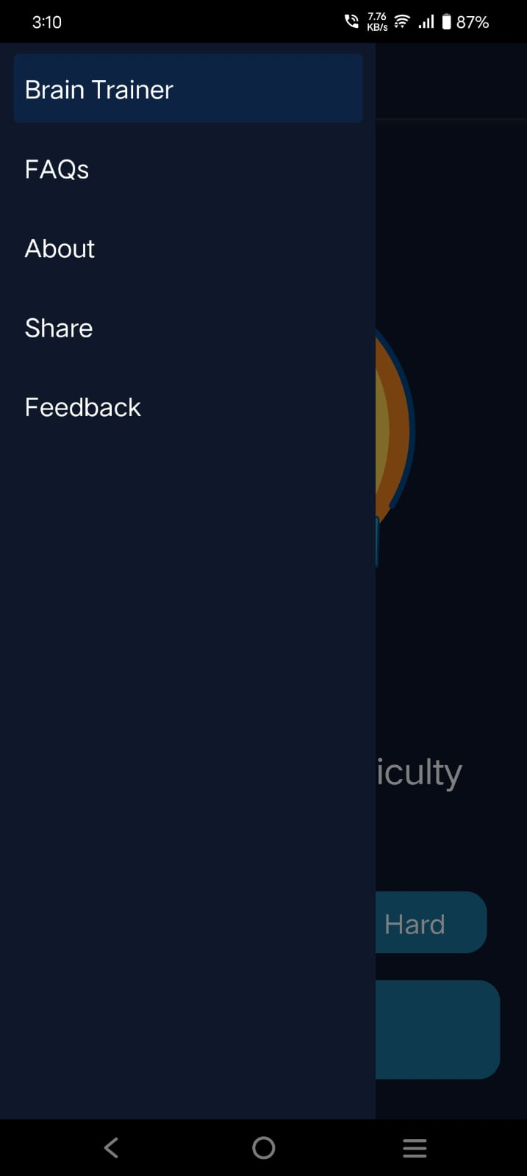
Sample Output Screen

Slide 11
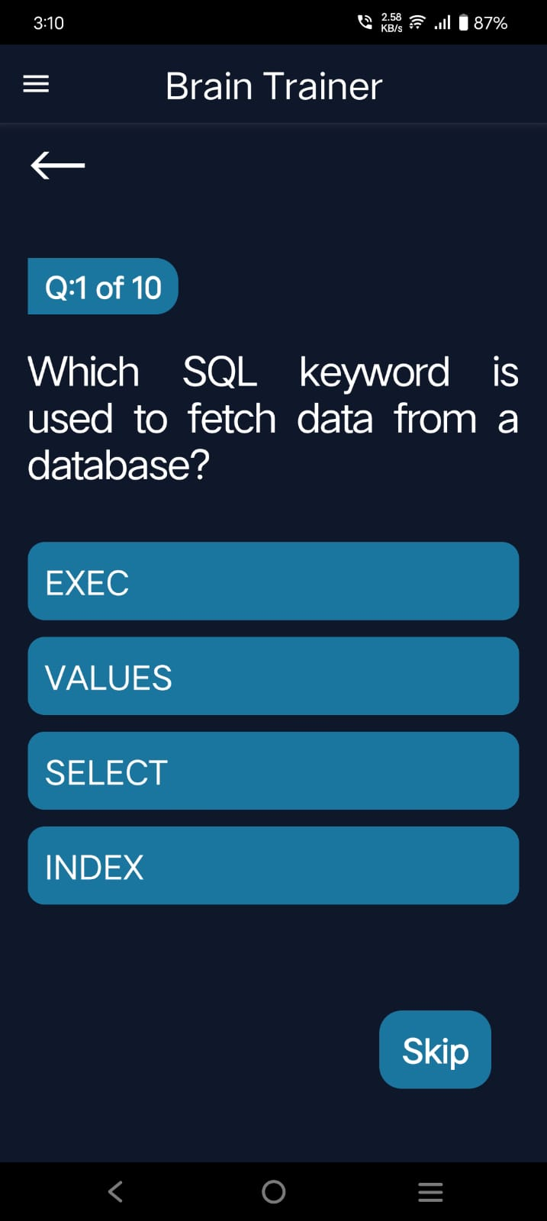
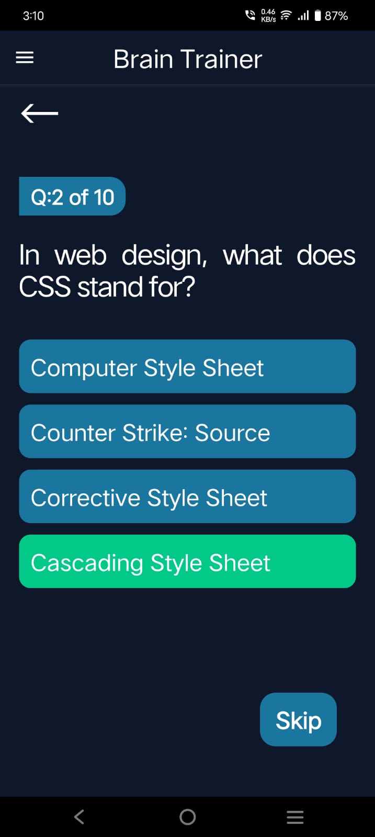

Slide 12
Conclusion
The project demonstrates the feasibility of a cross-platform quiz app using modern web/mobile technologies.
It enhances learning by providing an engaging and accessible quiz environment.
Future improvements may include AI-based question recommendations, Leaderboard, Login and voice input features.
Clean UI and simple UX for all age groups.
Offline Mode enabling users to continue quizzing without an internet connection, making the app more accessible in low-connectivity areas.

Slide 13
References
Smith, J., & Allen, L. (2020). Gamification in education: Enhancing student engagement through interactive tools. Journal of Learning Technologies, 12(3), 45–56.
Meta Platforms, Inc. (n.d.). React Native documentation. Retrieved May 13, 2025, from https://reactnative.dev/docs
Tailwind Labs. (n.d.). Tailwind CSS documentation. Retrieved May 13, 2025, from https://tailwindcss.com/docs
Wang, H., & Zhao, M. (2019). Cross-platform app development frameworks: A comparative study. International Journal of Mobile Computing, 8(2), 101–115.

