Slide 1
Microcontroller Based Automatic Railway Gate Control

Slide 2
Overview
Introduction
Project Objective
Block Diagram
Working
Hardware and Software Description
Conclusion

Slide 3
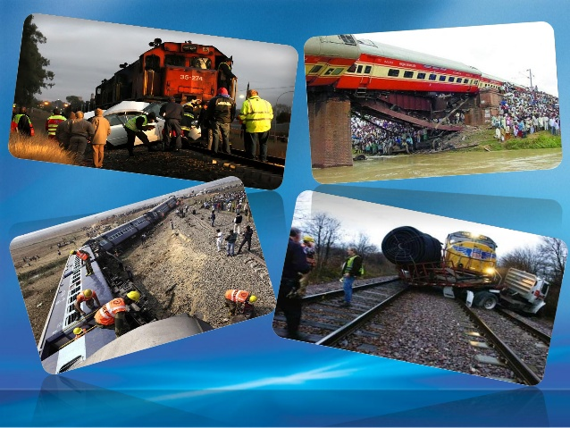
Purpose

Slide 4
Introduction
Railways being the cheapest mode of transportation are preferred over all the other means.
Everyday we come across many railway accidents.
Due to the carelessness in manual operations or lack of workers or unnamed railway stations.

Slide 5
Existing System :
Manual/Physical gate closing and opening.
Manual switch based gate closing and opening.
Limitations of existing system :
Chances of human errors.
Time Consuming.
A lot of human resource is required.

Slide 6
Project Objective
We, in order to overcome these dangerous problems in this project came up with a solution for the same.
Present project is designed using 89c51 microcontroller.
It has powerful IR transmitters and receivers.
The transmitter is fixed at up side and receiver is fixed at down side of train direction.

Slide 7
Block Diagram
Signals
IR Sensors
Microcontroller
Motor
Gates
Power Supply

Slide 8
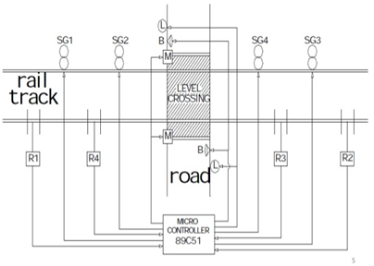
Working

Slide 9
Hardware Description:
Microcontroller : AT89C51
Crystal : 12MHz
Power Supply : 9v,5v
Transformer :
Sensors : IR Tx, IR Rx
Driver IC : L293D
Software description:
Program : Keil µ-vision3
Simulation : Proteus
PCB Design : Proteus

Slide 10
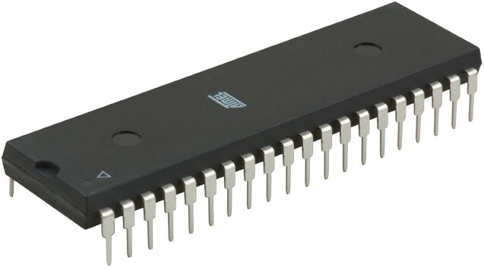
Microcontroller
Type:
Atmega16 microcontroller
Forms the brain of entire system.
Performs the complete operation of sensing, closing and opening of gate operation done by software code written on the controller.

Slide 11
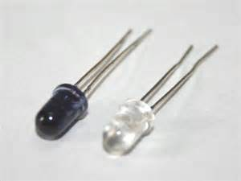
IR Sensor

Slide 12
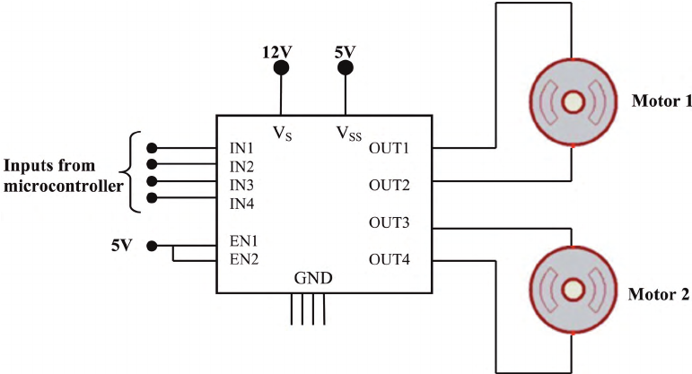
Driver IC
L293D is a typical Motor driver or Motor Driver IC which allows DC motor to drive on either direction. L293D is a 16-pin IC which can control a set of two DC motors simultaneously in any direction. It means that you can control two DC motor with a single L293D IC.

Slide 13
Conclusion
The idea of automating the process of railway gate operation in level crossing has been undertaken.
As the system is completely automated, it avoids manual errors and thus provides ultimate safety to road users.

Slide 14
Thank You…

