Slide 1
Vulnerabilities
By: Samiksha Regmi
Tutor: Clinton Hayes
Unit Coordinator: Jamie Shield

Slide 2
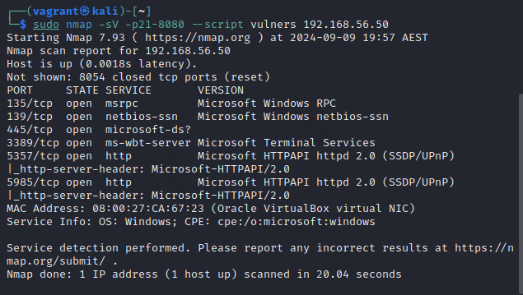
Nmap
Fig 1: Vulnerability scan of 192.168.56.50 using Nmap

Slide 3
Nmap
An open source tool designed for security auditing and network discovery.
It finds devices on a network.
It detects open ports and active services on a host.
It defines the operating services software version.
Determines the target device’s operating system.
Assists in locating possible flaws and configuration errors.

Slide 4
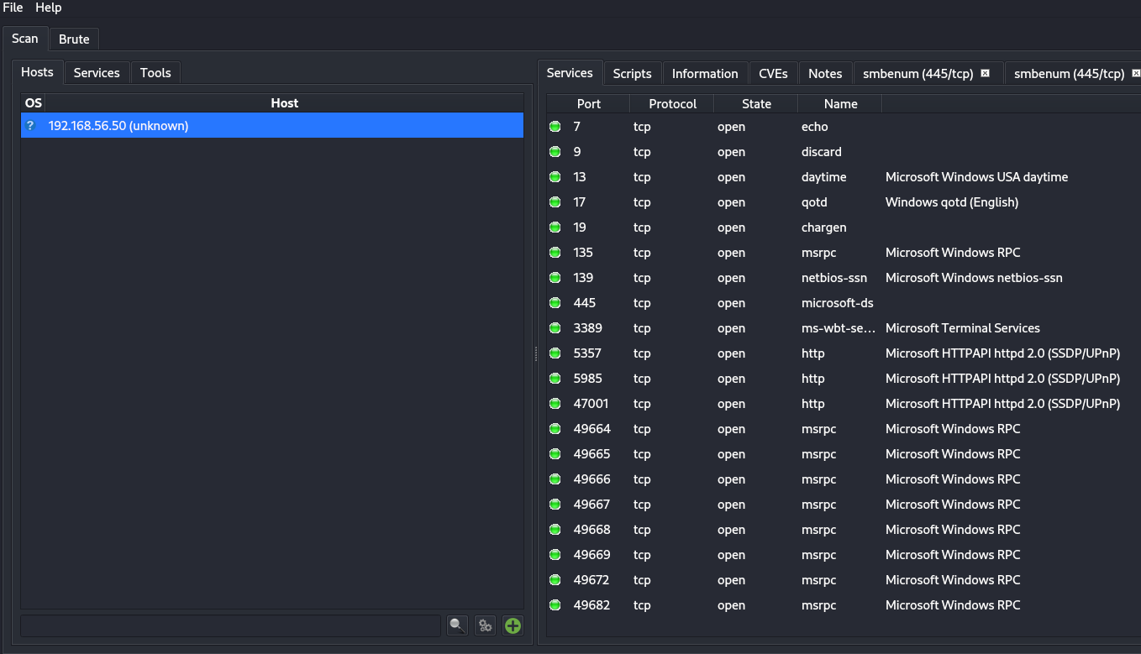
Legion
Fig 2: Vulnerability scan of 192.168.56.50 using Legion

Slide 5
Legion
An open-source tool for obtaining data and conducting network penetration tests.
It finds vulnerabilities, open ports and services.
It is user-friendly and provides real time scan results.
It finds configuration mistakes and security flaws.
It allows for customized scan scripts and profile.
It uses Nmap, Nikto and other comprehensive analysis.

Slide 6
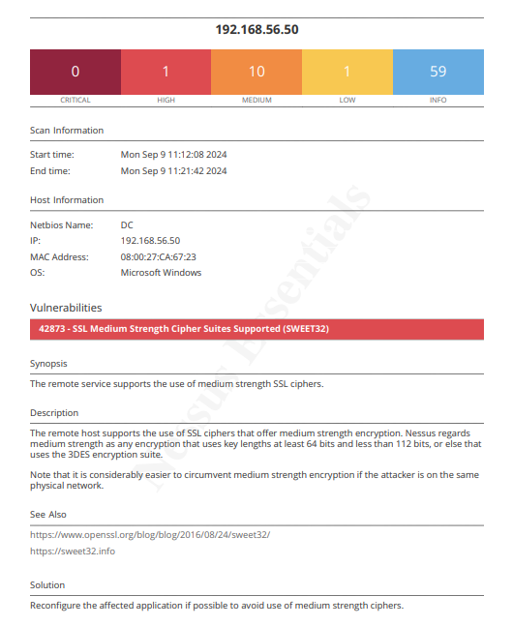
Nessus
Fig 3: Vulnerability scan of 192.168.56.50 using Nessus.

Slide 7
Nessus
A commonly used instrument for network security vulnerability evaluation.
Finds known flaws in configurations, weak passwords, and vulnerabilities.
Provides thousands of plugins to find different kinds of vulnerabilities.
Evaluates compliance with security regulations (PCI-DSS, HIPAA, etc.).

Slide 8
Nessus
Enables customized scans according to certain network requirements.
Provides in-depth reports on security threats and vulnerabilities.
Works on multiple OS including Windows, Linux, and macOS.

Slide 9
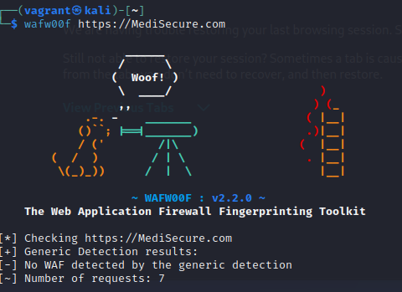
Wafw00f
Fig 4: Vulnerability scan of MediSecure using Wafw00f

Slide 10
Wafw00f
A tool for Web Application Firewall (WAF) detection and identification.
Determines whether a web application is firewall-protected.
Establishes the WAF's particular type and version.
Analyses WAF regulations and evaluates possible workarounds.
Enables automated WAF detection in security evaluations.

Slide 11
Nikto
An open source tool for detecting vulnerabilities on web servers.
Finds typical problems such as misconfigured systems, malicious files, and out-of-date software.
Scans for over 6,700 potential vulnerabilities.
Allows for user-defined options and scan settings.
Produces thorough information on vulnerabilities for web apps.
Compatible with multiple web servers (Apache, Nginx, IIS, and so on).

Slide 12
References
S. Liao et al., "A Comprehensive Detection Approach of Nmap: Principles, Rules and Experiments," 2020 International Conference on Cyber-Enabled Distributed Computing and Knowledge Discovery (CyberC), Chongqing, China, 2020, pp. 64-71, doi: 10.1109/CyberC49757.2020.00020.
Adeel, A. (2019) Network Penetration Testing with Legion Framework. https://www.hackingloops.com/legion-framework/.
Henriksen, C. (2023) 'WAFW00F — Web Application Firewall Fingerprinting,' Medium, 7 December. https://cbhsecurity.medium.com/wafw00f-web-application-firewall-fingerprinting-4e7853633bff.
Awati, R. (2023) Nessus. https://www.techtarget.com/searchnetworking/definition/Nessus.
Kanishka and Kanishka (2023) Nikto vulnerability scanner: Complete guide. https://www.hackercoolmagazine.com/nikto-vulnerability-scanner-complete-guide/.

