Slide 1

Design Patterns
Group 5S

Slide 2
What are Design Patterns ???
Represent the best practices used by experienced object-oriented software developers.
Solutions to general problems that software developers faced during software development.
Obtained by trial and error by numerous software developers over quite a substantial period of time.

Slide 3
Usage of Design Pattern
Common platform for developers
Provide a standard terminology.
Specific to particular scenario.
Best Practices
Have been evolved over a long period of time.
Provide best solutions to certain problems faced during software development.

Slide 4
What is Gang of Four (GOF)?
In 1994, four authors Erich Gamma, Richard Helm, Ralph Johnson and John Vlissides published a book titled Design Patterns - Elements of Reusable Object-Oriented Software.
These authors are collectively known as Gang of Four (GOF).
These design patterns are primarily based on the following principles of object orientated design.
Program to an interface not an implementation
Favor object composition over inheritance

Slide 5
Types of Design Patterns
There are four types of Design Patterns,
Creational Patterns
Provide a way to create objects while hiding the creation logic, rather than instantiating objects directly using new operator.
gives program more flexibility in deciding which objects need to be created for a given use case.
Structural Patterns
Concern class and object composition.
Concept of inheritance is used to compose interfaces and define ways to compose objects to obtain new functionalities.
Behavioral Patterns
Specifically concerned with communication between objects.
J2EE Patterns
Specifically concerned with the presentation tier and Identified by Sun Java Center.

Slide 6
Observer Pattern
Used for one-to-many relationship.
Can falls under behavioral pattern category.
Observer pattern uses three actor classes. Subject, Observer and Client.
Subject is an object having methods to attach and detach Observers to a Client object.
We have created an abstract class Observer and a concrete class Subject that is extending class Observer.

Slide 7
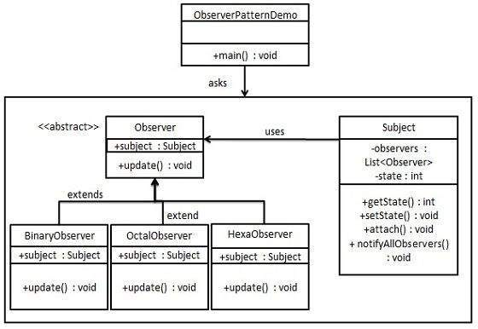
Example for Observer Pattern Class diagram :

Slide 8
Implementation Step 1 : Create Subject class.
import java.util.ArrayList;
import java.util.List;
public class Subject {
private List<Observer> observers = new ArrayList<Observer>();
private int state;
public int getState() {
return state;
}
public void setState(int state) {
this.state = state;
notifyAllObservers();
}
public void attach(Observer observer){
observers.add(observer);
}
public void notifyAllObservers(){
for (Observer observer : observers) {
observer.update();
}
}
}

Slide 9
Step 2 : Create Observer class.
public abstract class Observer
{
protected Subject subject;
public abstract void update();
}

Slide 10
Step 3 : Create concrete Observer classes
public class BinaryObserver extends Observer{
public BinaryObserver(Subject subject){
this.subject = subject;
this.subject.attach(this);
}
public void update() {
System.out.println( "Binary String: " + Integer.toBinaryString( subject.getState() ) );
}
}
public class OctalObserver extends Observer{
public OctalObserver(Subject subject){
this.subject = subject;
this.subject.attach(this);
}
public void update() {
System.out.println( "Octal String: " + Integer.toOctalString( subject.getState() ) );
}
}
public class HexaObserver extends Observer{
public HexaObserver(Subject subject){
this.subject = subject;
this.subject.attach(this);
}
public void update() {
System.out.println( "Hex String: " + Integer.toHexString( subject.getState() ).toUpperCase() );
}
}

Slide 11
Step 4 : Use Subject and concrete Observer objects.
public class ObserverPatternDemo {
public static void main(String[] args) {
Subject subject = new Subject();
new HexaObserver(subject);
new OctalObserver(subject);
new BinaryObserver(subject);
System.out.println("First state change: 15");
subject.setState(15);
System.out.println("Second state change: 10");
subject.setState(10);
}
}

Slide 12
Advantages & Disadvantages and when to use it
Advantages :
provide the loose coupling design between objects that interact with each other.
Loosely coupled objects are flexible with changing requirements.
Subject only knows that observer implement Observer interface.
There is no need to modify Subject to add or remove observers.
Disadvantages :
Memory leaks caused by Lapsed listener problem, because of explicit register and unregistering of observers.
If not correctly implemented, the Observer can add complexity and lead to inadvertent performance issues.

Slide 13

Conclusion :
Design Patterns make software development easier by providing you with a toolbox of solutions to common problems you encounter in object-oriented design and those are high level.

