Slide 1

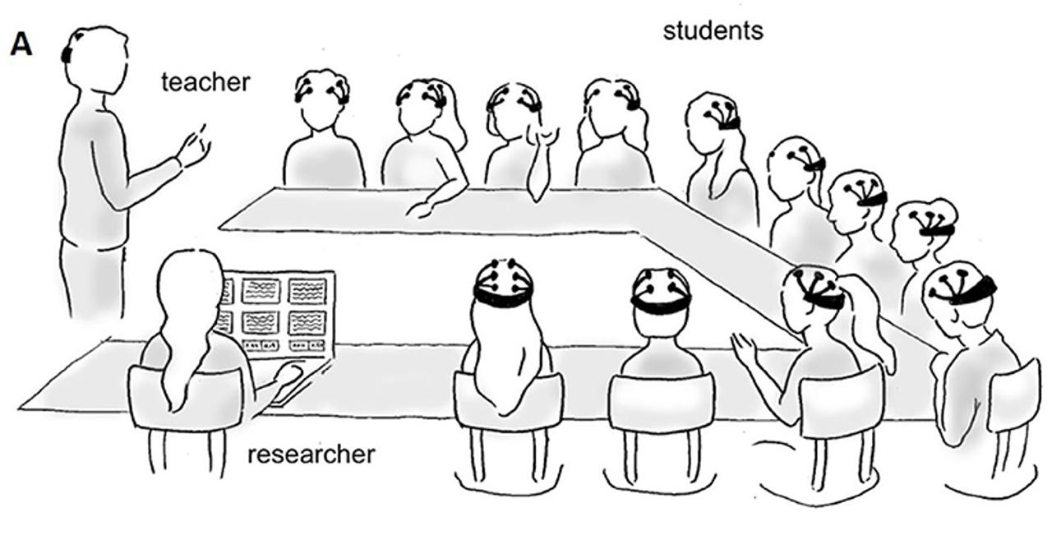
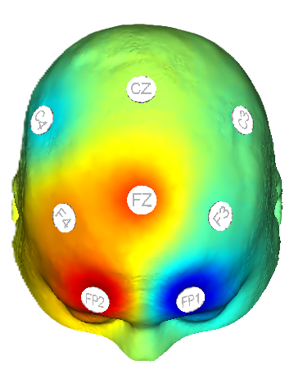
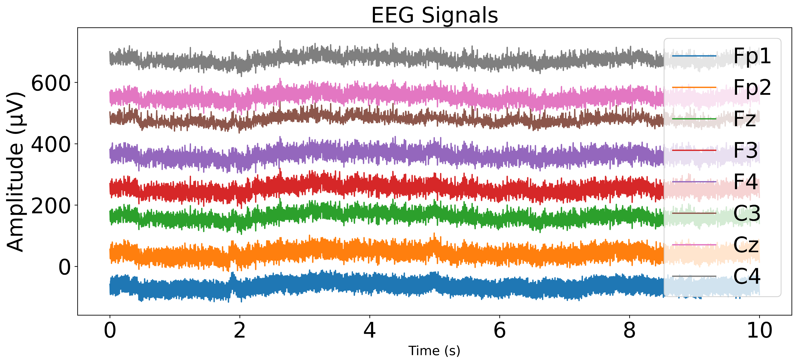
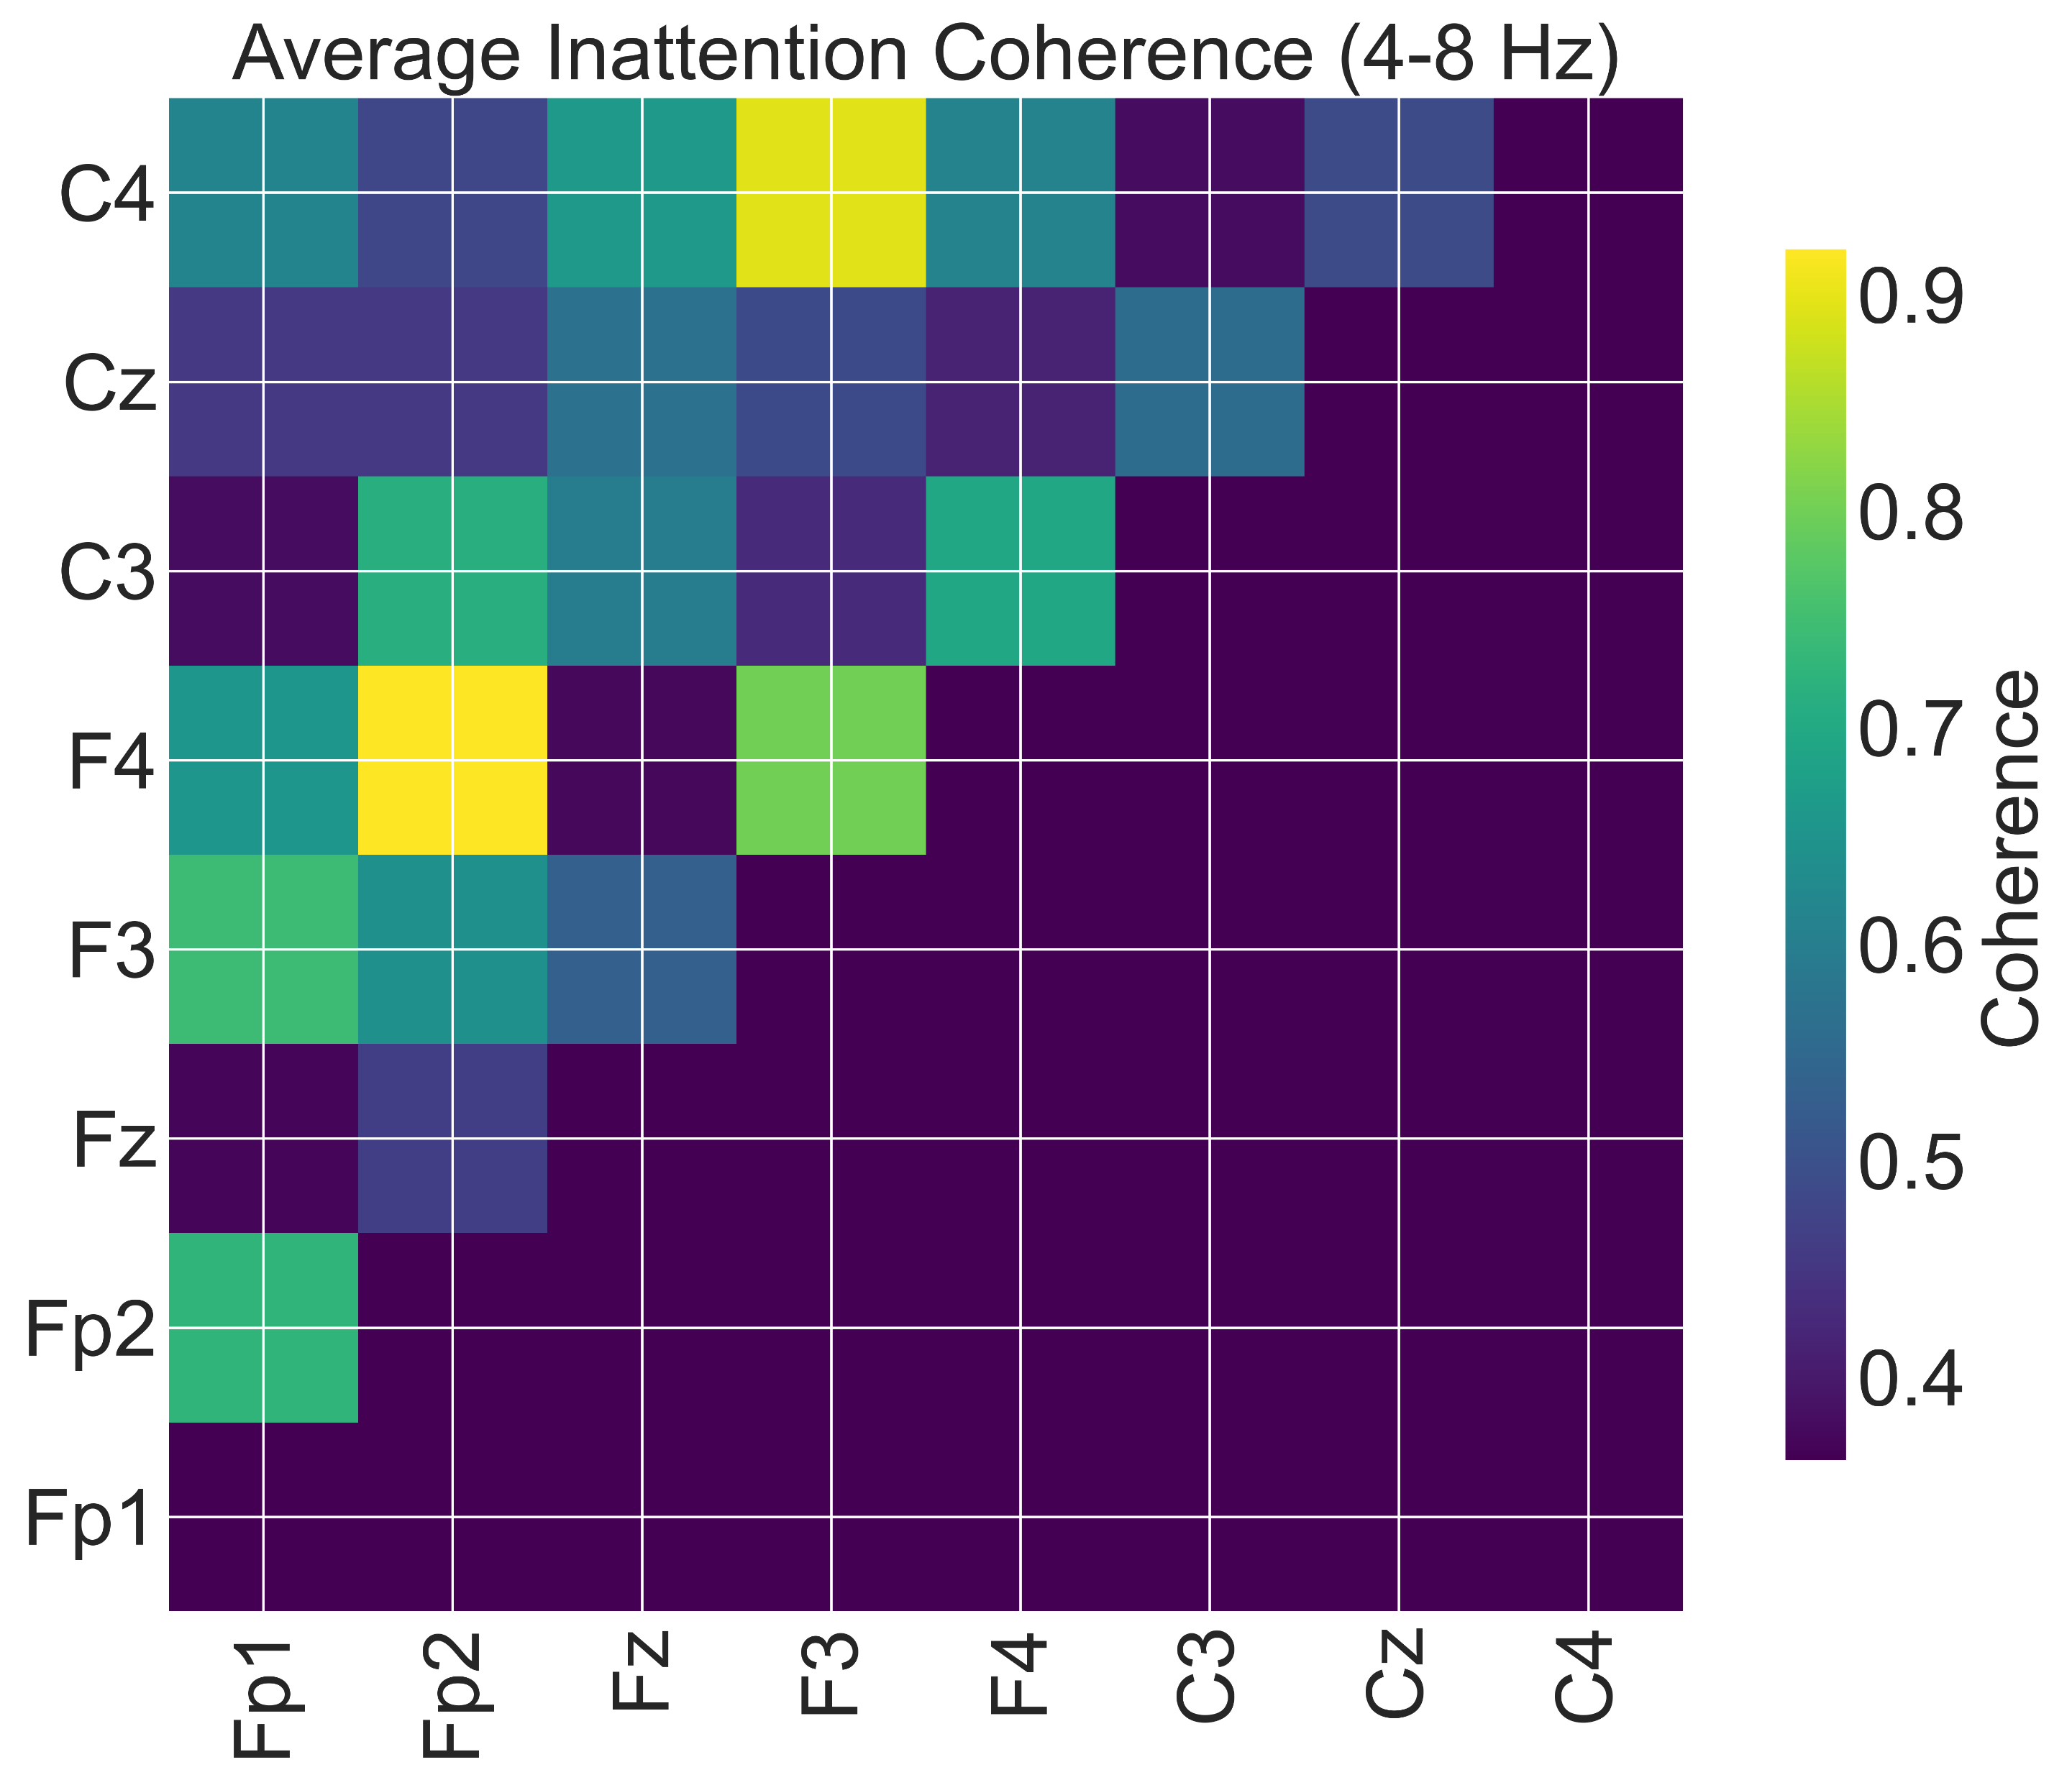
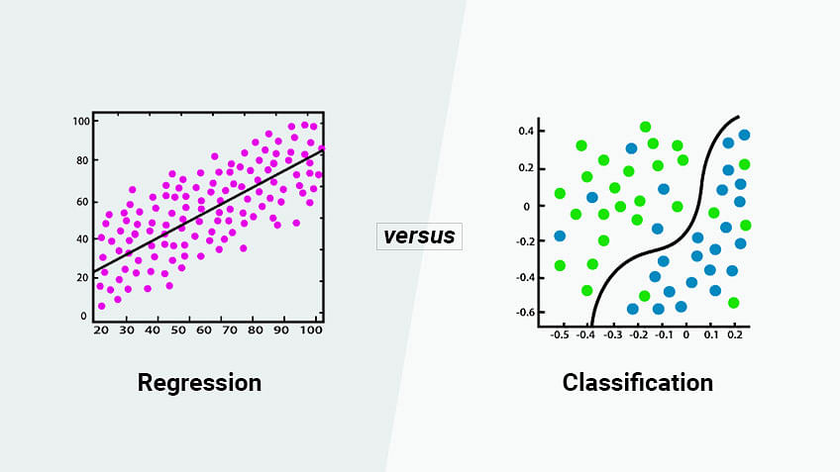
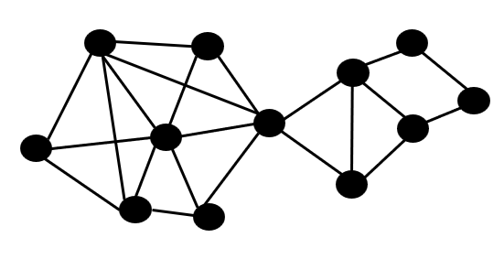
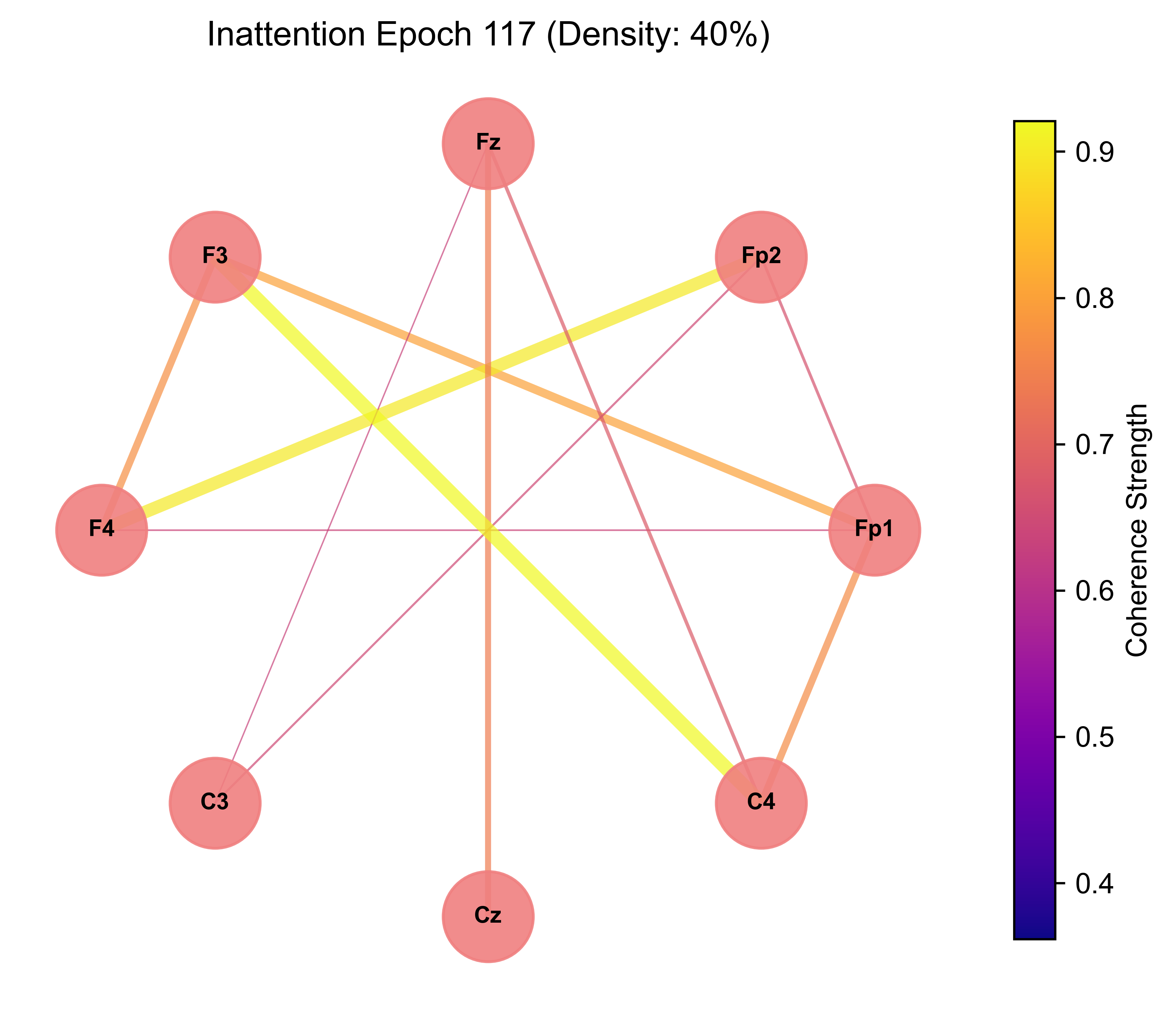
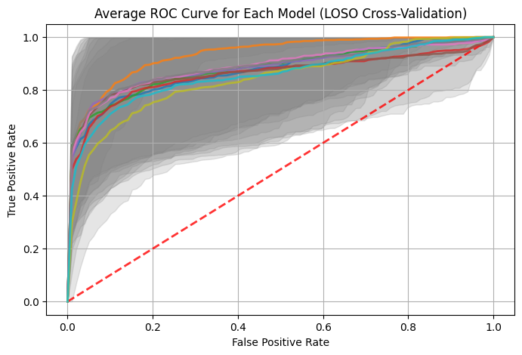
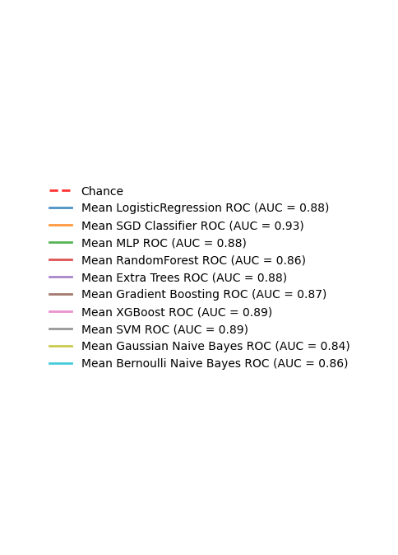
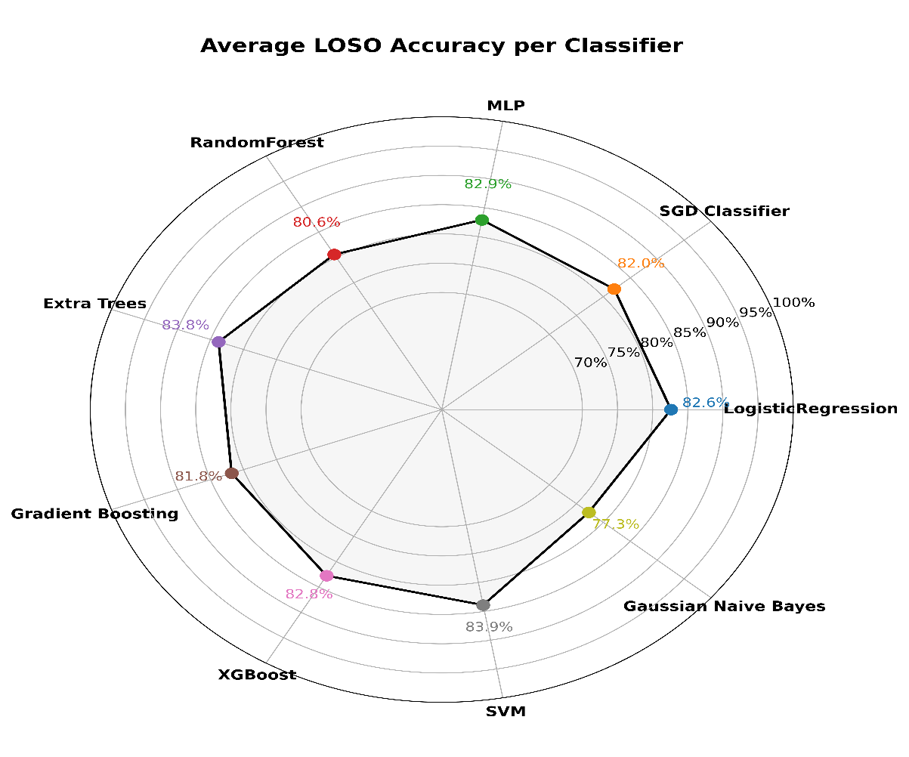
GBrain: A Graph Signal Processing Approach To EEG Based Attention Detection
Student: Sami Al Majanini
Abstract
Objectives
In a fast-paced world, accurately detecting attention is vital across fields like education, neurotechnology, and cognitive research.
Prior EEG studies often overlook inter-channel brain interactions and rely on high-density systems, limiting their practicality and comprehensive understanding of brain network dynamics during attention.
To accurately detect attention by extracting topological features from functional connectivity matrices.
To enhance understanding of brain network dynamics during attentive vs. inattentive states.
Methodology
1) EEG recording using 8 Electrodes
2) Raw EEG Data
3) Functional Connectivity Computation
6) Classification
5) Graph Feature Extraction
4) Graphs Construction
Results
Conclusion
Summary of attention classification performance, demonstrating superior accuracy of the proposed method compared to prior work.
The classification accuracy achieved by GBrain significantly outperforms current state-of-the-art methods in attention detection. Furthermore, the extracted graph-theoretical features demonstrate strong potential for use as reliable biomarkers of attention. Future work will focus on validating GBrain in real-world, portable EEG applications.
Authors | Methodes | Validation techniques | Accuracy
Nuamah & Seong (2021) | Features: Power bands ratio Model: SVM | k-fold CV subject dependent | 93.33% ± 8.16%
Wan et al. (2021) | Features: Frequency and entropy features Model: XGBoost | 5-fold cross-validation LOSO | 95.36% ± 2.31%, (CV) 73.39 ± 4.47, (LOSO)
Al-Nafjan & Aldayel (2022) | Features: PSD features Models: KNN, SVM, RF | Holdout / 5-fold CV | 96% (Holdout), 87% (5-fold
Chen et al. (2023) | Features: feature fusion time, frequency domains and nonlinear features. Models: RE, DT, SVM | 5-fold CV subject dependent LOSO | 95.36% ± 2.31%, (CV) 73.39 ± 4.47, (LOSO)
Our work | Features: Graph features Models: SVM, RF, LR, MLP, XGBOOST, SGD, GB, EXTRA TRESS, GNB | 2-fold CV LOSO | 98–99% ±1%, (CV) 80–84% ± 15–17%, (LOSO))

