Slide 1
A computational approach to politeness with application to social factors
Cristian Danescu-Niculescu-Mizil, Moritz Sudhof , Dan Jurafsky, Jure Leskovec , and Christopher Potts
Computer Science Department, Linguistics Department
Stanford University, Max Planck Institute SWS
Samin Islam, ID - 18101444
Nazmus Sakib Saad, ID - 18101562

Slide 2
Introduction
a computational framework for identifying linguistic aspects of politeness
a corpus of requests annotated for politeness
a classifier with domain-independent lexical and syntactic features operationalizing key components of politeness theory

Slide 3
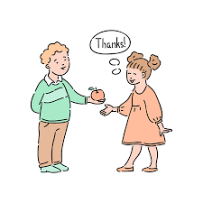

Slide 4
Motivations
evaluate aspects of politeness theory and to uncover new interactions between politeness markers and context
a preliminary analysis of politeness variation by gender and community

Slide 5
Datasets
Two large online communities in which members frequently make requests of other members:
Wikipedia, where the requests involve editing and other administrative functions
Stack Exchange, where the requests center around a diverse range of topics; specially on programming, gardening, cycling.

Slide 6
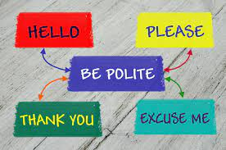

Slide 7
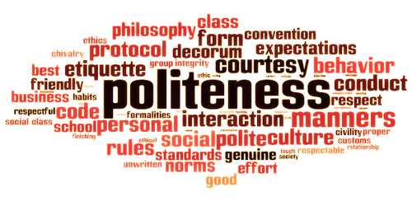

Slide 8
polite Wikipedia editors are more likely to achieve high status through elections; however, once elected, they become less polite
on Stack Exchange, we find that users at the top of the reputation scale are less polite than those at the bottom

Slide 9
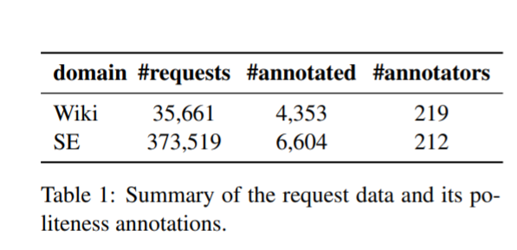
#Summary of the datasets

Slide 10
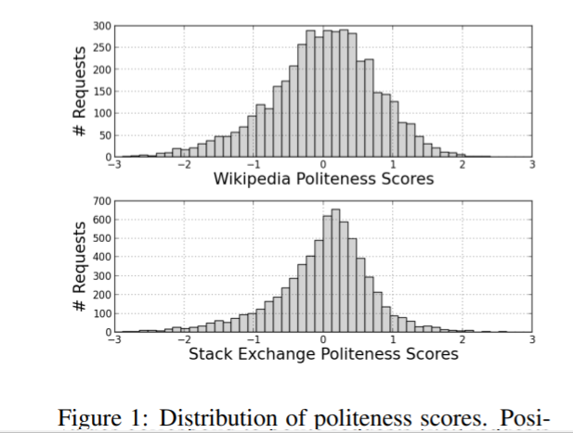
Distributions of the datasets

Slide 11
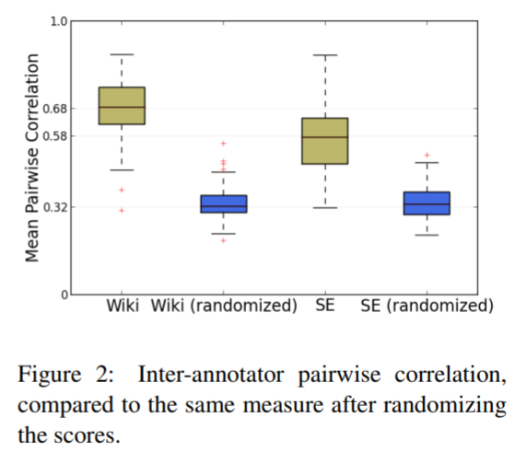

Slide 12
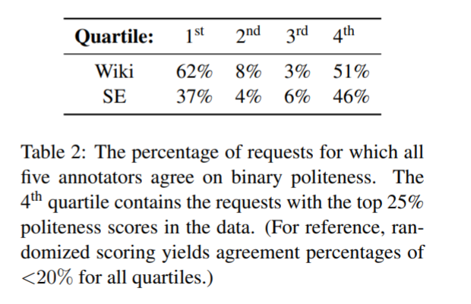

Slide 13
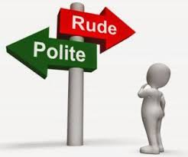
Politeness Strategies

Slide 14
Task Setup-
Domains -
Development domain => Wikipedia
Test domain => Stack Exchange
Domain-settings -
In-domain
Cross-domain
Classifiers -
BOW(Bag of words)
linguistically informed classifier (Ling.)

Slide 15
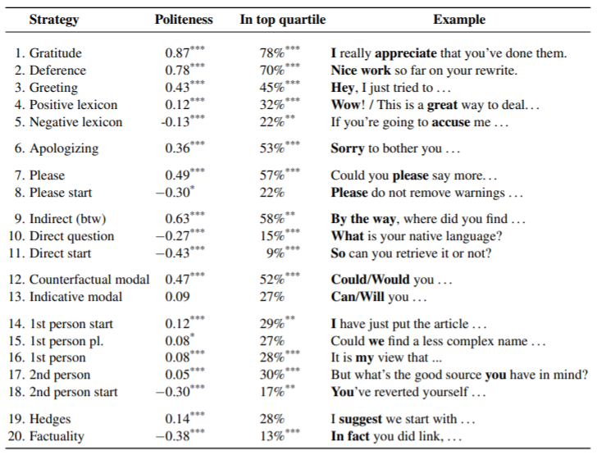

Slide 16
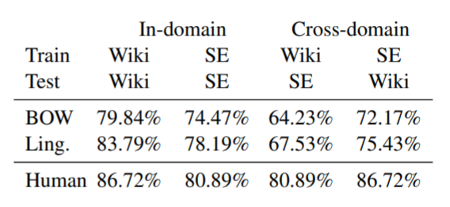

Slide 17
how politeness norms vary across communities and social groups?
established results about the relationship between politeness and gender, and they identify substantial variation in politeness across different programming language subcommunities on Stack Exchange.

Slide 18
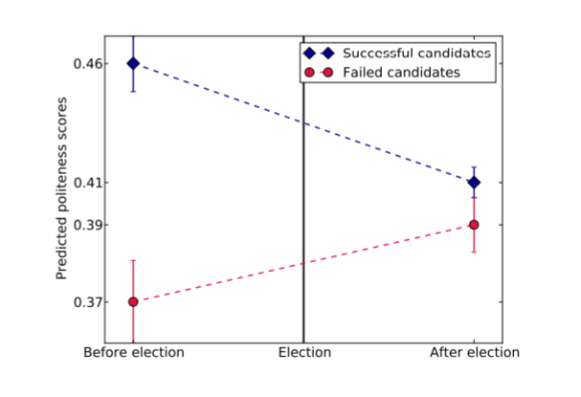

Slide 19
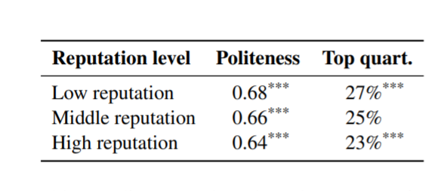
Politeness and power

