Slide 1
Machine Translation and Encoder-Decoder Models
Presented by -
Nazmus Sakib saad, ID - 18101562
Samin Islam, ID - 18101444

Slide 2
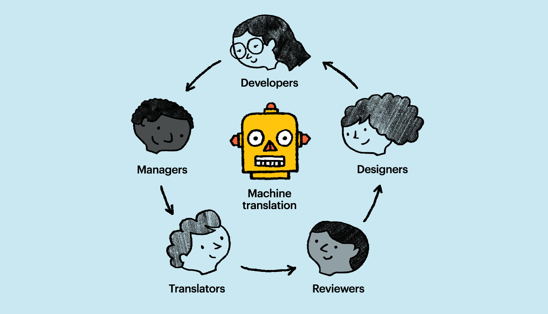

Slide 3
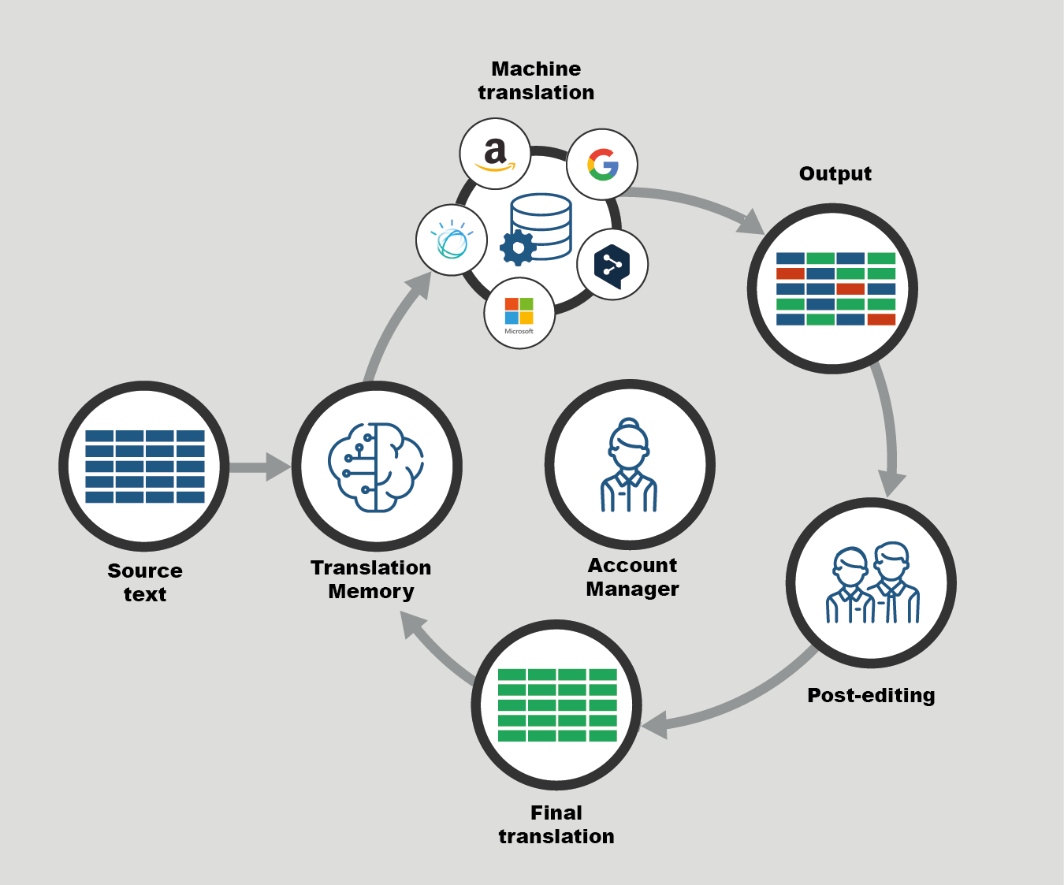

Slide 4


Slide 5
Encoder-decoder Models
RNN -based
Transformer-based

Slide 6
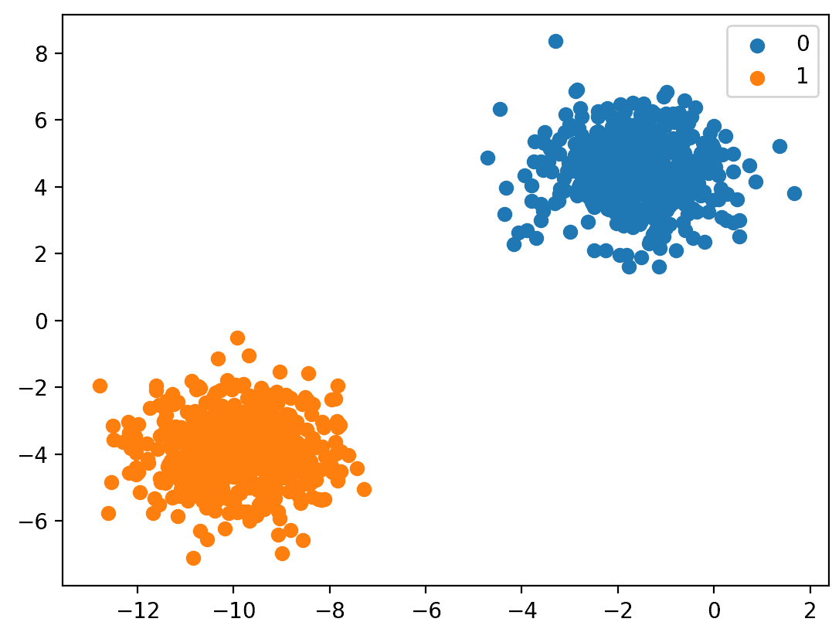
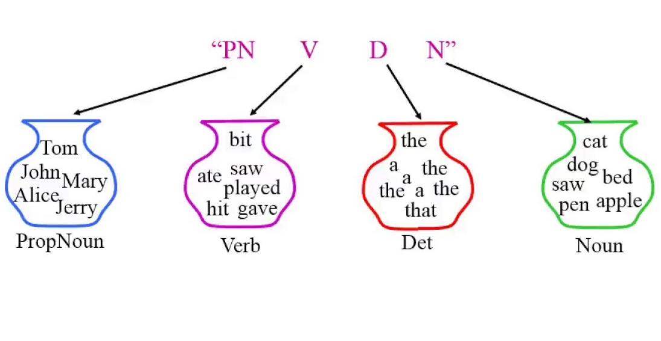
Classification
Sequence labeling

Slide 7
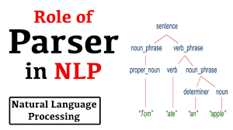
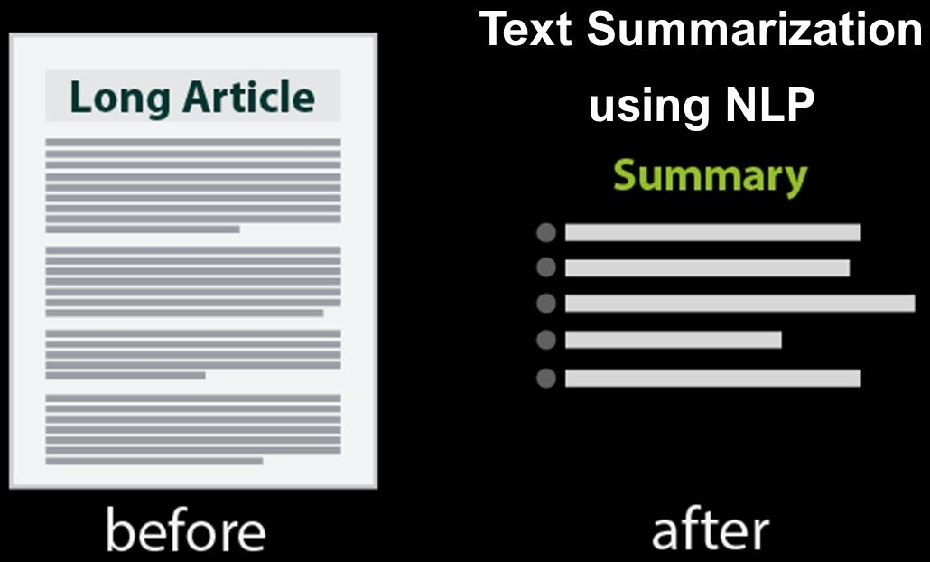
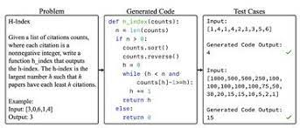
Tasks

Slide 8
Lexical Divergences of language
Linguistic topology -
Word Order Typology
Morphological Typology
Topological density - Referential density.

Slide 9
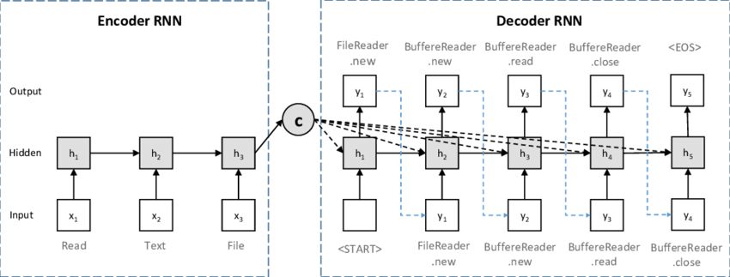

Slide 10
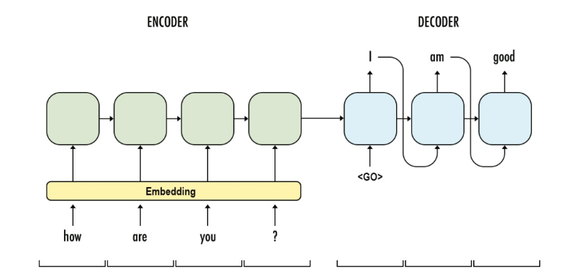

Slide 11
choosing the single most probable token to generate at each step is called greedy decoding.

Slide 12
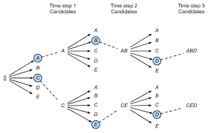
k possible tokens at each step

Slide 13

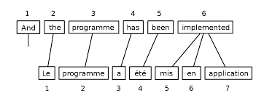

Slide 14
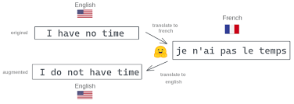

Slide 15
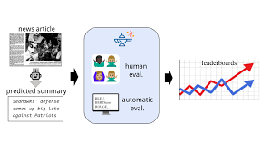
Adequacy
Fluency

Slide 16
