Slide 1
EHR(Electronic Health Record), Clinical Assertion modeling of COVID patients with NLP techniques
Samin Islam, ID - 18101444
Nazmus Sakib Saad, ID - 18101562

Slide 2


Slide 3


Slide 4


Slide 5


Slide 6
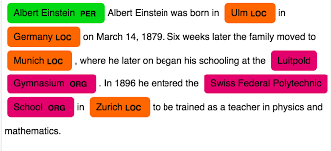
NER

Slide 7
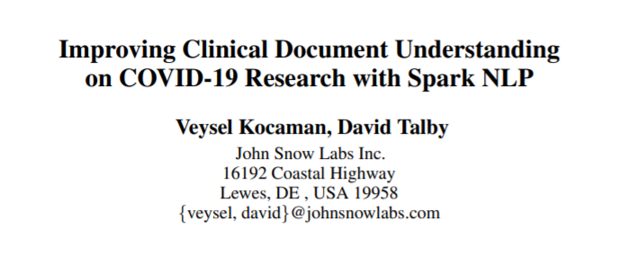
https://arxiv.org/abs/2012.04005

Slide 8


Slide 9
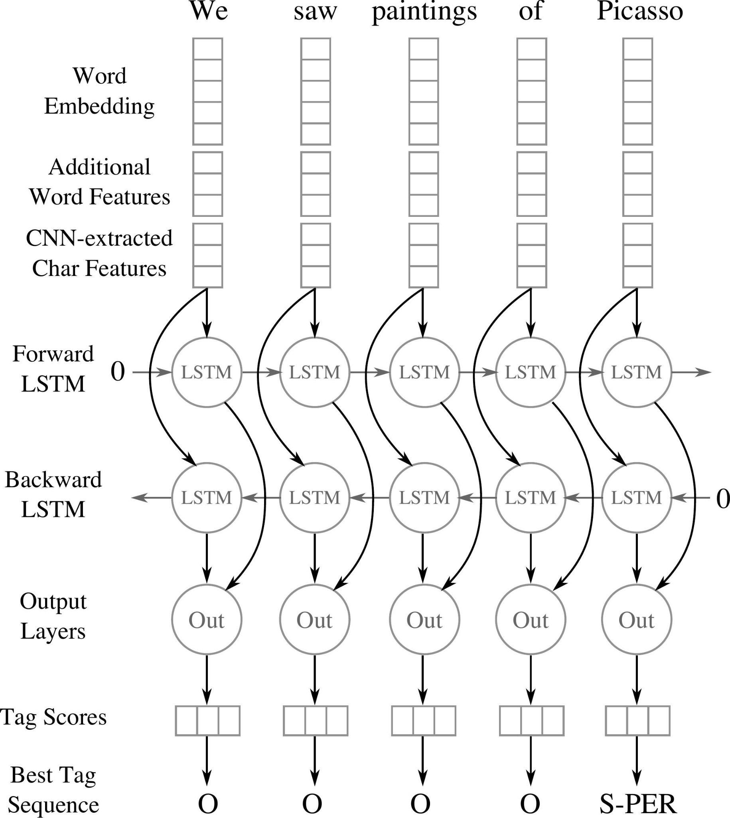

Slide 10
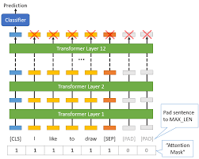

Slide 11
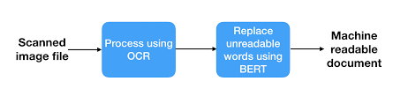
Why we want to use BERT?
X-rays and CT scan reports which re image type

Slide 12
Thank You

