Slide 1
Smart Shopping Cart
Group Members:
1. Samin Azhan-14101005
2. Seevieta Biswas Toa-14101003
3. Tahmid Abdullah-14101142
4. Anik Zaman-13201052

Slide 2
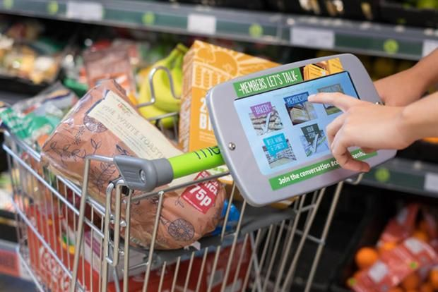
Introduction
Automated cart
Customer will enter a shopping list
The cart will bring everything from the store which are on the list
Automatic billing calculation system

Slide 3
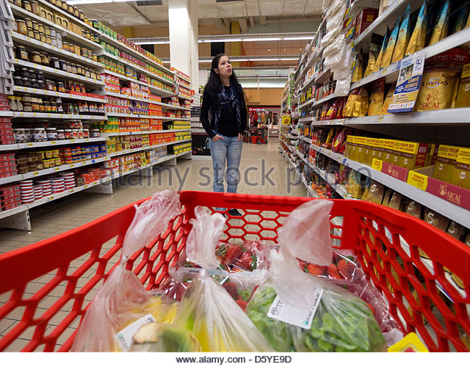
Motivation
Walking aisle after aisle
Wasting time on finding desired product
Difficulties due to over crowded area
Long lines at check out counters

Slide 4
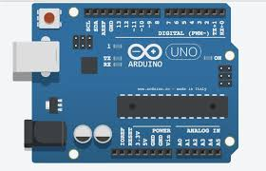
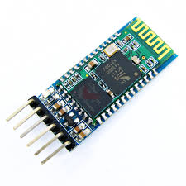
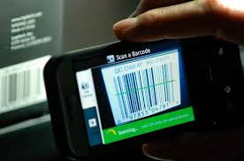
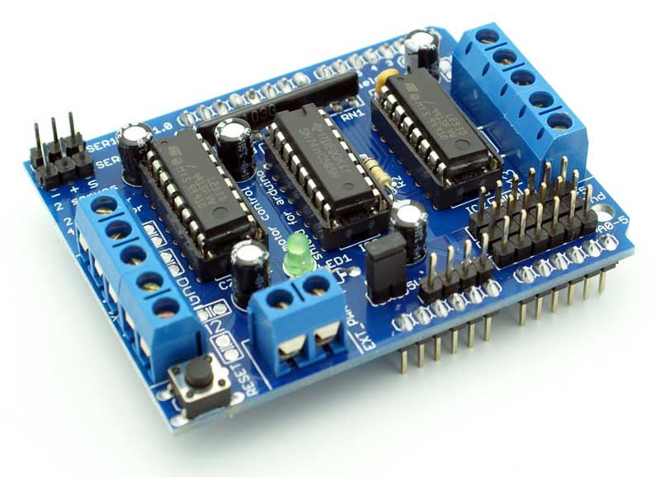
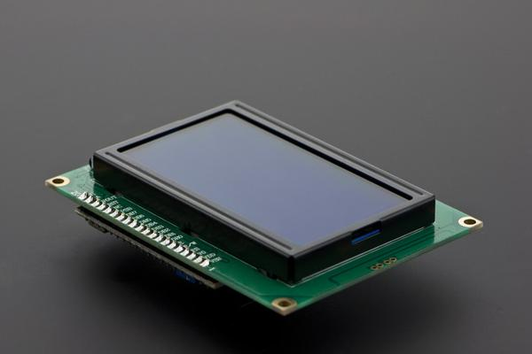
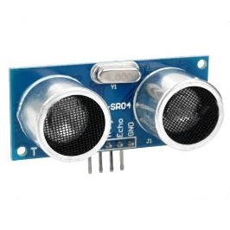
Devices and database
Arduino
Bluetooth Module: hc-05
Android phone as barcode reader
External Battery
Motor Driver Shield
Sonar Sensor
3-Wire LCD Display

Slide 5
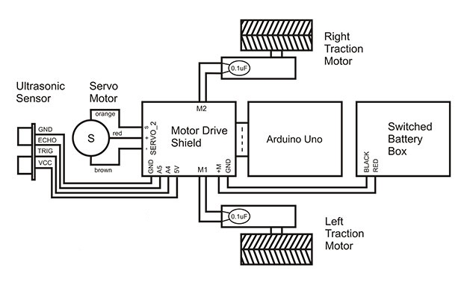
Basic Set-up

Slide 6
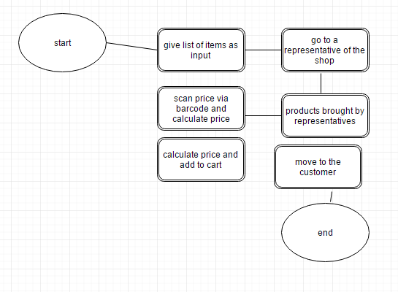
Methodology

Slide 7
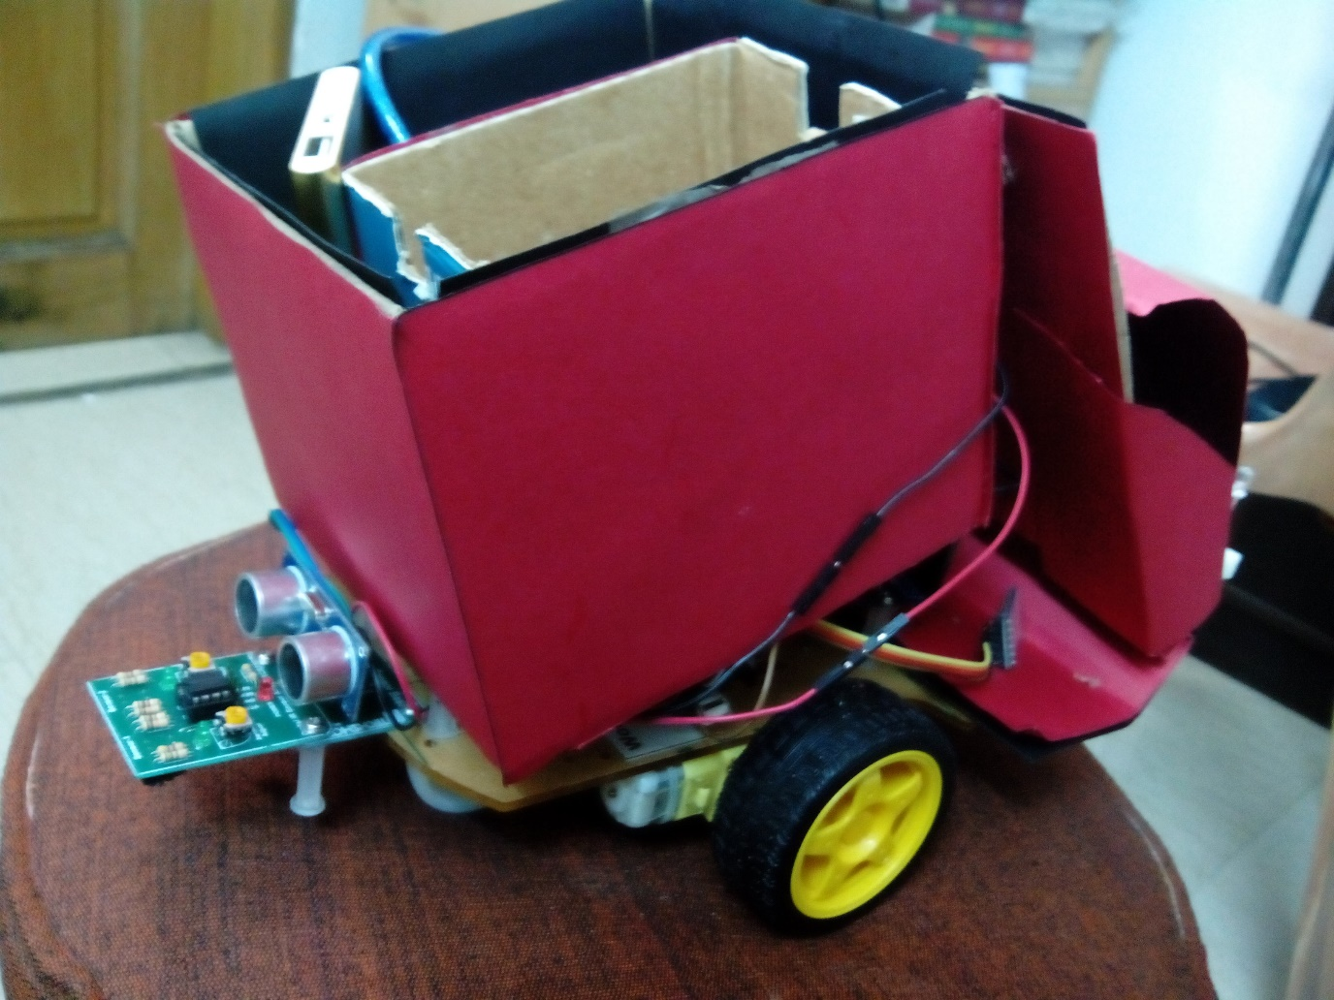
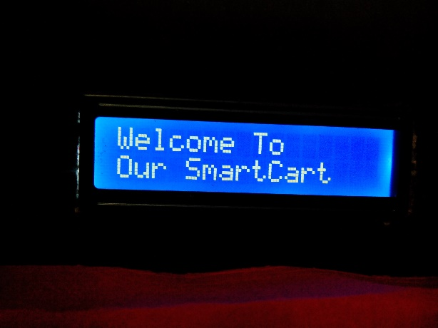
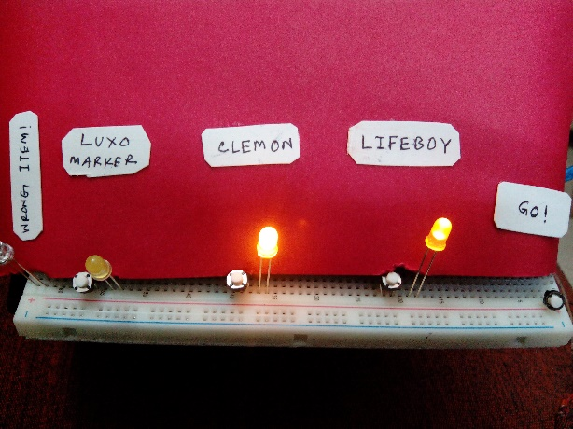
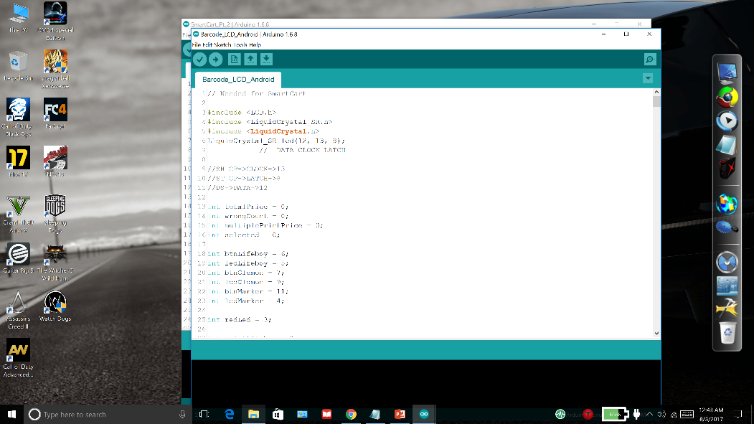
Implementation

Slide 8
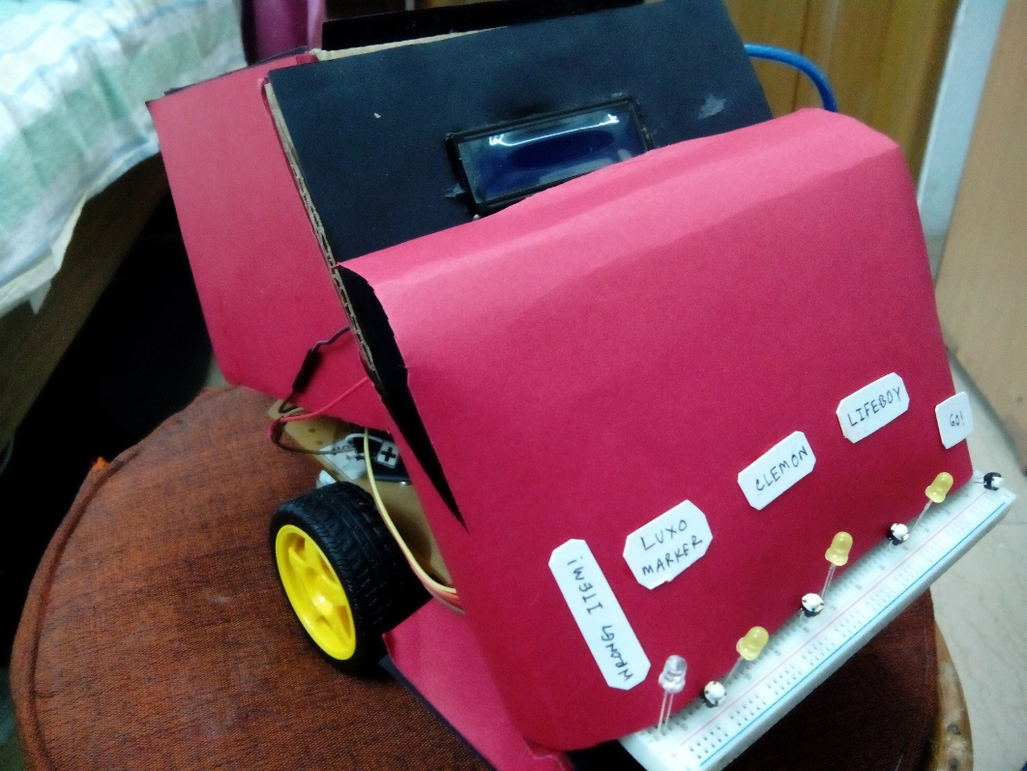
Drawbacks
Cannot check the quality of the product
Maybe expensive to be implemented on a large scale
Difficult for small scale vendors to implement
Requires constant power supply

Slide 9
Result
The cart is able to match the barcode data flawlessly and detect the selected items by the customers.
The android app is precise at sending data to the Arduino.
It is difficult for the cart to carry items that are too heavy and move around the super market.
The LCD display is working perfectly at showing the correct inputs and final bill for the customers.

