Slide 1
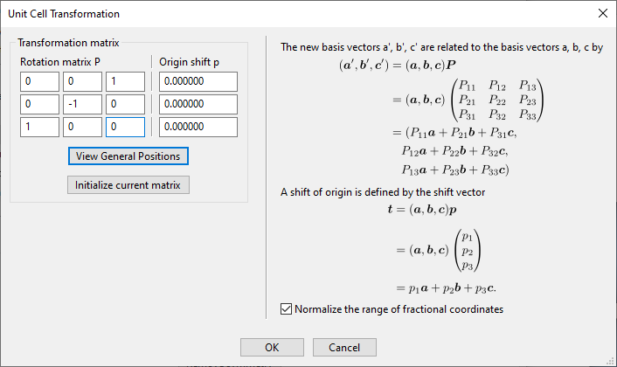


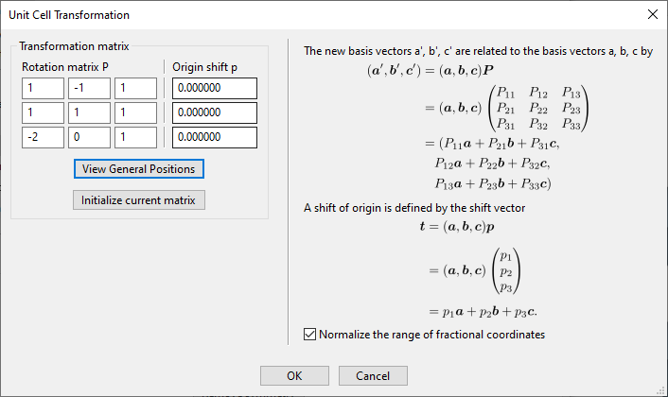
(1 0 0) R
Matrix
(1 1 0) R
Matrix
(0 1 0) R
Matrix
(1 1 1) R
Matrix

Slide 2
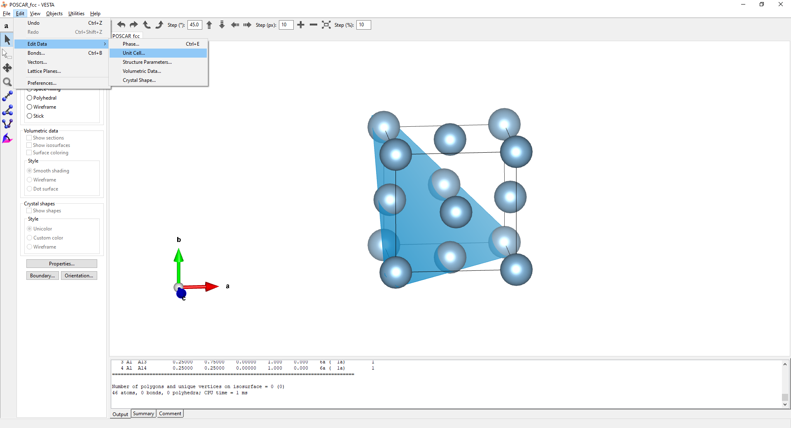
1. Drag and drop the POSCAR file into VESTA window
2. Edit > Edit Data > Unit Cell…

Slide 3
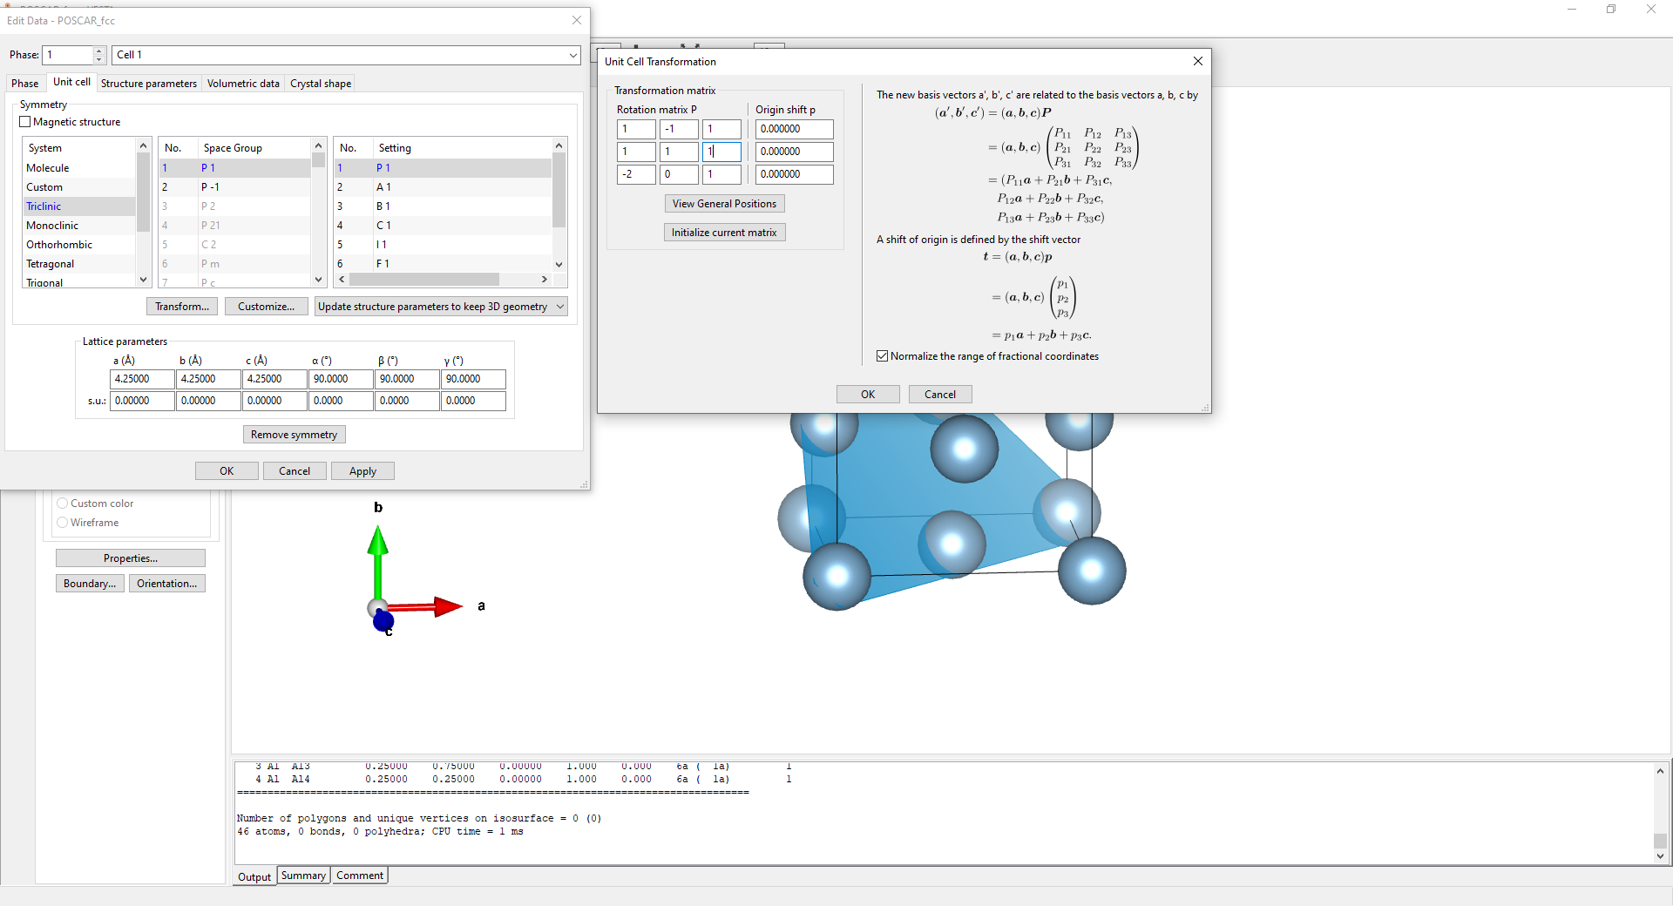
Origin shift:
If you have a particular atom you’d like to be the origin of the new cell input the Direct coordinates of it as:
a
b
c
3. Select Transform…
4. Input rotation matrix (see first page for reference)

Slide 4
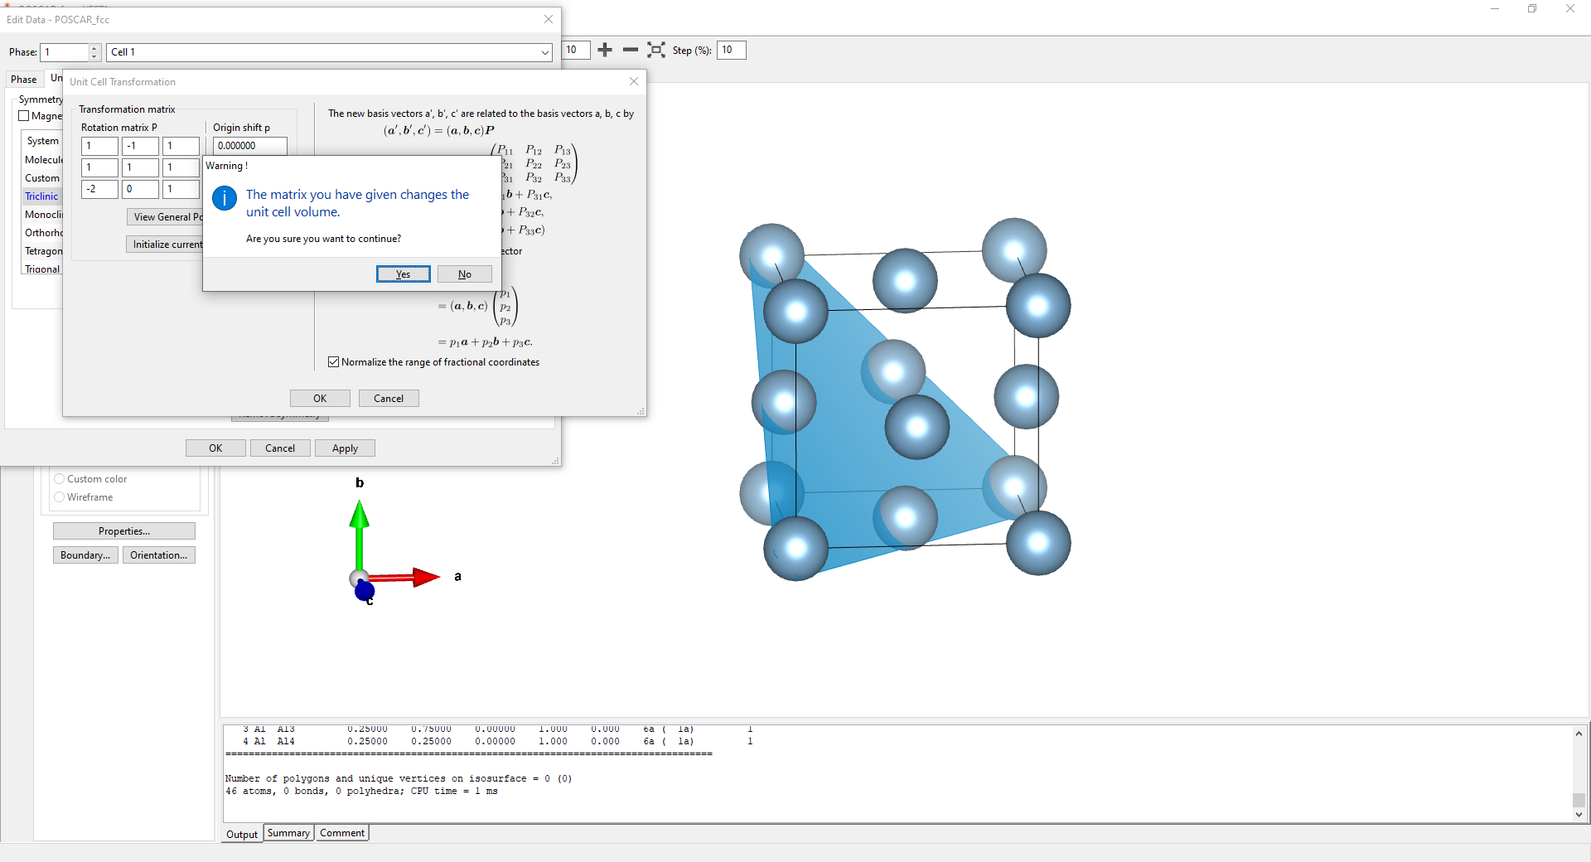
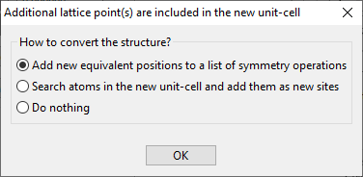
5. Select Yes for the warning
6. Check the first option
7. Click okay

Slide 5
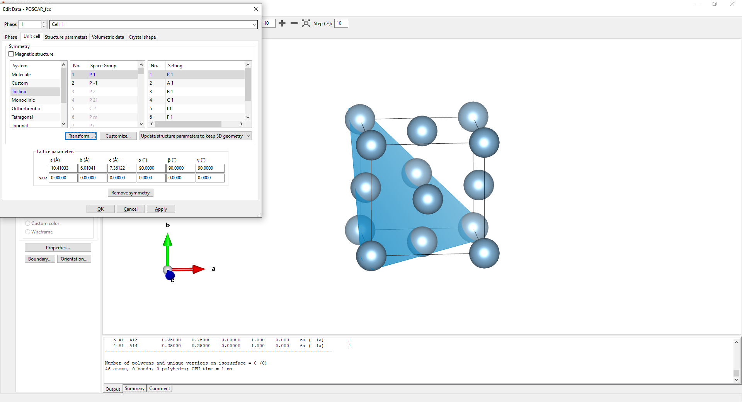
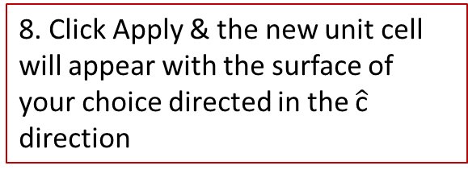
8. Click Apply & the new unit cell will appear with the surface of your choice directed in the $\hat{\text{c}}$ direction

Slide 6
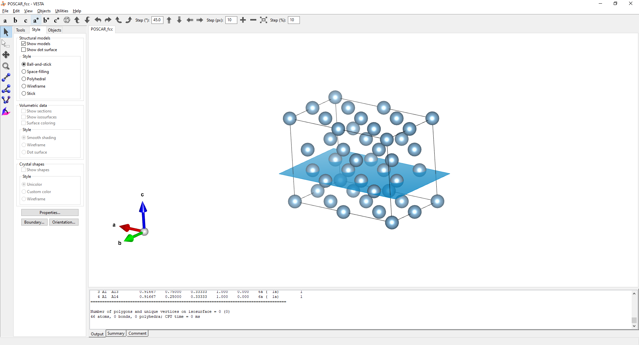
FCC (111) surface unit cell

Slide 7
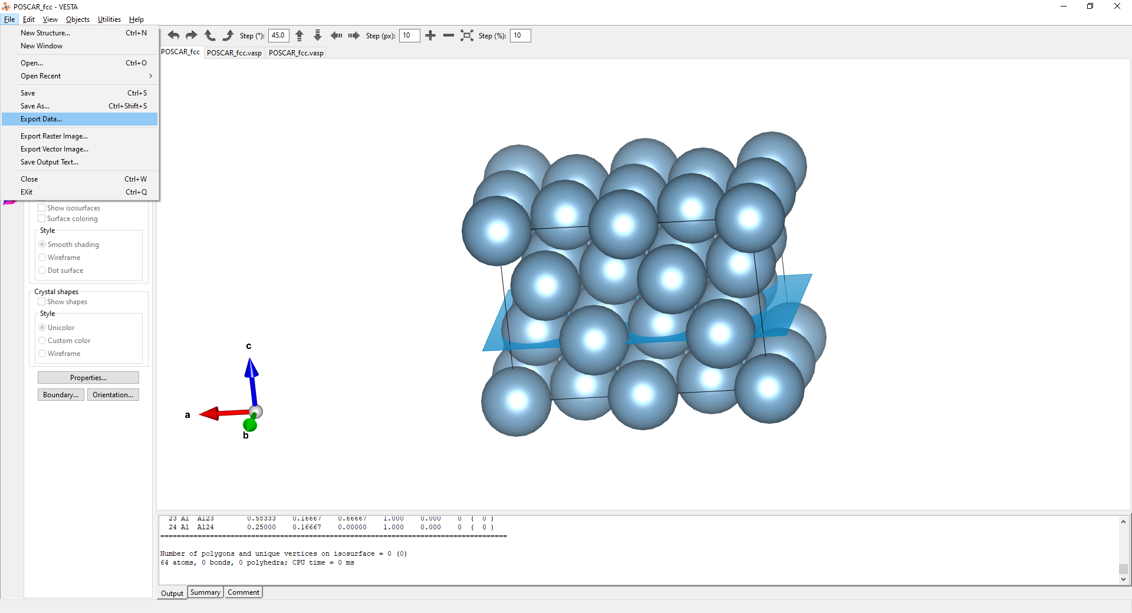
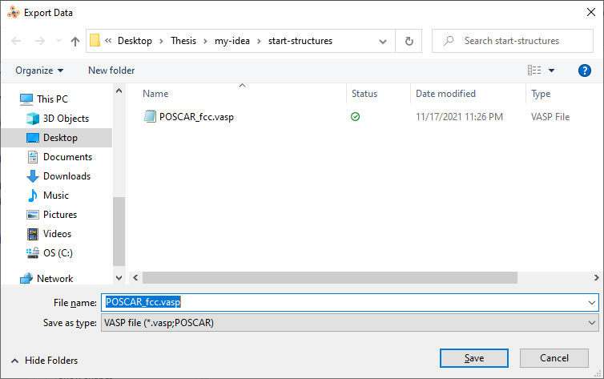
9. Export Data…
10. Save as VASP POSCAR
11. Drag and drop the new POSCAR into VESTA

Slide 8
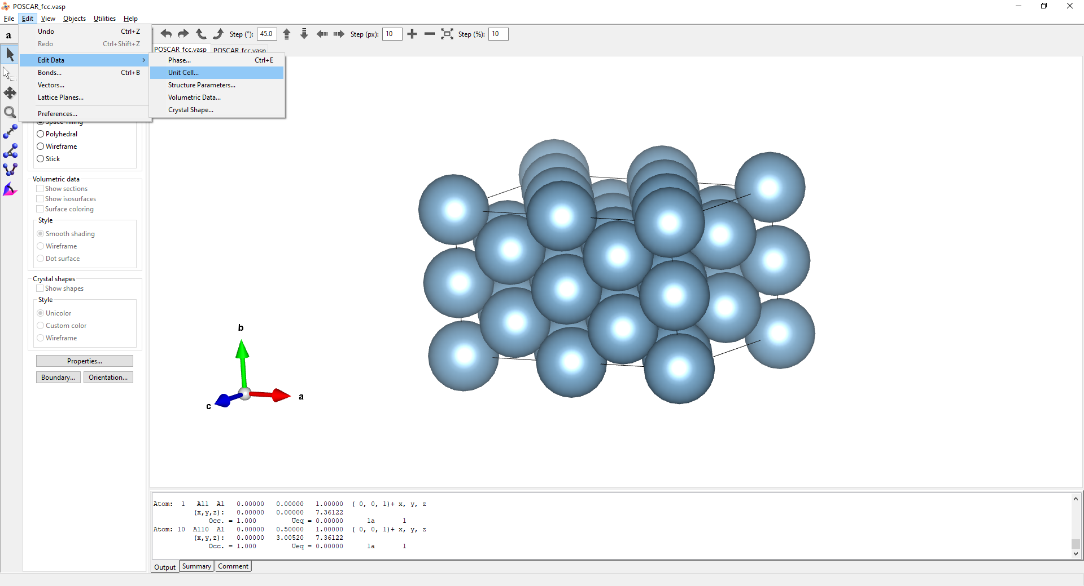
12. Edit > Edit Data > Unit Cell
13. Click Transform

Slide 9
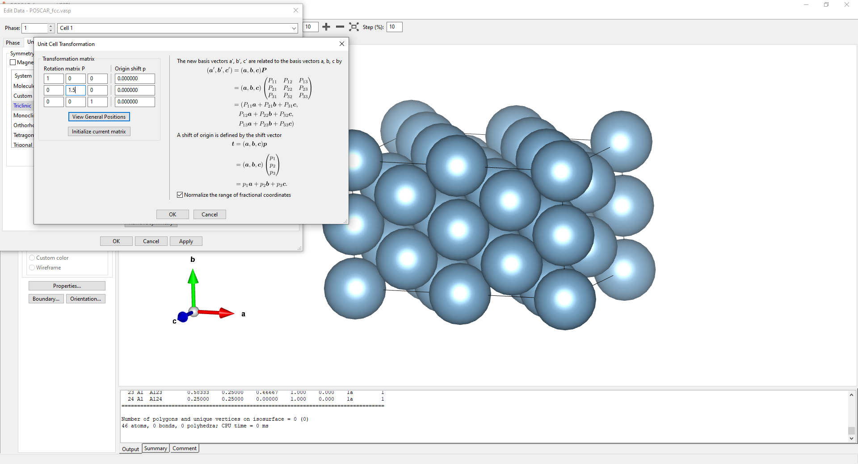
Adjust cell boundaries to change number of atoms in each layer (a,b) or number of layers in your slab model (c)

Slide 10
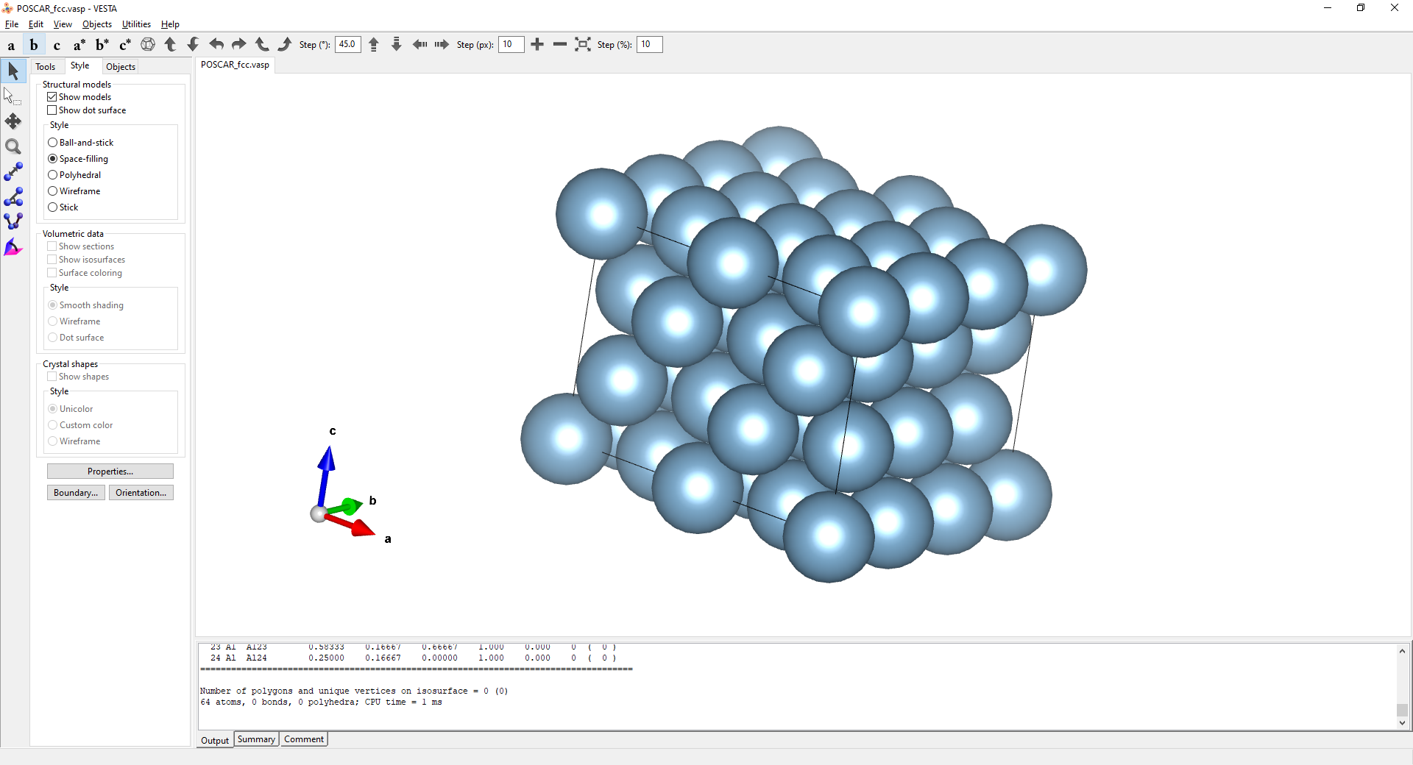
Here is a FCC slab model with 18 atoms/layer and 4 layers

Slide 11
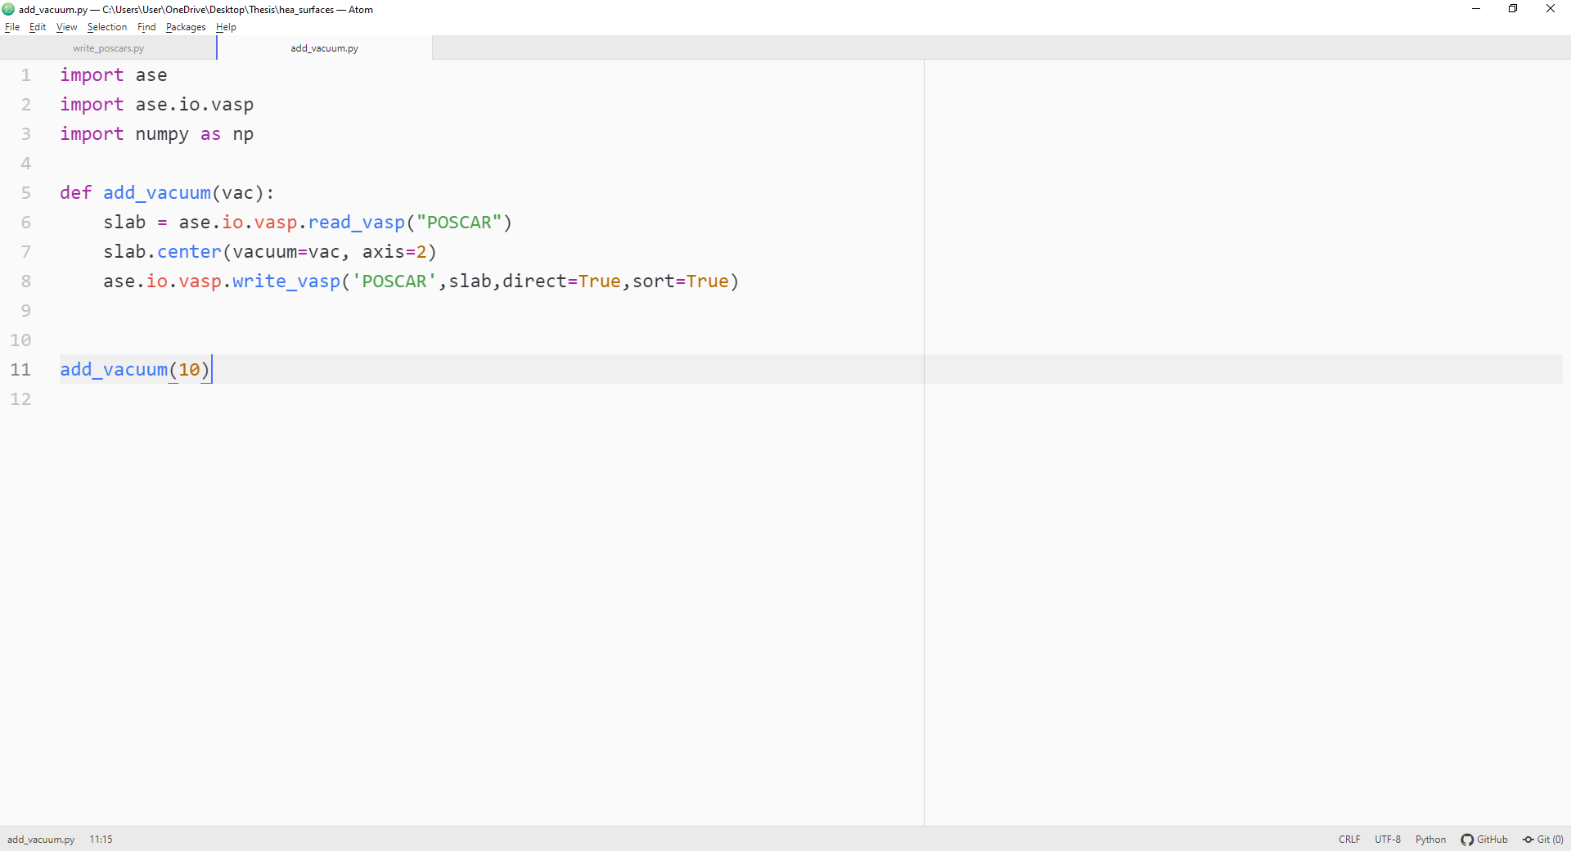
Easily add vacuum to surface slab using ASE

