Slide 1


1
Covid Care
Group 10

Slide 2
Description
It is no surprise that covid’19 has been so heavy on us. Thousands of people died everyday. But on the brighter side, the pandemic made us realize the vulnerabilities of our healthcare system which went unnoticed for years. That’s where the idea of CovidCare belongs to.

Slide 3
What’s the objective?
Detect covid-19 possibilities using the applications of machine
learning.
find reliable hospital information where Covid’19
patients are treated
crowds can be avoided.

Slide 4

3
Problems Faced
Inconvenient Communication
Not enough health records
Too many crowd
Harassment of the people
Negligence to maintain health guidelines

Slide 5
3
Plans to Solve
Help to Maintain guidelines
Better Communication
Regular Health Monitoring
Faster result during emergencies
Faster Consultation

Slide 6
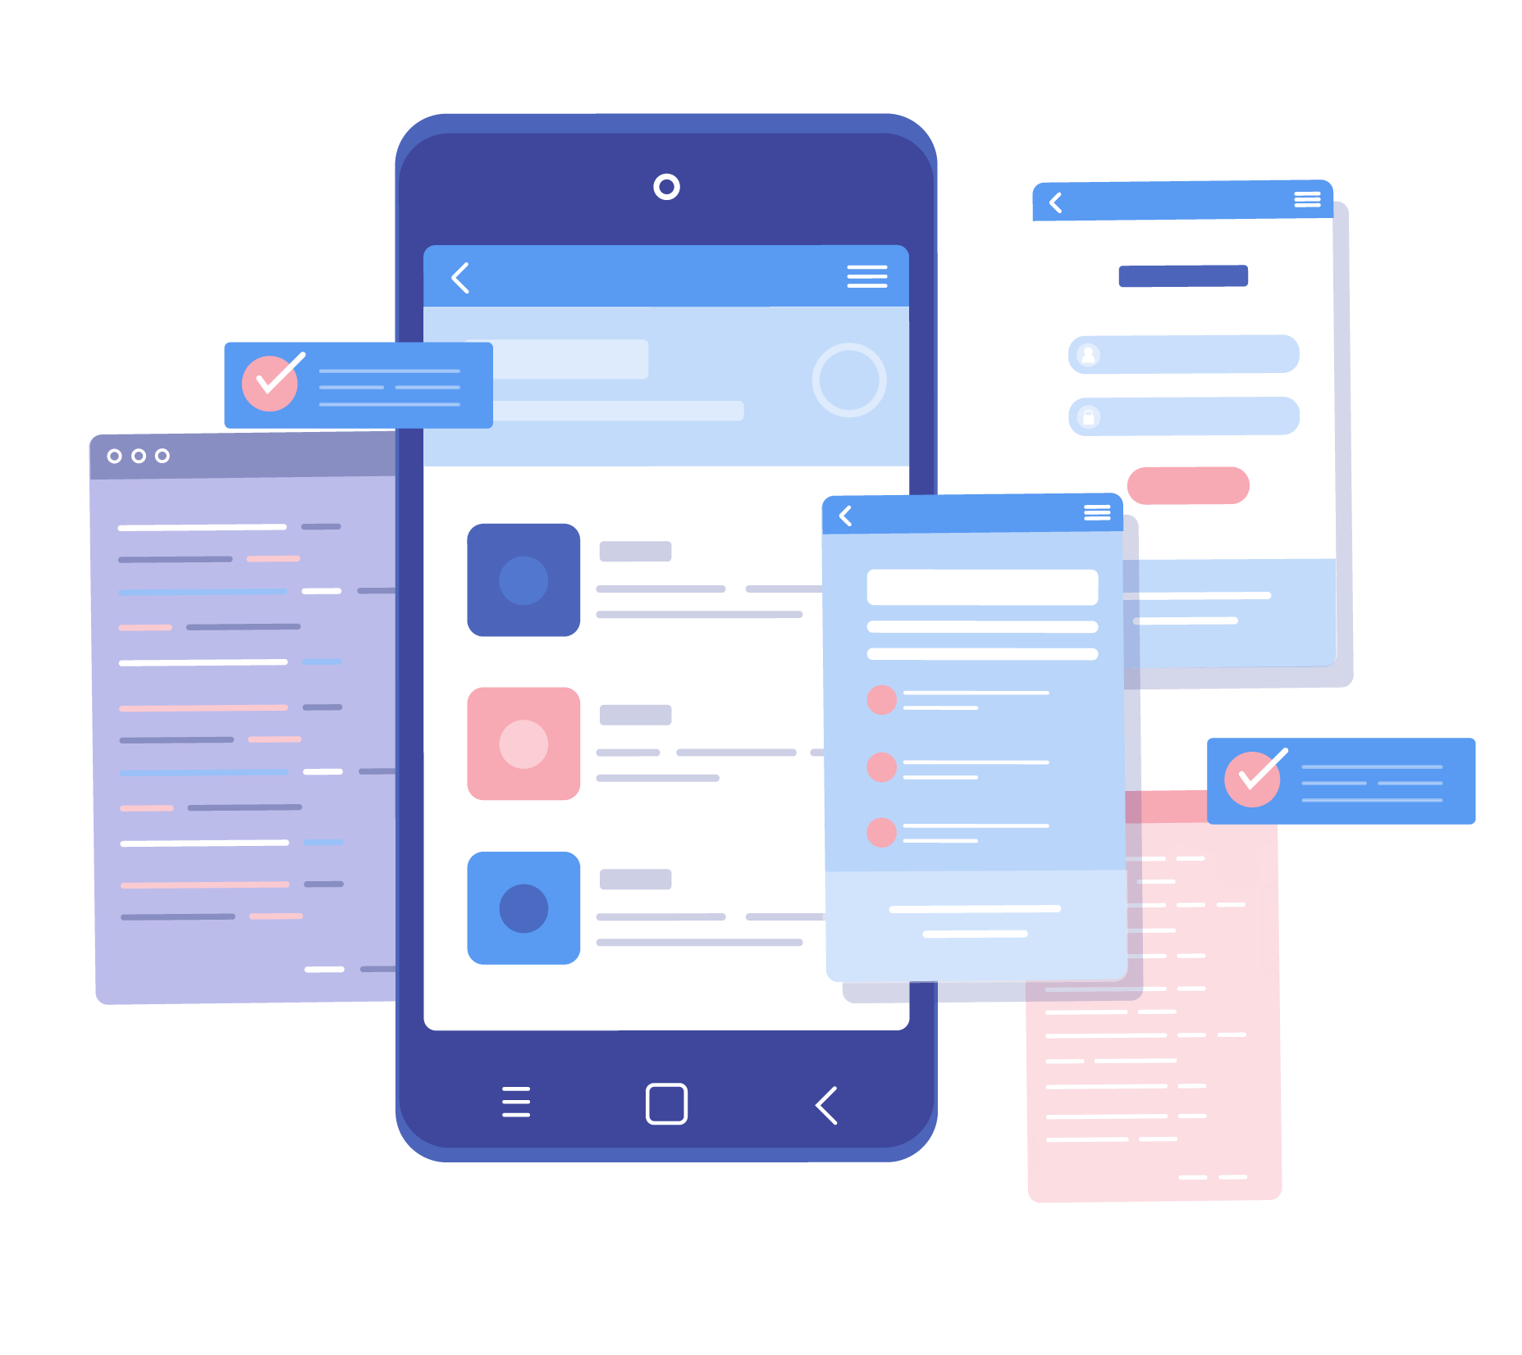
Application Features
4
Covid’19 possibilities detection
Information about hospitals from map
Health Record Keeper
Appointment system
Plasma Donation platform
Covid Updater

Slide 7
Home page / menu bar
6
A slider/menu bar will help users to switch from options in a faster way
This will offer more flexibility to the users

Slide 8


Firebase database
7
Firebase is used as the database of the application.
We need to store users data for further uses and login as well.

Slide 9
Covid Tracker
8
Worldwide covid updates can be showed in the app through this option
Details can be searched by regions also

Slide 10
BMI Calculator
9
Can easily calculate the BMI to maintain good health
Detailed updates of BMI related health hazards can be measured

Slide 11

Business opportunities
11
One of the early movers in Bangladesh
Each of our services adds value
Addition of wireless devices

Slide 12



14

