Slide 1
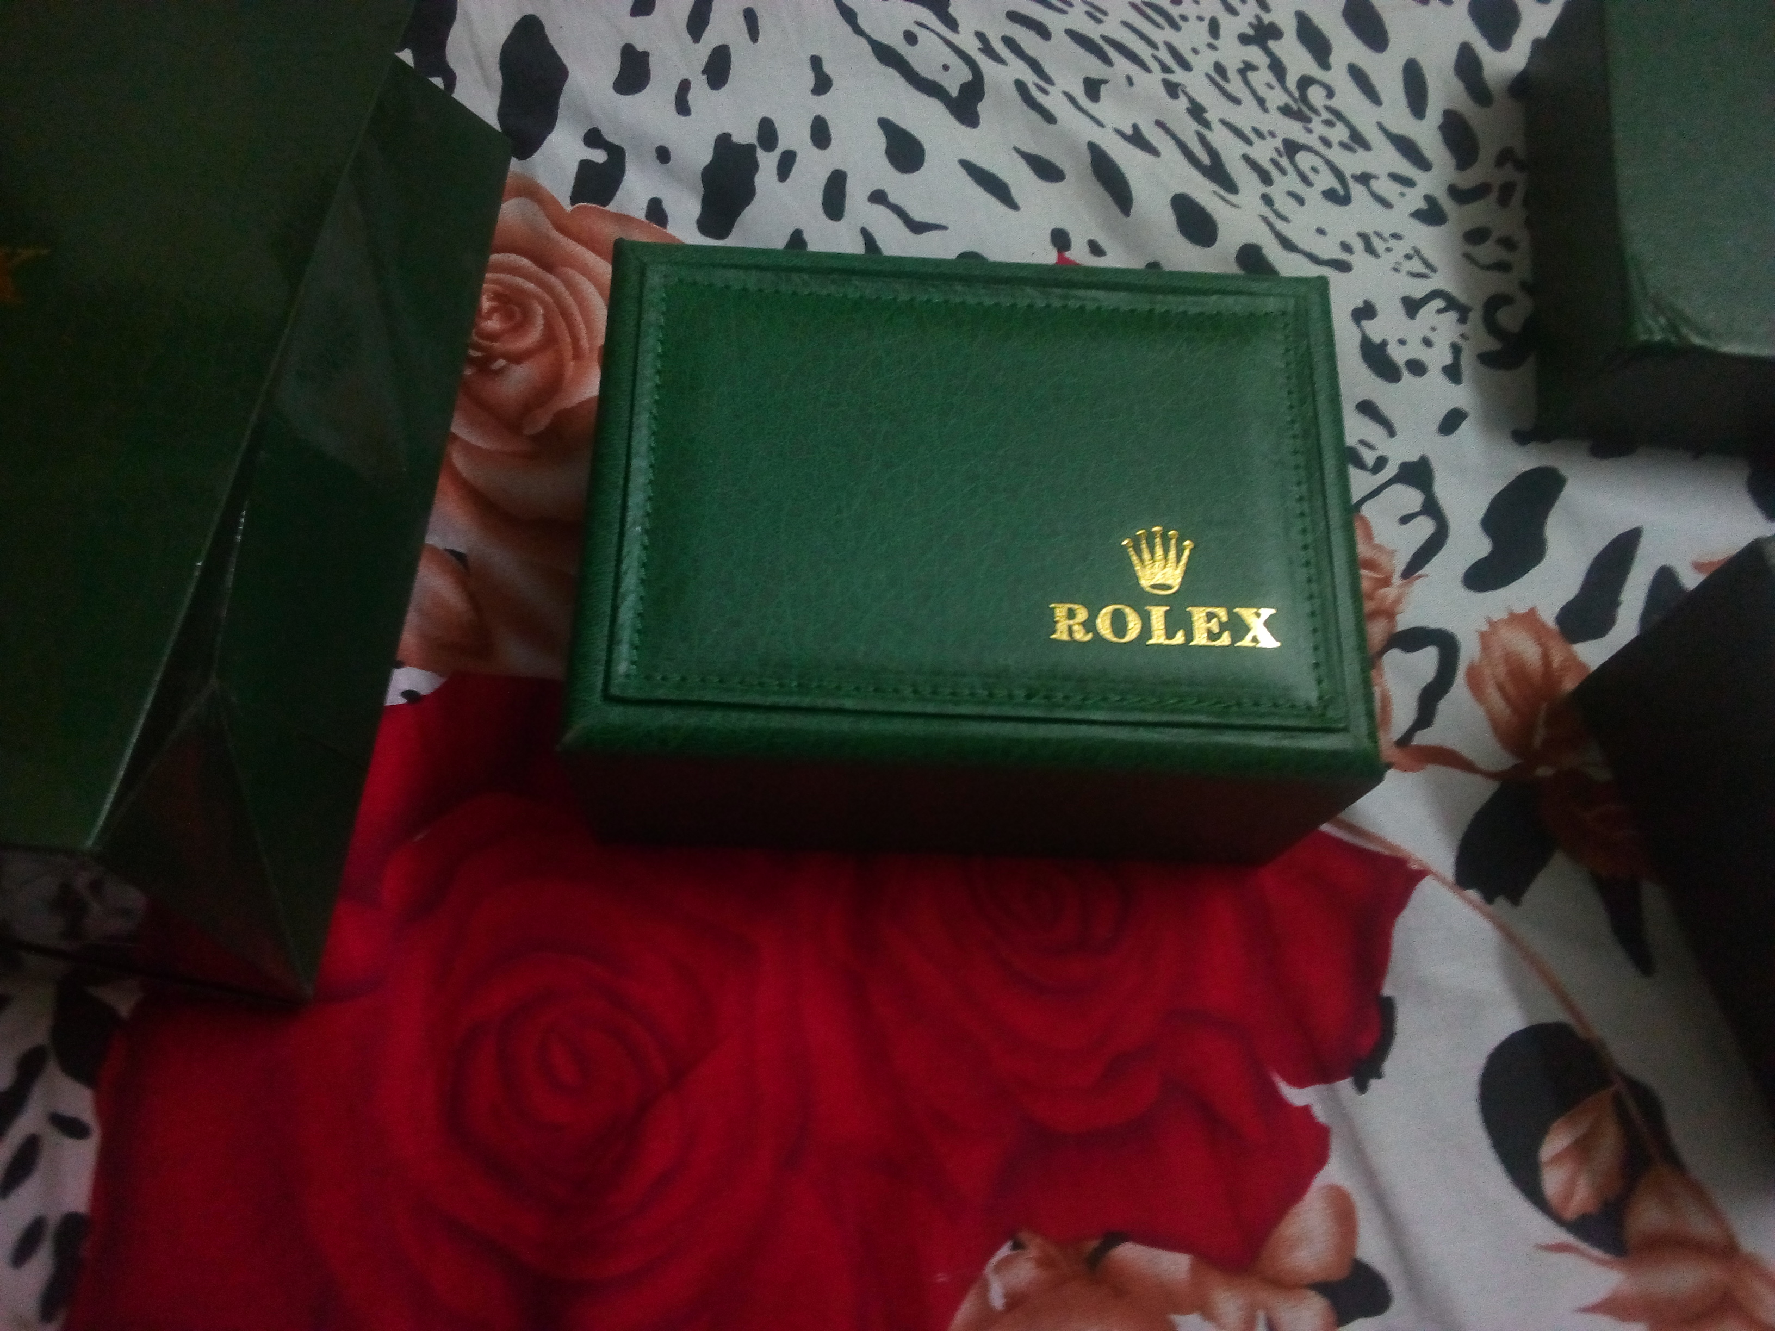
Rolex Counterfeit Papers and Box
Buy Rolex official counterfeit box and papers from us at a very low price.
To Buy, Contact us on freelance.tarek@gmail.com.
We ship it internationally. If you are wanting to buy then please contact us with your mail and we will give you some pictures of the Rolex box and papers in 24 hours.

Slide 2
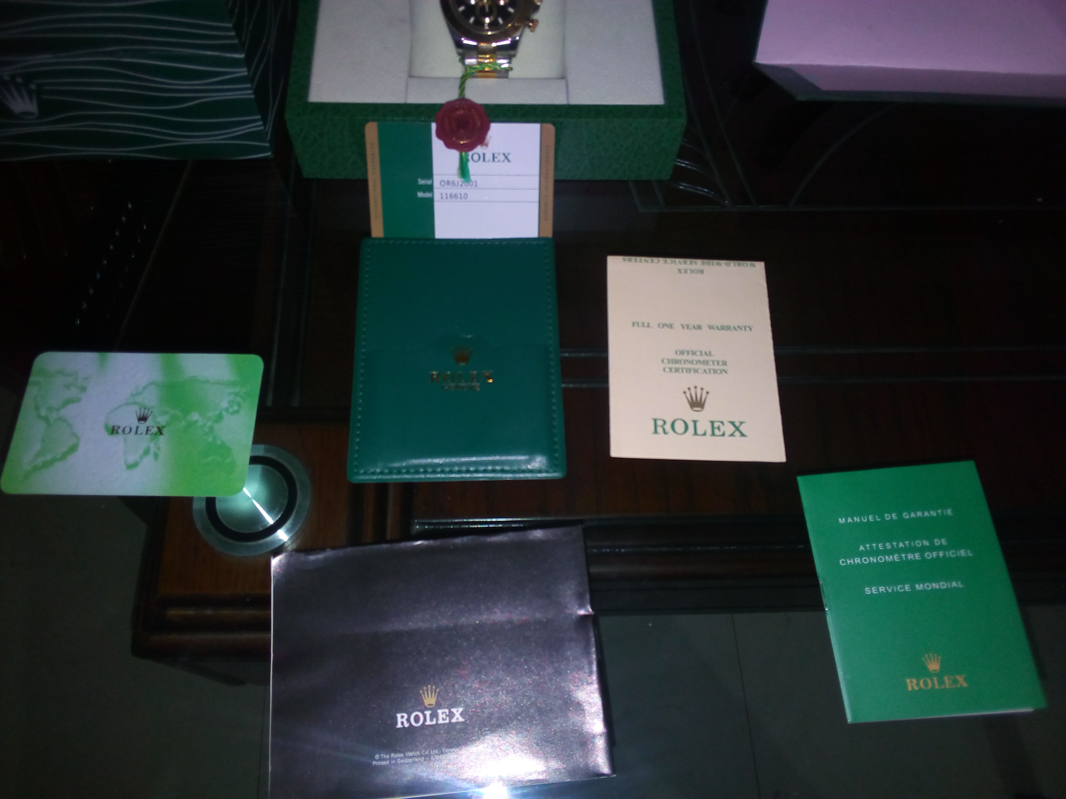
For Bangladeshi users, its available at Cash on Delivery.
Bangladeshi users can buy it on cash on delivery.
We are available with lots of (A Class) replica watches.
We are also offering 50% discount on the first order.
If you want some pictures of our products then mail us on that mail and we will give you some.
If you want more trust, then we will first give you a sample of our products. If liked then you can buy it.(only for Bangladeshi Users)

