Slide 1

GROUP 25
Md. Samir Hasan
201914045
Mahapara Naim
201914057
Lt. Mehedi Hasan
201814103

Slide 2

Members
Name of the project:
Members
Members
Temperature Controlled Fan

Slide 3
Components:
Arduino UNO
LCD display
LM35 Temperature Sensor
12V DC Fan
Bi-Polar LED Light
1k Resistors
12V Power Supply
5V Power Supply
L293D Motor Driver IC

Slide 4
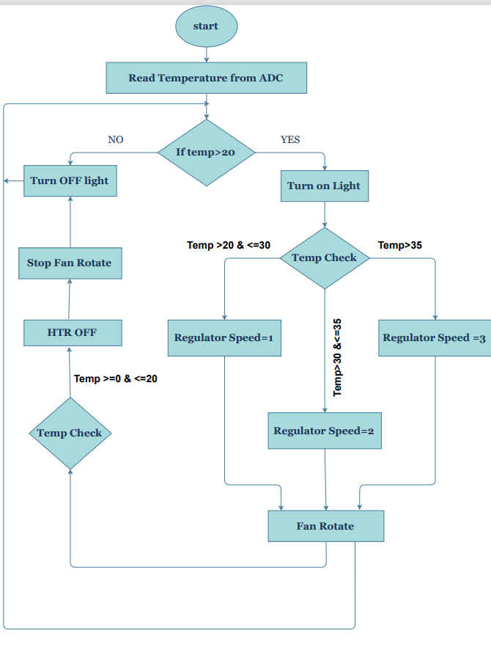

Slide 5
Procedure:
LM35 takes the surrounding temperature as analogue input.
It sends the data to Arduino UNOs analog input (A0 pin).
Arduino UNO, depending on the temperature can perform the following action:
FAN OFF: Power off the fan when temperature is below or equal to 20C. Show “Fan OFF” in LCD display. Power off the Bi-polar LED.
SPEED-1: Set the power of the fan to speed 1 when temperature is above 20C. Show “SPEED 1” in LCD display. Power the Bi-polar LED so that it glows Yellow.

Slide 6
3.SPEED-3: Set the power of the fan to speed 3 when temperature is above 35C. Show “SPEED 3” in LCD display. Power the Bi-polar LED so that it glows Red.
Arduino UNO sends the speed data to LM293D motor driver IC. The IC then powers the 12V motor using data provided by the microcontroller. Here, the IC is used because Arduino can provide a maximum of 5v power supply which is not enough to power the 12v DC motor.

Slide 7
Features:
Automatic regulation control using data provided by LM35 temperature sensor.
Fan speed display using LCD display.
Hazard level indication using BI-polar LED bulb. When temperature level is below 20C, the LED is off, indicating the off state of the fan. When temperature level is above 20C, the LED glows yellow, indicating safe zone. When temperature exceeds 35C, LED glows red, indicating danger zone.
The logic of temperature regulation is provided by Arduino UNO micro-controller.
The fan is operated by a high power DC motor.
The power of the motor is provided by L293D motor driver IC.

