Slide 1
Satellite
in orbit
ULFG
Samir Al Sabbagh / Dr. Wassim El Falou
2178

Slide 2
Introduction
Geostationary satellite
ISS (International Satellite Station)
GPS (Global Positioning System)
Simulation of two satellites (Custom Option)
Newton Law of gravitation and Rk4 (Numerical analysis)
Tkinter code description (GUI)

Slide 3
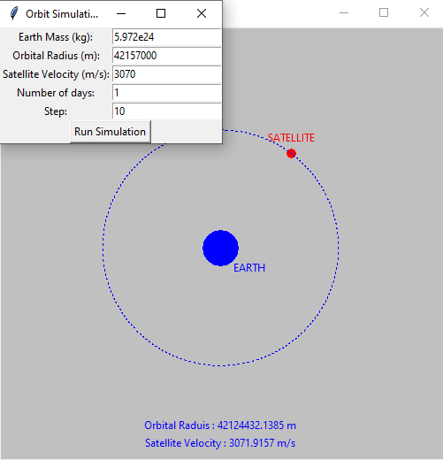
Geostationary (Circular)
It takes a full day (24 h) for a geostationary satellite to make one cycle around the earth
Earth mass is approximately constant
“Step” is the divider of a complete orbit in “linspace” function
Orbit
Live rk4

Slide 4
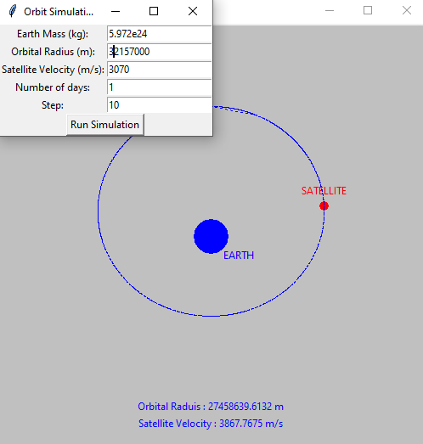
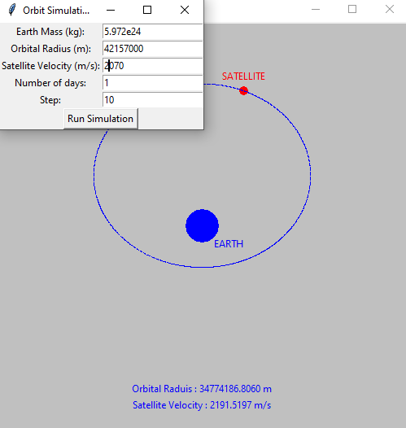
Geostationary
Small change in orbital radius have a lesser impact on the orbit than changing the velocity

Slide 5
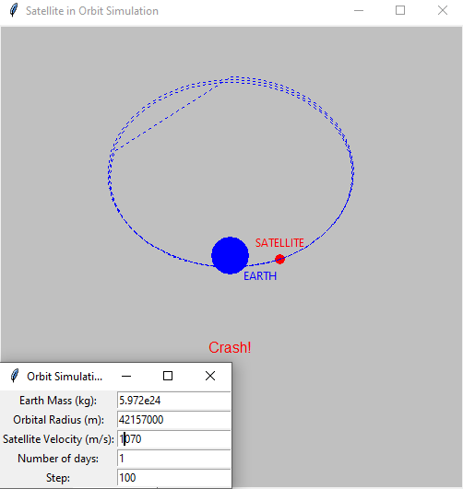
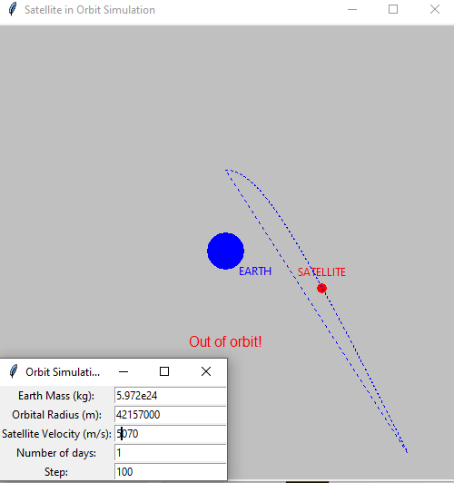
Geostationary
Changing the velocity (or orbital radius) by a lot results in two catastrophes

Slide 6
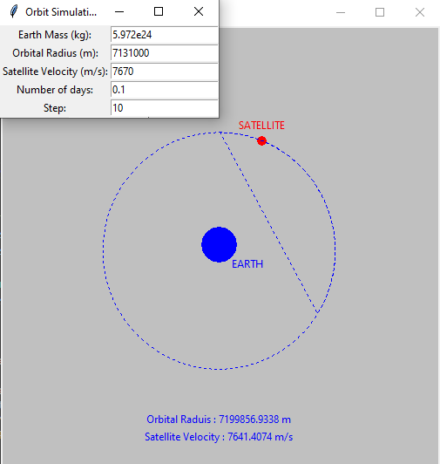
ISS (Circular)
It takes a 93 minutes for ISS to make one cycle around the earth
Earth mass is approximately constant
“Step” is the divider of a complete orbit in “linspace” function

Slide 7
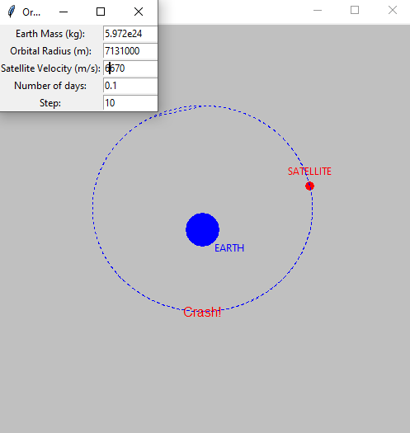
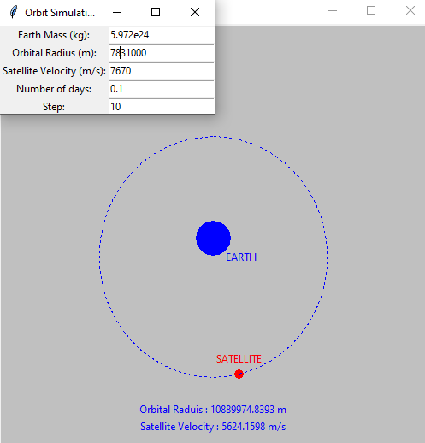
ISS
Immediate crash: ISS is too large and too close to earth
Small change in radius or velocity in ISs have a bigger impact than for geostationary because ISS is closer to earth

Slide 8
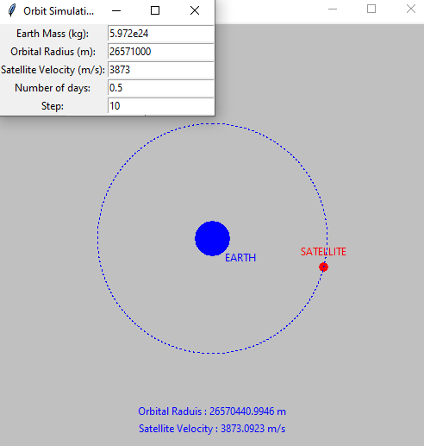
GPS (Circular)
It takes a 12 hours for GPS to make one cycle around the earth
Earth mass is approximately constant
“Step” is the divider of a complete orbit in “linspace” function

Slide 9
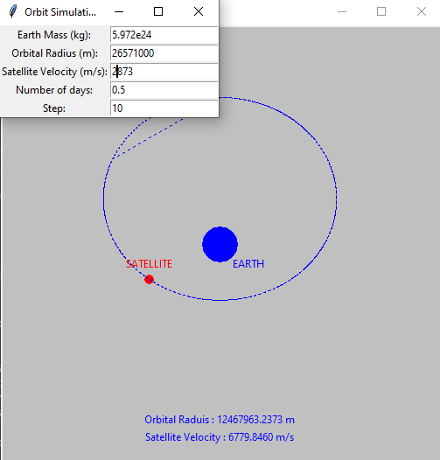
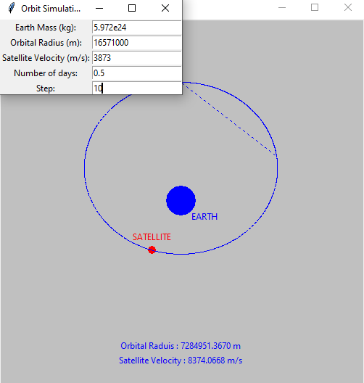
GPS
Small change in orbital radius have a Bigger impact on the orbit than changing the velocity

Slide 10
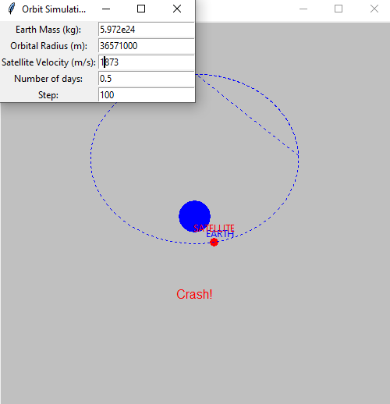
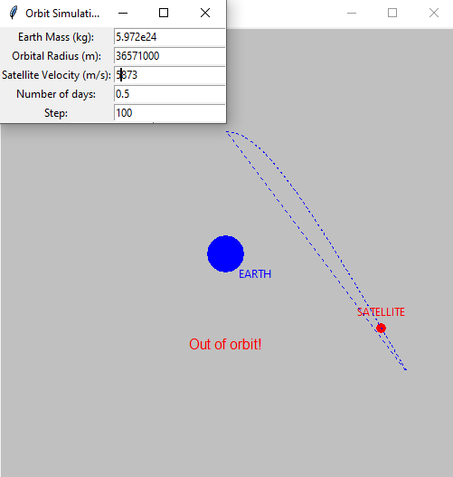
GPS
Changing the velocity (or orbital radius) by a lot results in two catastrophes

Slide 11
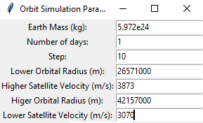
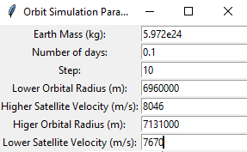
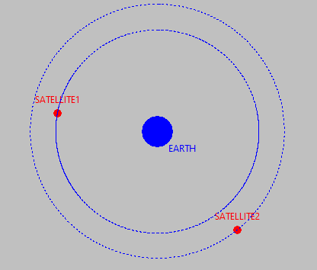
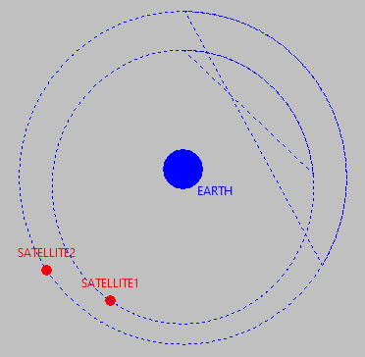
Custom
User-defined parameters
Further from earth and lower satellite mass
Closer to earth and higher satellite mass (that’s why there is a slight lack of precision)

Slide 12
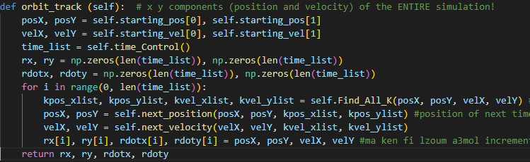
Numerical analysis
Using the newton law of gravitation: F= (G*m1*m2)/r^2
Find velocity of x and y-axis
I assumed that satellite mass is negligeable to earth mass
Now, having initial parameters, I find Ki
Do a step by step calculation of position
Do a step by step calculation of velocity
Step over time using NumPy library
Finish the process
Output will be used to draw the simulation

Slide 13
Tkinter GUi
“animation” function focuses on the external appearance and animations
“run_simulation” function runs the desired simulation based on the user’s defined parameters
“run_parameters” function runs the desired parameters based on the user’s choice
“choose_parameters” function runs the choice Tkinter window
At the end of my code, I created to first (choice) Tkinter window

Slide 14
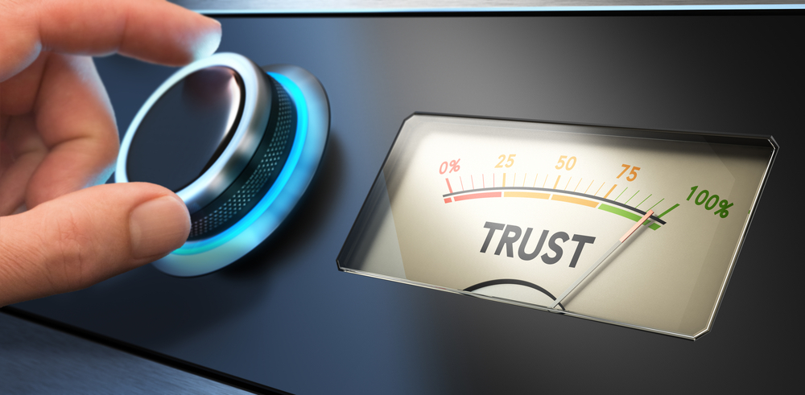
Thank you
Q/A

