Slide 1
Towards Detecting Political Bias in Hindi News Articles
Team 03
Muhtadi Zubair
ID: 22166041
SK.M.M. Samir Shakir
ID: 22366012
Ananya Rahaman
ID: 22366039

Slide 2
Abstract and Introduction
Biased news reporting issue
Paper focuses on political biasness
Annotated dataset
Different approaches to detect biasness

Slide 3
Dataset Description
Data Collection
Data Annotation
Dataset Analysis
Source
Extraction
Procedure
Annotator
Features
Classes
Instances of data

Slide 4
ML Models
mBERT
XLM-RoBERTa
INDICBERT
SVM
LR
RF

Slide 5
Result Analysis
Deep learning models perform better than Machine learning models
Simpler models can give decent results.
The model perform very well in biased classes but suffers heavily in neutral classes.

Slide 6
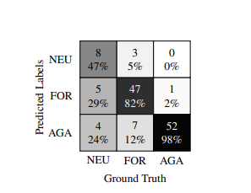
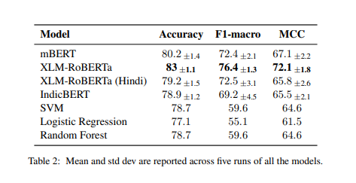
Result Analysis

Slide 7
Conclusion and future work
Proposed a dataset to detect biases in hindi news article.
Analyzed the difficulty level of each class
Provides several baseline models on the proposed dataset
Discussed some ethical and societal implication of the proposed work.
Aim to extend the system by shifting the focus from a particular political party
Propose a general approach for any set of political parties.

