Slide 1
SDS

Slide 2
Content
Architecture Diagram
Class Diagram & Class Descriptions
Sequence diagrams
State Diagram
SOLID Principles & Design Patterns
Tools

Slide 3
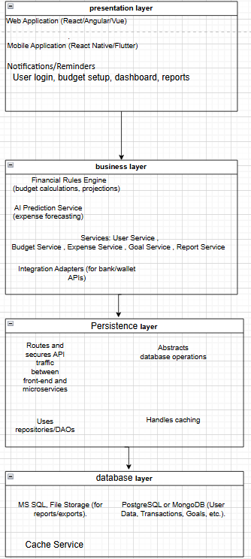
Architecture Diagram
Uses a Layered (N-tier) architecture to separate presentation, business logic, and data access layers.
This structure improves scalability, maintainability, and security.
It supports integration with external services like bank APIs and e-wallets.
Ideal for mobile/web apps backed by a cloud database.

Slide 4
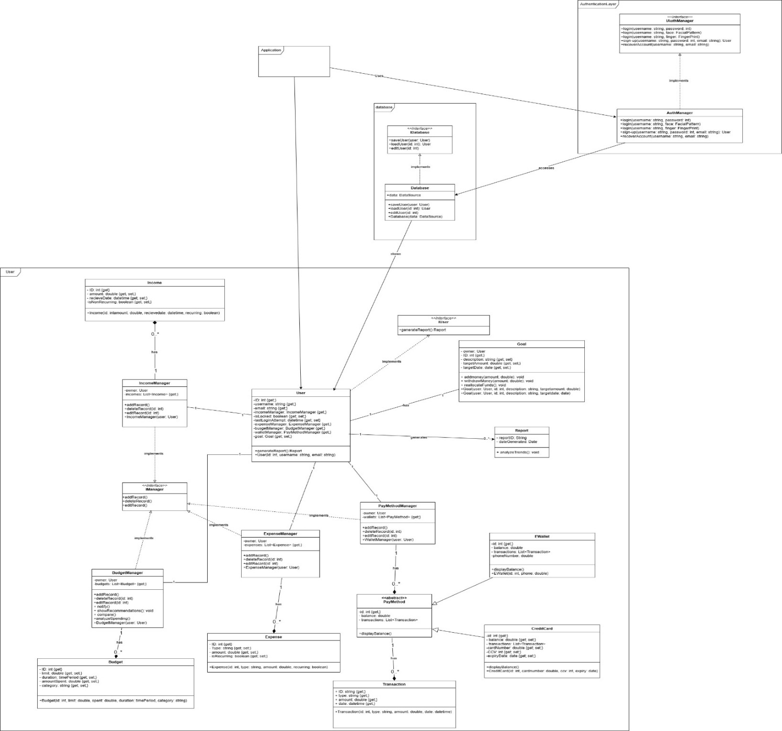
Class Diagram
Defines core system classes such as User, AuthManager, and BudgetManager.Each class has clear responsibilities and many follow interface-based design (IManager).Supports reusability and extension with inheritance (e.g., PayMethod, CreditCard, EWallet).Enables organized, object-oriented structure for development.

Slide 5
Class Description
AuthManager – Handles user authentication and recovery emails.
User – Stores user-related runtime data.
Database – Central interface for data storage, updates, and retrieval.
IncomeManager / ExpenseManager / BudgetManager / PayMethodManager – Manage user’s
income, expenses, budgets, and payment methods (all implement a shared interface).

Slide 6
Class Description – continued
Goal – Tracks a user's personal financial target and constraints.
Income / Budget – Store detailed income and budget data per user.
PayMethod (Abstract) – Base class for user payment methods.
CreditCard / EWallet – Inherit from PayMethod, adding card details or wallet phone number.
Transaction – Logs a payment method’s transaction details.Report – Generates performance
insights for the user's budgeting behavior.

Slide 7
Sequence Diagrams
Illustrate interactions between system components for specific user stories.
Covers flows like Sign Up, Login, Tracking Income, and Budgeting.
Helps visualize method calls between objects like AuthManager and Database.
Ensures all user functionalities are mapped to system logic clearly.
We did user stories : 1,2,3,4,6,7

Slide 8
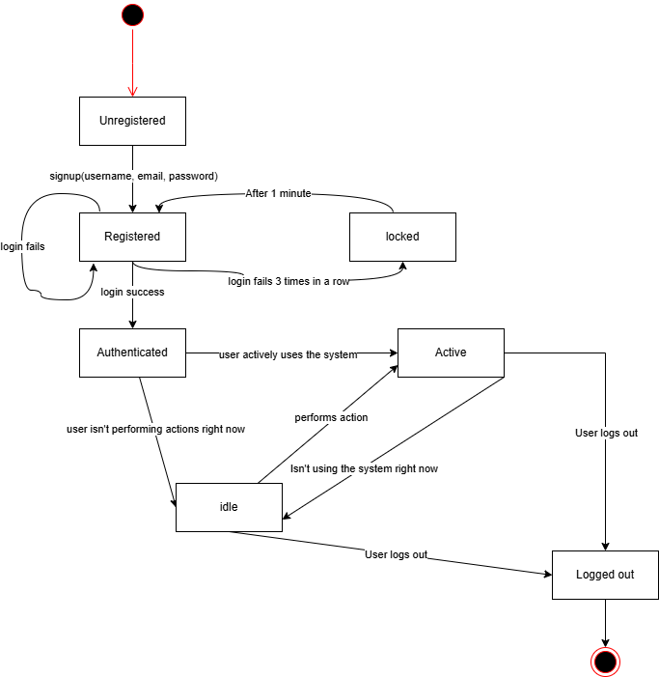
State Diagram
Focuses on the User class, showing states like logged in, editing profile, or managing budgets.
Captures dynamic behavior and transitions based on user actions.
Useful for understanding lifecycle and edge cases.
Enhances system reliability through clear state management.

Slide 9
SOLID Principles
Applies all five SOLID principles for clean and maintainable code.
Example: AuthManager follows Single Responsibility, and IManager supports Interface Segregation.
Open/Closed principle is applied by extending without modifying existing classes.
Encourages modular, testable, and scalable design.

Slide 10
Design Patterns
Implements Strategy Pattern for managers (IncomeManager, BudgetManager, etc.).
Factory Pattern is used for payment method creation (CreditCard, EWallet).
Singleton Pattern is applied to the Database class for global access.
These patterns improve flexibility, code reuse, and system consistency.

Slide 11
Tools
Used Draw.io and PlantUML for diagrams and modeling.
These tools ensure clear and professional visual documentation.
Support team collaboration and iterative design.
Helpful for maintaining a unified design standard throughout the project.

Slide 12
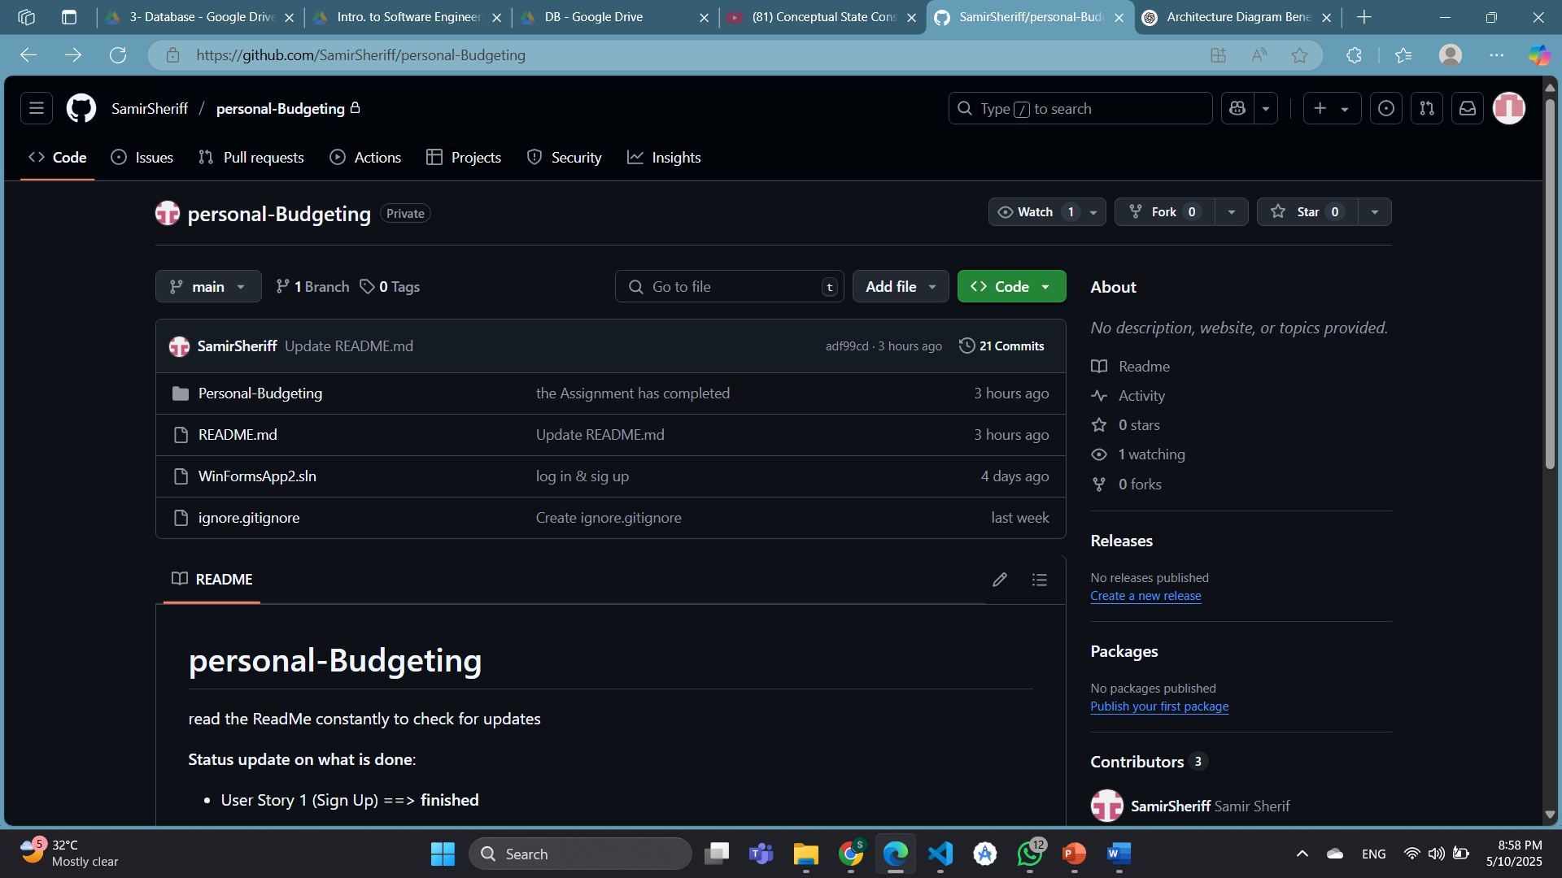
Tools – continued
Github

Slide 13
Thank you
Marawan mohamed
Ziad Sabri
Samir Sherif

