Slide 1


Reinforcement Learning for Continuous Control
Samir Wadhwania
MIT 6.881 Fall 2018

Slide 2
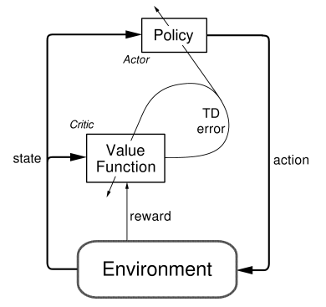
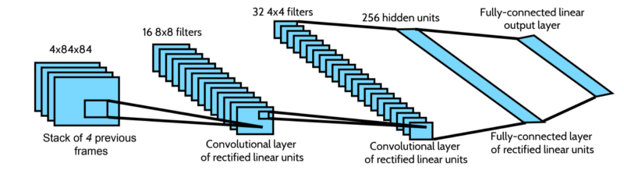
Background
Reinforcement learning aims to find a policy to maximize expected reward in a given environment
DDPG^{[3]} is an actor-critic algorithm that extends Deep Q-Learning^{[2]} to continuous domains
Variations of DDPG aim to reduce learning times and/or increase performance
Actor-Critic Architecture^{[1]}
I implemented Twin Dueling Deep Deterministic Policy Gradients^{[4]}
I implemented Twin Dueling Deep Deterministic Policy Gradients^{[4]} (TD3)
DQN Network Structure^{[2]}
[1] Sutton, Richard S., and Andrew G. Barto. Reinforcement learning: An introduction. (http://www.incompleteideas.net/book/the-book.html)
[2] Mnih et al. Playing Atari with Deep Reinforcement Learning.
[3] Lillicrap et al. Continuous Control with Deep Reinforcement Learning.
[4] Fujimoto et al. Addressing Function Approximation Error in Actor-Critic Methods.

Slide 3
The RL Environment
Making the PyDrake Simulator() work for Reinforcement Learning
Reset(): Pick a random initial state and reset the context (Kuka configuration)
Step(action): Simulate forward one time-step given the chosen action
  Action is a 7-vector representating a new relative configuration of the Kuka
  A JointSpacePlanRelative is solved with one time-step duration
  Simulator is simulated forward (StepTo) to the next time-step
Reward(state): Depends on the chosen reward function

Slide 4
Task/Reward Selection
I don’t have enough time for this
First choice: Learn to open the door
  Reward: Position of door (sparse)
Second choice: Place block in cabinet
  Reward: Position of block (dense, kind of)
  Contact dynamics are hard
Final choice: Reach specific position
  Reward: Position of EE (dense)

Slide 5
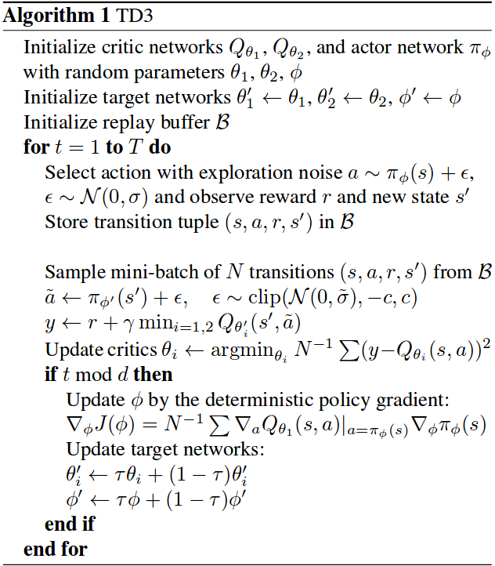
The TD3 Algorithm
Very similar to DDPG in that it is a deterministic actor-critic algorithm
Key contribution: maintain two
Q-Functions the minimize error
TD3 Algorithm^{[1]}
[1] Fujimoto et al. Addressing Function Approximation Error in Actor-Critic Methods.

Slide 6
Results
Better than random
Random Initialization

Slide 7
Results
Better than random
Block represents goal
Constant goal, random starting EE pose
Mean reward: -27.83
Avg distance: 0.37m
Time spent training:
~ 15 hours
Final Policy
Random Initialization

Slide 8
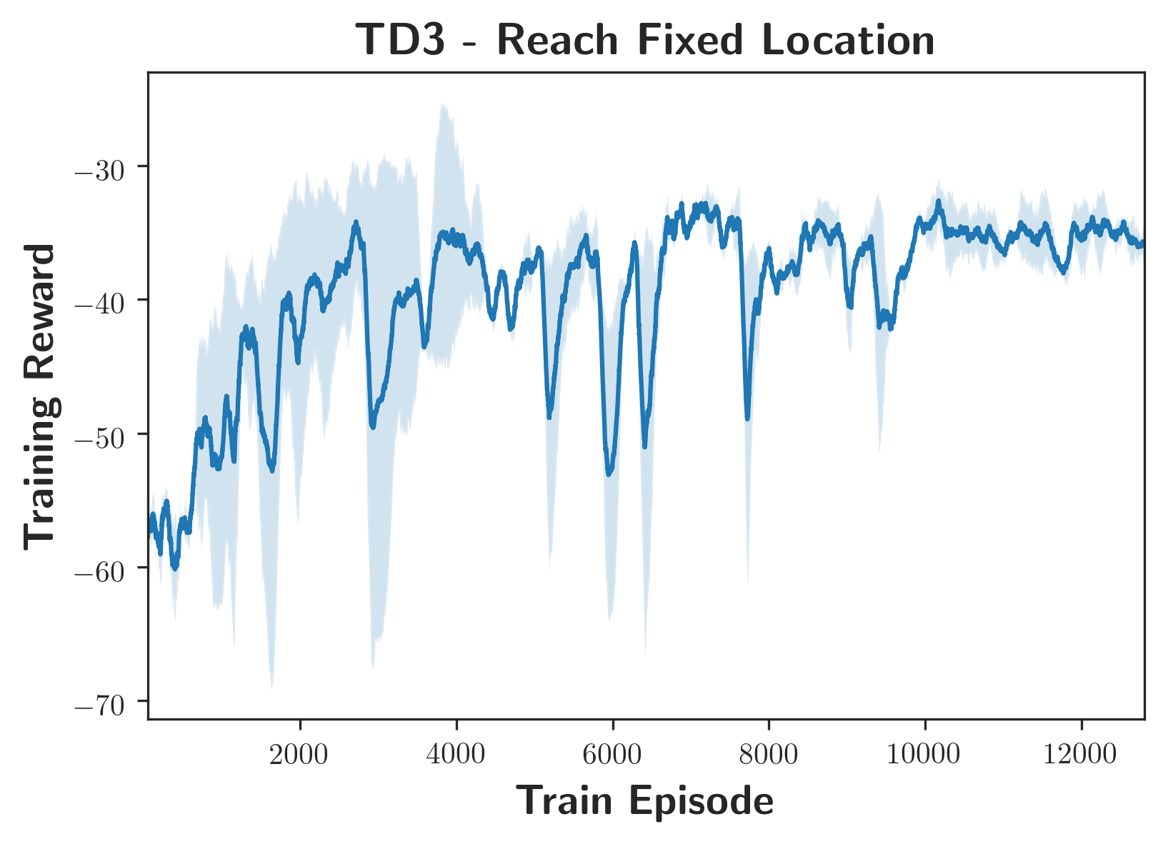
Results
Better than random
Block represents goal
Constant goal, random starting EE pose
Mean reward: -27.83
Avg distance: 0.37m
Time spent training:
~ 15 hours

Slide 9
Soft Actor Critic
Thanks for eating up my Amazon credits
Stochastic policy
Maximizes entropy during learning
Failed spectacularly
SAC

Slide 10
Questions?
Presenter: Samir Wadhwania
Contact: samirw@mit.edu

