Slide 1



Checkpoint: Introduction to Databases
The three relational RDBMS :
MySQL, PostgreSQL and SQL SERVER

Slide 2
Plan
MySQL and their Features
PostgreSQL and their Features
SQL Server and their Features
MySQL vs PostgreSQL vs SQL Server: Popularity
MySQL vs PostgreSQL vs SQL Server: Speed
MySQL vs PostgreSQL vs SQL Server: Performance
MySQL vs PostgreSQL vs SQL Server: Ranking Score

Slide 3
MySQL (Structured Query Language)
MySQL :
is an open-source database management system developed by the Oracle Corporation.
It is more of a relational database system thus stands as RDBMS.
is a form of database for storing data in a closely structured format using rows and columns format.

Slide 4
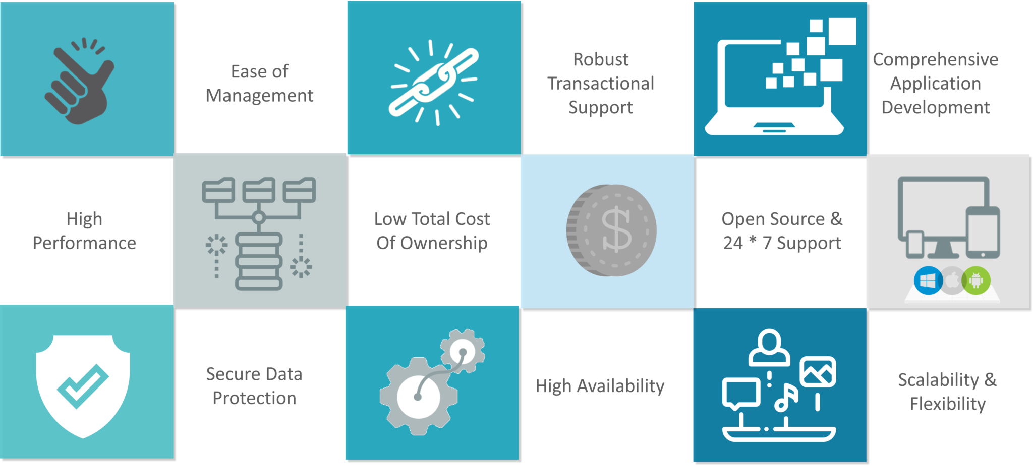
MySQL Features

Slide 5
PostgreSQL
PostgreSQL
is a powerful, open source object-relational database system
uses and extends the SQL language combined
safely store and scale the most complicated data workloads.

Slide 6
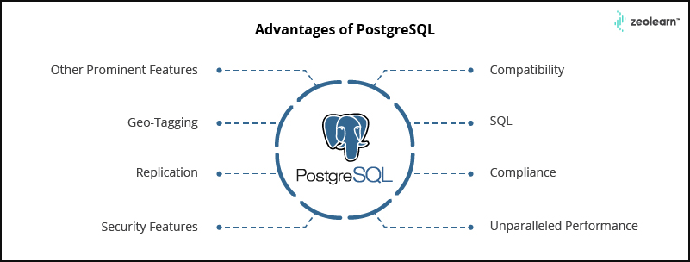
PostgreSQL Features

Slide 7
SQL Server
The SQL Server
is a relational database management system from Microsoft.
The system is designed and built is to manage and store information.
The system supports various business intelligence operations, analytics operations, and transaction processing.

Slide 8
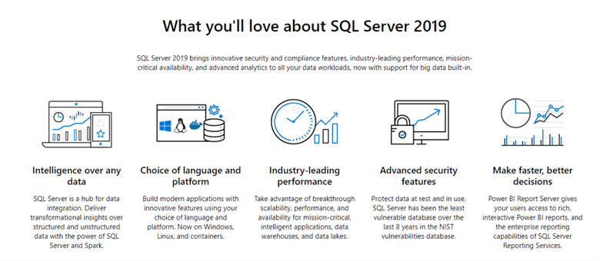
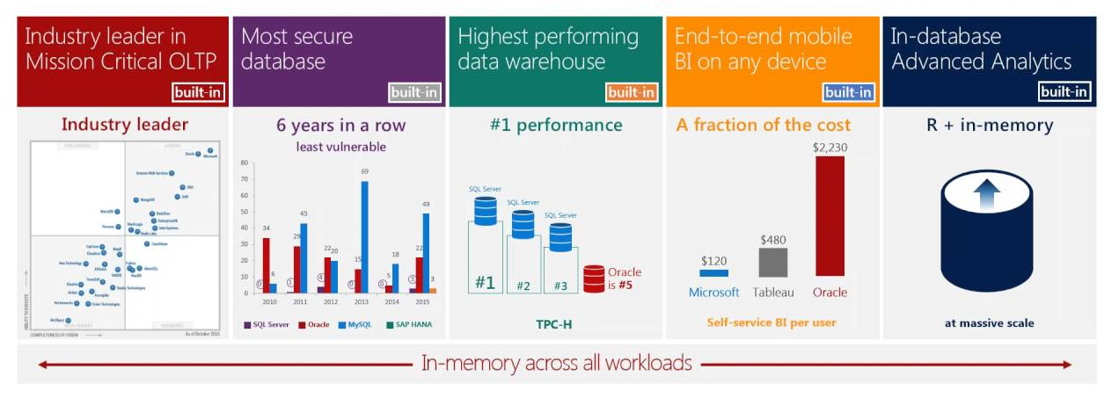
SQL Server Features

Slide 9
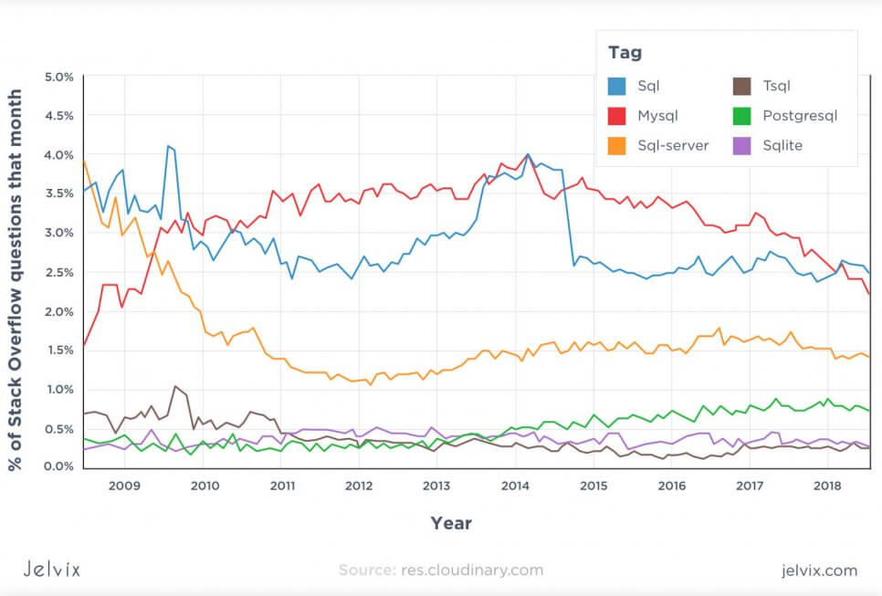
MySQL vs PostgreSQL vs SQL Server: Popularity

Slide 10
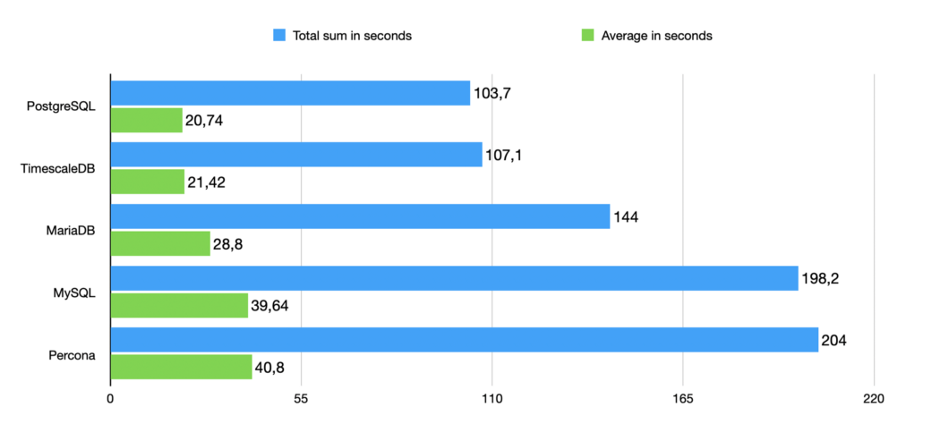
MySQL vs PostgreSQL vs SQL Server: Speed

Slide 11
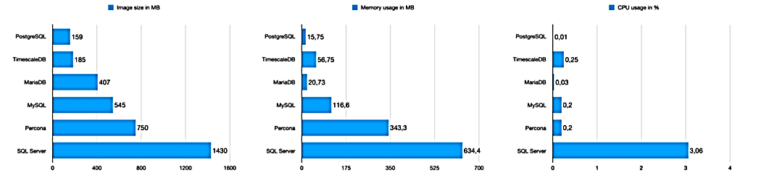
MySQL vs PostgreSQL vs SQL Server: Performance

Slide 12
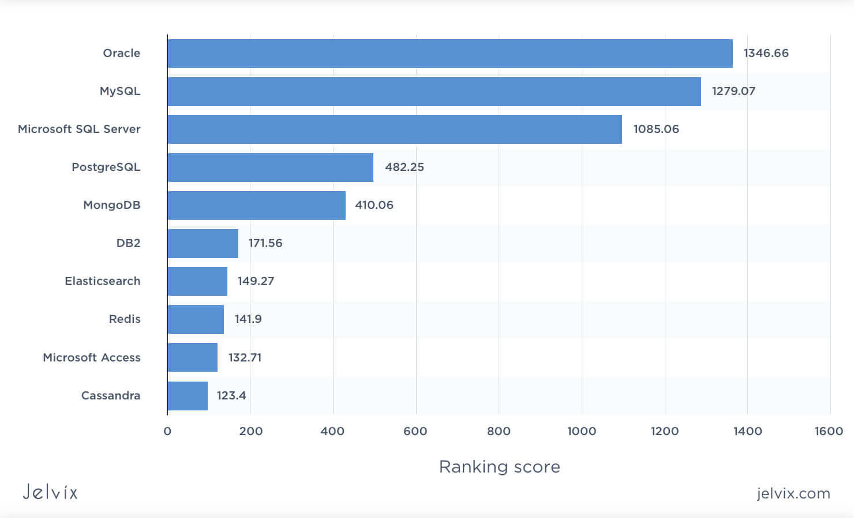
MySQL vs PostgreSQL vs SQL Server: Ranking Score

