Slide 1

Lab 5 Assignment
Advanced R
Team 13
Fatemeh & Samira

Slide 2
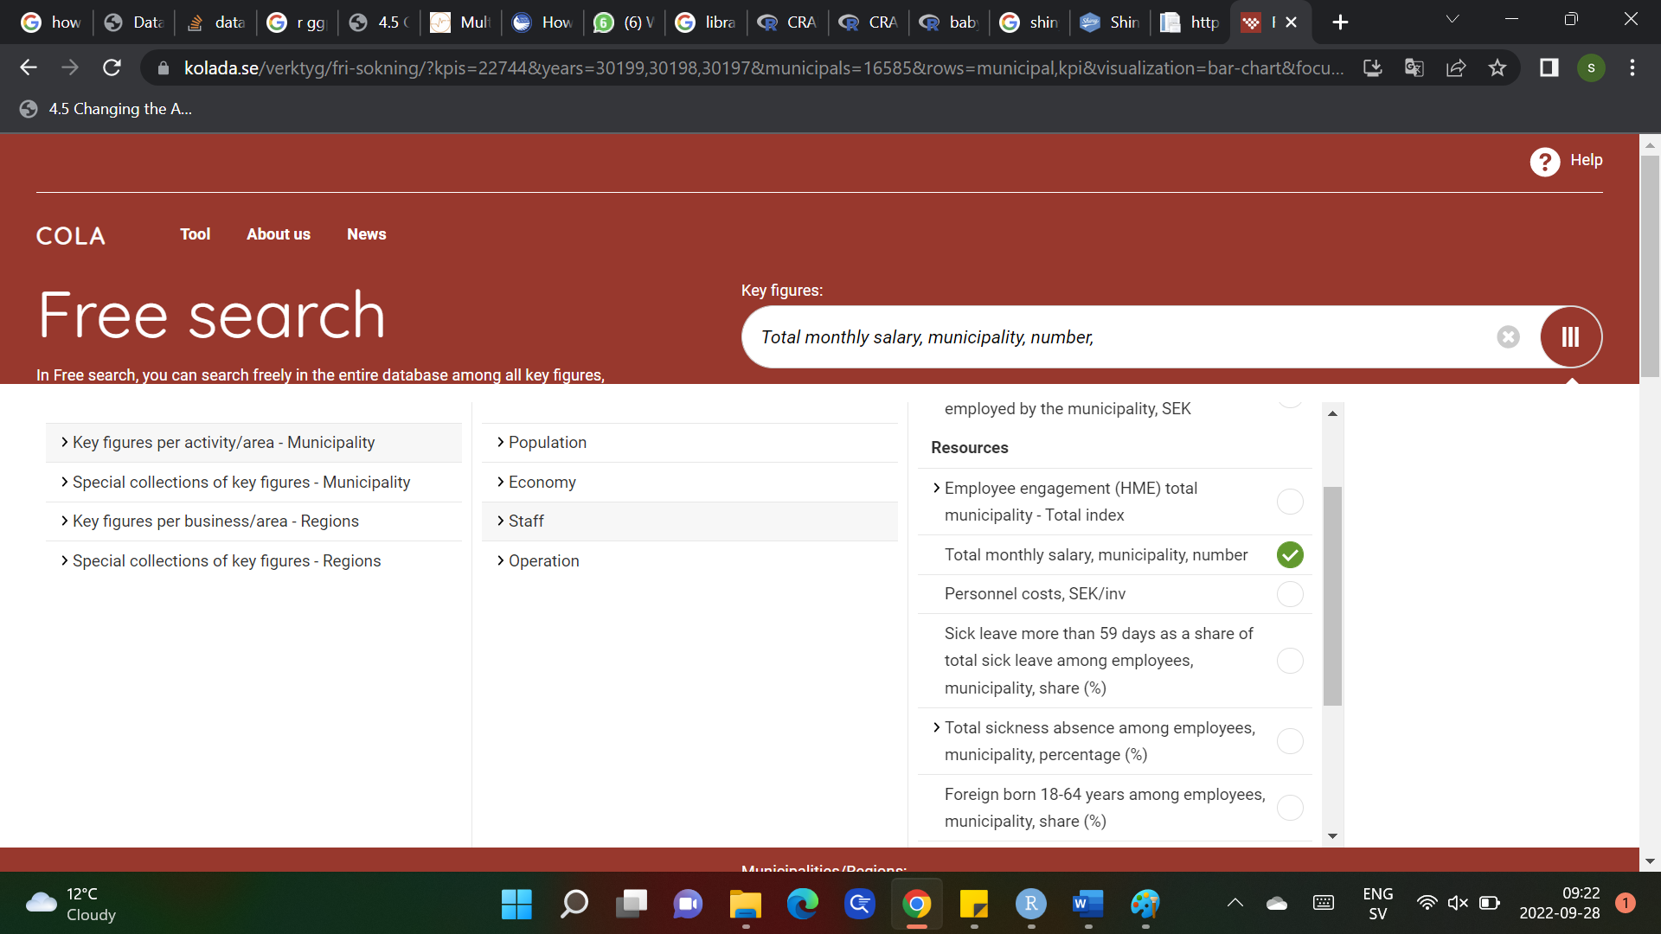


Slide 3


