Slide 1
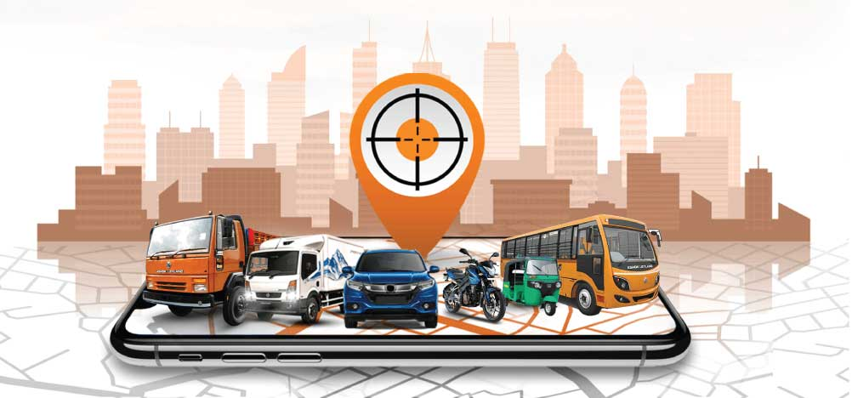
Dhaka Public Bus Live
Tracking System Using GPS
A Technology-Based Solution for Public Transportation
Kazi H. Robin
Associate Professor, MSc UEL
Associate Professor, Department of Computer Science & Engineering
Sakhawat Hossain
73A/5226
Computer Science and Engineering
Notes:
Good morning everyone. My topic is a live bus tracking system for Dhaka using GPS. It is a technology-based idea to make public bus travel easier for passengers.

Slide 2



Introduction and Problem
Many passengers
Uncertainty
Delays
Dhaka has a large number of daily public bus passengers.
Passengers often do not know where a bus is or when it will arrive.
Long waiting times and uncertain arrival times cause inconvenience and delays.
2
Notes:
Every day, a large number of people in Dhaka depend on public buses. The main problem is that passengers do not know where the bus is or when it will come. This means long waiting and uncertainty, which can make people late for work or class.

Slide 3




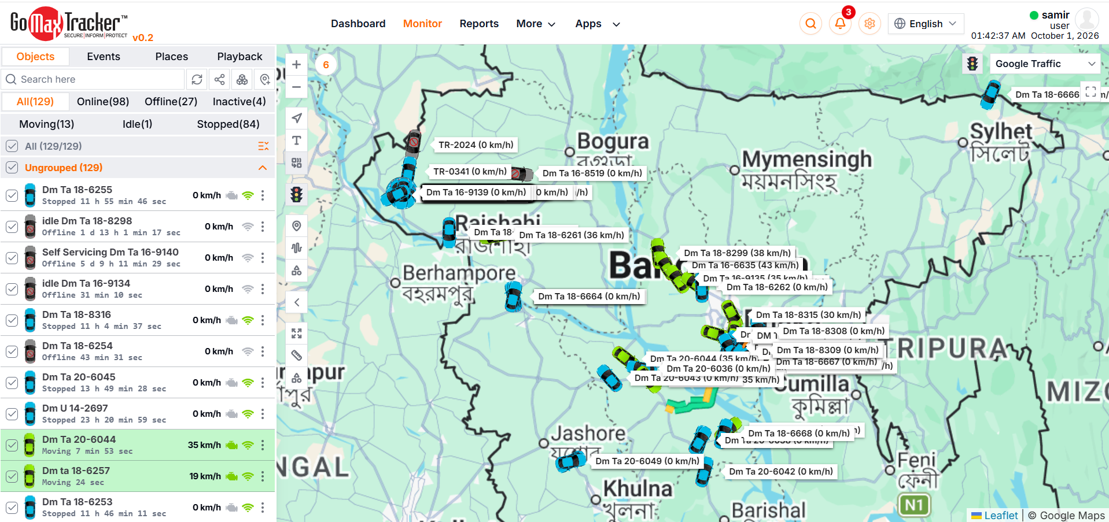
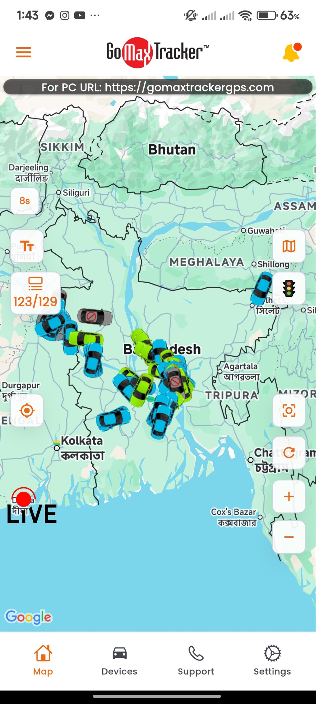
Proposed Solution
Install GPS
Send live data
Process in cloud
Show in app
GPS tracking devices are installed in buses.
Location data is sent through mobile internet.
A cloud server processes the data.
Live bus locations and estimated arrival times appear in a mobile app.
Example: a real GPS tracking platform already shows live vehicle positions in a web dashboard and a mobile app (see slide 6).
3
Notes:
My solution has four parts. First, we install GPS devices in buses. Second, the location is sent through mobile internet. Third, a cloud server processes the data. Finally, a mobile app shows the live bus location and the estimated arrival time to passengers.

Slide 4


Technologies Used
GPS
IoT
Mobile Application
Finds the bus location
Connects the bus device to the network
Shows information to passengers
Cloud Computing
Mobile Internet / 4G
AI (optional)
Stores and processes the data
Sends data from the bus
Can help predict arrival time (ETA)
4
Notes:
These are the technologies used. GPS finds the location. IoT connects the device to the network. The mobile app shows information to passengers. Cloud computing stores and processes the data, and mobile internet sends it. AI is optional and can help predict the arrival time.

Slide 5



How It Works
Bus
GPS Device
Mobile Internet / 4G
Cloud Server
Mobile App
Passenger
›
›
›
›
›
The bus runs on its route.
Finds the bus location.
Sends location data online.
Stores and processes data, and calculates ETA.
Shows live map and arrival time.
Plans the trip using live information.
5
Notes:
Here is the full flow. The bus moves on its route. The GPS device finds its location. The data goes through mobile internet to a cloud server. The server processes it and calculates the arrival time. The mobile app shows this to the passenger, who can then plan the journey.

Slide 6
Real-World Example: GPS Tracking Platform
Web dashboard: live location, speed and status of vehicles
Mobile app
6

Slide 7






Benefits
Live bus location
Reduced waiting time
Better journey planning
Easier bus monitoring
Useful transportation data
More organized public transportation
7
Notes:
The main benefit is that passengers can see the live bus location, so waiting time is reduced and they can plan their journey better. Bus operators can monitor buses more easily. The collected data can also be useful for transportation planning, and the whole system becomes more organized.

Slide 8





Challenges
GPS device and maintenance cost
Internet / data cost
Bus operator cooperation
Traffic can affect ETA accuracy
GPS accuracy limitations
Privacy and data security
Smartphone / internet access limitations
8
Notes:
Every idea has limits. There is a cost for devices, maintenance and internet. Bus operators need to cooperate. Traffic can affect arrival time accuracy, and GPS is not always perfectly accurate. We must also protect privacy and data, and remember that not everyone has a smartphone or internet access.

Slide 9
Conclusion
1
GPS and IoT devices collect live bus location data.
2
Cloud computing processes the data and prepares arrival times.
3
Mobile apps give passengers clear information, so they can plan trips and wait less.
9
Notes:
To conclude: GPS and IoT collect live location data, cloud computing processes it, and a mobile app shows it to passengers. Together they can make bus travel in Dhaka more organized and less stressful. Thank you. I am happy to answer questions.

