Slide 1
Movie Actor Finder Project
Helps you find where to watch your favorite actor

Slide 2
Movie Actor Finder - Elevator pitch
Do you have a favorite movie actor? Would you like to easily learn how to watch your favorite actor in your favorite movies? The Movie Actor Finder application allows you to search for movies by an actor’s name and not only see a list of the movies the actor is in but also get information on what platforms those movies are being shown right now.

Slide 3
Concept
Description: an application to locate movie venue/platforms for a particular actor
Motivation for development: we like movies but sometimes with all of the different movie platforms (Netflix, HBO, iTunes, Amazon, etc.) it is hard to know where to find movies that your favorite actor is in
User story: As a movie watcher, I want to be able to search for movies by an actor’s name and see a list of movies that actor is in and also see what venues I can watch those movies today

Slide 4
Process
Technologies used
CSS – Bulma
APIs:
Data-IMBD1 – to get actor id
Data-IMBD1 – to get movie titles
Utelly-TV-Shows-and-Movies – to get current venues for each movie
Breakdown of tasks and roles
Sam – responsible for page formatting, utilized Bulma, setup initial page, search bar and background
Taylor – responsible for search bar code, callable modal, when scrapped due to API problems, helped complete JS code to present data from APIs, helped merged code from feature branches
Brad – responsible for APIs and PowerPoint presentation, helped merge code from feature branches
Joey – responsible for initial page structure and modal
Challenges – orignal plan to show snippets of videos didn’t work due to lack of API documentation / we couldn’t get the API to work. Switched to venue information instead of movie snippets.
Successes – utilized Bulma’s card functionality to quickly format data cards for each movie

Slide 5
Demo

Slide 6
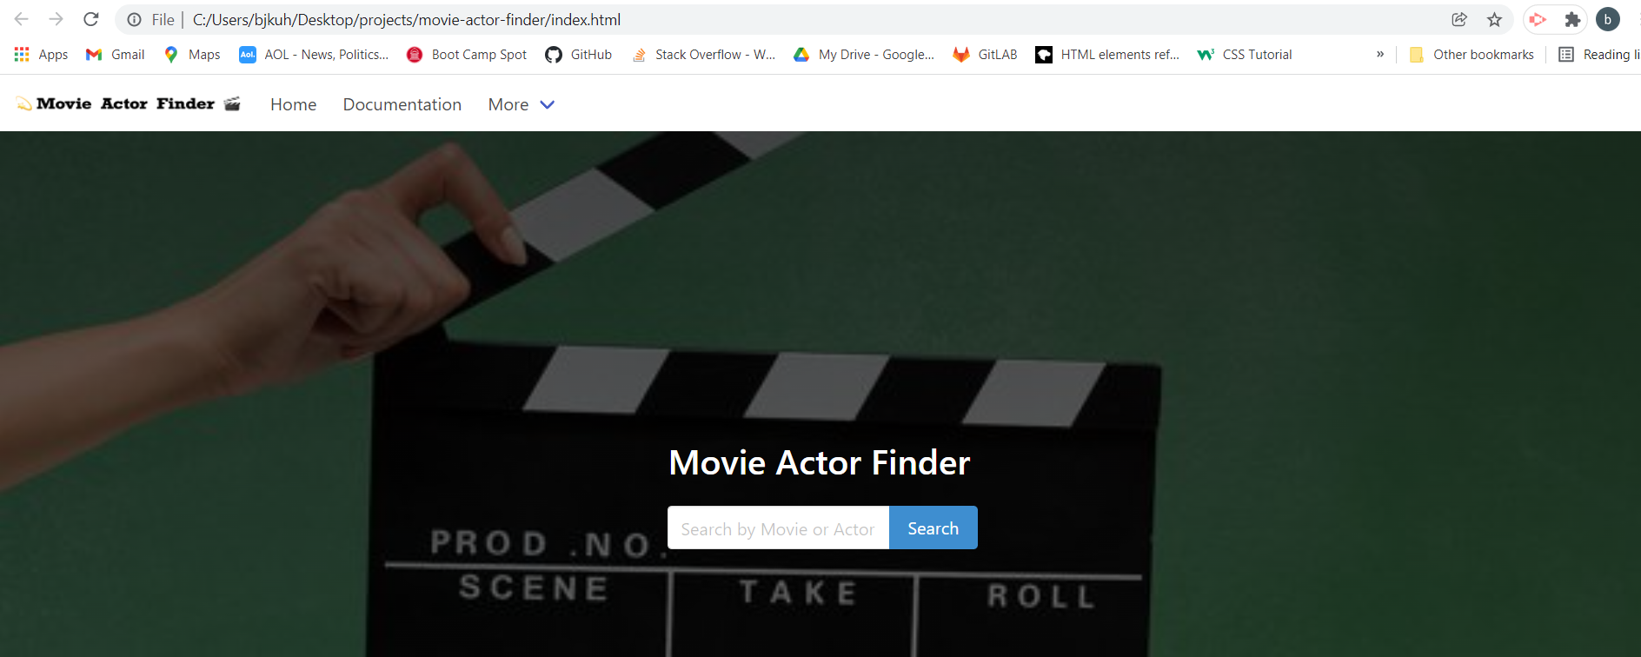

Slide 7
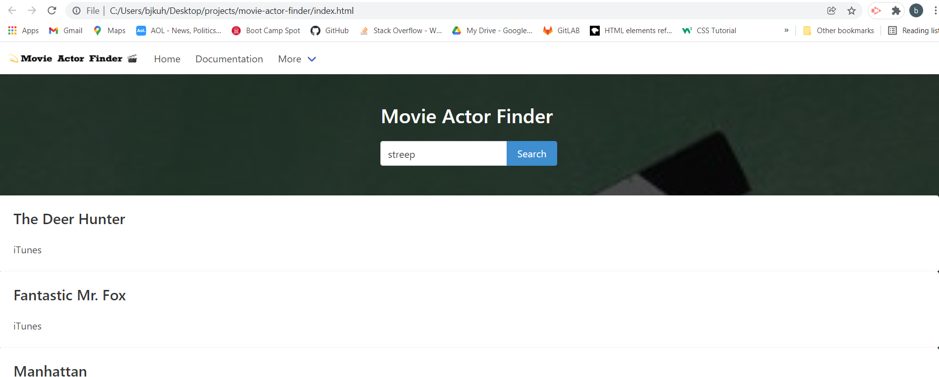

Slide 8
Directions for Future Development
We would like to only show one venue if duplicates are provided by the API
We did not save search history to local storage but could do so to make it easier on users
We did not include error handling. User friendly messages for blank or movies not found would be helpful.
We only use the last name of the actor and we use the first actor found with that last name. The application should allow for actors with the same last name to be selected from a list rather than automatically choosing the first one in the list.

Slide 9
Links
Deployed – Taylor needs to add
GitHub repo - https://github.com/TaylorH07/movie-actor-finder

