Slide 1
Lead Scoring Assignment
Predicting Lead Conversion for X Education
Prepared by: Samit Kumar Das
D – 20/08/2024

Slide 2
Problem Statement
Objective: The goal is to predict whether a potential customer will enroll in a course offered by X Education based on 36 predictor variables.
Business Relevance: Understanding which leads are most likely to convert allows the business to allocate resources more efficiently and tailor marketing strategies to maximize ROI.

Slide 3
Data Preparation
Overview: The dataset contains information on leads and various attributes that might influence their decision to enroll in a course.
Steps Taken:
- Imported and explored the dataset to understand its structure.
- Performed data cleaning, handling missing values, and encoding categorical variables.
- Split the data into training and testing sets for model evaluation.

Slide 4
Feature Selection
Approach: Used Recursive Feature Elimination (RFE) to select the top 15 most important features for predicting lead conversion.
Focused on reducing dimensionality while retaining the most predictive variables.

Slide 5
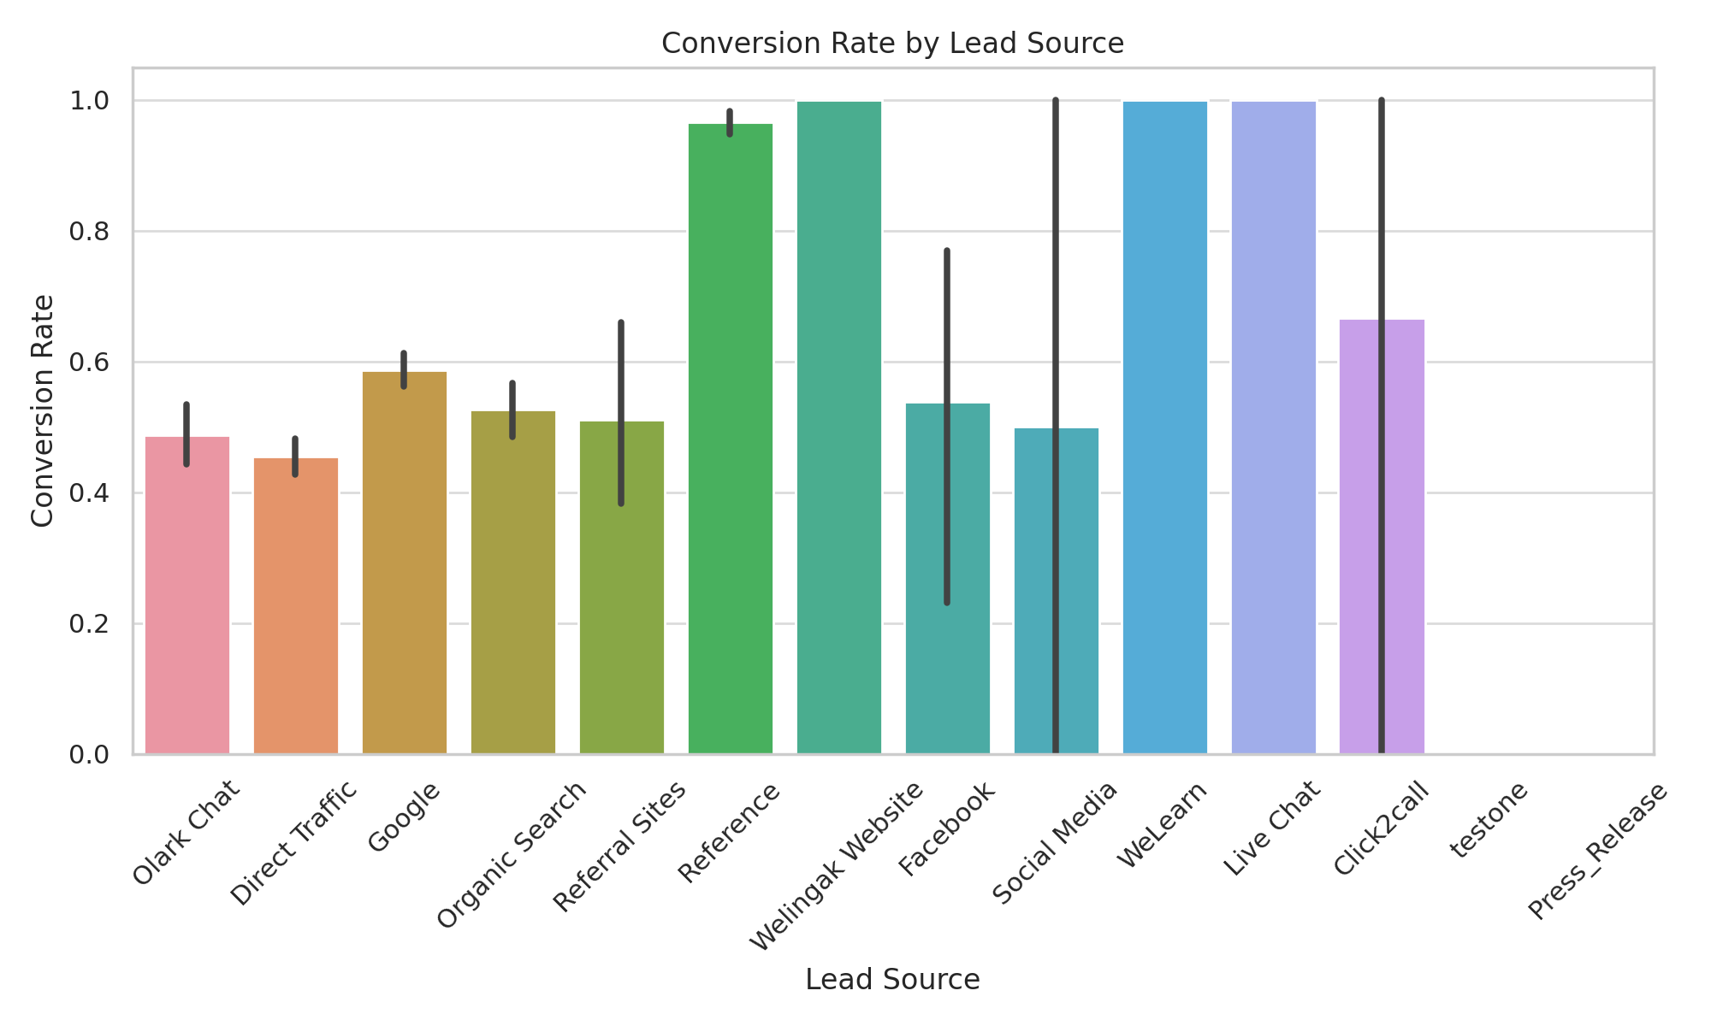
Conversion Rate by Lead Source

Slide 6
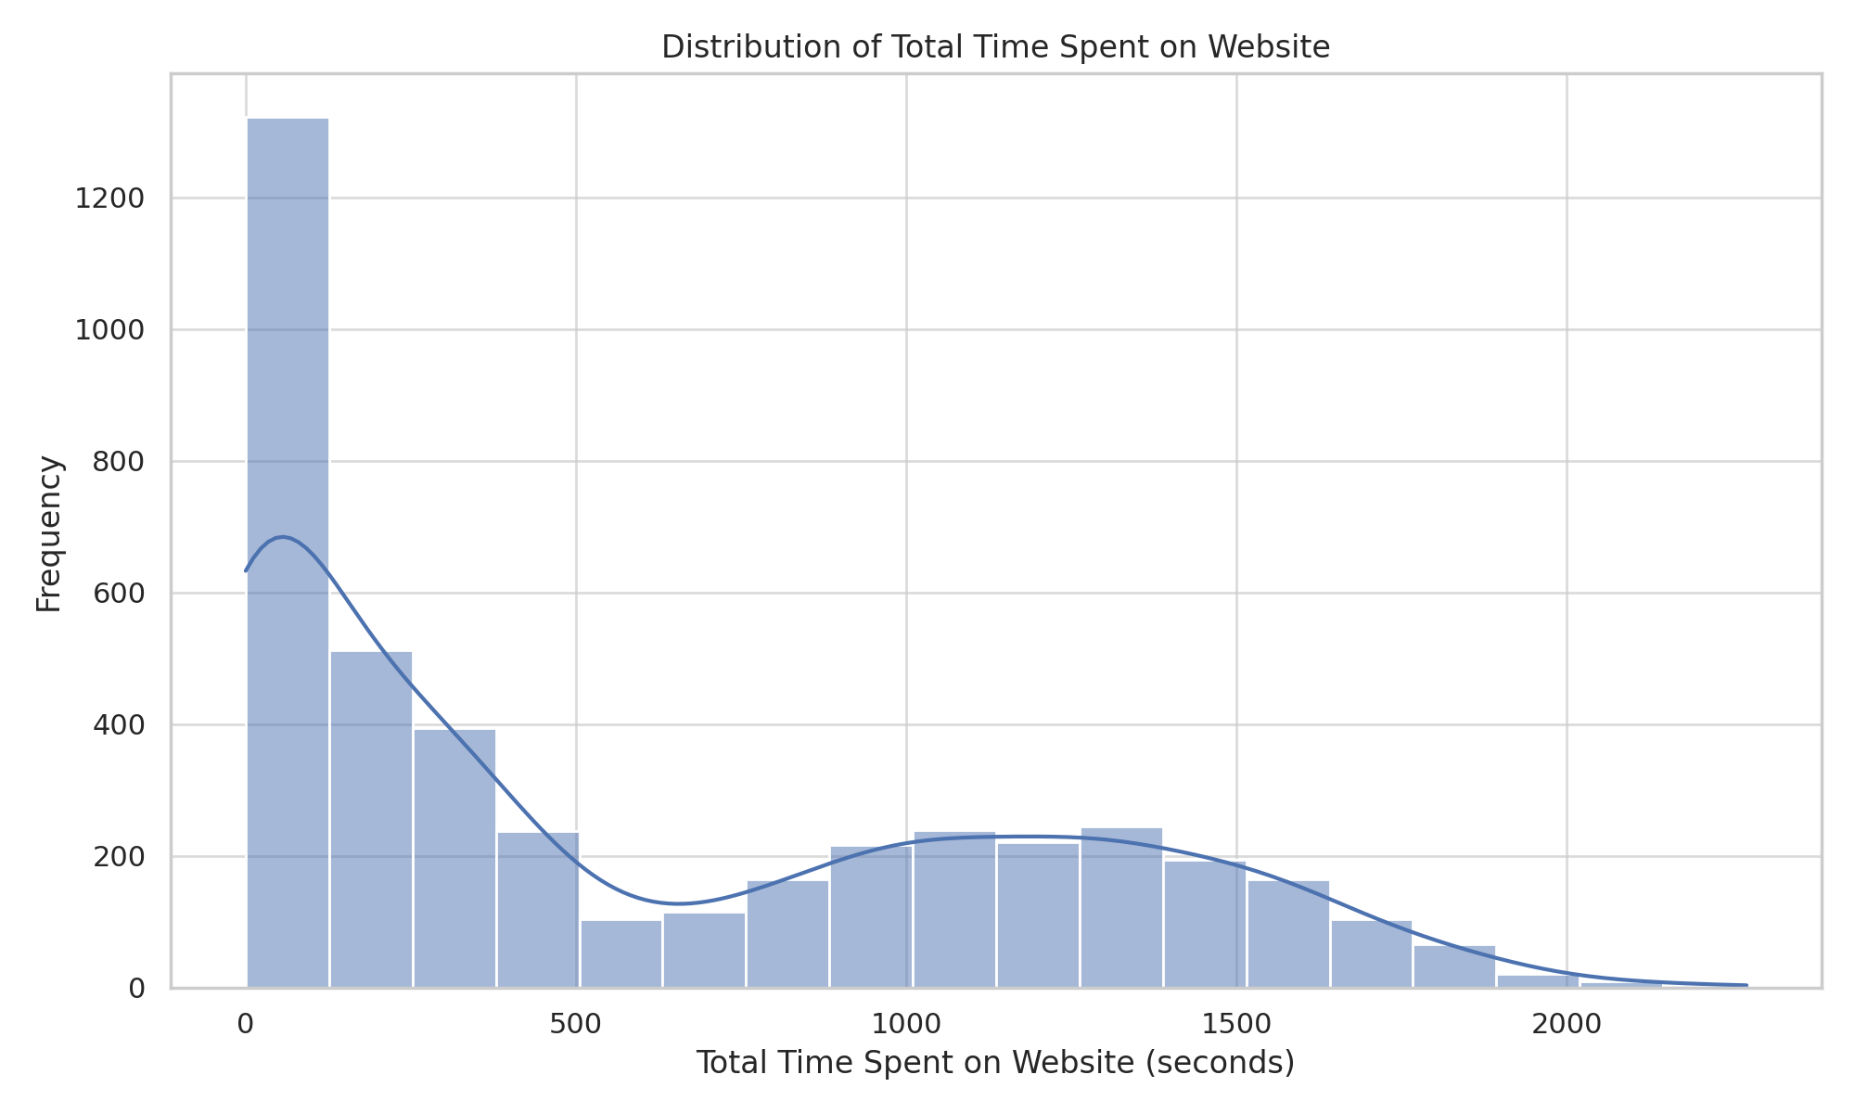
Distribution of Total Time Spent on Website

Slide 7
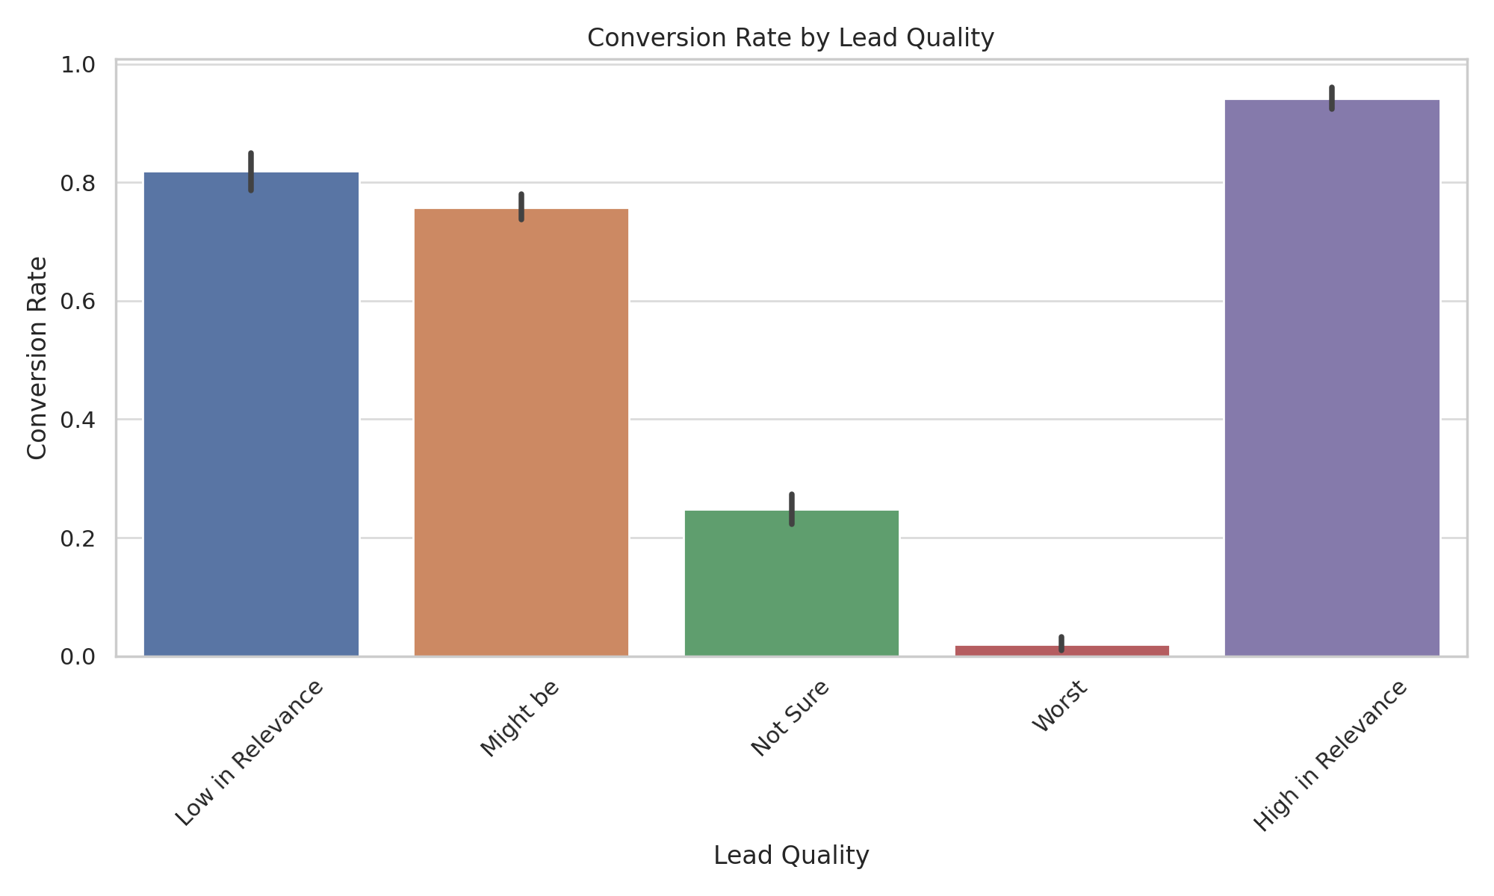
Conversion Rate by Lead Quality

Slide 8
Conclusion
Key Takeaways: Data-driven insights can significantly enhance lead conversion strategies.
The model provides a foundation for continuous improvement in targeting potential customers.
Next Steps: Implement the model in the lead management system.
Monitor and refine the model based on real-world performance.

