Slide 1

Customer feedback and survey system
MADE BY:-SAMIT
ROLL NO:- 35
SEC:-K23GD
SUBMITTED TO:-BRIJENDRA PAL SINGH
www.lpu.in Lovely Professional University

Slide 2
ABOUT THE PROJECT:-
This project is about how to customer give feedback.
I have done this by making a website .
This website is made using HTML CSS and JAVASCRIPT.
It includes basic format in which customer give feedback on product.

Slide 3
Home Page:-
> It contains the introduction part of the website .
> It has a photo running in the background of the start page .
> The photo is being added using CSS.
> I have used padding , position ,opacity, box sizzing etc to make this happen .
> I have also added horizontal grids using CSS to excess different tasks like login , contact , feedback page.

Slide 4
Login Page & Welcome Page :-
In login Page user can login though his Gmail ID and password .
In login page input tag , button tag is used.
Styling like margin , border, padding etc are used.
After clicking the submit button , the feedback will be submit on website .
He can also give feedback about product with expression

Slide 5
> Here I have used basic JavaScript to do arithmetic operation .
> This include a feedback form with emoji expression.
> Collect feedback on the login process to ensure friendly.
> Welcome page show format for login.

Slide 6
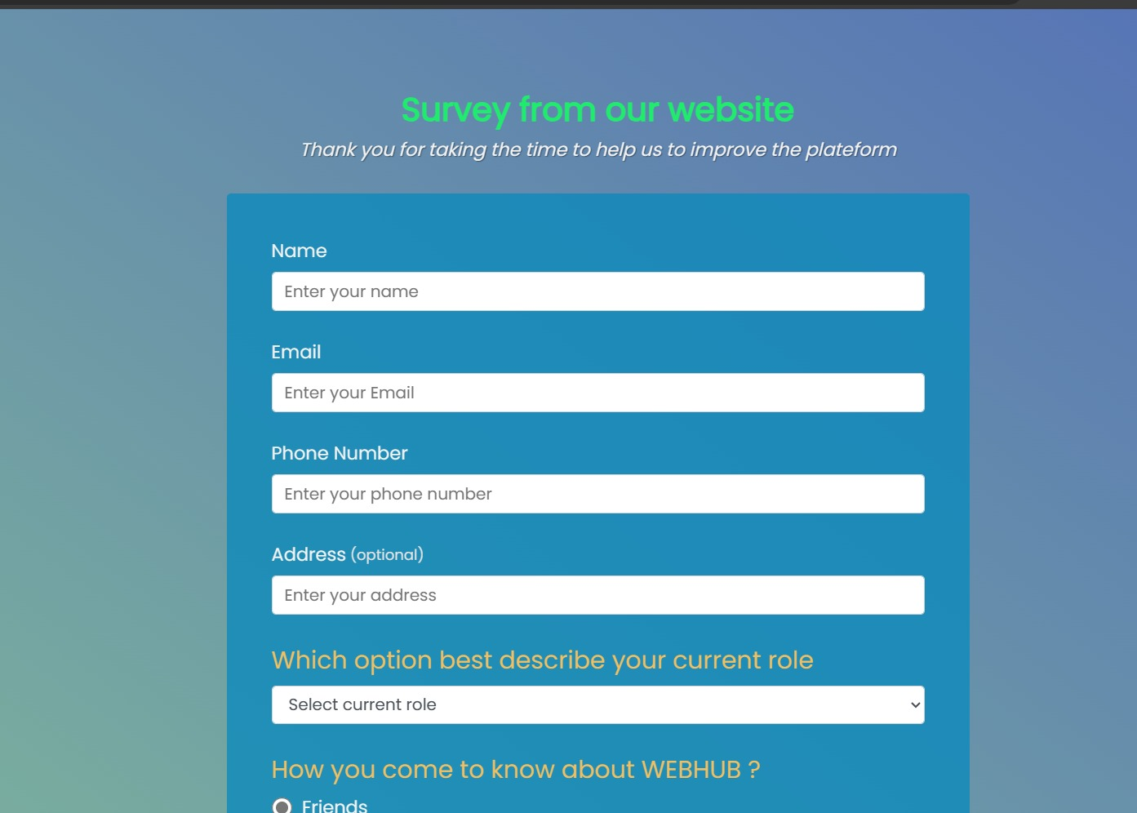
Home Page

Slide 7
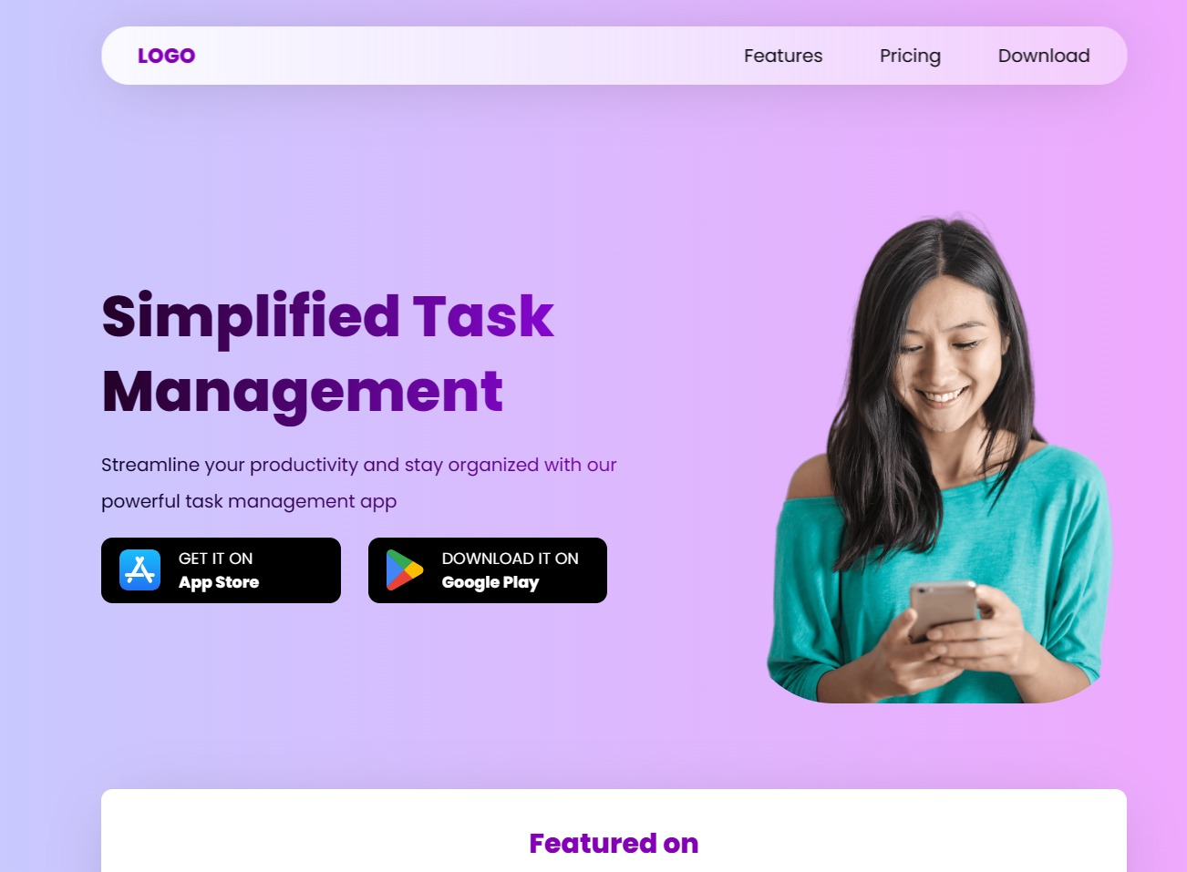
LLLLLLLLLLLLLLLLLLLLLLLLLLHOME PAGE PAGE

Slide 8
Reference:-
https://www.w3schools.com
https://web.dev/learn/html
https://tailwindcss.com/
https://www.youtube.com/

