Slide 1
Keylogger
NAAN MUDHALVAN PROJECT
Presented By:
Samiukktha Dharmalingam-CEG Anna University-Information Science and Technology

Slide 2
OUTLINE
Problem Statement
Proposed System/Solution
System Development Approach
Algorithm & Deployment
Result
Conclusion
Future Scope
References

Slide 3
Problem Statement
In today's digital age, where cybersecurity threats loom large, one of the significant concerns is the proliferation of keyloggers, stealthy software tools designed to monitor and record keystrokes on a user's computer without their knowledge. Keyloggers pose a severe threat to individuals and organizations as they can capture sensitive information such as passwords, credit card details, and other personal data, leading to identity theft, financial loss, and privacy breaches.

Slide 4
Proposed Solution
A simple keylogger application designed to monitor keyboard events and log them in both text and JSON formats. This solution aims to provide users with a flexible and user-friendly tool for capturing keystrokes while prioritizing security and data integrity.
Key Features:
1. Keyboard Event Monitoring: The application utilizes the `pynput` library to monitor three types of keyboard events: key press, key hold, and key release. This comprehensive approach ensures accurate recording of all keystrokes.
2. Dual Logging Mechanism: Captured keystrokes are logged in two formats - a text file (`key_log.txt`) and a JSON file (`key_log.json`). This dual logging mechanism offers flexibility and compatibility with various data processing and analysis tools.
3. User-Friendly Interface: The application features a graphical user interface (GUI) created using the `tkinter` library, providing users with easy access to start and stop the keylogging process.
4. Real-Time Monitoring: The keylogger operates in real-time, continuously monitoring keyboard events as they occur. Users can start and stop the keylogger at their convenience, providing flexibility in data collection and analysis.
5. Security Considerations: The keylogger application is developed with security considerations in mind. It operates locally on the user's system and does not transmit captured data over the network, minimizing the risk of unauthorized access or data breaches.
By utilizing this keylogger application, users can effectively capture and analyze keystrokes while maintaining security and data privacy. Additionally, the modular design of the application allows for further customization and enhancement to meet specific user requirements and preferences.

Slide 5
System Approach
The system development approach for the keylogger application harnessed specific technologies and libraries within the Python ecosystem to ensure robust functionality and efficient keystroke monitoring and logging:
1. Python Programming Language:
- Python was selected as the primary programming language for its simplicity, flexibility, and extensive library support, enabling rapid development and ease of maintenance.
2. tkinter Library for GUI:
- The tkinter library was instrumental in crafting an intuitive graphical user interface (GUI) for the application. Its simplicity and versatility allowed for the creation of windows, buttons, and labels, enhancing user interaction.
3. pynput Library for Keyboard Monitoring:
- Leveraging the pynput library facilitated precise monitoring of keyboard events in real-time. This library abstracted low-level keyboard input details, ensuring seamless integration and accurate capture of keystrokes.
4. JSON Serialization for Data Storage:
- JSON serialization was employed for storing captured keystrokes due to its lightweight and human-readable nature. Python's built-in json module simplified the serialization process, enabling efficient storage and retrieval of keystroke data.
5. File I/O Operations:
- Python's robust file input/output (I/O) functionalities were utilized for writing keystroke data to both text and JSON files. This streamlined approach ensured efficient data storage and retrieval, enhancing overall system performance.
6. Cross-Platform Compatibility:
- Python's inherent cross-platform compatibility was pivotal in ensuring seamless operation across various operating systems. The keylogger application could run seamlessly on different platforms without necessitating platform-specific modifications, enhancing accessibility and usability.

Slide 6
Algorithm & Deployment
Algorithm:
Continuous Keyboard Event Monitoring:
Utilize the pynput library to continuously monitor keyboard events in real-time.
Detect key press, hold, and release events to capture all keystrokes accurately.
Event Handling:
When a key is pressed, register it as a "Pressed" event and add the corresponding key to the keystroke log.
If a key is held down, record it as a "Held" event to ensure comprehensive logging of keystrokes.
Upon releasing a key, log it as a "Released" event and add it to the keystroke log.
Data Storage:
Maintain a keystroke log in memory to store captured keystrokes.
Periodically save the keystroke log to both a text file ('key_log.txt') and a JSON file ('key_log.json') for persistence and analysis.
Deployment:
Standalone Execution:
Deploy the keylogger application as a standalone executable or script on the target system.
Users can execute the Python script or launch the executable file to start the keylogger.
Background Operation:
Ensure the keylogger operates discreetly in the background, capturing keyboard events without interrupting the user's workflow.
User Interaction:
Provide a graphical user interface (GUI) with buttons to start and stop the keylogger.
Users have the flexibility to initiate or terminate the keylogging process as needed, enhancing convenience and control.
Log Accessibility:
After stopping the keylogger, users can access the generated text and JSON log files to review captured keystrokes and analyze user activities.
Simplified Deployment:
Design the deployment process to be straightforward and intuitive, allowing users to deploy and utilize the keylogger application effortlessly.
By following this algorithm and deployment strategy, the keylogger application ensures comprehensive monitoring of keyboard events while providing users with a seamless and user-friendly experience.

Slide 7
Result
Upon execution, the keylogger application operates seamlessly in the background, offering users clear insights and results through various aspects:
1. Graphical User Interface (GUI) Display:
- The application launches a GUI window upon execution, presenting users with options to start and stop the keylogging process.
- A dynamic label within the GUI indicates the current status of the keylogger, prompting users to initiate the keylogging process by clicking "Start."
2. Keylogging Process:
- Upon clicking the "Start" button, the keylogger begins capturing keyboard events in real-time, including key presses, holds, and releases.
- Users observe the application actively logging each keystroke as they interact with the keyboard, ensuring comprehensive data collection.
3. Real-Time Status Updates:
- The GUI label dynamically updates to reflect the operational status of the keylogger, reassuring users that keyboard events are being captured effectively.
- Real-time feedback through the GUI enhances user confidence in the keylogging process and the application's functionality.
4. Logging Files Creation:
- Simultaneously with capturing keystrokes, the keylogger writes the logged data to two output files: 'key_log.txt' and 'key_log.json.'
- These logging files meticulously document all keyboard interactions during the keylogging session, detailing event types and corresponding keys.
5. User Interaction and Control:
- Users retain control over the keylogging process, with the ability to halt it at any time by clicking the "Stop" button on the GUI.
- Upon cessation, the GUI label updates to signify the termination of the keylogger, providing users with immediate feedback.
6. Accessing and Analyzing Logged Data:
- Post-session, users can access the generated text and JSON logging files to review the recorded keystrokes comprehensively.
- These logging files serve as valuable resources for further analysis or investigation, enabling users to gain insights into user keyboard activities.
Through the combined functionality of the GUI, real-time status updates, logging file creation, user control features, and accessibility of logged data, the keylogger application empowers users with a robust tool for monitoring and analyzing keyboard interactions effectively.

Slide 8
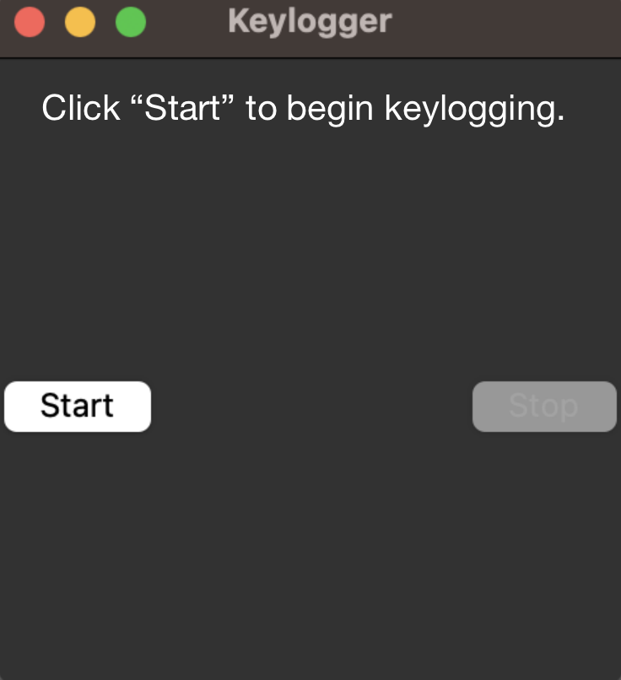
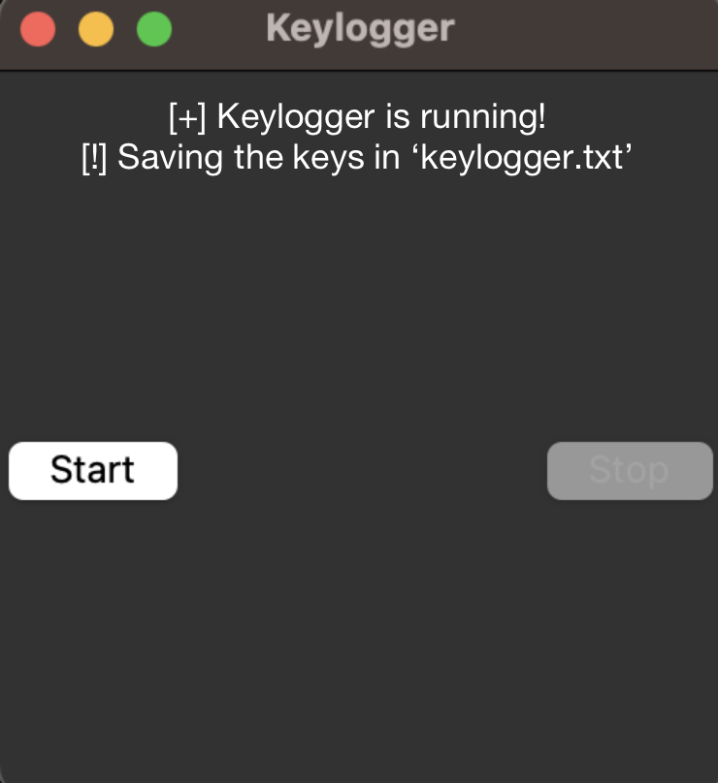
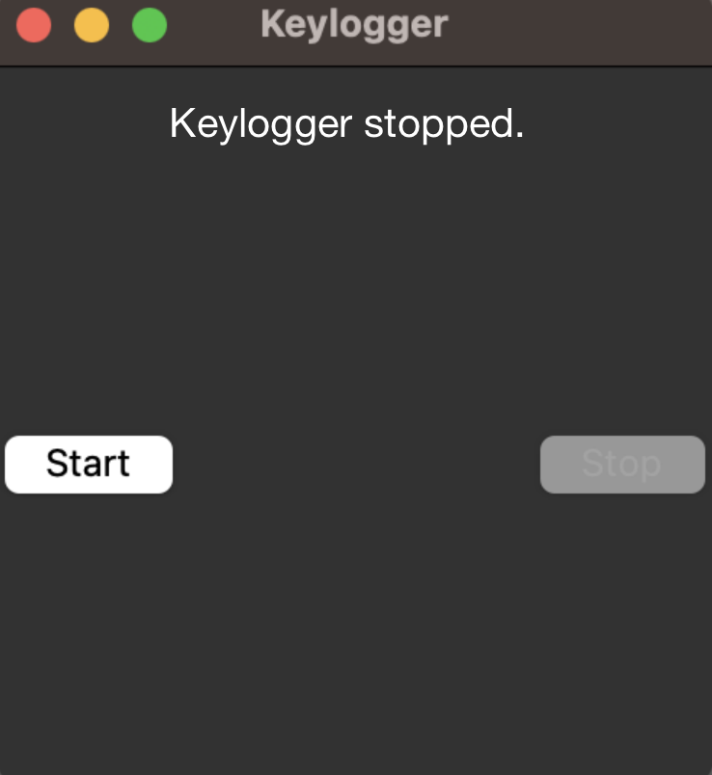
Result
The GUI display
After “Start” button is pressed.
After “Stop” button is pressed.

Slide 9
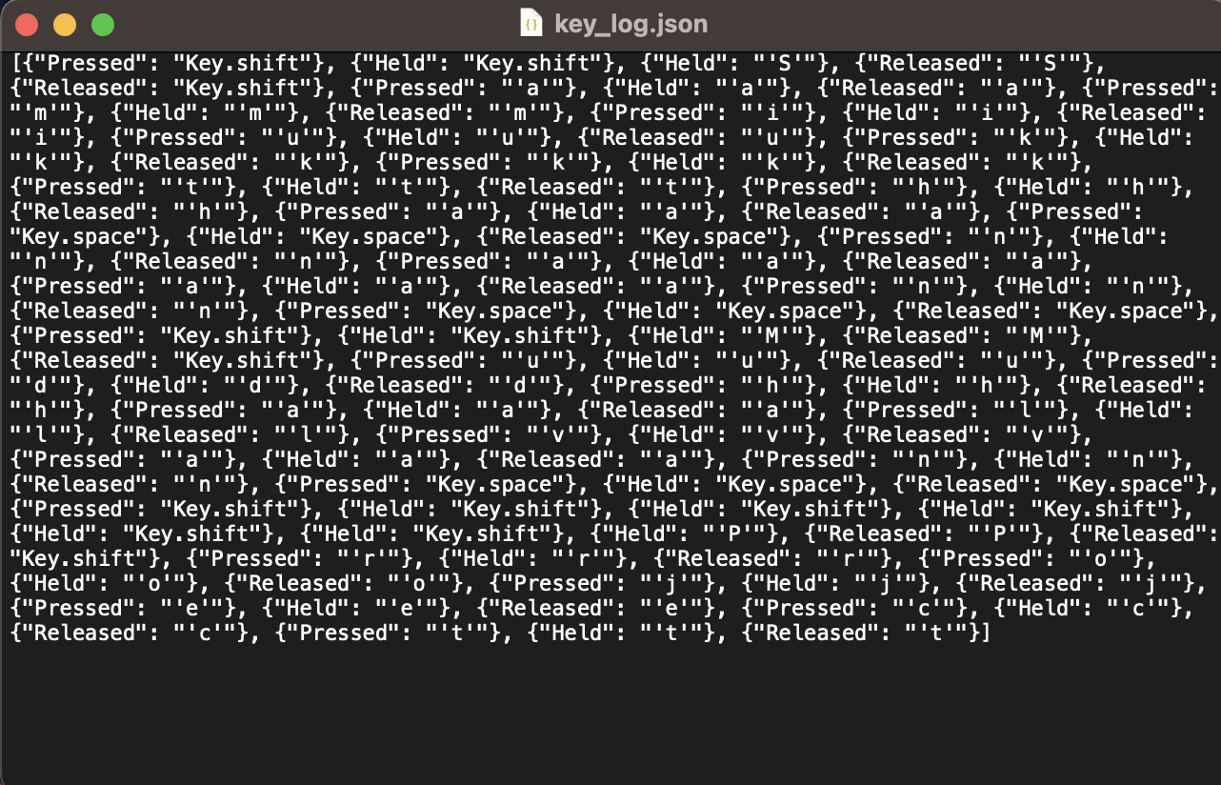
Result
Contents of key_log.txt file

Slide 10
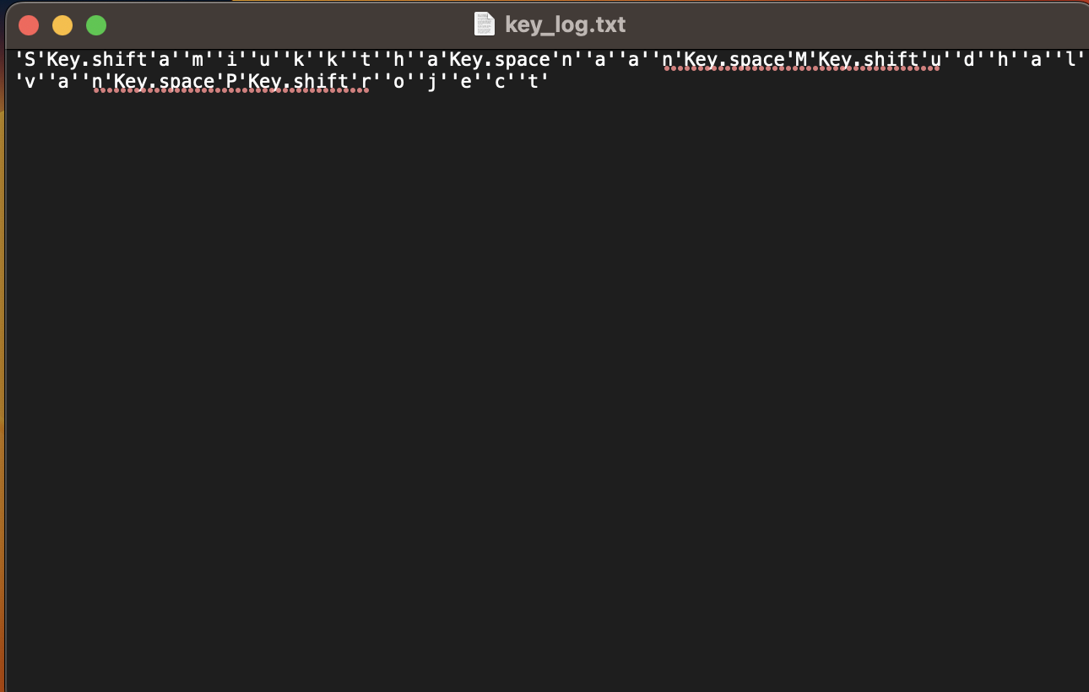
Result
Contents of key_log.json

Slide 11
Conclusion
In conclusion, the keylogger application provides a comprehensive solution for monitoring and logging keyboard events with efficiency and user-friendliness. Through the utilization of a graphical user interface (GUI), real-time status updates, and logging file creation, users can easily initiate and control the keylogging process while obtaining valuable insights into keyboard activities.
The application's seamless operation in the background ensures discreet monitoring of keyboard events, without interrupting the user's workflow. Users receive immediate feedback through the GUI, reassuring them of the keylogger's active functionality.
By capturing keystrokes in real-time and storing them in both text and JSON logging files, the application facilitates detailed analysis and investigation of user keyboard interactions. This comprehensive logging capability enhances cybersecurity measures and aids in identifying potential security threats or suspicious activities.
Overall, the keylogger application offers users a reliable and user-friendly tool for monitoring keyboard events, providing valuable insights into user activities while prioritizing ease of use and data integrity.

Slide 12
Future scope
1. Enhanced User Interface:
Develop a more intuitive GUI with customizable settings to cater to user preferences. Incorporate visualizations such as charts or graphs to provide users with insightful data representations.
2. Advanced Logging:
Implement advanced logging functionalities such as data encryption to ensure the security of logged information. Introduce metadata logging to include timestamps and application context, enhancing the depth of logged data. Enable integration with cloud storage solutions for convenient access to logged data from anywhere.
3. Machine Learning Integration:
Explore the integration of machine learning algorithms to analyze keystroke patterns and detect anomalies indicative of potential security threats. This could involve training models to recognize normal user behavior and flagging deviations for further investigation.
4. Remote Monitoring:
Develop capabilities for remote monitoring and control, allowing administrators to start, stop, and configure the keylogger application from a central management console. This would enhance flexibility and facilitate centralized management in enterprise environments.
5. Cross-Platform Support:
Extend compatibility to mobile platforms such as iOS and Android, enabling users to monitor keyboard activities across a wider range of devices. This expansion would cater to the increasing use of mobile devices in today's computing landscape.
6. Compliance Features:
Implement features to assist organizations in meeting regulatory compliance requirements, such as GDPR or HIPAA. This may include providing detailed audit trails, generating compliance reports, and ensuring adherence to data privacy regulations.

Slide 13
Future scope
7. Security Integration:
Integrate the keylogger application with existing security solutions such as antivirus software and intrusion detection systems. This collaboration would enhance overall cybersecurity posture by leveraging complementary technologies for threat detection and mitigation.
8. User Activity Monitoring:
Expand the scope of the application to monitor additional user activities beyond keyboard events, such as mouse movements, application usage, and network interactions. This comprehensive approach would provide a more holistic view of user behavior for security analysis.
9. Alerts and Notifications:
Allow users to configure alerts and notifications based on predefined triggers, such as unusual keystroke patterns or unauthorized access attempts. This proactive approach would enable users to respond promptly to potential security incidents.
10. Community Engagement:
Foster a community around the keylogger application to encourage collaboration, feedback, and contributions from users and developers. This collaborative environment would drive ongoing innovation and improvement, ensuring the application remains relevant and effective in addressing evolving cybersecurity challenges.

Slide 14
References
Python Documentation - https://docs.python.org/
tkinter Documentation - https://docs.python.org/3/library/tkinter.html
pynput Documentation - https://pynput.readthedocs.io/en/latest/
JSON Documentation - https://docs.python.org/3/library/json.html
Brownlee, Jason. "How to Develop a Keylogger in Python." Machine Learning Mastery, 2020. [Online]. Available:.https://machinelearningmastery.com/how-to-develop-a-keylogger-in-python/
"Keylogger Detection Techniques: A Survey" by Abdullah N. Al-Dhelaan and Hazem M. El-Bakry
(https://www.researchgate.net/publication/265402553_Keylogger_Detection_Techniques_A_Survey)
"A Review of Keylogging and Spyware Detection and Removal Software" by Akashdeep Bhardwaj, Simranjit Kaur, and Gurpreet Singh (https://www.researchgate.net/publication/318759702_A_Review_of_Keylogging_and_Spyware_Detection_and_Removal_Software)
"Detection and Prevention of Keyloggers Using Data Mining Techniques" by A. Saravanan and A. Murugan (https://www.researchgate.net/publication/273634444_Detection_and_Prevention_of_Keyloggers_Using_Data_Mining_Techniques)
"Keystroke Dynamics-Based Authentication for Online Examinations" by Pranav Kumar Singh, Shalini Singh, and Praveen Ranjan Srivastava
(https://www.researchgate.net/publication/324355946_Keystroke_Dynamics-Based_Authentication_for_Online_Examinations)

Slide 15
THANK YOU

