Slide 1
Human Computer Interaction (HCI)

Slide 2
Defining Scenarios for each persona [2]
Scenarios are concise narrative descriptions of one or more personas using a product to achieve specific goals
They allow us to start our designs from a story describing an ideal experience from the persona’s perspective, focusing on people, and how they think and behave, rather than on technology or business goals
Scenario content and context are derived from information gathered during the Research phase and analyzed during the Modeling phase
It helps in real-time synthesis of structure and behavior— typically, at a whiteboard— and later informs the detailed look-and-feel. Moreover, personas and scenarios are used to test the validity of design ideas and assumptions throughout the process

Slide 3
Types of Scenarios [2]
Context scenarios
Key path scenarios
Validation scenarios

Slide 4
Types of Scenarios (cont.) [2]
Context scenario: It is used to explore, at a high level, how the product can best serve the needs of the personas
Created before any design is performed and are written from the perspective of the persona, focused on human activities, perceptions, and desires
It will help in extracting the needs of users which includes
1. data needs: Common examples include accounts, people, documents, messages, songs, images, as well as attributes of those such as status, dates, size, creator, subject, and so on.
2. functional needs: Functional needs are the operations or actions that need to be performed on the objects of the system and which are typically translated into interface controls. These can be thought of as the actions of the product. Functional needs also define places or containers where objects or information in the interface must be displayed
3. other needs: For example technical, business, customer or partner needs

Slide 5
Types of Scenarios (cont.) [2]
Context scenarios address questions such as the following:
In what setting(s) will the product be used?
Will it be used for extended amounts of time?
Is the persona frequently interrupted?
Are there multiple users on a single workstation or device?
With what other products will it be used?
What primary activities does the persona need to perform to meet her goals?
What is the expected end result of using the product?
How much complexity is permissible, based on persona skill and frequency of use?

Slide 6
Types of Scenarios (cont.) [2]
Brainstorming:
The primary purpose here is to eliminate as much preconception as possible, allowing designers to be open-minded and flexible as they use their imagination to construct scenarios, and use their analytic minds to derive requirements from these scenarios
Brainstorming should be unconstrained and uncritical — put all the wacky ideas you’ve been considering (plus some you haven’t) out on the table and then be prepared to record them
Don’t spend too much time on the brainstorming step; a few hours should be more than sufficient for you and your teammates to get all those crazy ideas out of your systems.

Slide 7
Types of Scenarios (Cont.) [2]
Pretending it’s magic:
A powerful tool in the early stages of developing scenarios is to pretend the interface is magic. If your persona has goals and the product has magical powers to meet them, how simple could the interaction be?
Magical solutions obviously won’t suffice, but figuring out creative ways to technically accomplish interactions that are as close to magical solutions as possible (from the personas’ perspective) is the essence of great interaction design
Products that meet goals with the minimum of hassle and intrusion seem almost magical to users

Slide 8
An Example Context Scenario [2]
An example context scenario: a context scenario for a primary persona for a personal digital assistant (PDA) type phone, including both the device and its service.
Our persona is Vivien Strong, a real-estate agent in Indianapolis, whose goals are to balance work and home life, close the deal, and make each client feel like he is her only client

Slide 9
An Example Context Scenario [2]
While getting ready in the morning, Vivien uses her phone to check her e-mail.
It has a large enough screen and quick connection time so that it’s more convenient than booting up a computer as she rushes to make her daughter, Alice, a sandwich for school.
.

Slide 10
An Example Context Scenario [2]
2. Vivien sees an e-mail from her newest client, Frank, who wants to see a house this afternoon.
The device has his contact info,
so now she can call him with a simple action right from the e- mail.

Slide 11
An Example Context Scenario [2]
3. While on the phone with Frank, Vivien switches to speakerphone so she can look at the screen while talking.
She looks at her appointments to see when she’s free.
When she creates a new appointment, the phone automatically makes it an appointment with Frank, because it knows with whom she is talking.
She quickly enters the address of the property into the appointment as she finishes her conversation.

Slide 12
An Example Context Scenario [2]
4. After sending Alice off to school, Vivien heads into the real-estate office to gather some papers for another appointment.
Her phone has already updated her Outlook appointments,
so the rest of the office knows where she’ll be in the afternoon.

Slide 13
An Example Context Scenario [2]
5. The day goes by quickly, and she’s running a bit late.
As she heads towards the property she’ll be showing Frank, the phone alerts her that her appointment is in 15 minutes.
When she flips open the phone, it shows not only the appointment, but a list of all documents related to Frank, including e-mails, memos, phone messages, and call logs to Frank’s number.
Vivien presses the call button, and the phone automatically connects to Frank because it knows her appointment with him is soon.
She lets him know she’ll be there in 20 minutes.

Slide 14
An Example Context Scenario [2]
6. Vivien knows the address of the property but is a bit unsure exactly where it is.
She pulls over and taps the address she put into the appointment.
The phone downloads directions along with a thumbnail map showing her location relative to the destination.

Slide 15
An Example Context Scenario [2]
7. Vivien gets to the property on time and starts showing it to Frank.
She hears the phone ring from her purse.
Normally while she is in an appointment, the phone will automatically transfer directly to voicemail,
But Alice has a code she can press to get through.
The phone knows it’s Alice calling, and uses a distinctive ring tone.

Slide 16
An Example Context Scenario [2]
8. Vivien takes the call — Alice missed the bus and needs a pickup.
Vivien calls her husband to see if he can do it.
She gets his voicemail; he must be out of service range.
She tells him she’s with a client and asks if he can get Alice.
Five minutes later the phone makes a brief tone Vivien recognizes as her husband’s;
she sees he’s sent her an instant message:
“I’ll get Alice; good luck on the deal!”

Slide 17
Types of Scenarios (cont.) [2]
Key path scenario: More specifically describing user interactions with the product.
Focus on the most significant user interactions, always maintaining attention on how a persona uses the product to achieve their goals
It must describe in exacting detail the precise behavior of each major interaction and provide a walkthrough of each major pathway

Slide 18
Types of Scenarios (cont.) [2]
Validation scenarios: To test the design solution in a variety of situations
Focus on less frequent or less important interactions
The goal here is to adjust the design as needed.
These scenarios tend to be less detailed and typically take the form of a number of “what if . . .” questions about the proposed solutions

Slide 19
Scenarios Vs. Use Cases [2]
Scenarios covers not only the functionality of the system but the way those functions are expressed in terms of what the user sees and how she interacts with the system
The precise behavior of the system — precisely how the system responds — is not typically part of a conventional or concrete use case; many assumptions about the form and behavior of the system to be designed remain implicit
Use cases permit a complete cataloguing of user tasks for different classes of users but say little or nothing about how these tasks are presented to the user

Slide 20
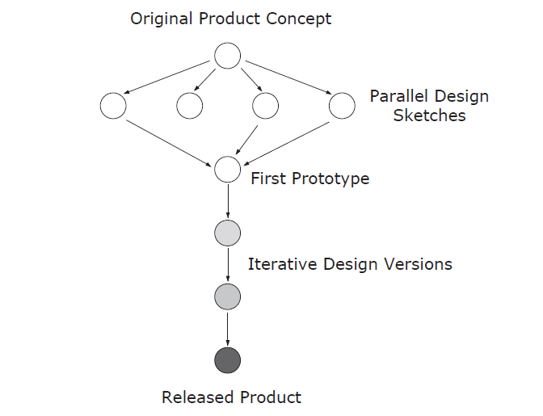
Important things while designing detailed interactions [1]
Parallel Design: If time and resources allow, explore design alternatives
Have several design teams work independently, then compare draft designs

Slide 21
Important things while designing detailed interactions (cont.) [2]
Pretend the product is human:
Interactions with a digital system should be similar in tone and helpfulness to interactions with a polite, considerate human
You should ask yourself
What would a helpful human do?
What would a thoughtful, considerate interaction feel like?
Is the primary persona being treated humanely by the product?
In what ways can the software offer helpful information without getting in the way?
How can it minimize the persona’s effort in reaching his goals?

Slide 22
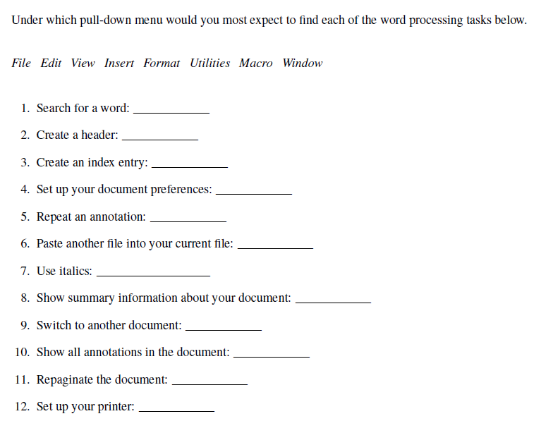
Important things while designing detailed interactions (cont.) [1]
Getting Ideas from Your Users:
A simple user survey can quickly tell you where users would expect to find certain functionality.

Slide 23
Important things while designing interactions (cont.) [1]
Follow Conventions: Following the standard way of doing things is generally good
Only break the convention for good reason.
For example: Link styles, An Asterisk Means a Required Field, Platform Conventions (e.g., Macintosh Human Interface Guidelines, Microsoft Windows User Experience, Java Look and Feel Design Guidelines) often supported by widget libraries of shared code, Design Patterns (for example, the shopping cart design pattern for an e-commerce web site)

Slide 24
References
[1] Lecture Notes of Prof. Keith Andrews, Available at: www.iicm.tugraz.at/hci‎
[2] “About Face 3.0, the Essentials of Interaction Design”, by Alan Cooper, Robert Reimann, and David Cronin, Third Edition

