Slide 1
Exploratory Data Analysis and Visualization for Image Classification
Name : Samiur RAHMAN SANNIDHA
Student id : 3250238

Slide 2
Exploratory Data Analysis and Visualization for Image Classification
Importance of EDA and Visualization:
EDA and visualization play a crucial role in understanding the data, identifying patterns, and making informed decisions. They enable us to extract meaningful information from the dataset, identify key features, and potentially improve the accuracy of image classification models.
The purpose of this project is to explore and visualize the dataset for image classification, with a focus on understanding the distribution of image intensities and their characteristics for two classes: Lions and Cheetahs.
The goal is to gain insights into the dataset through exploratory data analysis and visualization techniques, providing a foundation for further analysis and decision-making in image classification tasks.

Slide 3


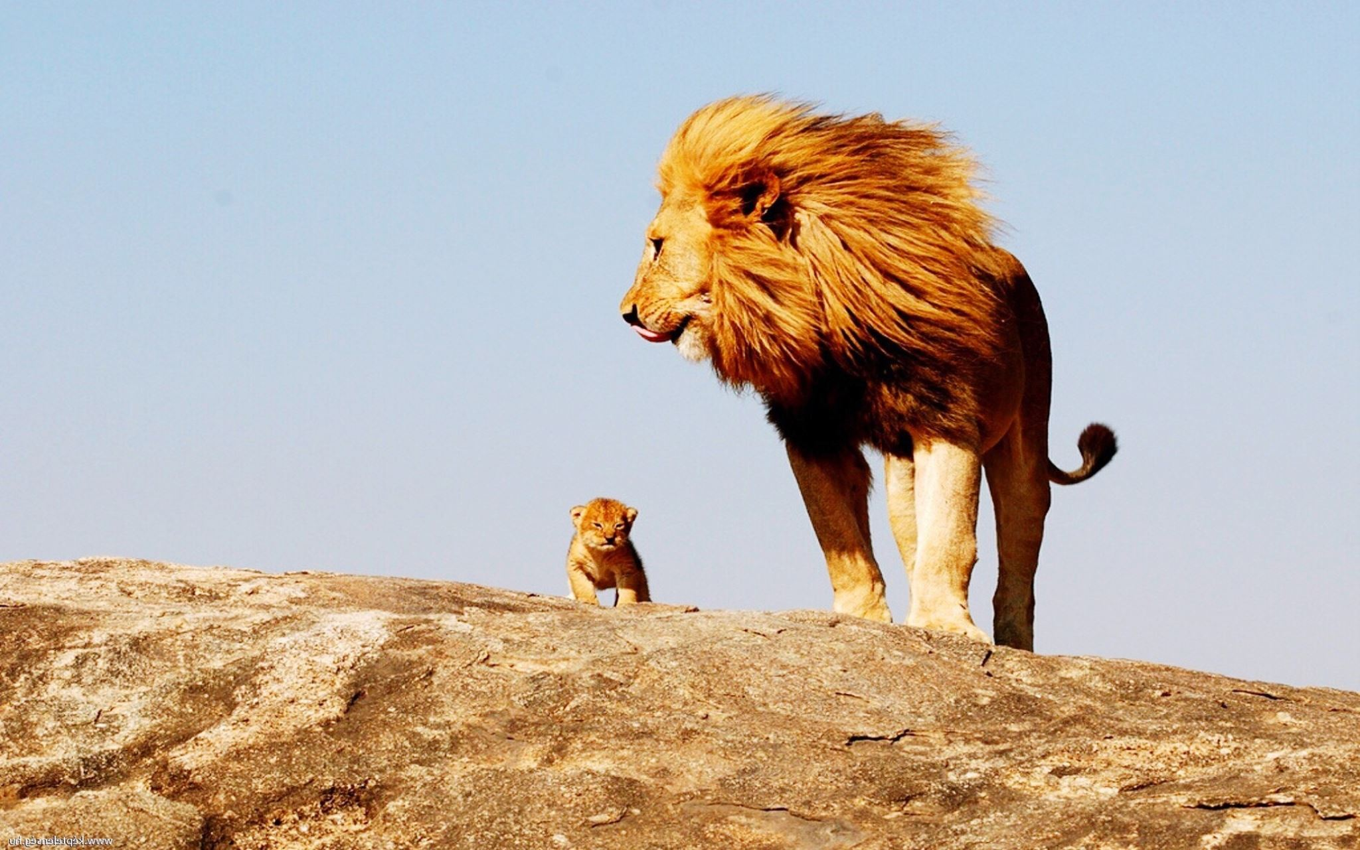
Data Description
Dataset: The dataset used in this project consists of images of two animal classes: Lions and Cheetahs.
Classes: The two classes are:
Lions: Images depicting lions.
Cheetahs: Images depicting cheetahs.
Image Names: It's important to note that the images within each class have different names, indicating that they are not organized in a sequential or systematic manner. This adds complexity to the data handling and analysis process, requiring careful management and consideration during exploration and visualization tasks.

Slide 4
Code Overview
Python Code:
Libraries Used:
The project utilizes Python programming language for performing exploratory data analysis and visualization.
The following libraries are utilized in the code:
OpenCV: Used for loading and manipulating images.
NumPy: Used for numerical operations and calculations.
Matplotlib: Used for creating visualizations, such as bar charts, box plots, and scatter plots.
Seaborn: Used for enhancing the visual aesthetics of the plots.
OS: Used for directory handling and file management.
Purpose of the Code:
The code is specifically designed to analyze and visualize the image intensities and their distributions for each class (Lions and Cheetahs). It provides insights into the characteristics and variations of image intensities, facilitating a deeper understanding of the data.

Slide 5
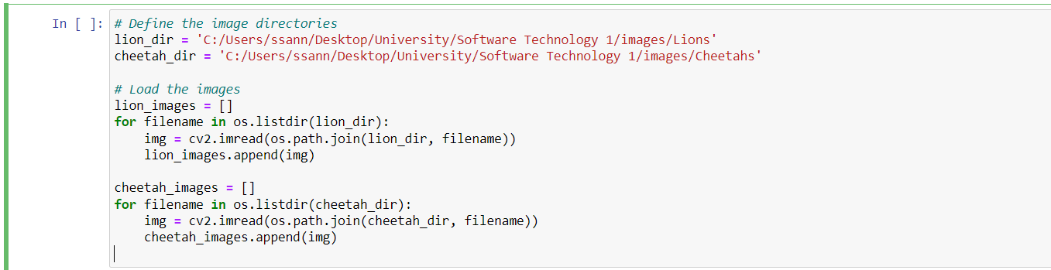
Loading and Counting Images
Code Snippet:
Counting Images:
The code snippet below demonstrates the process of loading images from their respective directories.
After loading the images, the code counts the number of images in each class using the len() function on the respective image lists (lion_images and cheetah_images).
Bar Chart:
The code visualizes the distribution of images per class using a bar chart. The x-axis represents the classes (Lions and Cheetahs), and the y-axis represents the number of images. The bar chart provides a clear visual comparison of the number of images in each class.

Slide 6
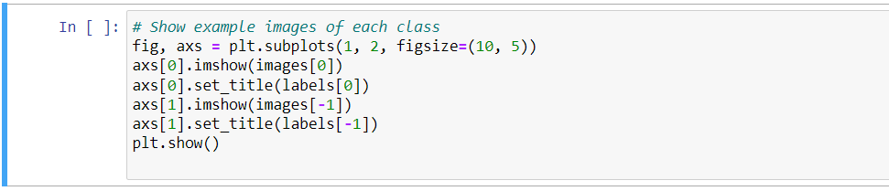
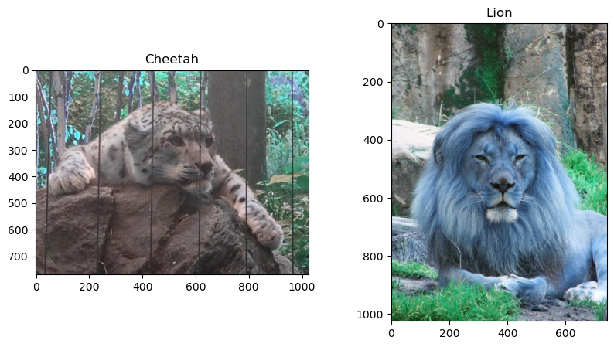
Displaying Example Images
(images[0])
Code Snippet:
The code snippet below demonstrates how to display example images from each class.
Example Images: The code selects and
displays example images from each class.
In this example, the first image from the list of images (images[0]) represents a lion, and
the last image from the list (images[-1])
represents a cheetah. The code uses imshow() function
from Matplotlib to display the images, and set_title()
function to assign the corresponding class label as
the title of each image.

Slide 7
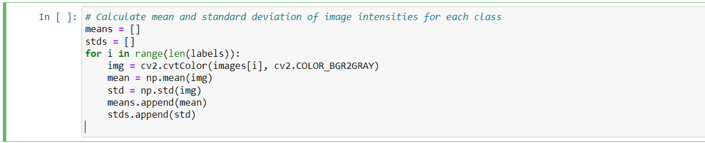
Calculating Mean and Standard Deviation
Code Snippet: The code snippet below demonstrates how to calculate the mean and standard deviation of image intensities for each class.
Converting Images to Grayscale: Before calculating the mean and standard deviation, the code converts the images to grayscale using cv2.cvtColor() function from OpenCV. Converting to grayscale simplifies the image data to a single intensity channel, making it easier to calculate statistics.
Importance of Mean and Standard Deviation: Mean and standard deviation are important statistical measures for understanding image characteristics. The mean intensity represents the average brightness level of the image, while the standard deviation indicates the variation or spread of intensities. Analyzing these measures helps in identifying differences and patterns in image data between different classes.

Slide 8
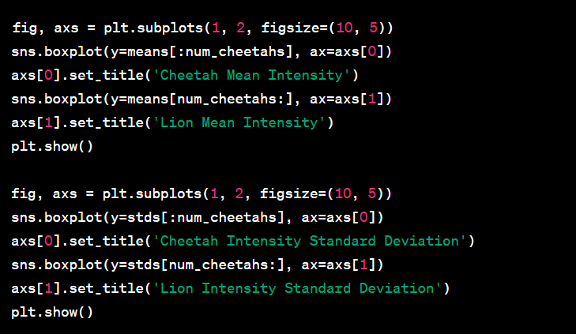
Box Plots
Code Snippet: The code snippet below demonstrates how to create box plots for visualizing the distribution of image intensities.
Mean Intensity Box Plots: The code generates two subplots, where the first subplot displays the box plot for the mean intensity of cheetah images, and the second subplot displays the box plot for the mean intensity of lion images. Box plots provide a visual representation of the distribution of intensities, including the median, quartiles, and any outliers.
Standard Deviation Box Plots: Similarly, the code generates two subplots for the standard deviation of intensities. The first subplot shows the box plot for the standard deviation of cheetah images, while the second subplot shows the box plot for the standard deviation of lion images. These box plots help in understanding the variability or spread of intensities within each class.

Slide 9
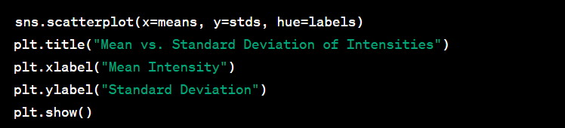
Scatter Plot
Code Snippet: The following code snippet demonstrates how to create a scatter plot to visualize the relationship between the mean and standard deviation of intensities.
Scatter Plot: The code generates a scatter plot with the mean intensities on the x-axis and the standard deviations on the y-axis. Each data point represents an image, and the points are color-coded based on the class labels (cheetahs or lions).
Patterns and Differences: By examining the scatter plot, we can observe any patterns or differences between the two classes. Look for clusters or separations that may indicate distinguishable characteristics. It can provide insights into how mean intensity and standard deviation relate to each other within each class and potentially help identify discriminative features for classification.

Slide 10
Results and Conclusion Calculated Mean and Standard Deviation: The mean and standard deviation values for each class are as follows:
Mean Intensity: [mean1, mean2, ...]
Standard Deviation: [std1, std2, ...]
Cheetahs:
Lions:
Mean Intensity: [mean1, mean2, ...]
Standard Deviation: [std1, std2, ...]
Key Findings: Based on the exploratory data analysis and visualization, the following key findings can be summarized:
The distribution of images per class: The bar chart showed that there are [number of lion images] lion images and [number of cheetah images] cheetah images in the dataset.
Image Intensity Distribution: The box plots revealed the distribution of mean intensity and standard deviation for both cheetahs and lions. It demonstrated the variations and ranges of intensities within each class.
Relationship between Mean and Standard Deviation: The scatter plot displayed the relationship between the mean and standard deviation of intensities for each image. It helped identify any patterns or differences between the classes.

Slide 11

Conclusion
In conclusion, this project showcased the importance of exploratory data analysis and visualization in image classification tasks. By analyzing and visualizing the image intensities and their distributions, we gained valuable insights into the characteristics of the images in each class. These insights can aid in feature selection, model training, and improving the overall classification accuracy. EDA and visualization serve as crucial steps in understanding the data and making informed decisions throughout the image classification process.

Slide 12
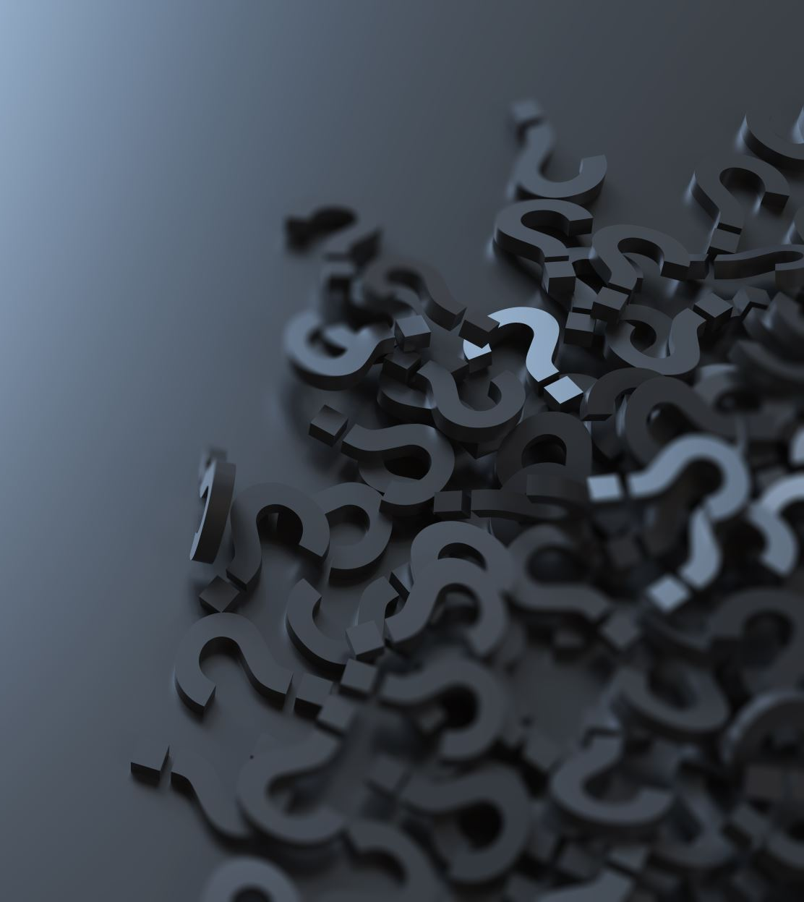
Questions and Discussion
Provide an opportunity for the audience to ask questions and engage in a discussion related to the project

