Slide 1
Assessing the Severity of Road Traffic Accident Casualties: A Comprehensive Estimation in the Context of Bangladesh
Presented by
Mir Samiur Rahim
09-001-29
Dept. of Computer Science and Engineering
University of Barishal

Slide 2
Outline
Introduction
Problem Statement
Background Study
Research Question
Related Works
Methodology
Performance Criteria
Conclusion and Future Work

Slide 3
Problem Statement
In Bangladesh approximately 25,000 lives are lost in road accidents every year. That’s why enhancing our comprehension of factors influencing the severity of injuries is crucial for advancing crash prediction and implementing effective strategies to mitigate harm.
Notes:
That’s why we are working on the finding out the core factors affecting the accident from previous data. So that necessary precautions can be taken and losses and deaths can be reduced.

Slide 4
Background Study
With the rapid development of today’s society, traffic accidents have also increased, resulting in huge human and economic losses.
Traffic accidents are usually caused by the influence of people, vehicles, roads, and environment. This research prioritized the influence of traffic accident factors on the severity of traffic accidents using machine learning algorithms.

Slide 5
Research Questions
How do various factors such as road infrastructure, vehicle safety standards, and driver behavior contribute to the severity of road traffic accident casualties in Bangladesh?
How effective are existing emergency response systems and medical facilities in managing and treating road traffic accident casualties in Bangladesh?
What measures can be implemented to reduce the severity of road traffic accident casualties in Bangladesh, considering both preventive strategies and post-accident interventions?
What role does government policy and enforcement play in addressing road safety issues and reducing the impact of road traffic accidents on casualties in Bangladesh?
How can technology and innovation be leveraged to enhance road safety measures and mitigate the severity of road traffic accident casualties in Bangladesh?

Slide 6

Related Works
[1]
Some works analyzed by factors like the location of a car in road transects, the road safety grade, presence of camera at signals, street lighting, nature of lanes, the involvement of pedestrians, and time of the day, the vehicle condition etc.
[2]
Some of works are done by analyzing injury degrees through artificial neural networks.

Slide 7
Related Works
[3]
Many types of works has been done using traditional statistical model method have been applied to predict severity.

Slide 8
Methodology
Collecting Dataset.
Preprocessing the dataset.
Feature Detection and find interrelationships
Split the dataset on train and test.
Classify by running the algorithms on them.
Train the proposed Model.
Run the model for test dataset.

Slide 9
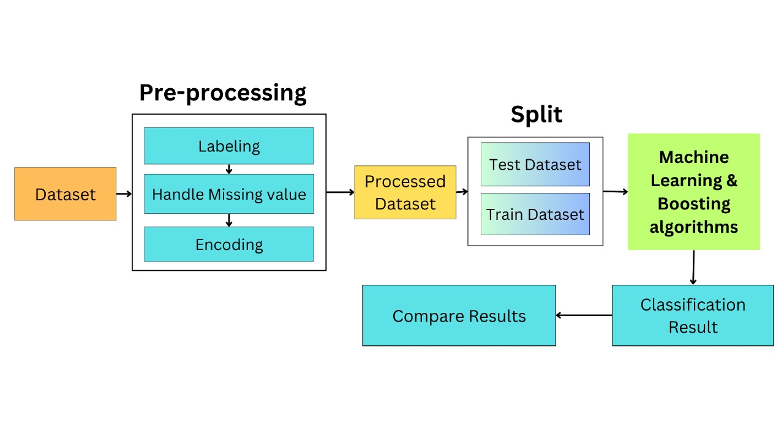
Methodology

Slide 10
Collecting Dataset
Road Traffic Accident dataset is procured from Accident Research Institute (ARI), BUET
It’s a Newspaper based dataset.

Slide 11
Dataset
The dataset file contains the following information:
Day of week, Time
District, Thana, Area accident occurred, Road Name, Type of collision
Number of vehicles involved, Type of vehicles, Number of casualties, Casualty class, Accident severity

Slide 12
Preprocessing Dataset
Removing of duplicate and null values
After feature detection organizing the relevant data
Irrelevant feature deduction

Slide 13
Main Model
We will follow the following steps to create accident severity prediction system using classifier algorithms:
Determine the key features mainly input and target variable
Find out the interrelationship and dependency between the features
Under-sampling using Smote
Training the model
Evaluating the performance of the model by running it on test data

Slide 14
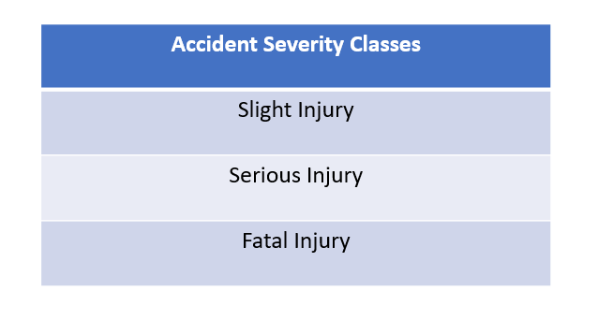
Algorithms Used to Train Model
Logistic Regression
Decision Tree
Support Vector Machine
K-Nearest Neighbor
Gaussian Naive Bayes
Random Forest
AdaBoost
Gradient Boosting Classifier

Slide 15
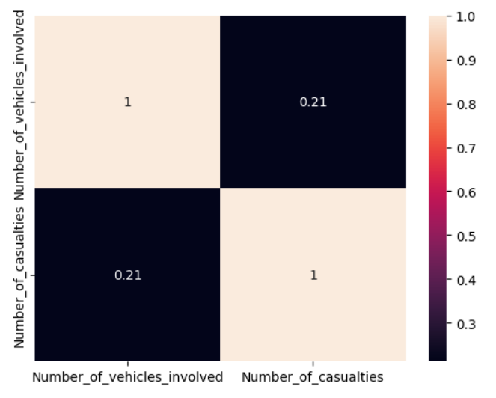
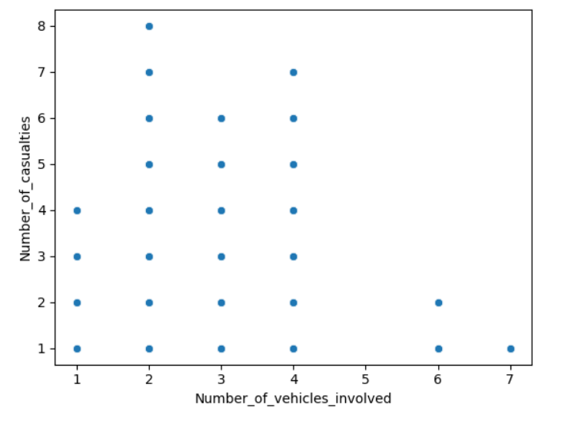
Evaluation
Fig: Confusion Matrix
Fig: Correlation Matrix of Vehicles and Casualty
Fig: Vehicles involved vs Casualty

Slide 16
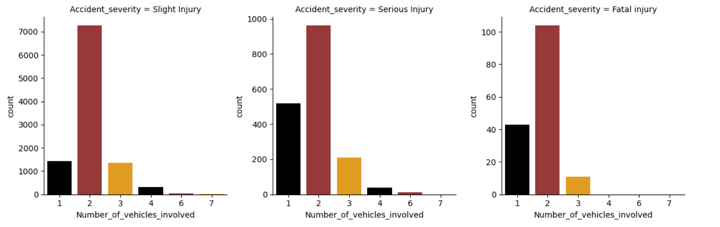
Evaluation
Fig: Vehicle wise accident severity

Slide 17
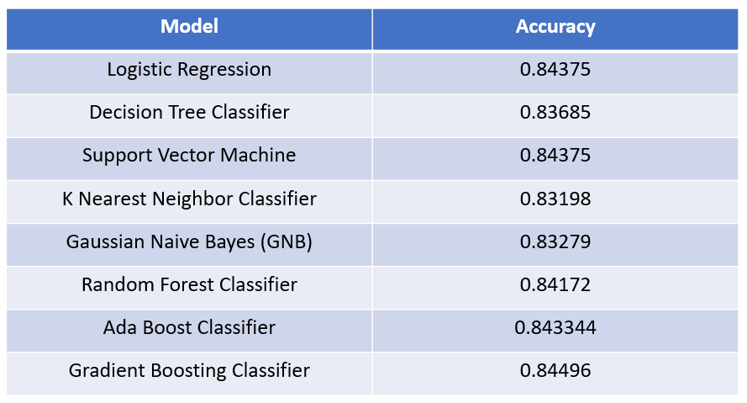
Result
Fig: Accuracy of different models

Slide 18
Conclusion and Future Work
Finds out feature importance analysis to explore the key risk factors influencing the accident injury severity in vehicle collisions and eventually lessens losses from road accidents.
More feature like weather condition, road surface condition can be incorporated to have more accuracy.

Slide 19


Slide 20


