Slide 1

Seasonal Agricultural Performance Analysis
Samiya Rahiman Patel
Vivekanand Education Society's College of Arts, Science & Commerce (Autonomous)
AICTE STU ID : STU6a63ae83c95261784917635

Slide 2

PROBLEM STATEMENT
Agricultural productivity and profitability are influenced by multiple factors such as weather conditions, soil characteristics, irrigation methods, farm inputs, and crop selection. However, farmers often face challenges in identifying the key factors that maximize yield, optimize resource utilization, and improve profitability. This study aims to analyze seasonal agricultural performance data to identify the factors affecting crop production, water efficiency, and farm profitability, and to provide data-driven recommendations for sustainable agricultural practices.

Slide 3
Project Description
This project analyzes seasonal agricultural performance using data on crops, weather conditions, soil properties, irrigation methods, and farm inputs. The objective is to identify factors affecting crop yield, production, profitability, and water efficiency. Through data analysis and visualization, the study provides insights that can help improve agricultural productivity, resource utilization, and sustainable farming practices.

Slide 4
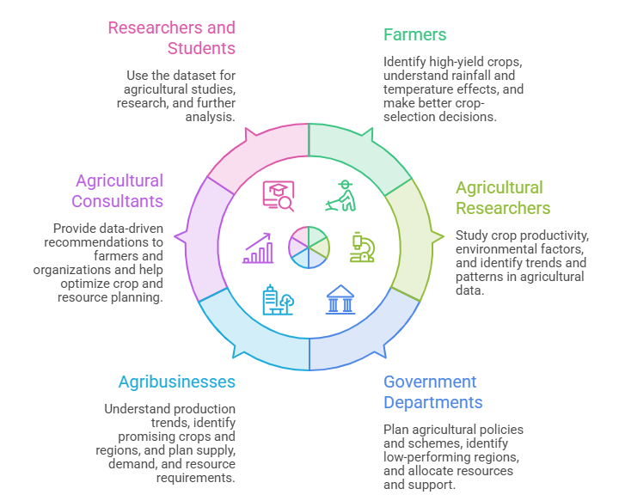

WHO ARE THE END USERS?

Slide 5

Technology Used
Python – Data analysis and processing
Pandas – Data cleaning, manipulation, and aggregation
NumPy – Numerical calculations
Matplotlib – Data visualization
Seaborn – Statistical visualization and charts
Google Colab – Development and analysis environment

Slide 6
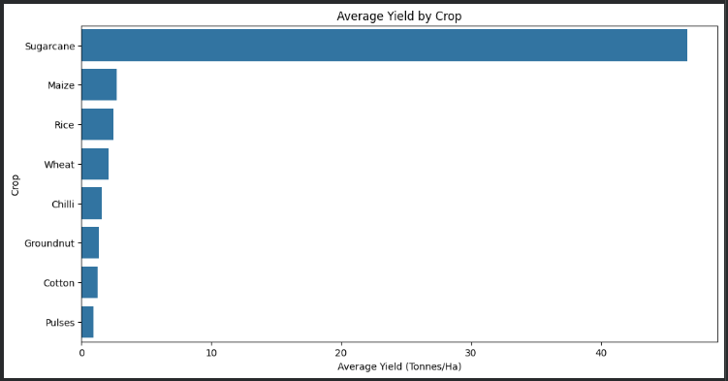
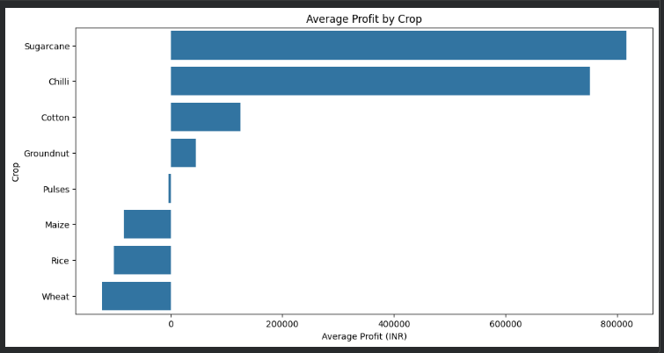
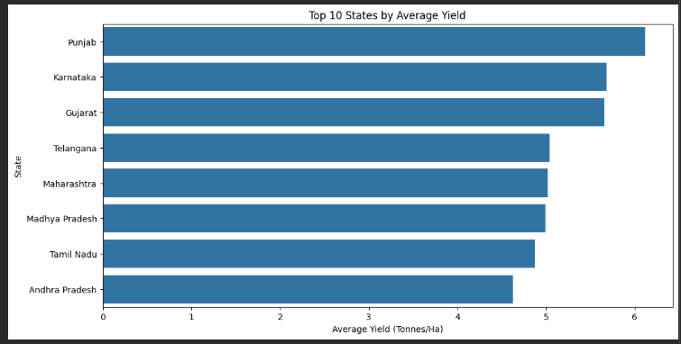
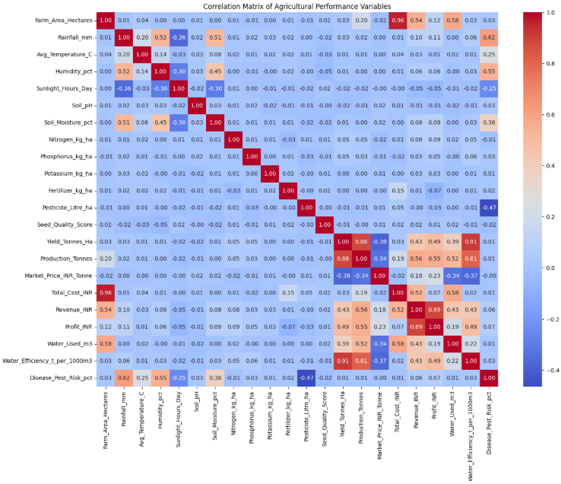
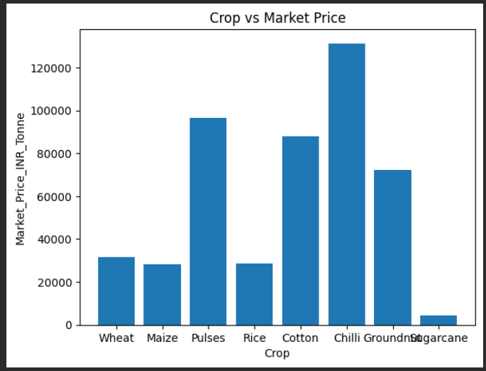
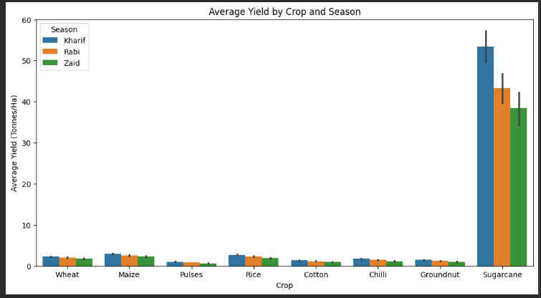
RESULTS
Sugarcane → Highest average yield, far exceeding all others.
Maize, Rice, Wheat → Moderate yields.
Chilli, Groundnut, Cotton, Pulses → Lower yields compared to staples and sugarcane.
Cash crops dominate: Sugarcane and Chilli stand out as highly profitable, likely due to strong market demand and higher price per tonne.
Staple crops (Rice, Wheat, Pulses): Lower profitability despite being essential for food security. This reflects lower market prices and higher production costs relative to returns.
Punjab has highest productivity followed by Karnataka,Gujrat,Telangana, Maharashtra, Madhya Pradesh, Tamil Nadu and then Andhra Pradesh
Sugarcane dominates: Yield is far higher than all other crops (up to ~60 tonnes/ha), especially in the Kharif season.
Other crops (Wheat, Maize, Pulses, Rice, Cotton, Chilli, Groundnut): All remain below 5 tonnes/ha across seasons.
Chilli’s premium value: Despite lower production and fewer farms, Chilli commands the highest price, making it a high-value cash crop.
Seed quality ↔ Yield: Positive correlation, showing genetic potential matters.
Farm size ↔ Cost: Very strong positive correlation (~0.96). Larger farms naturally incur higher costs.

Slide 7
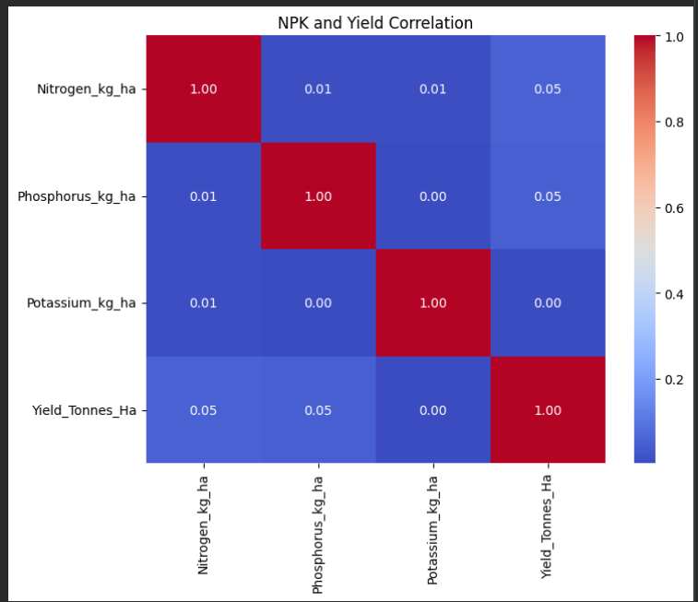
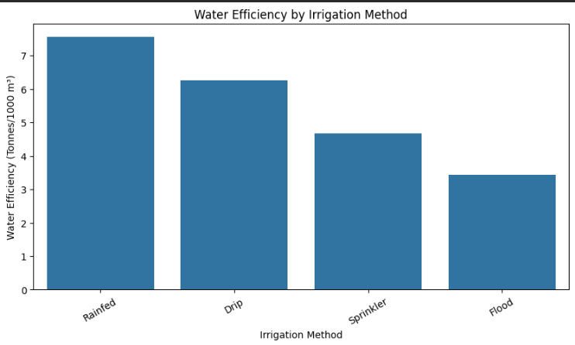
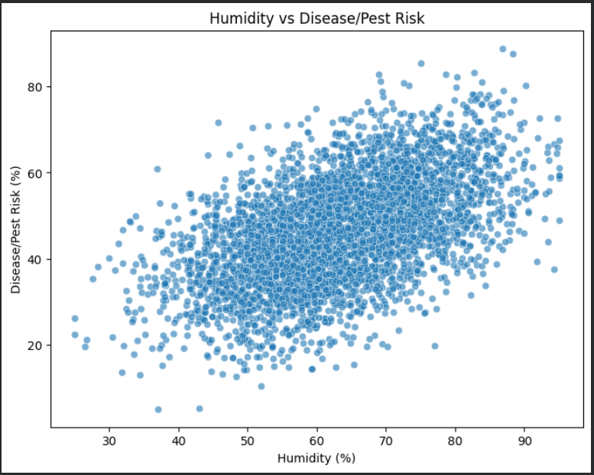
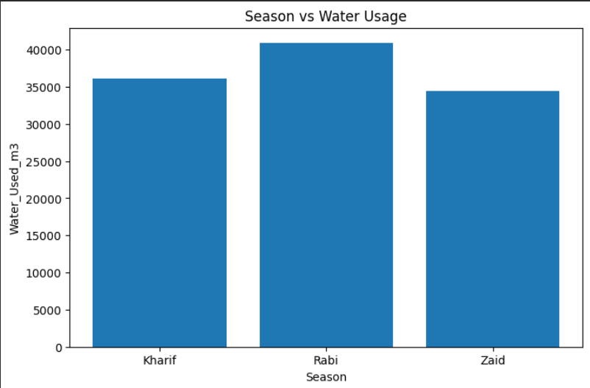
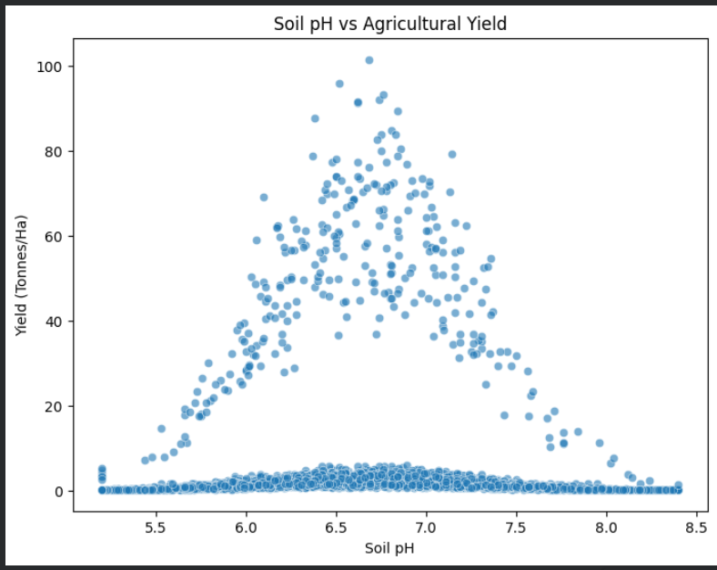
RESULTS
Rainfed → Highest efficiency (natural rainfall, no irrigation cost).
Drip → Next best, very efficient because water is delivered directly to plant roots.
Sprinkler → Moderate efficiency, but some water loss through evaporation.
Flood → Lowest efficiency, with large losses due to runoff and deep percolation
Interpretation: Simply adding more fertilizer (NPK) doesn’t guarantee higher yield. Other factors—rainfall, soil pH, crop type, farming practices—play a much bigger role.
Positive correlation: As humidity increases, disease/pest risk also rises. This makes sense biologically—fungal pathogens, bacteria, and many pests thrive in moist environments.
Dense clustering: Most points fall along an upward trend, suggesting this relationship is consistent across different conditions.
Risk threshold: Once humidity exceeds ~70%, risk levels tend to be significantly higher, indicating a critical zone where crops become more vulnerable
Rabi season dominates water usage — around 41,000 m³, making it the most irrigation-intensive season.
Kharif season follows with ~36,000 m³, but rainfall during monsoon reduces irrigation needs compared to Rabi. Zaid season uses the least (~34,000 m³), reflecting its short crop cycle and lower water demand
Triangular pattern: Suggests that only within the optimal pH range do crops reach their maximum potential. Outside this range, yields taper off.

Slide 8
Future scope
Predictive Analytics
Use Machine Learning models to predict crop yield based on rainfall, temperature, and soil conditions.
Crop Recommendation System
Develop a system that suggests the most suitable crop for a region based on climate and soil characteristics.
Disease and Pest Detection
Use AI and image processing techniques to identify crop diseases and pests at an early stage.
Smart Farming Solutions
Combine AI, IoT, and data analytics to optimize irrigation, fertilizer usage, and resource management.
Satellite and Remote Sensing Integration
Utilize satellite imagery to monitor crop growth, land usage, and agricultural productivity.

Slide 9
GitHub Link
https://github.com/SamiyaP/Seasonal-Agricultural-Performance-Analysis.git

Slide 10
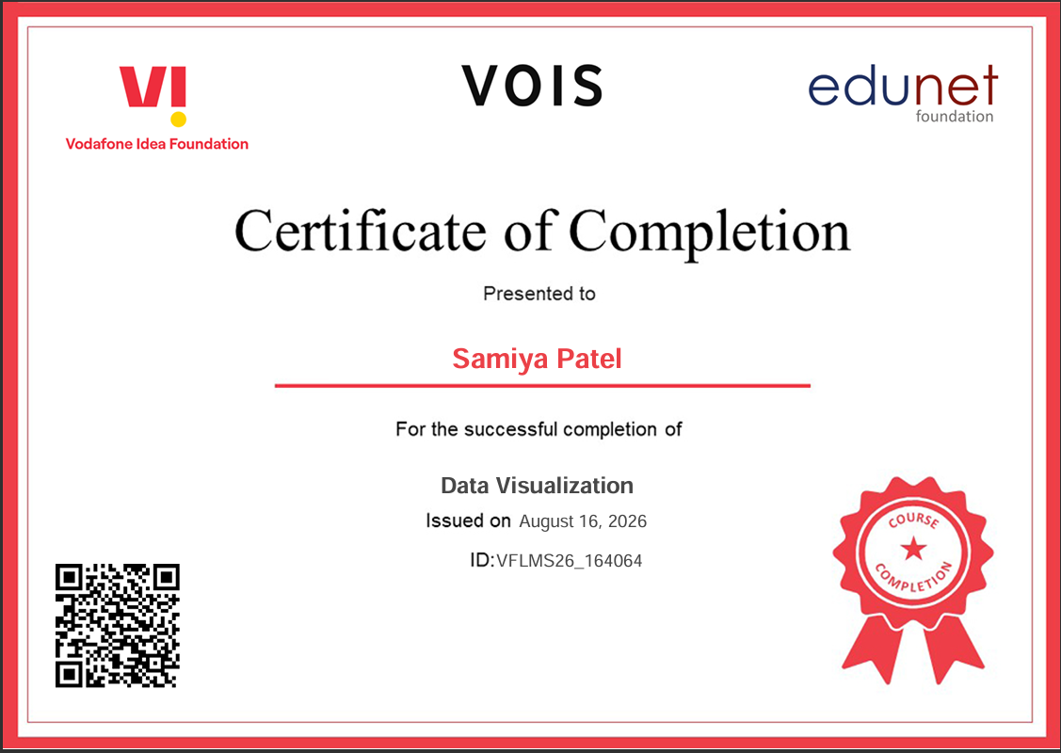
VOIS Course Completion Certificate Course name - Data Visualization

Slide 11
Thank you
.
.

