Slide 1
BELMAZ CREDIT
POWERED BY:
BELMAZ MULTI-PURPOSE CO-OPERATIVE SOCIETY LIMITED

Slide 2
INTRODUCTION
Belmaz Credit is a system created by Belmaz Multi-purpose cooperative society Ltd. Solely for her members to enable them raise finance to build their businesses irrespective of where they are in Nigeria.

Slide 3

Our Vision
To create a platform where every member can be financially encouraged through their involvement in the financial activities of the society.

Slide 4
Our Mission
To become a financial voice to our members through the empowerment of the individual businesses of everyone within the society by making sources available for the circulation of financial resources within the society.

Slide 5




Our Services

Slide 6




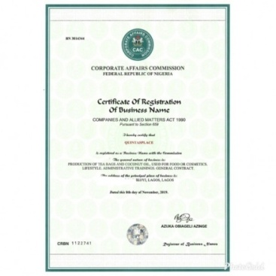
Levels and Benefits
Level 1:
CASH REWARD OF N40,000
Level 2:
CASH REWARD OF N30,000
SUPPLY PRODUCT WORTH N100,000
PAY SHOP RENT OF N50,000
Or
ACCESS LOAN WORTH N130,000
BUSINESS NAME REGISTRATION

Slide 7




Level 3:
SUPPLY PRODUCT WORTH N500,000
CASH REWARD OF N100,000
ACCESS LOAN WORTH N350,000
Level 4:
SMART PHONE
SUPPLY PRODUCT WORTH N2,000,000
CASH REWARD OF N500,000
LAPTOP
ACCESS LOAN WORTH N9,00,000

Slide 8
Leadership
At the end of the 4th level you automatically become a leader.
Benefits
Monthly Residual Income
Of 20,000 For 24 months
Car Award
Responsibility
Hold seminars and send pictures to us
Coordinate and direct new members

Slide 9

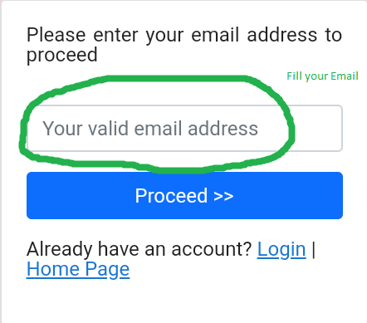
How to Register
STEP 1
Go to belmazcredit.com
STEP 2
Click on SIGN UP
STEP 3
A page will pop up for you to
fill your EMAIL
and click on Proceed

Slide 10
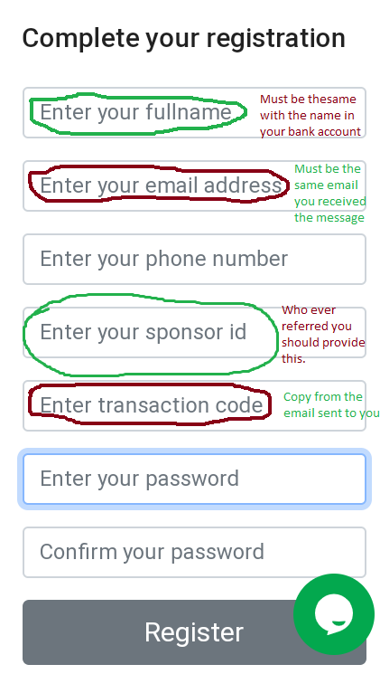
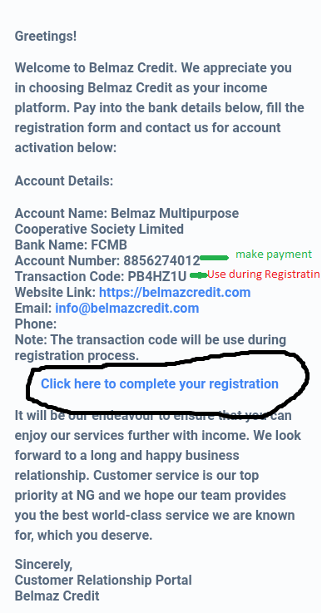
STEP 4
STEP 5
You will receive an email
message containing
Fill the registration form
STEP 6
Wait for confirmation.
This is after you have paid the registration sum of N10,000 (ten thousand naira only).

Slide 11
How to Contribute

