Slide 1


Agile Development

Slide 2
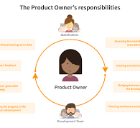
Agile Development
Product Owner
In an Agile project, every team member is vital. This is a crucial feature since it allows the client and the Development Team to communicate directly with each other. As Product Owner, I am accountable for more than simply testing. I had to outline the actions that needed to be followed to finish the work. Some of the requirements were provided directly by the client, while the remainder were derived via a focus group of various end users (Todaro, 2019).

Slide 3
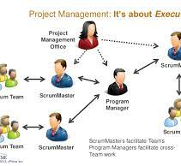
Agile Development
Development Team
As a member of the Development Team and a Developer, I was allowed to structure my code anyway I saw fit, as long as I followed industry best practices (Trapani, 2018).

Slide 4
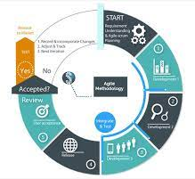
Agile Development
Scrum Tester
When I assumed the role of Scrum Tester, I was tasked with supporting the Product Owner with Backlog creation and maintenance while ensuring total transparency at all levels within the Scrum team (Team, 2024). The Product Owner and the development team work together closely on Scrum to make the product (Team, 2024).

Slide 5
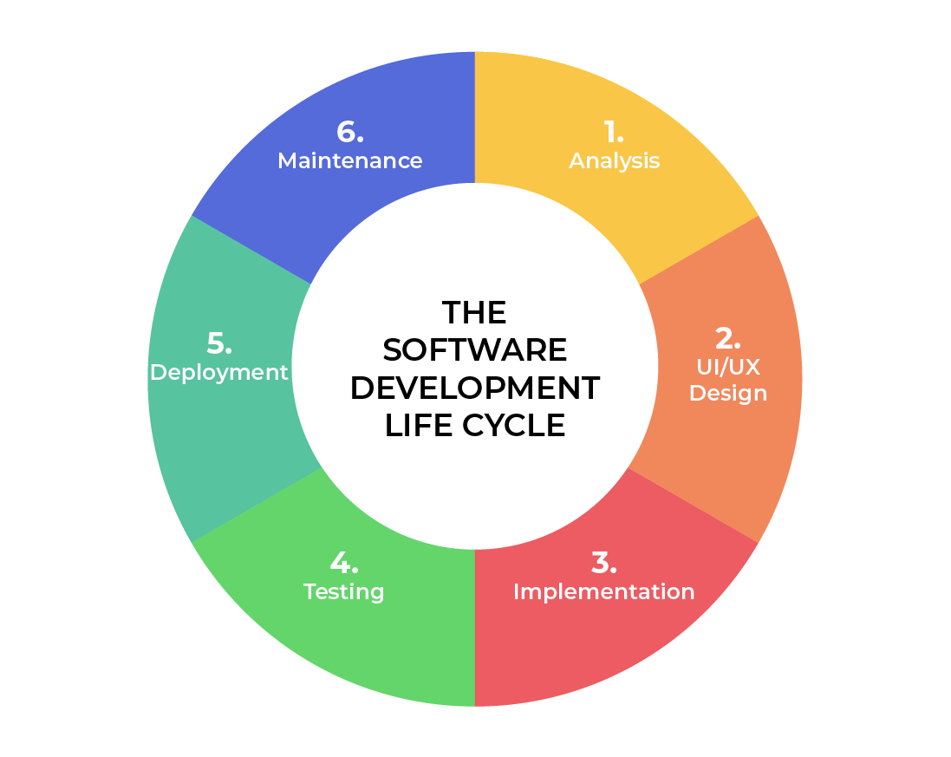
SOFTWARE DEVELOPMENT LIFECYCLE
Analysis
Work together with partners.
Get your needs together.
Design
Define the steps needed for functioning in depth.
List the tools, their limits, the time frames, and the budget.
Implementation
Development starts.
The functionality is broken up into smaller pieces.
Testing
Happens when Development is present.
A method for finding and fixing known bugs and keeping track of issues.
Deployment
The product is now on the market after being tested.
Maintenance
In a work setting, the result.
New features and bug fixes need to be added by developers as soon as they become available.
Notes:
Analysis – This is the basic building block of the software development lifecycle. This is where leadership collaborates with various stakeholders to collect the requirements of the project.
Design – In this phase, the functionality is defined in detail. The technologies used and project resources, limitations, time frames and budgets are also discussed.
Development – In this phase, the development begins. The programming language used is dependent on the project. This is the longest phase in the SDLC because each functionality is broken into smaller increments to allow for value-based code development.
Testing – In conjunction with development, testing is also a common activity. Happens at all phases but specifically reserved for defects and issue tracking with existing code base.
Deployment – In this stage, testing is complete, and the product is ready to be deployed to market. UAT (User Acceptance Testing) may be performed in a limited environment before releasing to market.
Maintenance – In this stage, the product has been deployed into market. Developers must be ready and able to address any new features and bug fixes that users request and experience in production.

Slide 6
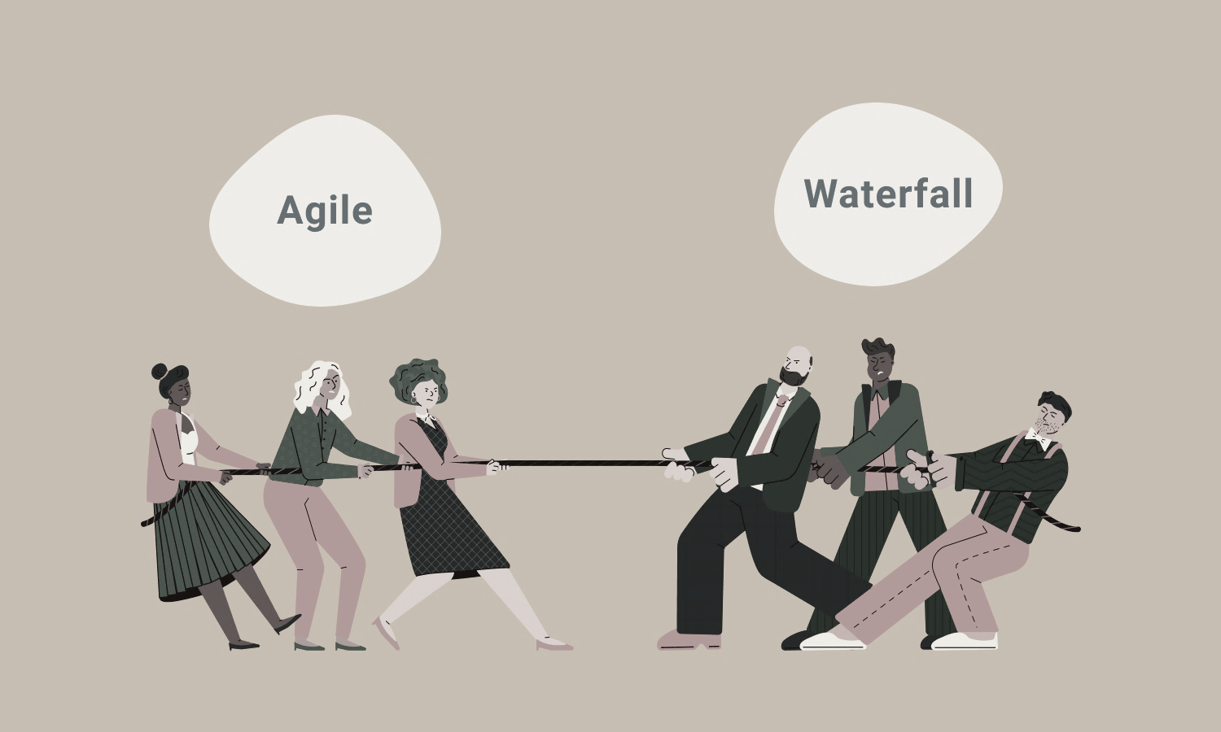
vs
There is no need to list all the conditions.
It is possible to set major standards, but features can change over time.
Not enough time to market
Every need has to be spelled out.
Negotiating a contract.
Linear or sequential steps.
Best for projects that don't change much
Notes:
The SNHU Travel project would have been difficult to complete under a waterfall approach. Given the amount of uncertainty any changes would have had a negative impact on the project. Even with the high level of uncertainty with agile, any issues discovered would require a change order to the agreement which can be costly.

Slide 7
References
Alami, A., & Krancher, O. (2022). How Scrum adds value to achieving software quality? Empirical Software Engineering, 27(7). https://doi.org/10.1007/s10664-022-10208-4
Team, C. (2024, April 10). Roles and Responsibilities in a High-Performing Software Testing Team. CodiumAI. https://www.codium.ai/blog/roles-and-responsibilities-in-a-high-performing-software-testing-team/#:~:text=Software%20tester%20responsibilities%3A
Trapani, K. (2018, May 22). What is Agile/Scrum. CPrime; cPrime. https://www.cprime.com/resources/what-is-agile-what-is-scrum/
Todaro, D. (2019, October 23). Scrum Product Owner Roles and Responsibilities. Ascendle. https://ascendle.com/ideas/scrum-product-owner-roles-and-responsibilities/#:~:text=One%20of%20the%20most%20important
Understand Agile vs Scrum: Uncovering Differences & Similarities. (2019, September 26). Simplilearn.com. https://www.simplilearn.com/agile-vs-scrum-article#:~:text=In%20Agile%20methodology%2C%20software%20is

