Slide 1

FUTURECARIBBEAN BUILDATHON 2026
LIGHTHOUSE
The rail between disaster capital and households.
Sammarieo Brown · Raheem Wilson · Matthew Stone
Team Project Lighthouse | Track 04: Climate Risk & Disaster Coordination
Notes:
Hi, I am Sammarieo Brown. I am a data scientist and software engineer. I work in banking at JN Bank and in payments at Lunipay, here in Jamaica. I am applying with my teammates Raheem Wilson and Matthew Stone as team Project Lighthouse, for Track 04, Climate Risk and Disaster Coordination. And this idea is not theoretical for us. We lived it.

Slide 2
Nine months ago: Hurricane Melissa
October 28, 2025. The strongest hurricane ever recorded to hit Jamaica.
45
626,000+
120,000
~25%
lives lost
people affected
buildings lost their roofs
of GDP in damage and loss
We prepared for it, sat through landfall, and spent months inside the aftermath.
Notes:
Nine months ago Hurricane Melissa hit Jamaica. Forty-five people died. Six hundred and twenty-six thousand people were affected. A hundred and twenty thousand buildings lost their roofs, and the damage came to nearly a quarter of our GDP. My team and I prepared for that storm, sat through landfall, and spent months inside the aftermath. That is why we want to be in this buildathon.

Slide 3
The paradox we cannot unsee
US$150M
1.8%
World Bank catastrophe bond, paid 100%,
announced about ten days after landfall
of J$1.44 billion in cash donations had
reached households four months later
The money is fast. The distribution is broken.
Lighthouse is the missing rail between capital and households.
Notes:
Here is what shocked us most. The world's money was fast. Jamaica's catastrophe bond paid out one hundred and fifty million US dollars about ten days after landfall. The IMF approved four hundred and fifteen million more. Donations poured in. And four months later, the Auditor General found that only one point eight percent of donated cash had reached households. The Caribbean does not have a disaster money problem. It has a last mile distribution problem. Nothing connects the forecast to the household, the household to a verified claim, and the claim to a payment.

Slide 4
One object: the Household Storm File
One record per household, moving through five states as the storm approaches, hits, and passes.
REGISTERED
→
AT-RISK
→
AFFECTED
→
VERIFIED
→
SETTLED
The report becomes the claim becomes the payment.
WhatsApp native. Patois and English. No app download. Humans approve everything that moves money.
Notes:
Lighthouse is that missing rail. Every household gets one record, a Storm File, that moves through five states: registered before the season, at risk when a storm approaches, affected when they report damage, verified when agents confirm it, and settled when help arrives. Families interact through WhatsApp, in Patois or English, no app to download. Someone sends a voice note, mi roof gone, mi deh a Black River, and the system turns it into a verified, geolocated claim. The report becomes the claim becomes the payment.

Slide 5
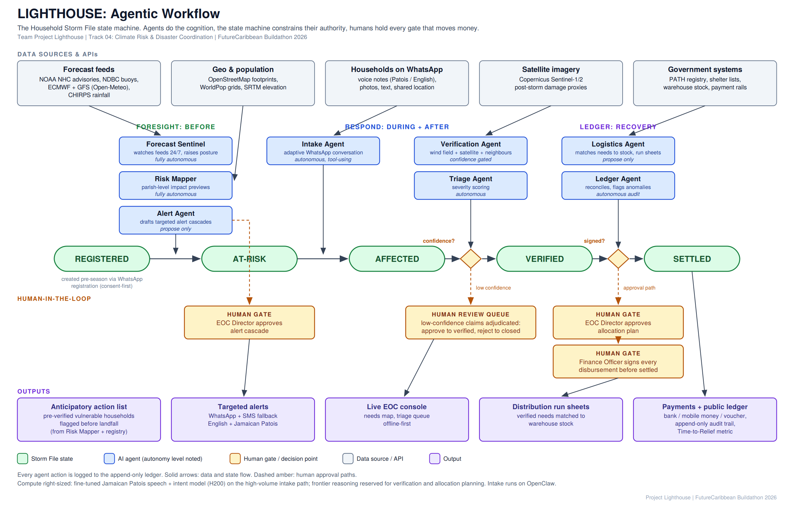
Agents do the cognition. Humans hold the money gates.
Notes:
Under the hood, this is an agentic system, and the agents are the reason it can exist. A forecast sentinel watches NOAA and ECMWF feeds around the clock. An intake agent holds thousands of conversations at once. A verification agent checks each claim against the storm's wind field, satellite imagery, and neighbouring reports. A logistics agent matches verified needs to supplies. And the rule that governs all of it: agents do the cognition, the state machine constrains their authority, and humans hold every gate that moves money. We will use the H200 compute to fine-tune a Jamaican Patois speech model, which no other team will have.

Slide 6
Why it matters, and where it goes
19
CDEMA member states share this exact gap
OUR METRIC
Time to Relief
58
small island developing states face the same pattern worldwide
months → 72 hours
1
shared regional platform is the only economics that work
In five years: the settlement layer for disaster capital in small states, from CDEMA to the wider island world.
Notes:
This matters far beyond Jamaica. Nineteen CDEMA member states share the same gap, and none is a big enough market alone, which is exactly why a shared Caribbean platform is the answer, and why nobody has built it yet. Our metric is Time to Relief, from months to seventy-two hours. In five years, Lighthouse is the settlement layer for disaster capital across the region and the wider small island world.

Slide 7
Why us
Sammarieo Brown
Raheem Wilson
Matthew Stone
Product & Software Engineer
Product & Software Engineer
Product & AI Engineer
Banking and payments (JN Bank, Lunipay), data science and ML
Software Engineer at Norus and Intelibus; full stack product engineering
Founder & President, Jamaica AI Association; applied AI and agent systems
One timezone. The pilot country. We lived this storm. Already building against NOAA data feeds.
The next storm will not wait.
Project Lighthouse | Track 04: Climate Risk & Disaster Coordination | FutureCaribbean Buildathon 2026
Notes:
So why us? Raheem builds production software at Norus and Intelibus. Matthew is the founder and President of the Jamaica AI Association. And my own background spans banking, payments, and data science. One timezone, the pilot country, and we have already started building against NOAA data feeds. We are continuing after this buildathon no matter what. Because the next storm will not wait. Thank you.

