Slide 1
HACKTOBERFEST HACK DAY 2026 · TRACK 2 · AUDIOVISUAL HERITAGE DAY
Smriti
Graph
— The Living Archive
A cultural context decoder, knowledge graph & grounded RAG engine —
built for Karnataka's endangered audiovisual heritage.
React 18 · Vite · Tailwind
MIT
Zero API keys
Works 100% offline
github.com/smritigraph/smritigraph · npm install && npm run dev → http://localhost:5173
01 / 10

Slide 2
THE PROBLEM
Digitization is not the same as comprehension.
“Where a heritage file says source: AIR Dharwad and nothing else, a researcher is stuck.”
Karnataka's tape archives — Akashvani discs, Doordarshan U-matics, Janapada field cassettes —
are digitizing fast. But a 1924 transcript is full of terms a modern listener can't parse:
Suvarna Karnataka? Bayalata? Charkha? Swaraj? Satellite Instructional Television?
Digitization preserves the file. It does not preserve the *understanding of the file*.
02 / 10

Slide 3
WHAT IT DOES
Decode · Connect · Liberate
DECODE
CONNECT
LIBERATE
Every cultural term gets a
Context Card: literal meaning,
cultural meaning, era, region
and 100 years of evolution —
in place, inside the transcript.
Each term is woven into an
interactive Heritage Constellation:
people ↔ places ↔ traditions ↔
institutions ↔ reels, built by
hand with canvas physics.
Reel + decoded annotations are
emitted as IIIF 3.0 JSON-LD,
Dublin Core, Wikimedia Markdown,
bulk CSV and a ready-to-merge
GitHub PR — no Git needed.
03 / 10

Slide 4
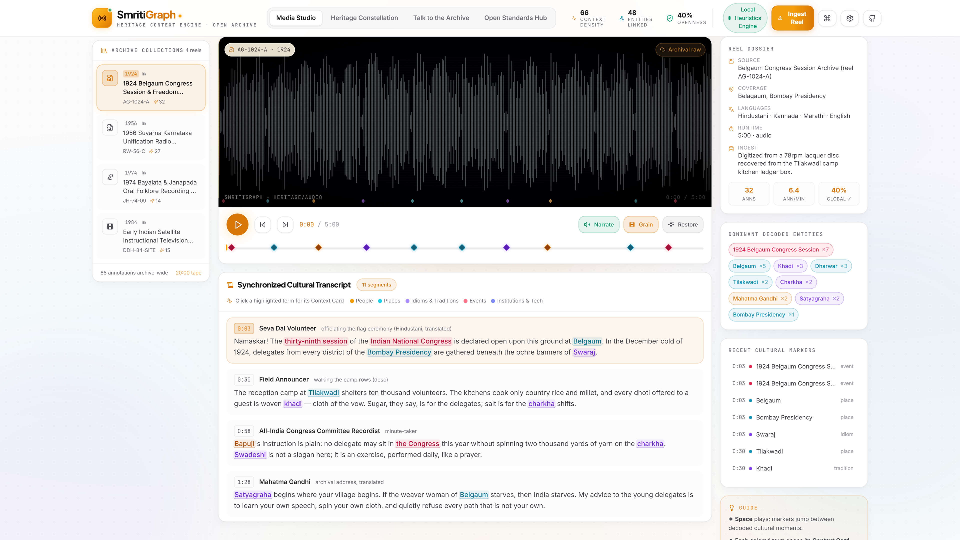
ROOM 1 · MEDIA STUDIO & DECODER
The reel decodes itself, in place.
Archival screen with film-grain & restoration toggle · generated waveform · timestamped transcript · click a highlighted term → Context Card.
04 / 10

Slide 5
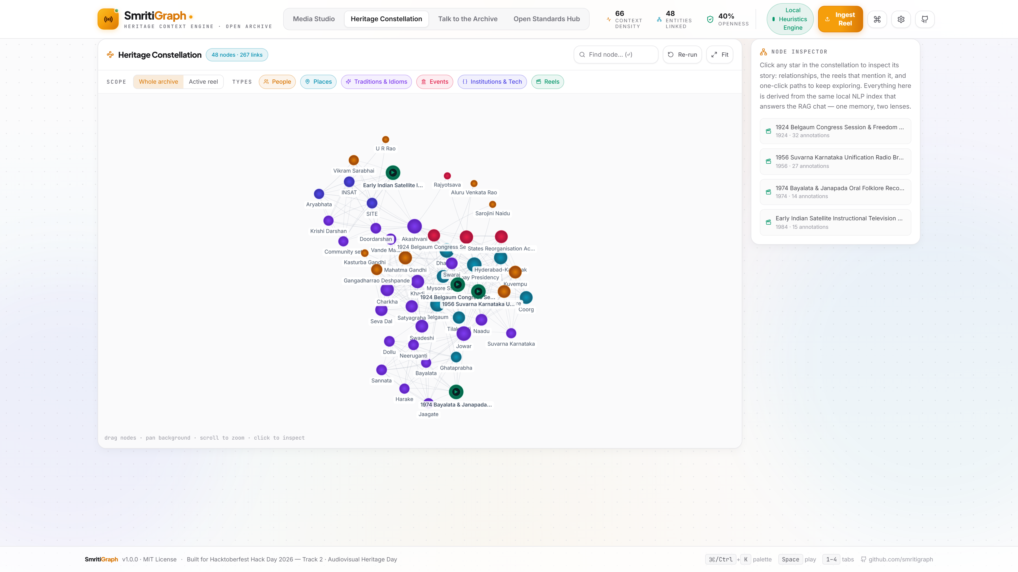
ROOM 2 · HERITAGE CONSTELLATION
One reel → a living knowledge graph.
48 nodes · 267 links · force-directed canvas physics, no graph libraries. Click a node → inspector, neighbours, reels, full gloss.
05 / 10

Slide 6
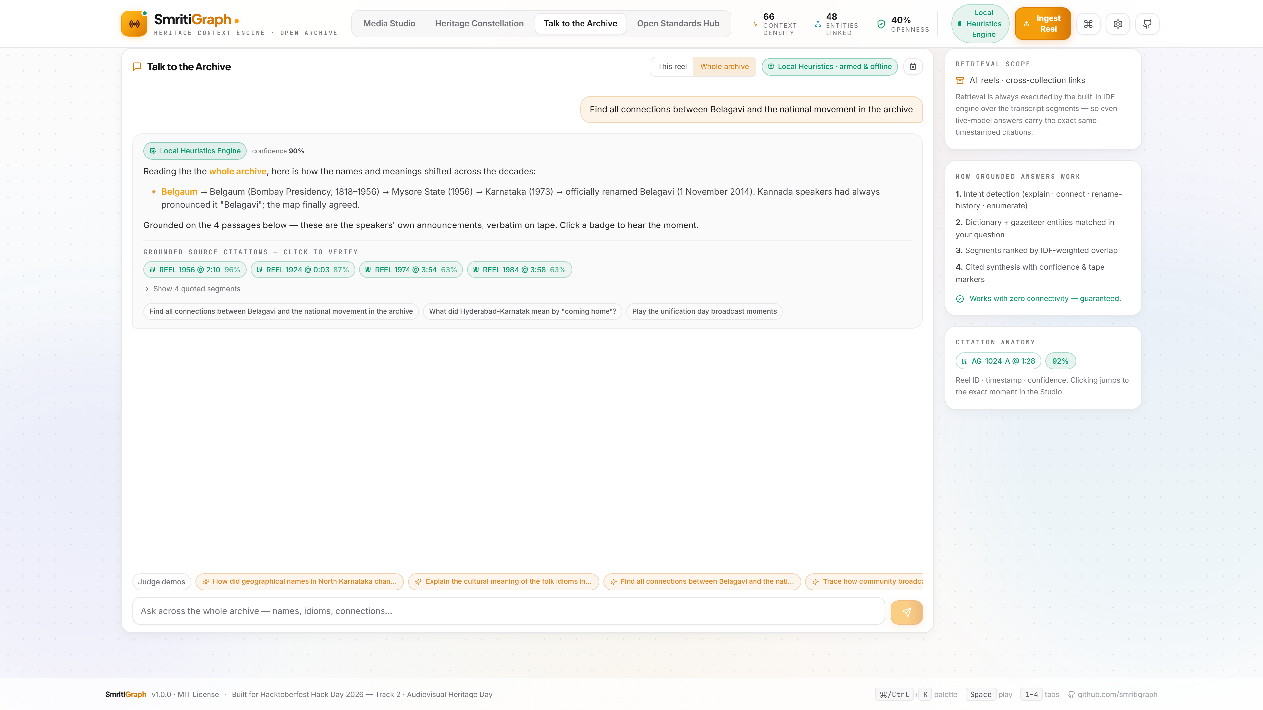
ROOM 3 · TALK TO THE ARCHIVE
The archive answers — with receipts.
Grounded RAG chat. Every answer carries reel + timestamp + confidence citations — click one to jump to the exact moment. Works fully offline; live LLM optional.
06 / 10

Slide 7
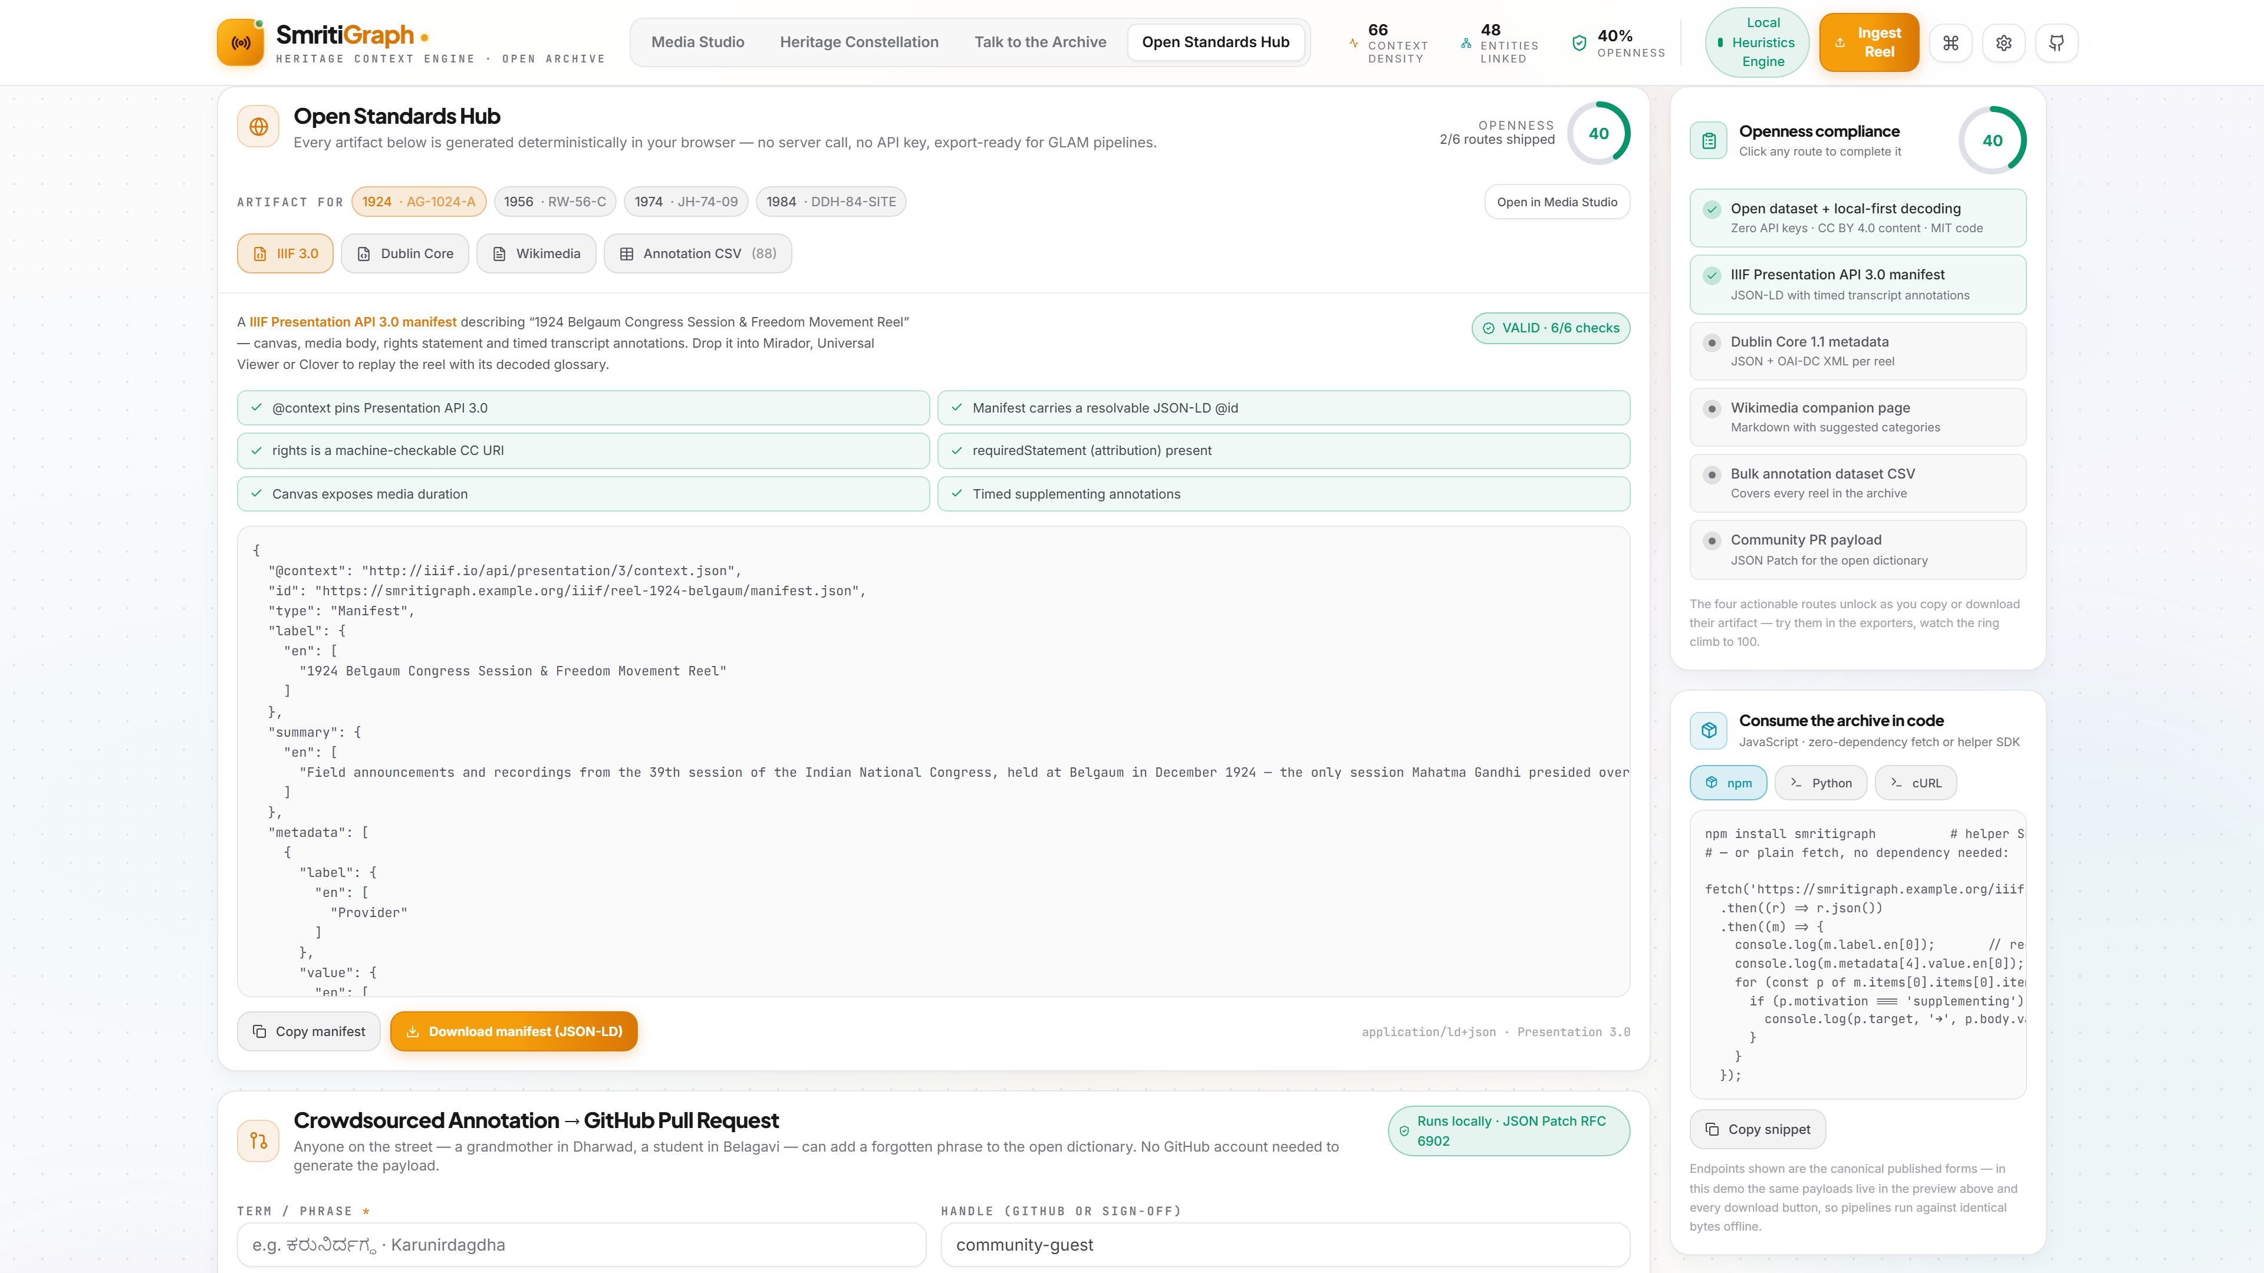
ROOM 4 · OPEN STANDARDS HUB
GLAM pipelines ingest it — same day.
IIIF Presentation 3.0 manifest · Dublin Core (JSON + OAI-DC XML) · Wikimedia page · RFC 4180 CSV · RFC 6902 JSON-Patch → one-click GitHub PR.
07 / 10

Slide 8
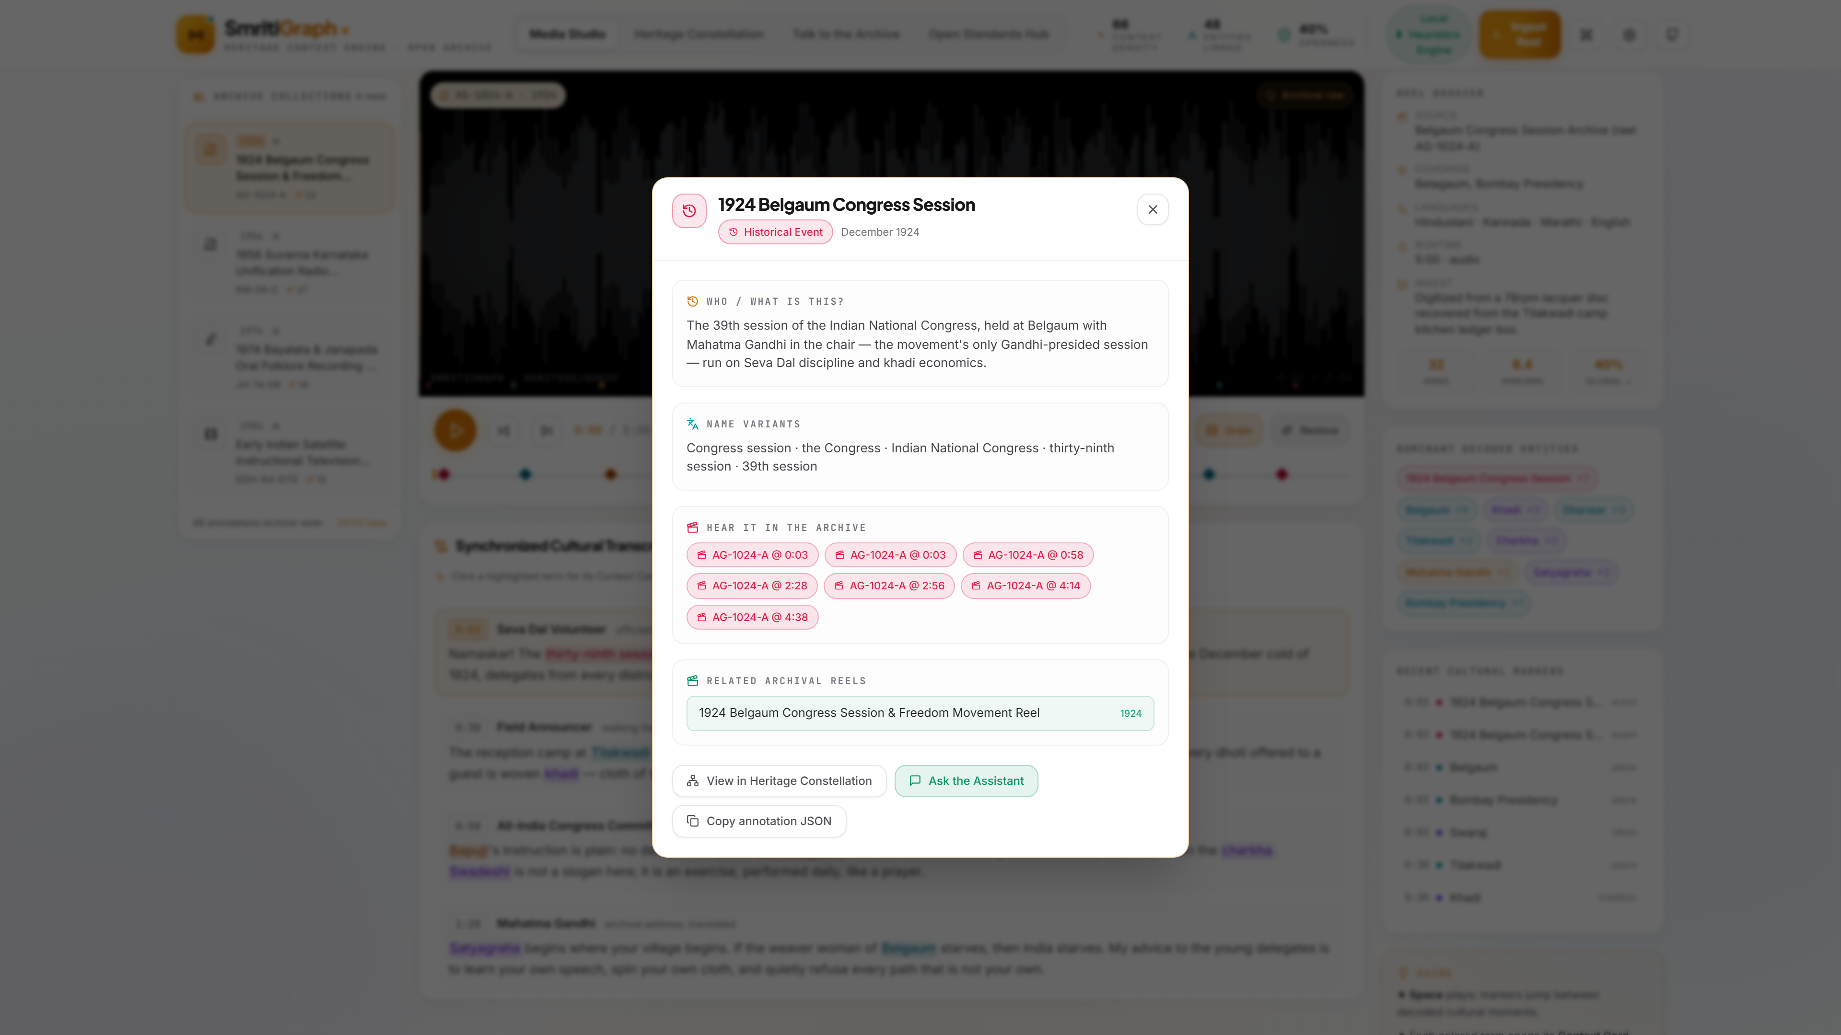
CONTEXT CARDS
Meaning, era, region — and every echo.
Literal + cultural meaning, name variants, every moment it appears on tape, and the reels that echo it — cross-reel, clickable to seek.
08 / 10

Slide 9
UNDER THE HOOD
Local-first. Deterministic. Open.
Annotation engine
Unicode-aware NLP matcher over scripted transcripts · 34-entry cultural dictionary · gazetteer
Smart Local Heuristics
Intent detection + IDF retrieval — the offline brain. Never throws; never invents a citation.
Live LLM (optional)
Ollama / Gemma, OpenAI-compatible or Gemini — rephrases grounded answers only, never sources them.
Exporter
IIIF Presentation 3.0 · Dublin Core · OAI-DC XML · Wikimedia · CSV · JSON Patch — all in-browser.
Build
Vite production build ≈ 370 kB JS (117 kB gzip) · no accounts, no keys, no server mode.
09 / 10

Slide 10
TRACK-2 THESIS
Heritage ends where
context begins.
We don't just preserve the file — we preserve the understanding of the file,
in open standards anyone can use, forever. The museum outlives us.
github.com/smritigraph/smritigraph · MIT · CC BY 4.0 annotations · Built with ♥ for Hacktoberfest Hack Day 2026
10 / 10

