Slide 1
Thesis Project
Uppsala University

Slide 2
Random Health Care Site
Diseases
Find Care
About

Slide 3
Random Health Care Site
Diseases
Find Care
About
Light
Serious
Uppsala
Stockho-lm
Contact
Blogs

Slide 4
Random Health Care Site
Diseases
Find Care
About
Light
Serious
Uppsala
Stockho-lm
Contact
Blogs
Cold
Nausea
Cancer
HIV
Adress
Contact
Adress
Contact
Phone
New
Old

Slide 5
Agenda
The problem
Motivation
Deliverable

Slide 6
The Problem
Mobile Websites
Information Hierarchies
Navigation

Slide 7
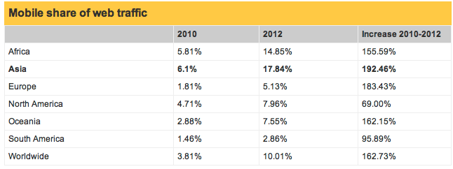
Motivation

Slide 8
Deliverable
Analysis
Implementation
User Tests

Slide 9
Questions?

Slide 10
Summary
Increase of Mobile Web Traffic
Need for a Solution To Navigation in information Hierarchies
Bright Future

